Slide 1
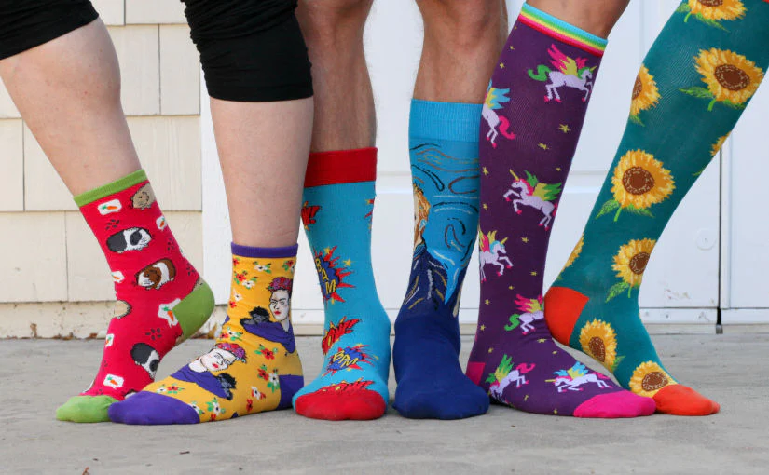
Happy Odd Sock Day!
What do we notice?
How many socks do we see?
How do we see them?
How can we compare them?
Notes:
Week 12
November 20, 2023

Slide 2
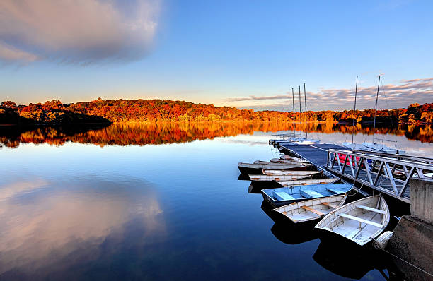
What can we count in this photo of Jamaica Pond in Boston?

Slide 3
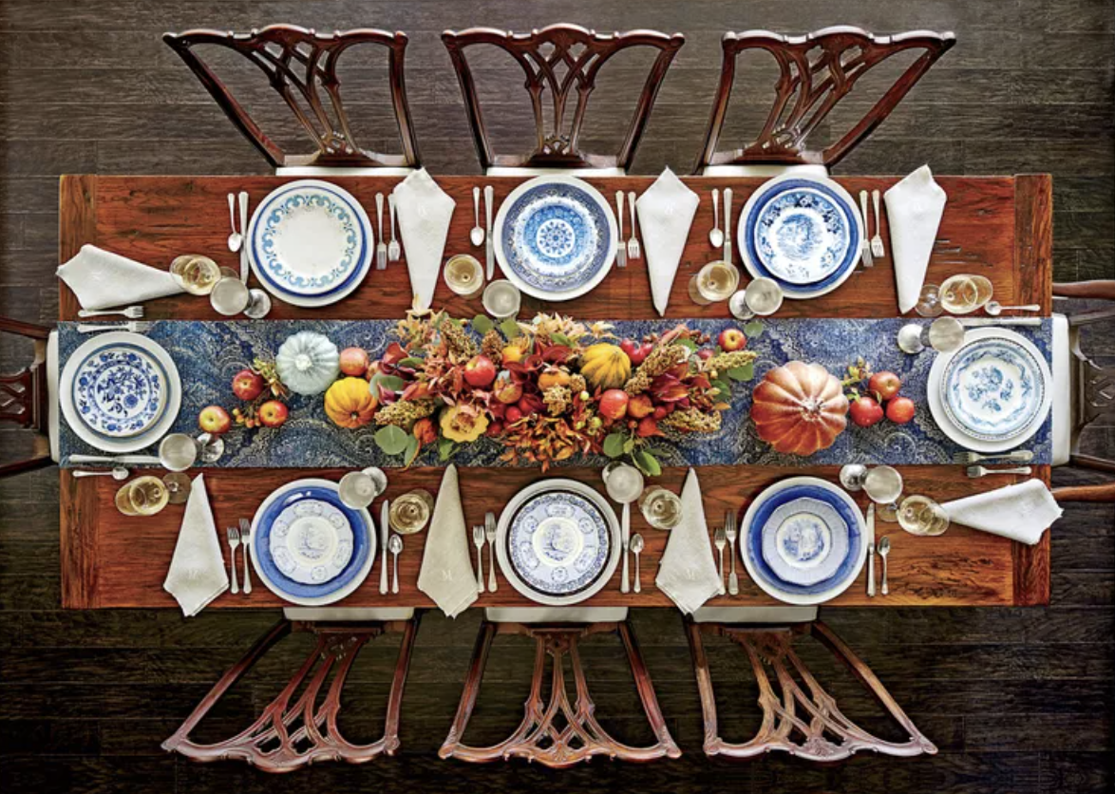
Happy Thanksgiving
Let’s be shape detectives!
Can we name all of the shapes we see on this Thanksgiving table?

