Slide 1

Happy Diwali!
Where do we see an array in these Diwali diyas?
Can we figure out how many diyas are in each square?

Slide 2
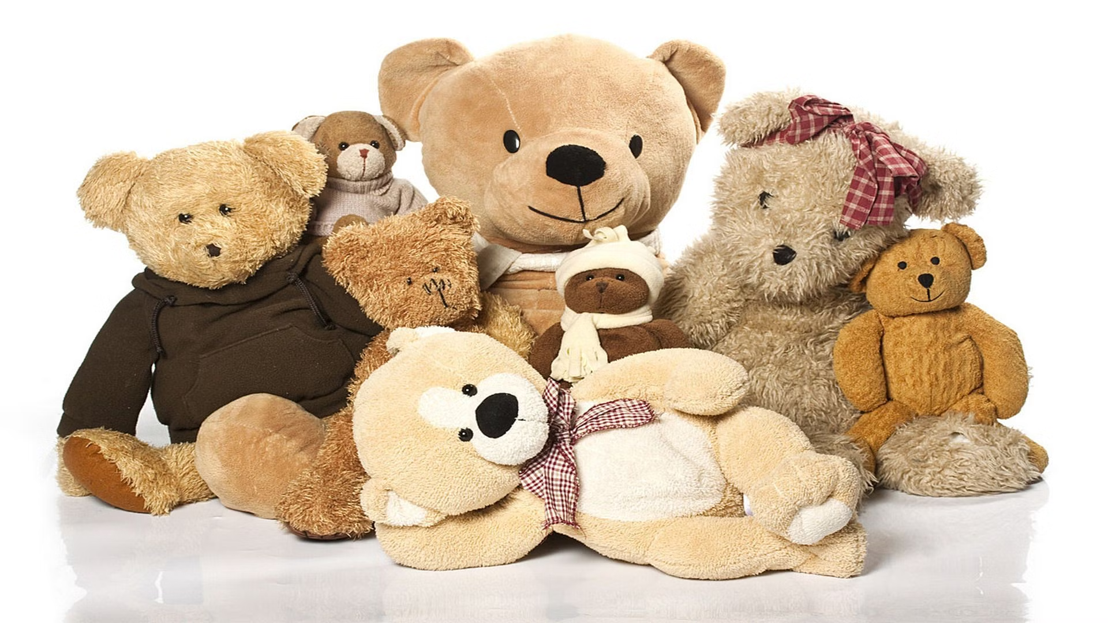
Happy Teddy Bear Day!
The first teddy bear was created 120 years ago!
What year was that?
What are some factor pairs of 120?

Slide 3
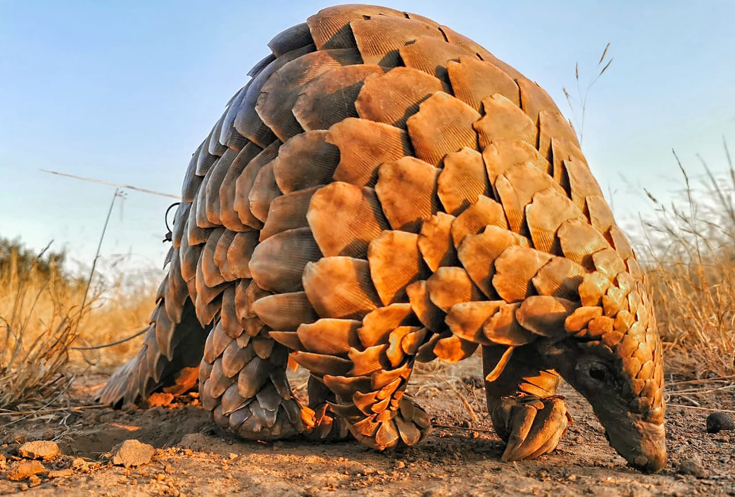
The Temminck's Ground Pangolin is on the critically endangered species list.
Pangolins are highly prized by consumers for their unique scales.
Over the past decade, over a million pangolins have been illegally taken from the wild.
The Temminck’s Pangolin has about 400 scales.
What can we say about the number 400?
What are some FACTOR PAIRS of 400?
4.OA.B4

Slide 4

“Creative Freedom” by Silvia López Chavez
This mural is on the Cambridge Public Library in Central Square.
Estimate the height of the mural.

Slide 5
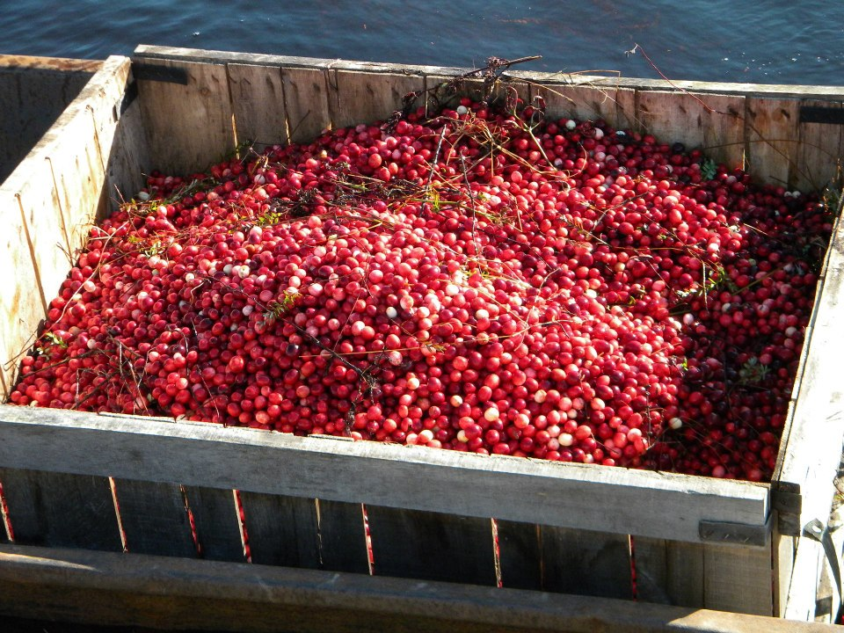
It’s Cranberry Season on the Cape!
The perimeter of this cranberry crate is 84 inches.
What is possible?

