Slide 1
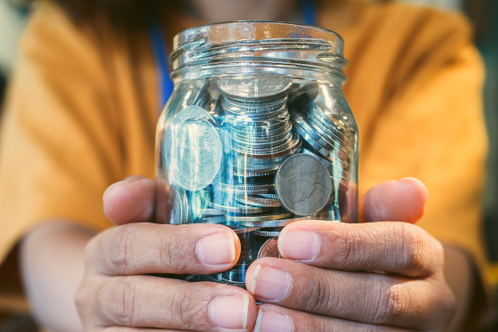
What do we think GIVING TUESDAY is?
If we donated 1 quarter today, and then doubled the amount every day for a week …
How much money would we be able to donate by the end of the week?
What about 2 weeks?
A month?
Today is GIVING TUESDAY!
Notes:
Week 13
November 28 - December 1

Slide 2
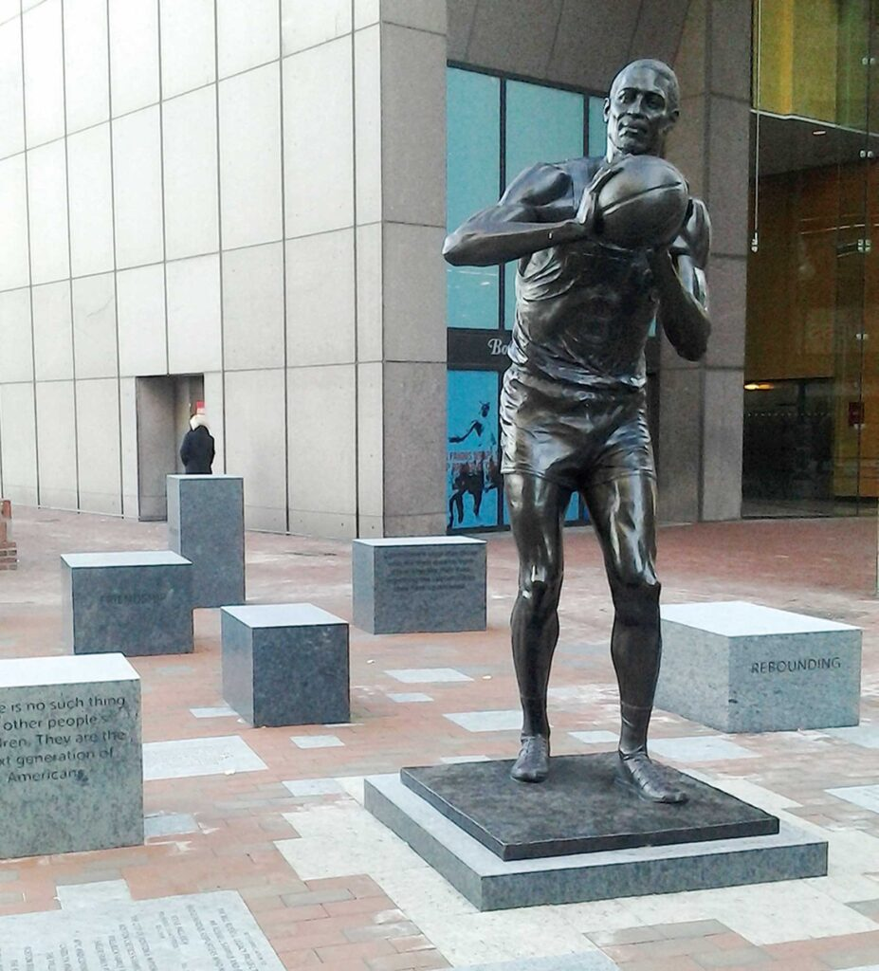
This statue of Bill Russell is in City Hall Plaza in Boston.
Bill Russell, a 6-foot-10-inch center from Monroe, LA., was a five-time NBA MVP and a 12-time All-Star. As Boston’s first African American star athlete, he helped the Celtics win 11 championships in 13 seasons from 1956-69, a feat that no athlete on a major American professional team has duplicated.
The statue is 8 feet tall! How many inches is that?
How long ago did he play for the Celtics?

Slide 3
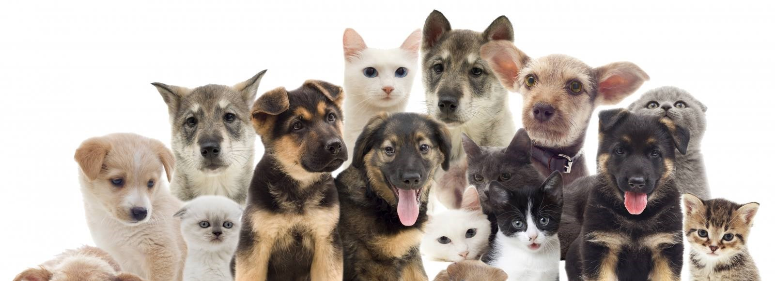
Today is National Shelter Pets Day!
Last year, 23,238 animals were adopted at shelters across Massachusetts.
What can we say about the number 23,238? Can we create an expression that equals 23,238?

Slide 4
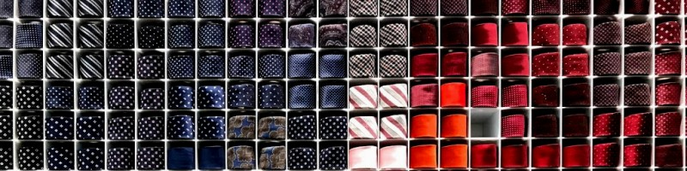
Today is National Tie Day!
How many ties are on this tie wall?
How many different equations can we create to match our math thinking?

