Slide 1
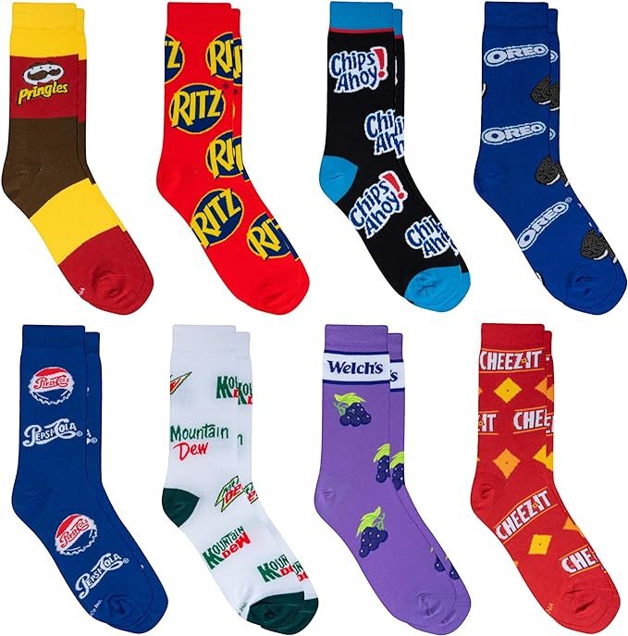
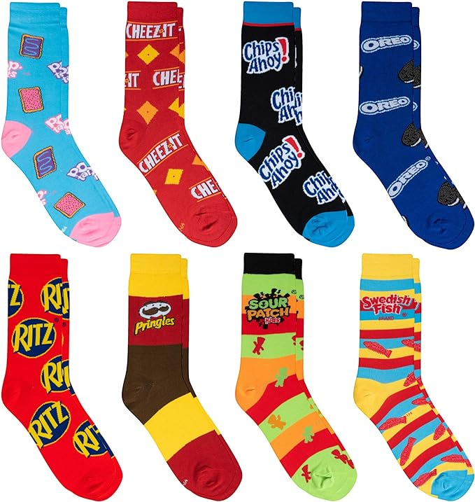
Happy Odd Socks Day!
How many socks are here?
How can we count them?
What interesting multiplication expressions can we create to match this photo?
Notes:
Week 12
November 20, 2023

Slide 2
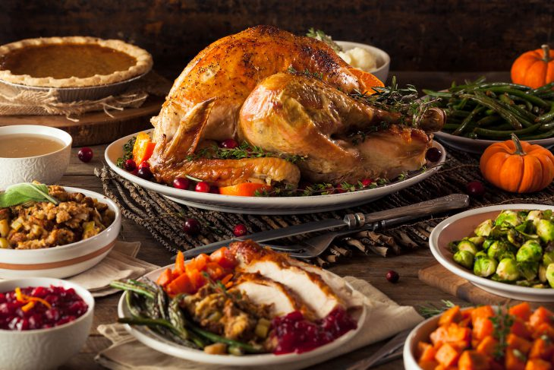
Happy Thanksgiving!
The event that Americans commonly call the "first Thanksgiving" was celebrated by the Pilgrims after their first harvest in the New World in October 1621. This feast lasted three days and was attended by 90 Native American Wampanoag people and 53 survivors of the Mayflower (Pilgrims).
How long ago was 1621?
How many people attended?

Slide 3
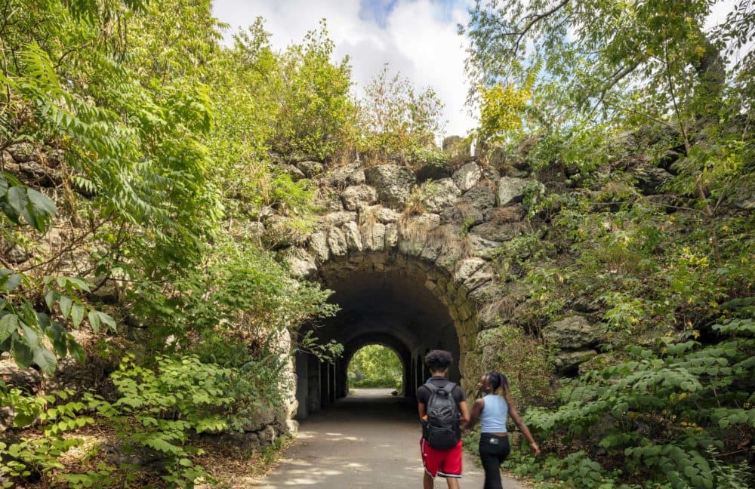
Franklin Park Trails!
Estimate the height of the arch on this trail.
What unit would you use to measure?
How do you know your estimation is close?

