Slide 1
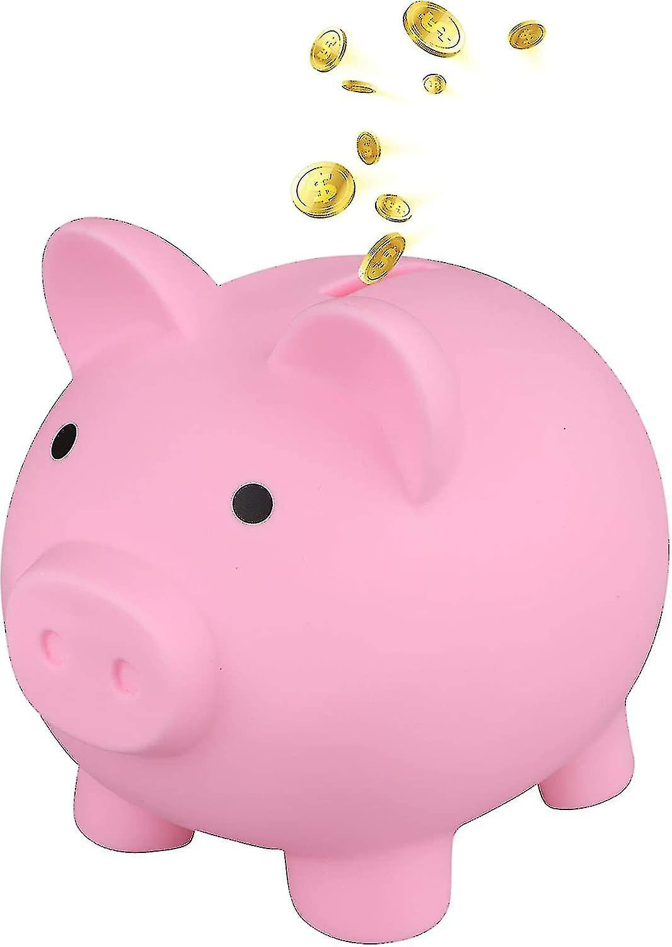
Today is GIVING TUESDAY!
What do we think GIVING TUESDAY is?
If we donated 1 dime today, and then doubled the amount every day for a week …
How much money would we be able to donate by the end of the week?
What about 2 weeks?
Notes:
Week 13
November 28 - December 1

Slide 2
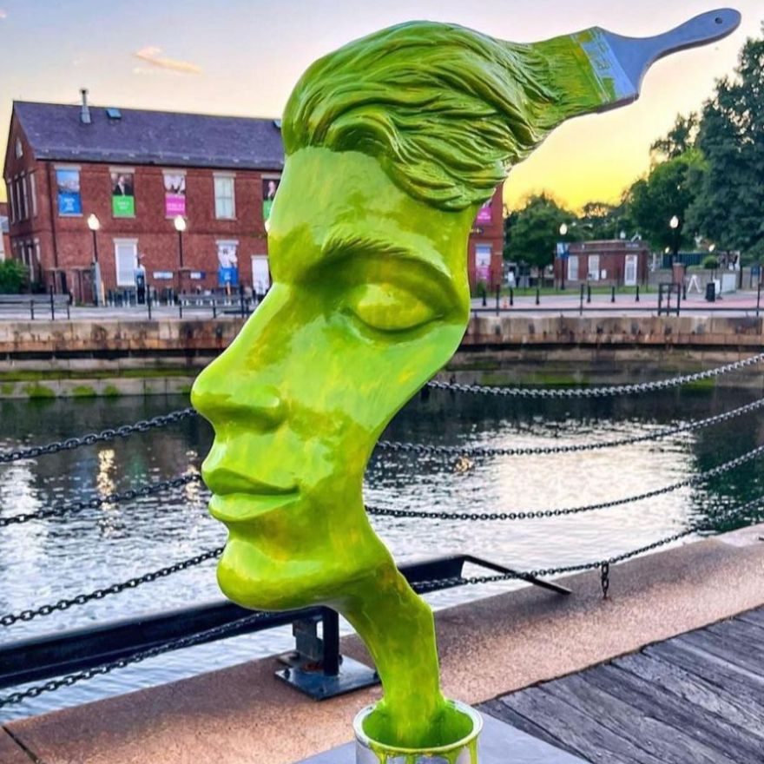
“Stroke of Genius” on the Boston Harborwalk
Estimate the height of this sculpture.
Would you be surprised if we told you it is 12 feet tall?
How tall is that? How many of YOU would be that tall?

Slide 3
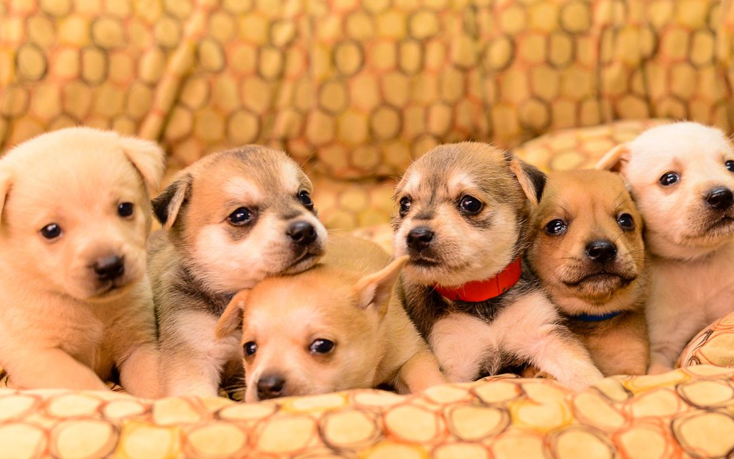
Today is Shelter Pets Day
These six puppies are ready for adoption!
Together, these six puppies weigh 25 pounds.
What is possible?

Slide 4
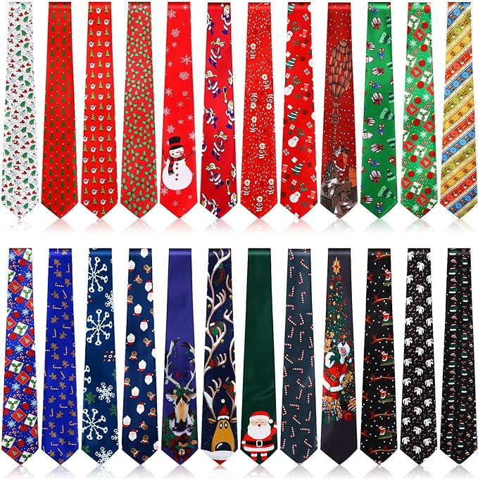
It’s National Tie Day!
How many ties are here?
Where do we see “groups of?”
How many different expressions can we create that equal 24?

