Slide 1
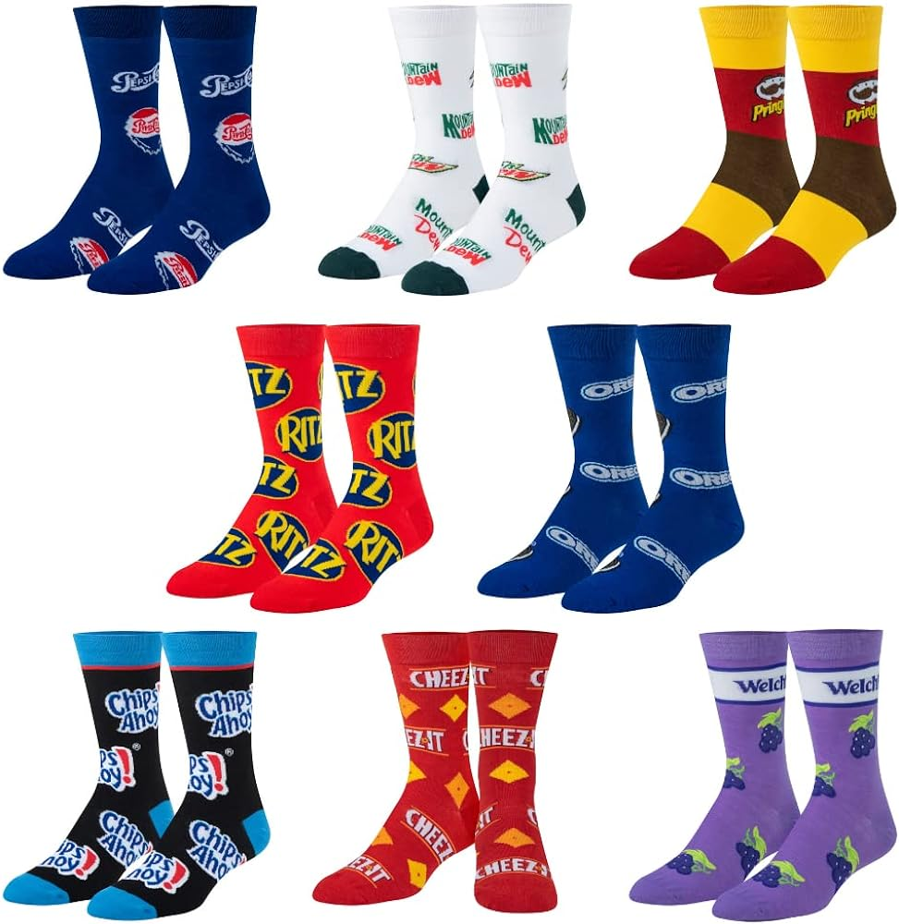
Happy Odd Sock Day!
What do we notice?
How many socks do we see?
How do we see them?
Let’s write an expression to match our great math thinking!
Notes:
Week 12
November 20, 2023

Slide 2
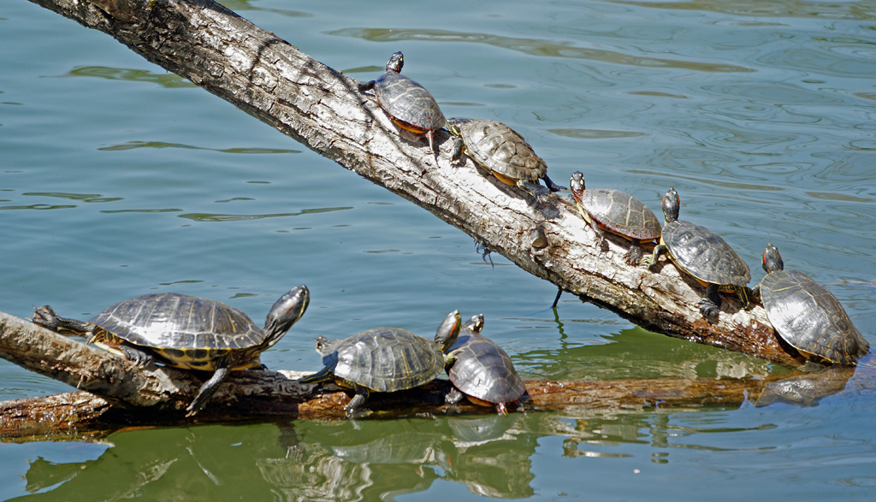
How many turtles are sunning at Jamaica Pond?
How many turtle legs is that?

Slide 3
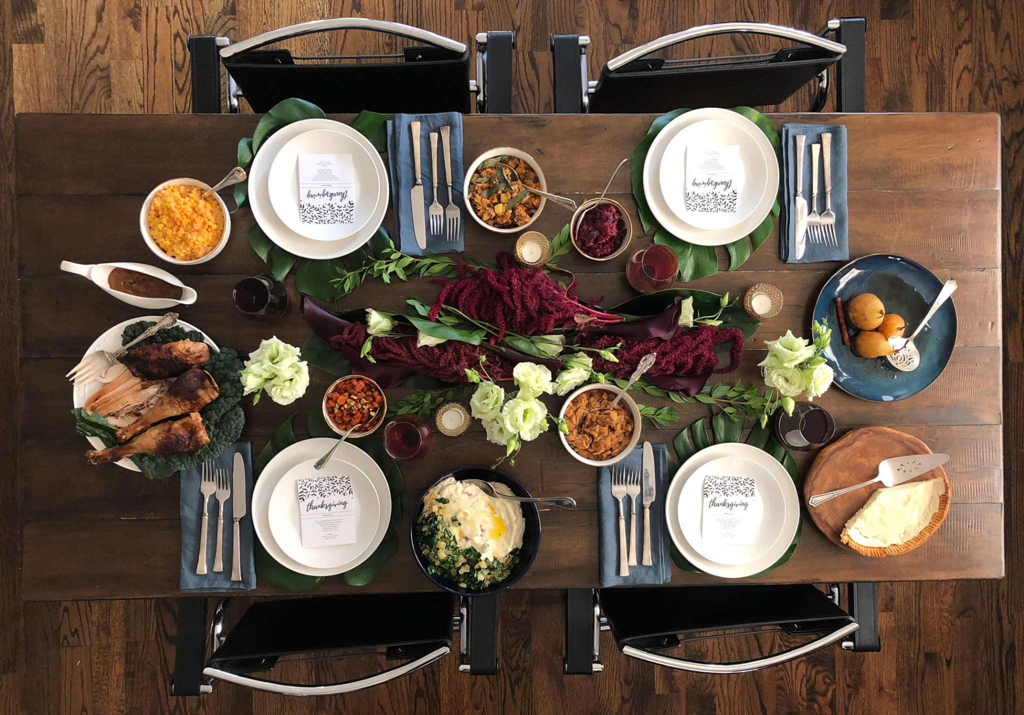
Happy Thanksgiving!
What can we say about the shapes on this Thanksgiving table?
Can we name all of the shapes we see?

