Slide 1
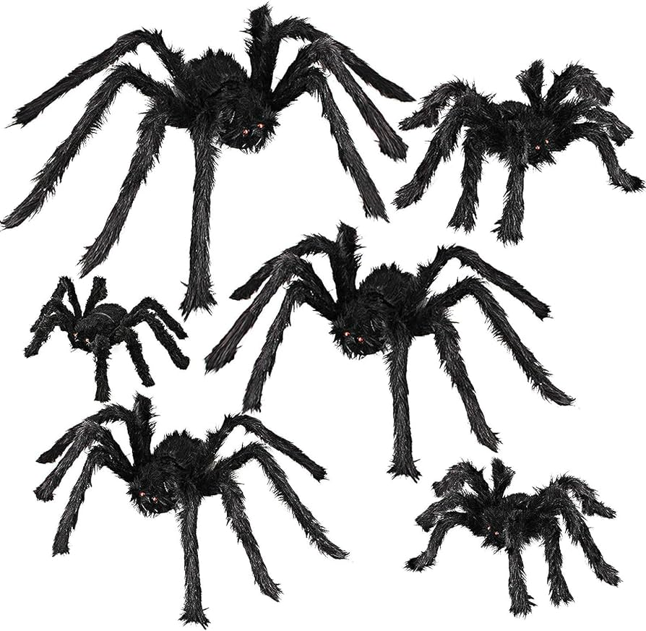
Scary Spiders!
What do we notice?
How can we compare these spiders?
Which one is the SMALLEST?
Which one is the BIGGEST?
Notes:
Week 8
October 23 - 27, 2023

Slide 2
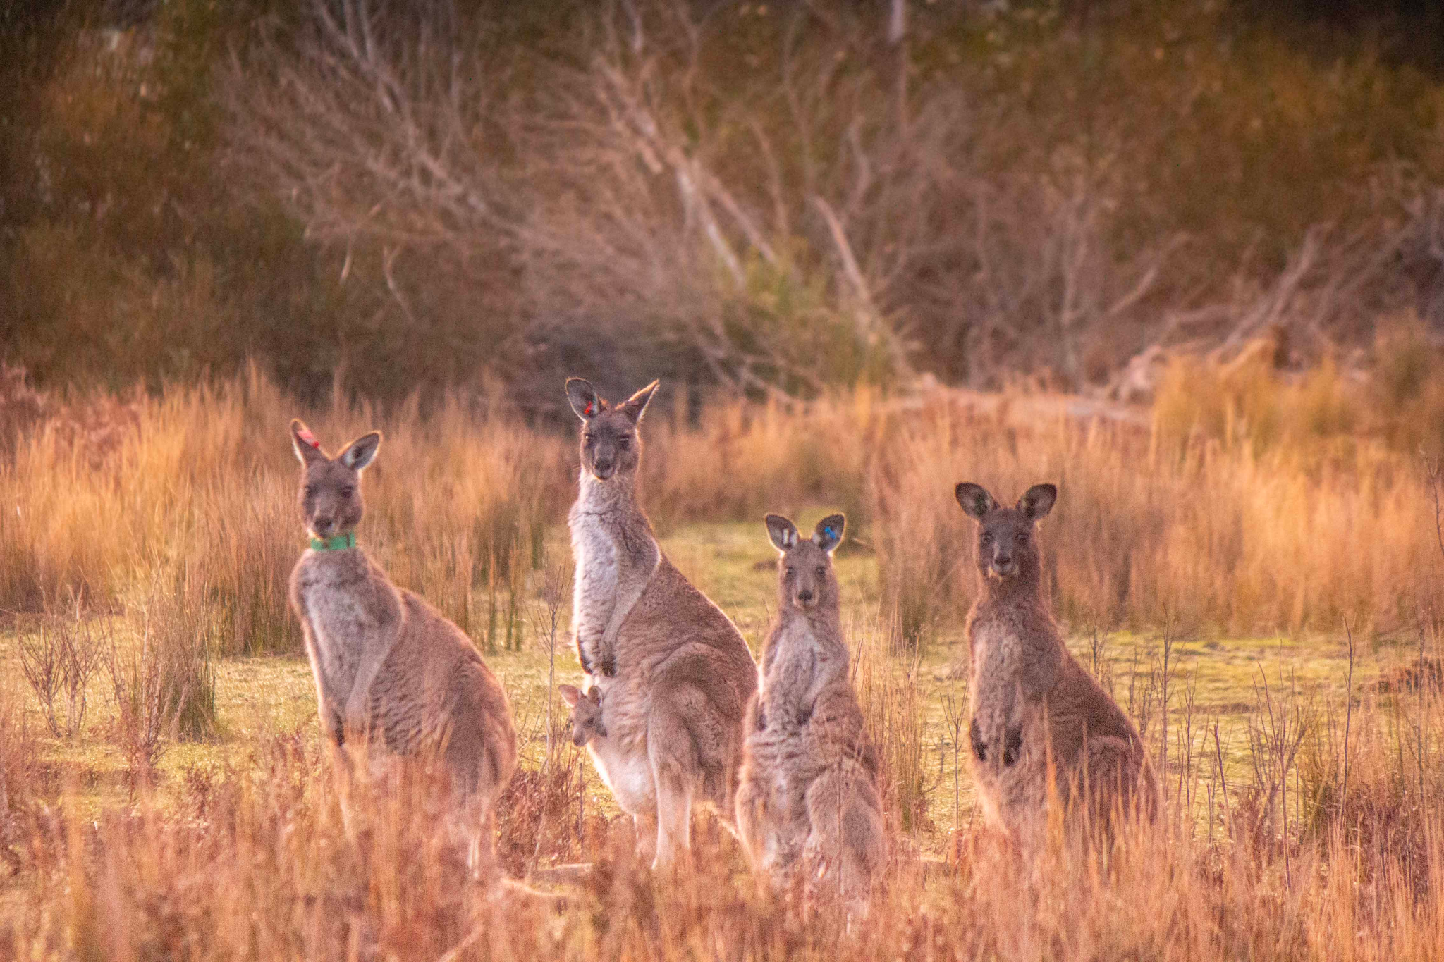
It’s World Kangaroo Day!
How many kangaroos are in this photo?
How many different ways can we represent the number 5?

Slide 3
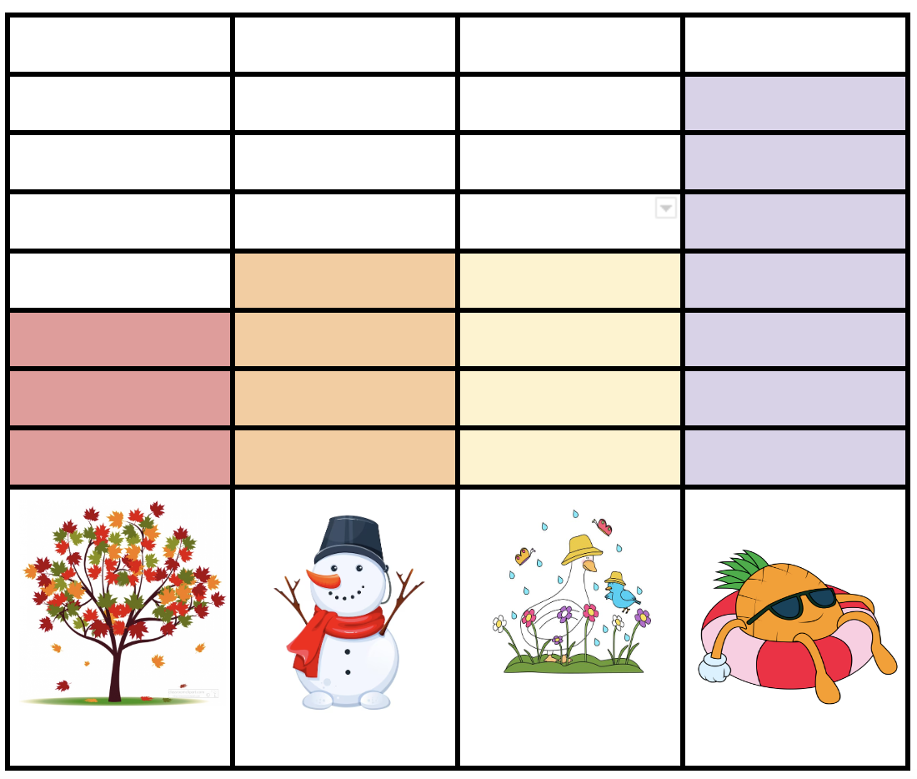
What do we notice?
What do we wonder?
What can we name this graph?

Slide 4
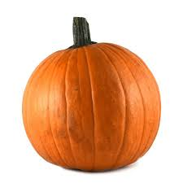
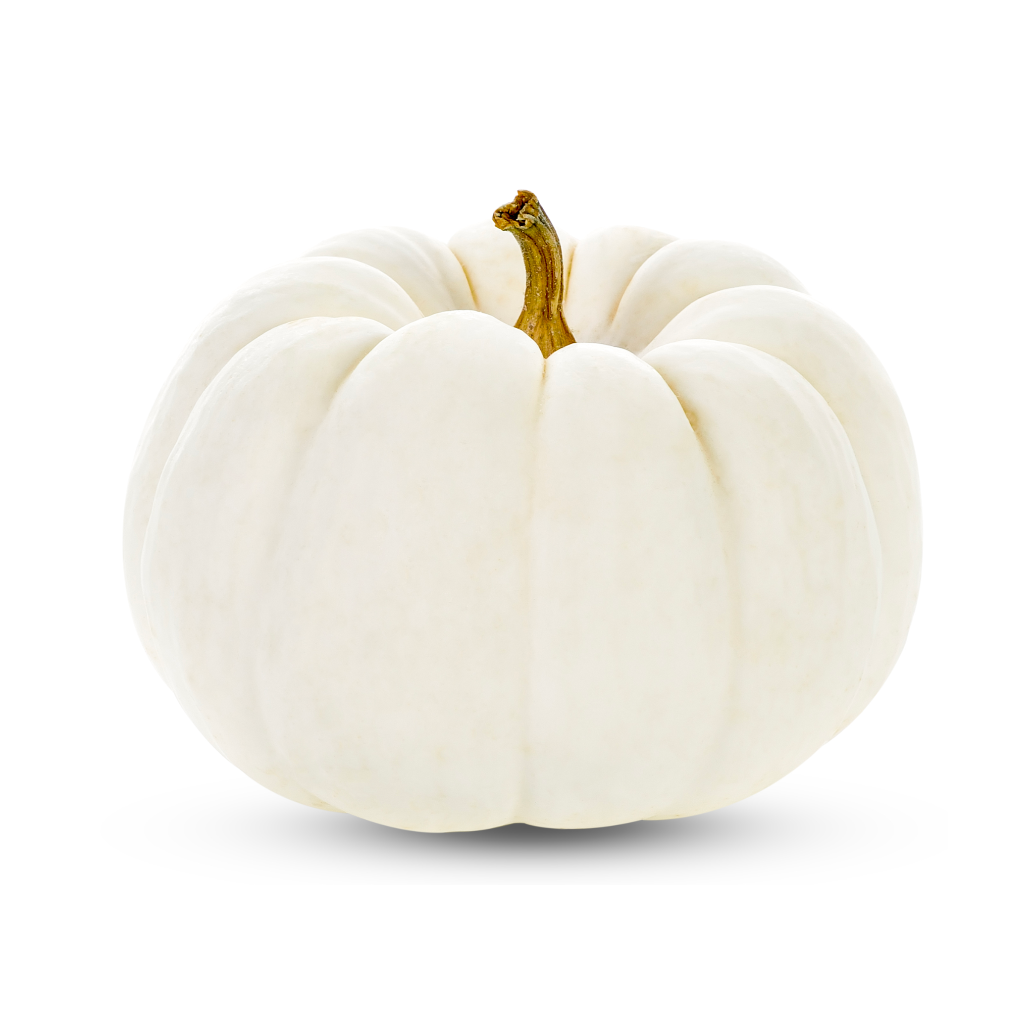
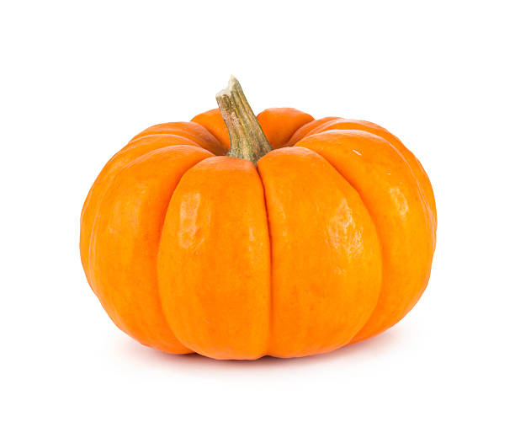
Happy Pumpkin Day!
How can we compare these pumpkins?

Slide 5
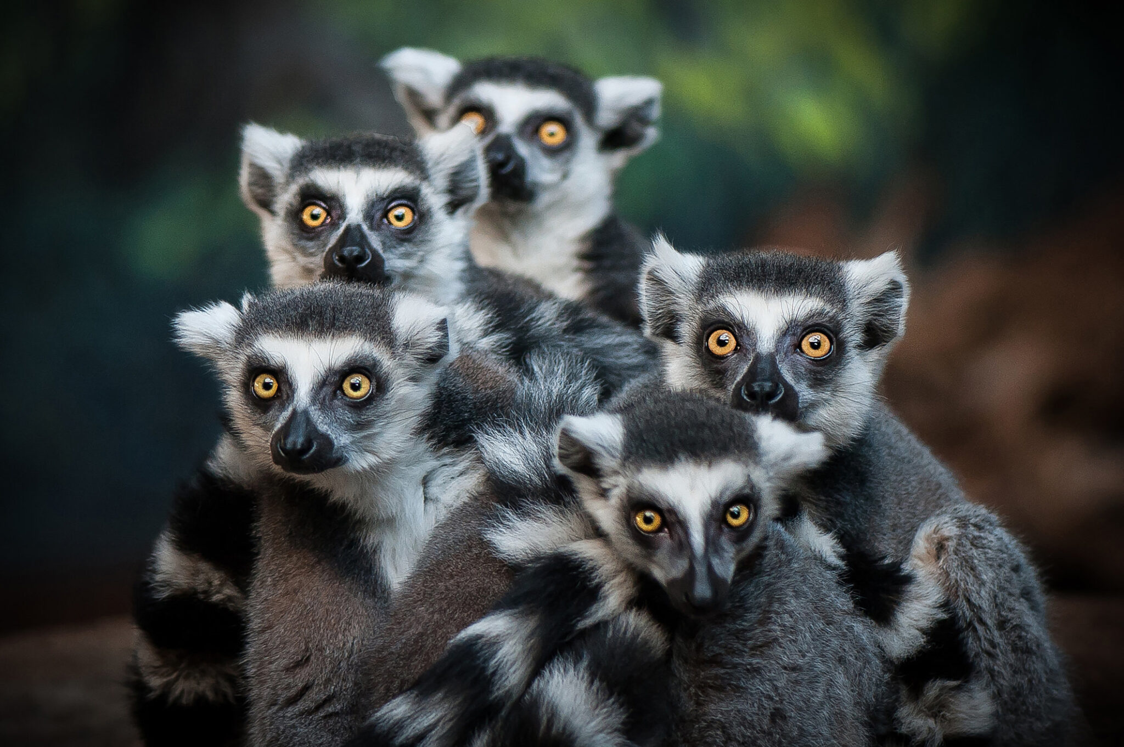
Happy World Lemur Day!
How many Lemurs do we see?
How many different expressions can we create that equal 5?

