Slide 1
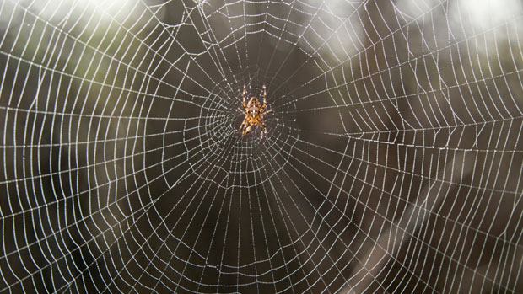
What an amazing web!
It takes an average spider about 45 minutes to spin her web.
A typical spider spins a new web every day.
How much time does she spend spinning webs each week?
How much time is that in a month?
A year?
Fun Fact! Many spiders are actually great recyclers, they eat their webs!
Notes:
Week 8
October 23 - 27

Slide 2
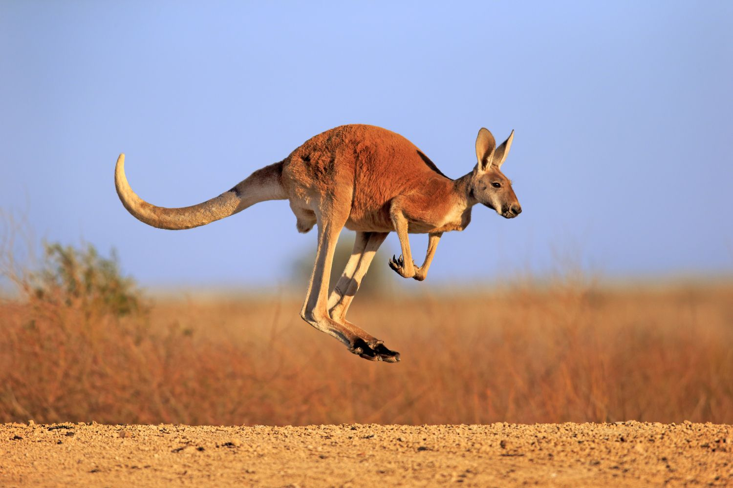
Today is World Kangaroo Day!
Kangaroos are the largest marsupials alive today.
The largest species of kangaroo (by weight) is the red kangaroo, which can stand more than 5 feet tall—not including a 3-foot-long tail—and weigh 180 pounds.
How do this compare to your size and weight?
How many time TALLER or HEAVIER is the red kangaroo than you?

Slide 3
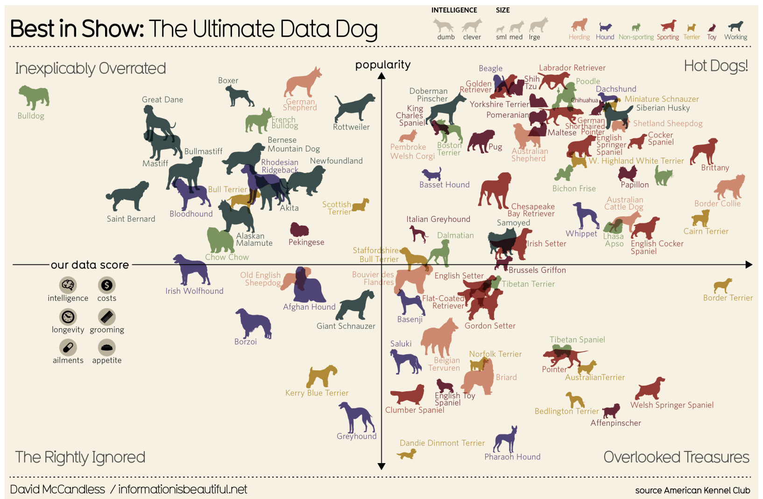
What do we notice?
What do we wonder?
What’s going on in this data visualization?

Slide 4
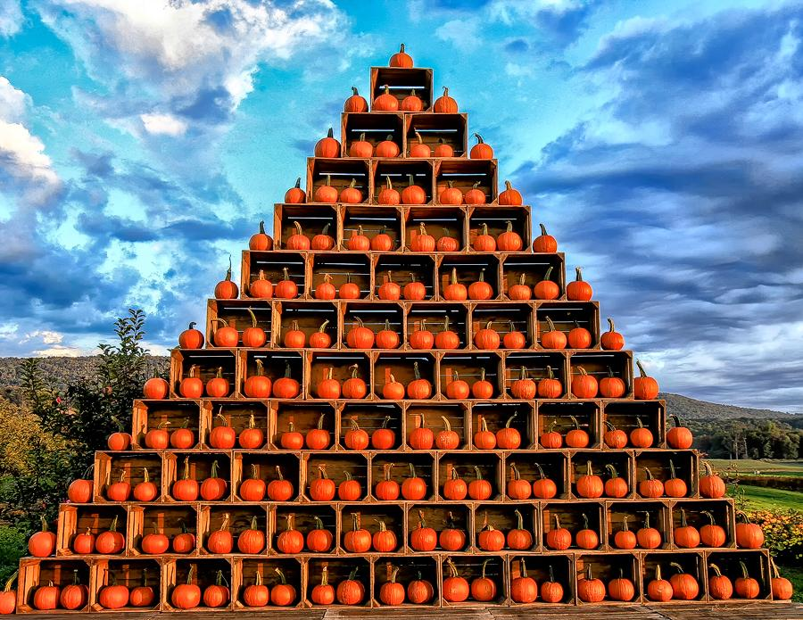
Happy Pumpkin Day!
What do we notice?
What do we wonder?
How can we use math to determine how many pumpkins are in this pyramid?

Slide 5
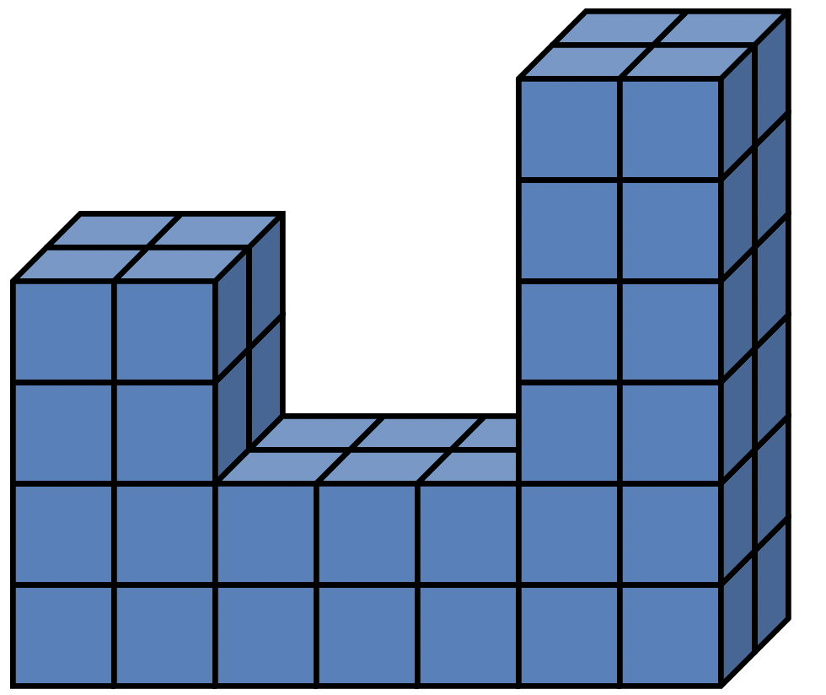
How many different expressions can we create to match the volume of this irregular prism?

