Slide 1
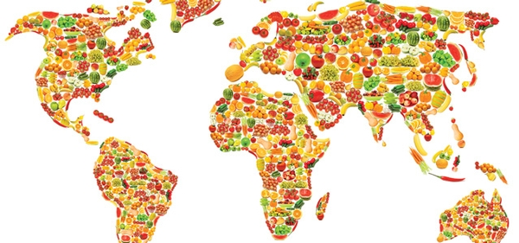
Today is World Food Day
Food is seen as a basic human right, and yet one in nine people globally experience chronic hunger.
What does that mean?
What can we say about 90 people?
900 people?
9,000 people?
90,000 people?
900,000 people? (about the population of Metro Boston)
Why does it matter?
The current U.S. population is 360,000,000 people.
The current world population is close to 8.1 billion people.
Notes:
Week 7
October 16 - 20, 2023
World Food Day!

Slide 2
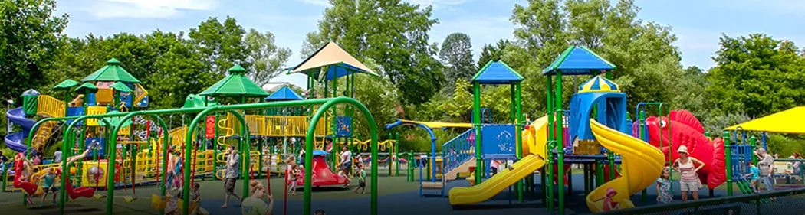
The Franklin Park Zoo Playground 10,000 square feet of fun!
If the playground is one big rectangle, what is possible?

Slide 3
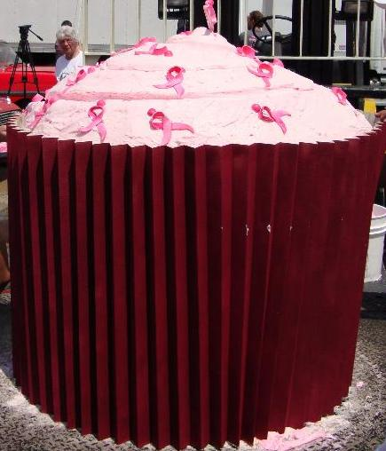
Happy Chocolate Cupcake Day!
On November 2, 2011, Georgetown Cupcake created a cupcake weighing close to 2,600 lbs, according to Guinness World Records.
What are some FACTOR PAIRS of 2,600?
How do you know we have them all?

Slide 4
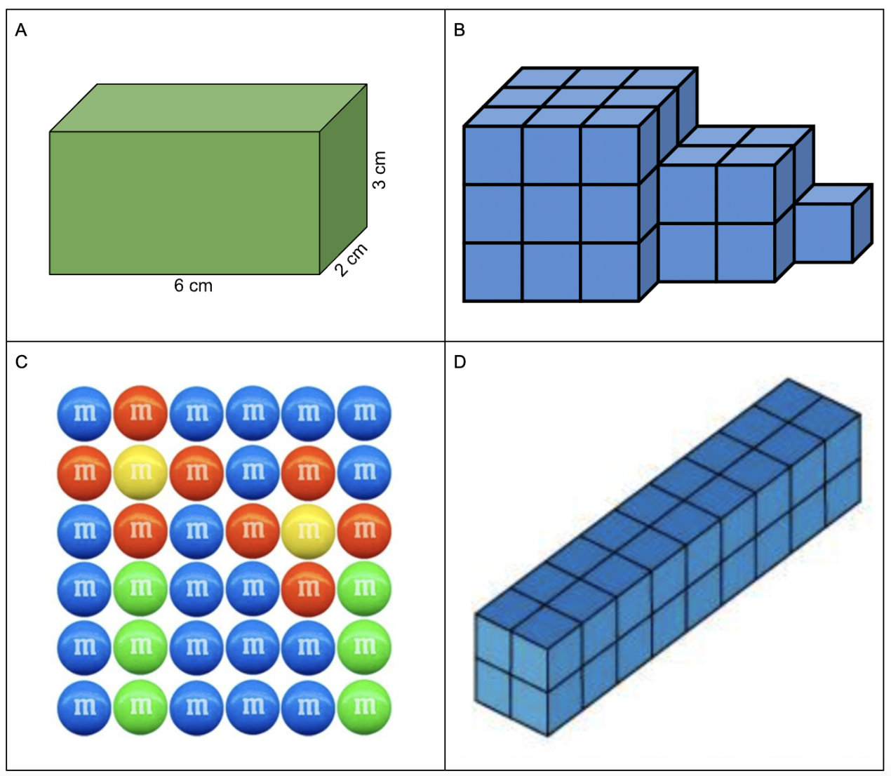
Which one doesn’t belong?

Slide 5
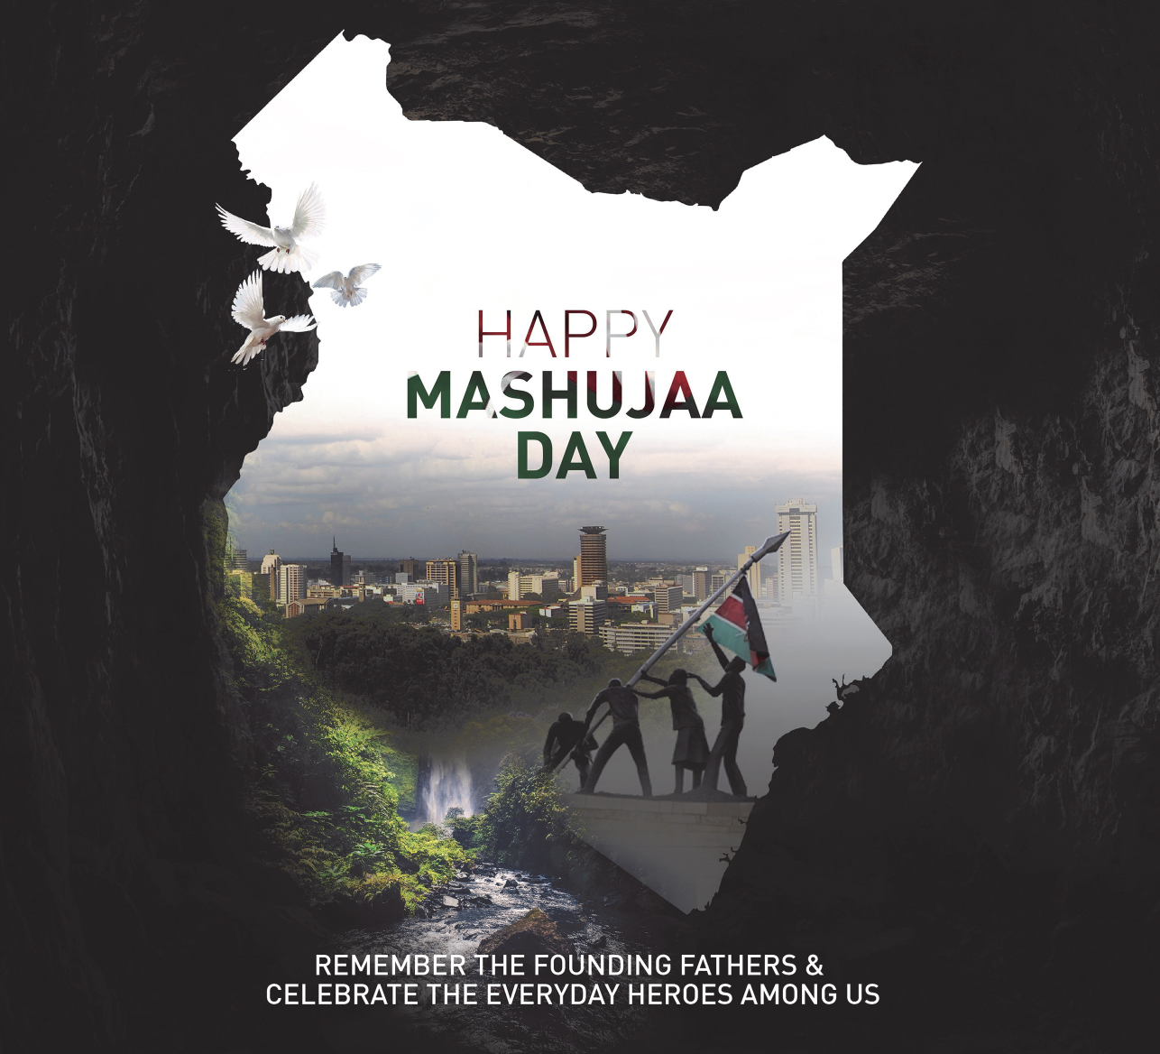
‘Mashujaa’ is the Swahili word for ‘Heroes,’ and because of this, Mashujaa Day is also called ‘Heroes’ Day’
Kenya gained her independence in 1963!
Is 60 years a long time for a country to be independent?
What are all of the factor pairs of 60?
How do we know when we have all of them?

