Slide 1
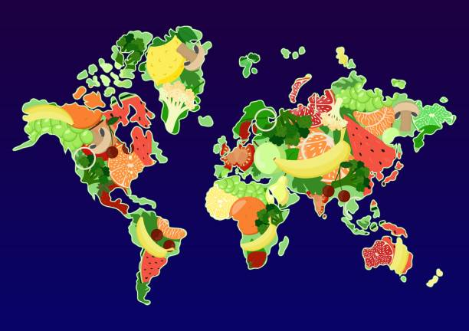
Today is World Food Day
Food is seen as a basic human right, and yet one in nine people globally experience chronic hunger.
What does that mean?
What can we say about 90 people?
900 people?
9,000 people?
90,000 people?
900,000 people? (about the population of Metro Boston)
Why does it matter?
Notes:
Week 7
October 16 - 20, 2023
World Food Day!

Slide 2
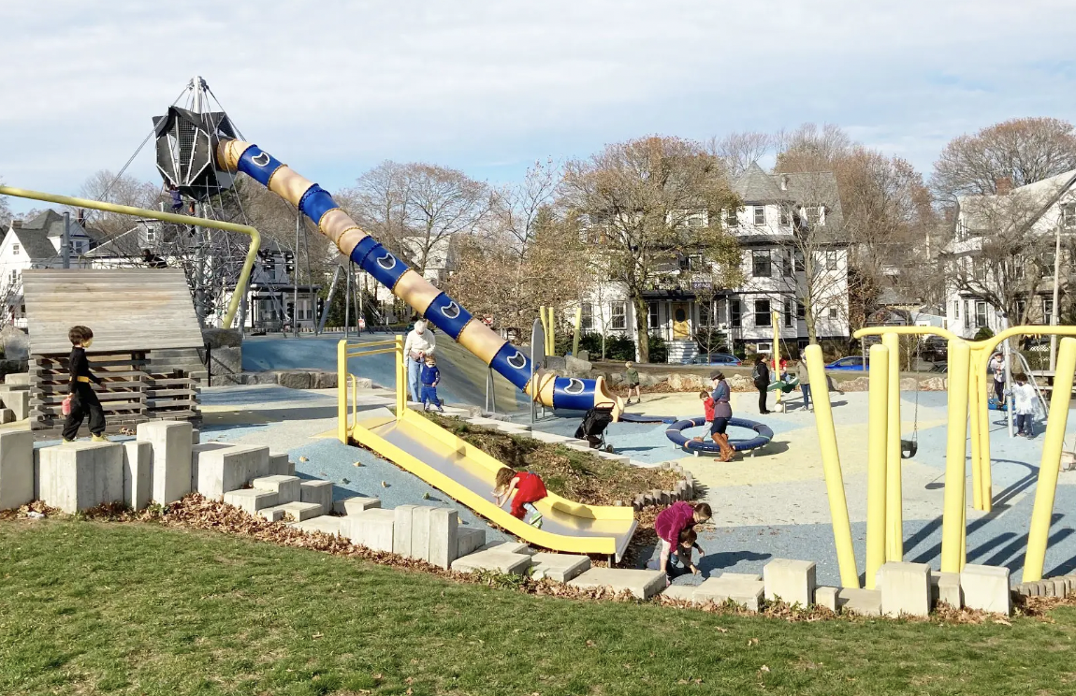
Fallon Field has the biggest slide in Boston!
Estimate the length of the slide.
How can you use clues in the photo to help?
What unit of measure would you use?

Slide 3
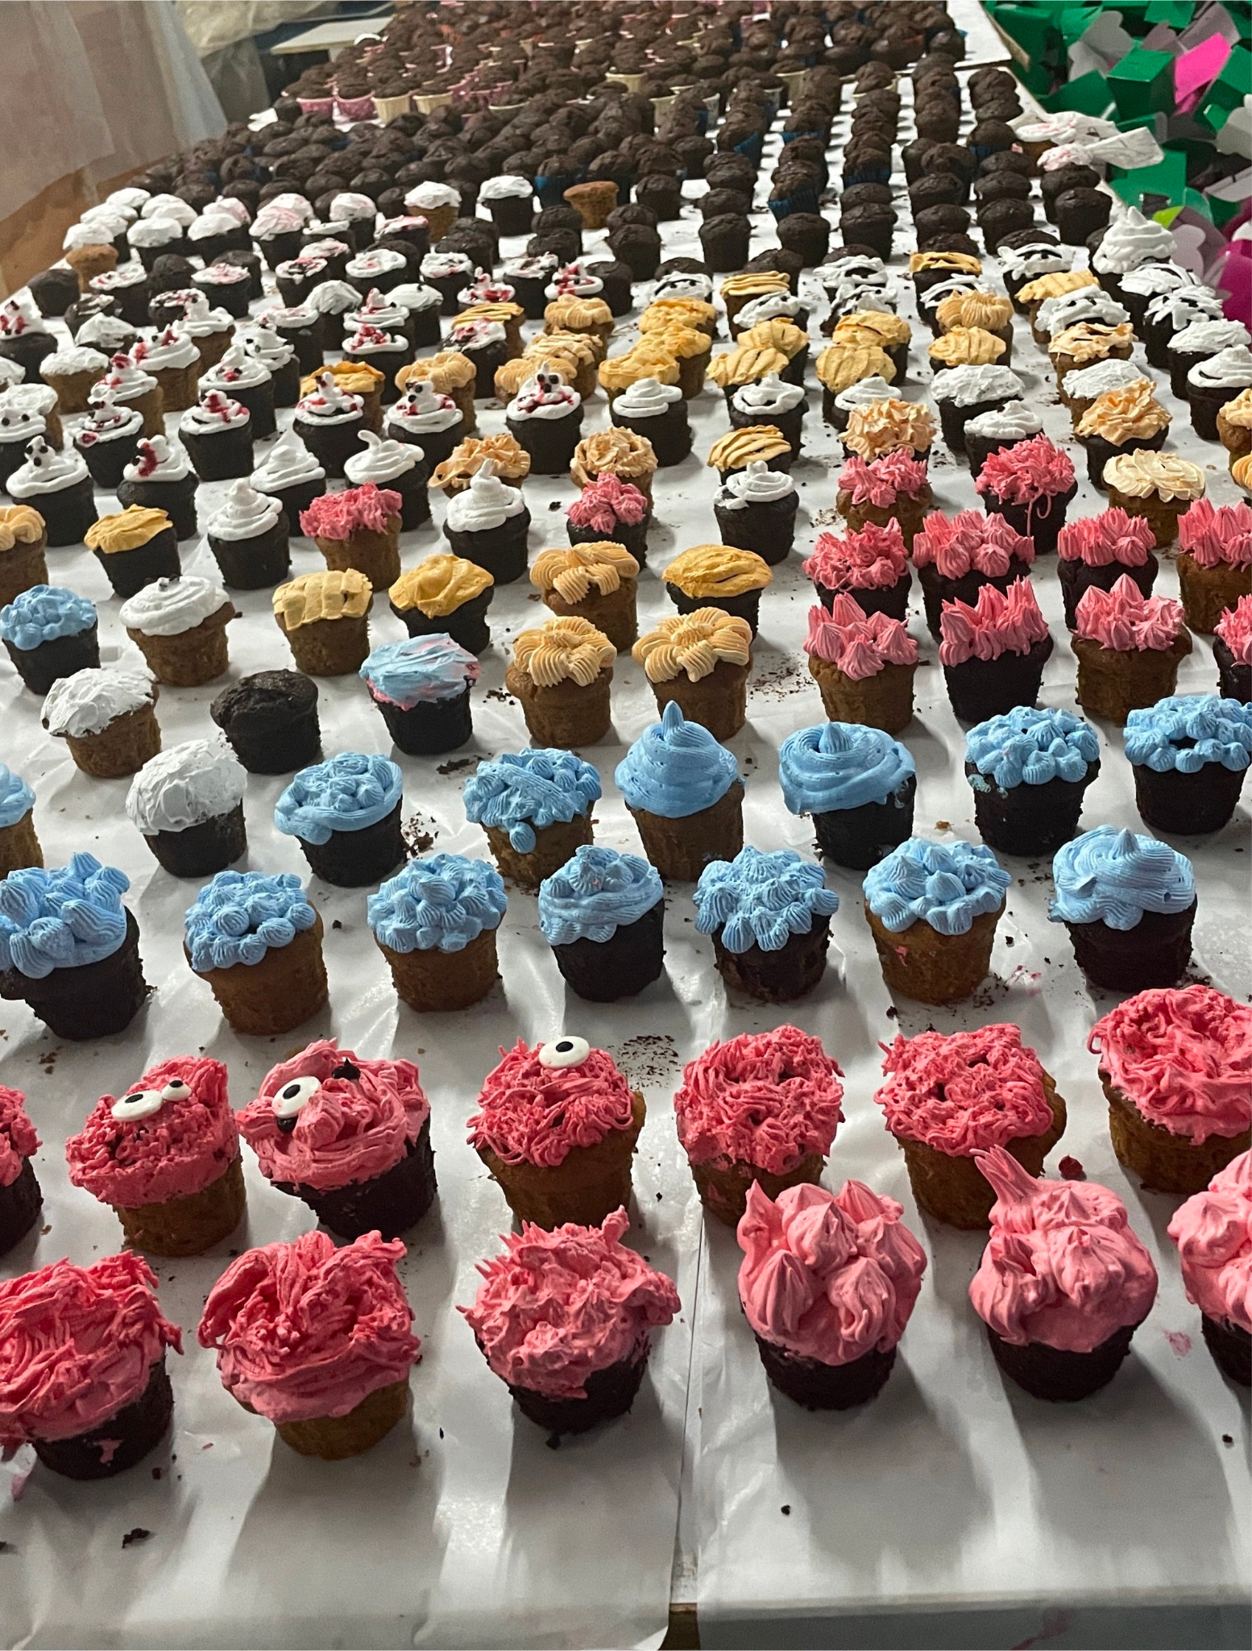
Celebrate Chocolate Cupcake Day!
Estimate the number of cupcakes on display here.
How can we use arrays to help us?
Write an equation to represent your mathematical thinking!

Slide 4
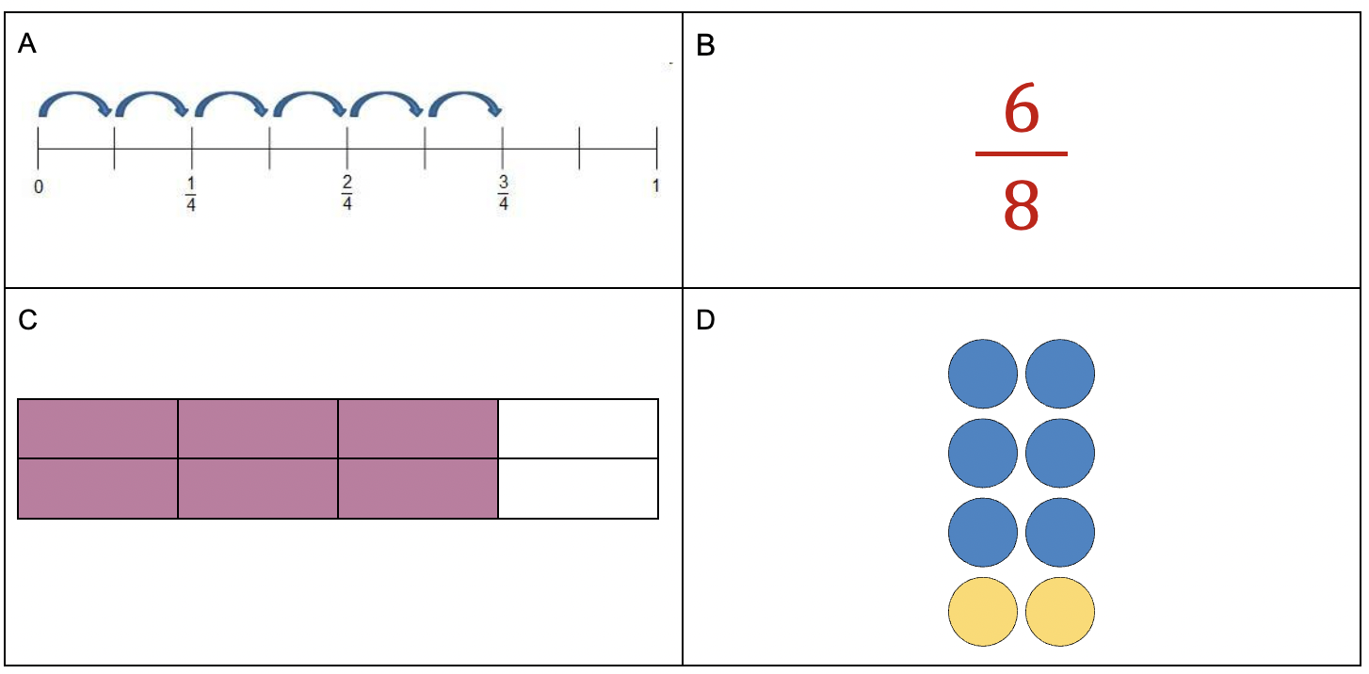
Which one doesn’t belong?

Slide 5
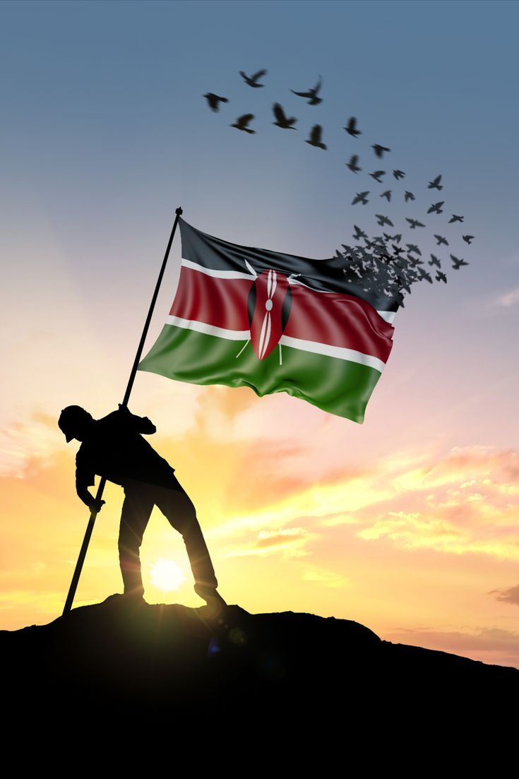
Today is Mashujaa Day in Kenya!
‘Mashujaa’ is the Swahili word for ‘Heroes,’ and because of this, Mashujaa Day is also called ‘Heroes’ Day’
Today is the 60th anniversary of Kenya’s independence!
Is 60 years a long time?
What are some factor pairs of 60?
How do we know when we have all of them?

