Slide 1
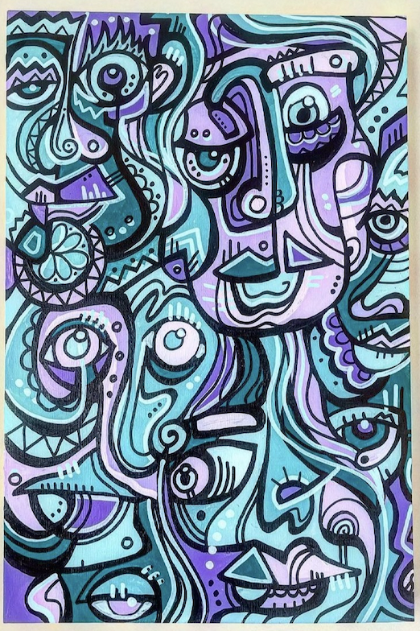
Celebrate Indigenous Peoples’ Day!
Let’s be shape detectives!
What interesting shapes can we find in “Making Connections” by Jake Ginga?
Choose a shape and sketch it.
Now sketch a shape that is the same in ONE way and different in ONE way.
Notes:
Week 6
October 10-13, 2023

Slide 2
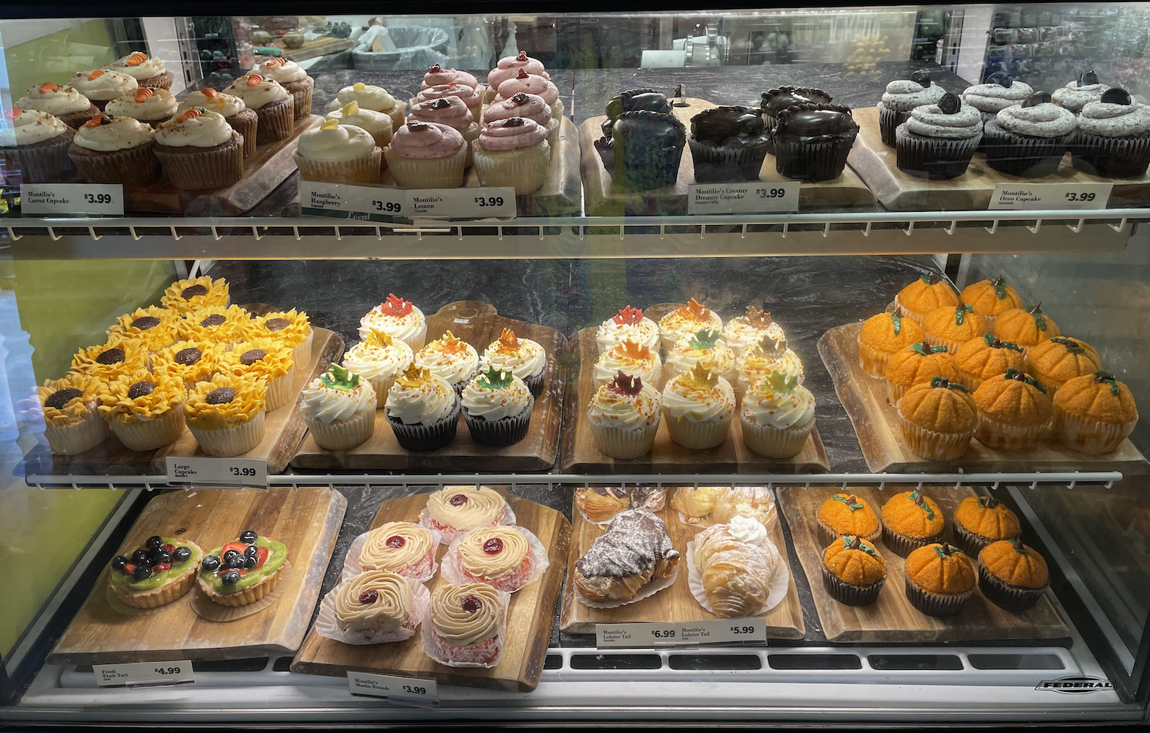
How can we use MATH to determine how many pastries are here?
Write an equation to match your math thinking!

Slide 3
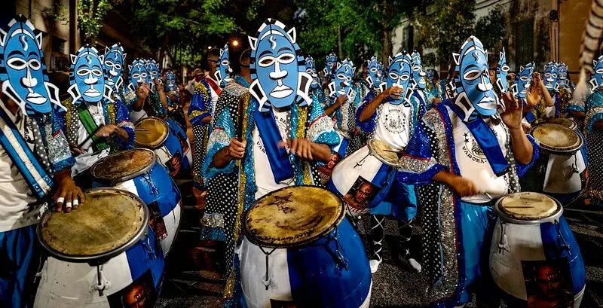
Today is Cultural Diversity Day in Uruguay!
Uruguay became an independent nation in 1828.
How long ago was that?

Slide 4
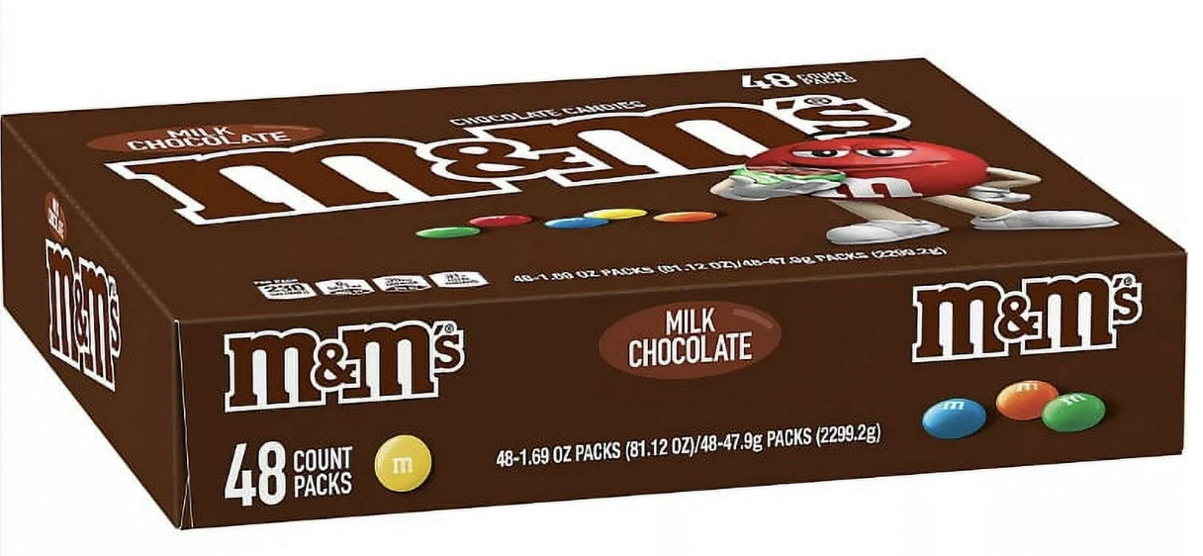
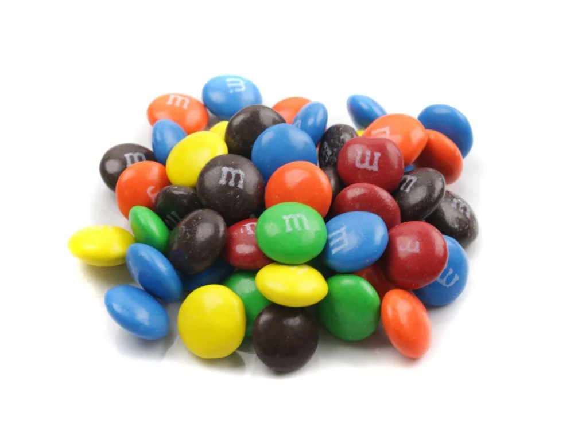
Happy m&m Day!
Inside this box is an array. What might it look like?

