Slide 1
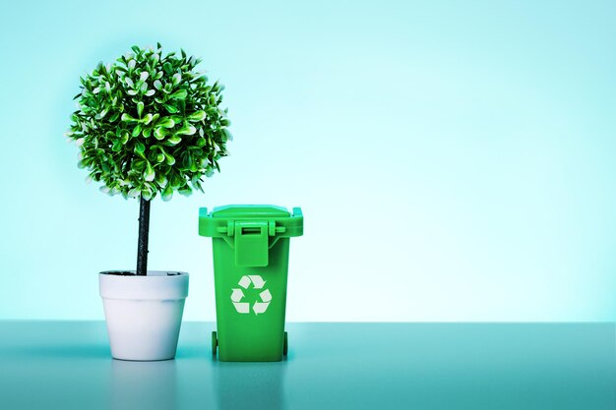
It’s International Recycling Week!
It takes 2,000 pounds of recycled paper to save 17 trees.
What does 2,000 pounds of paper look like?
(A case of paper weighs 44 pounds)
Why does it matter?
Notes:
Week 10
November 6-9

Slide 2
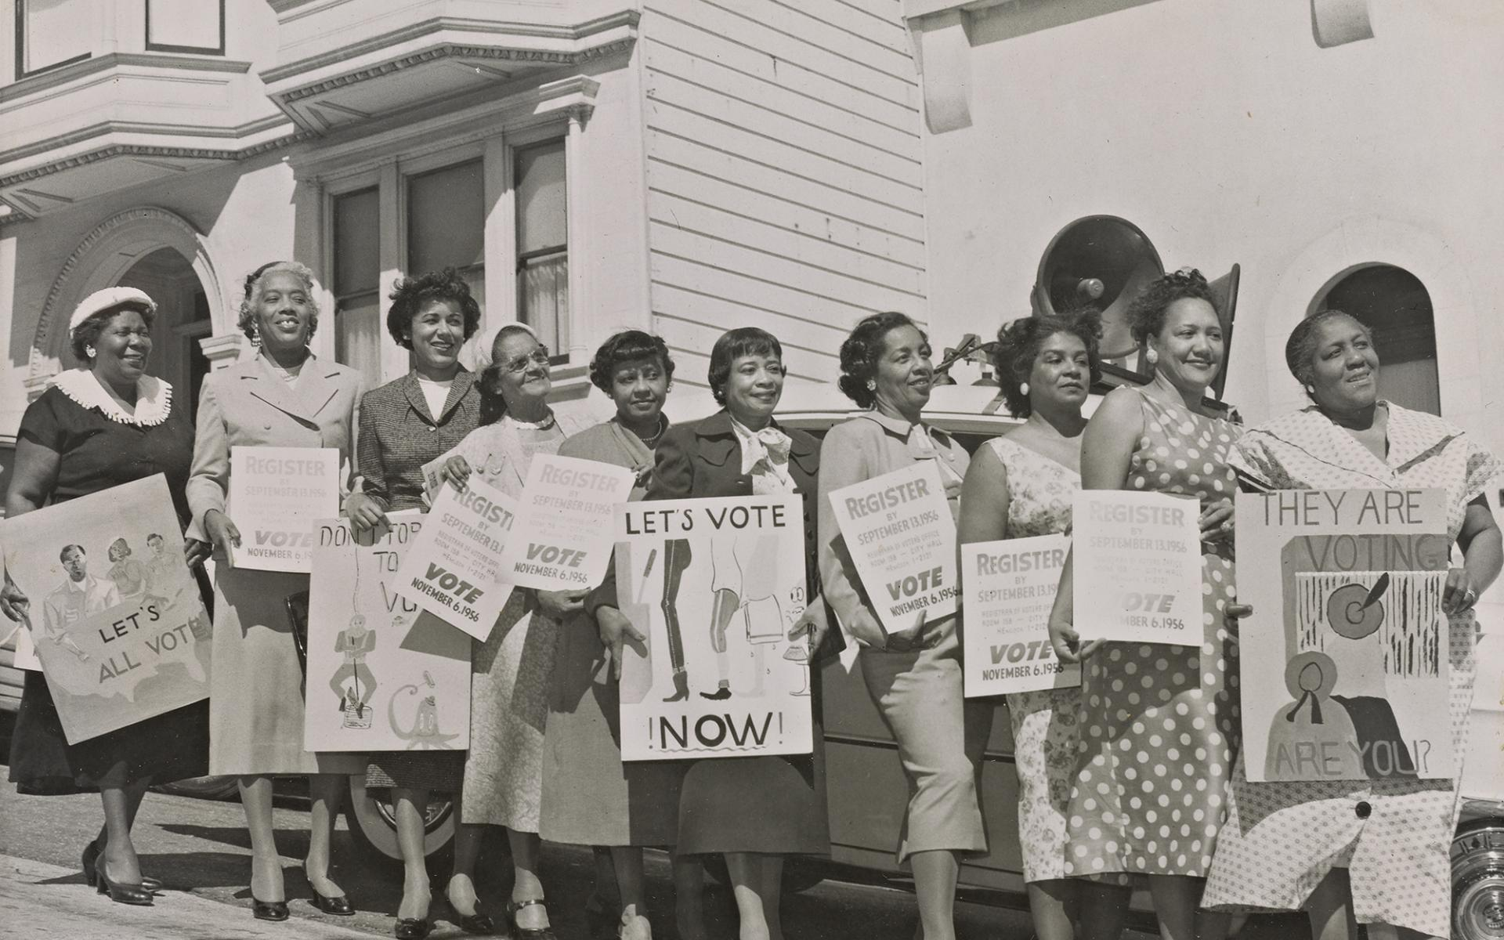
Today is Election Day!
Many brave and impassioned Americans protested, marched, were arrested and even died working toward voting equality. In 1963 and 1964, Dr. Martin Luther King Jr. brought hundreds of Black people to the courthouse in Selma, Alabama to register. When they were turned away, Dr. King organized and led protests that finally turned the tide of American political opinion.
In 1965, the Voting Rights Act directed the Attorney General to enforce the right to vote for African Americans.
How long ago was 1965?
Why does it matter?

Slide 3
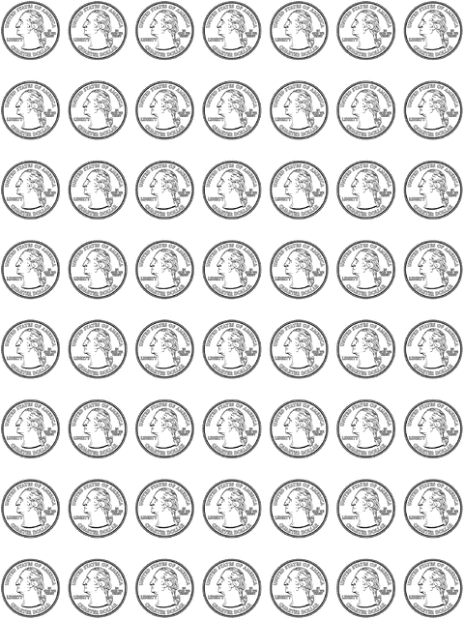
What can we say about this array of quarters?
How many quarters are here?
What is the value?

Slide 4
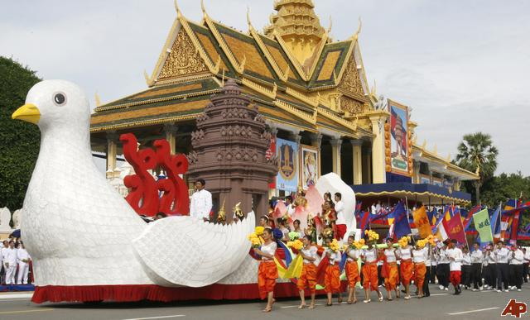
Today is Independence Day in Cambodia!
Today we celebrate Cambodia’s independence from France on November 9, 1953.
How long ago was that?
Can we find ALL of the factor pairs of 70?
Why does it matter?

