Slide 1
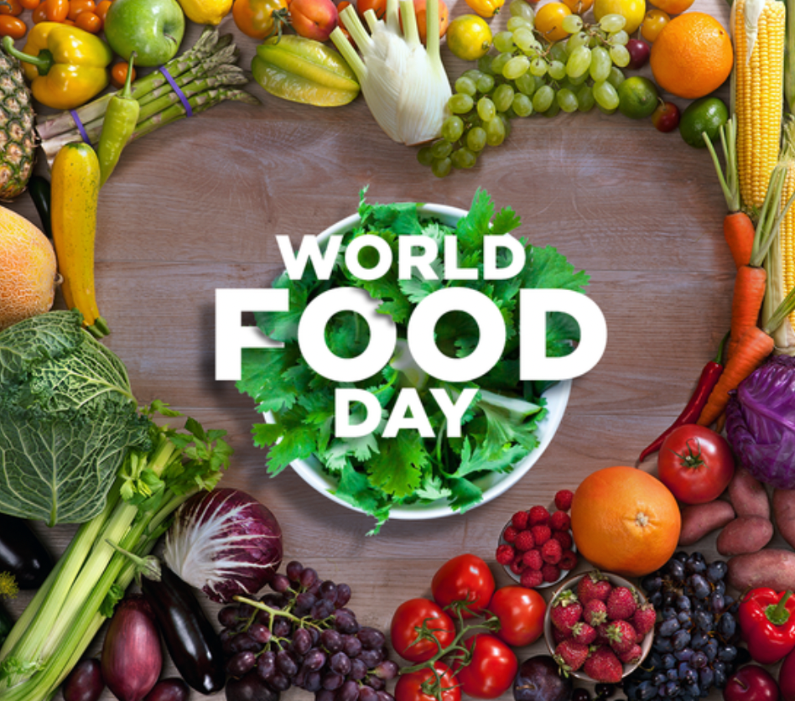
Food is seen as a basic human right, and yet one in nine people globally experience chronic hunger.
What does that mean?
What can we say about 90 people?
900 people?
9,000 people?
Why does it matter?
Notes:
Week 7
October 16 - 20, 2023
World Food Day!

Slide 2
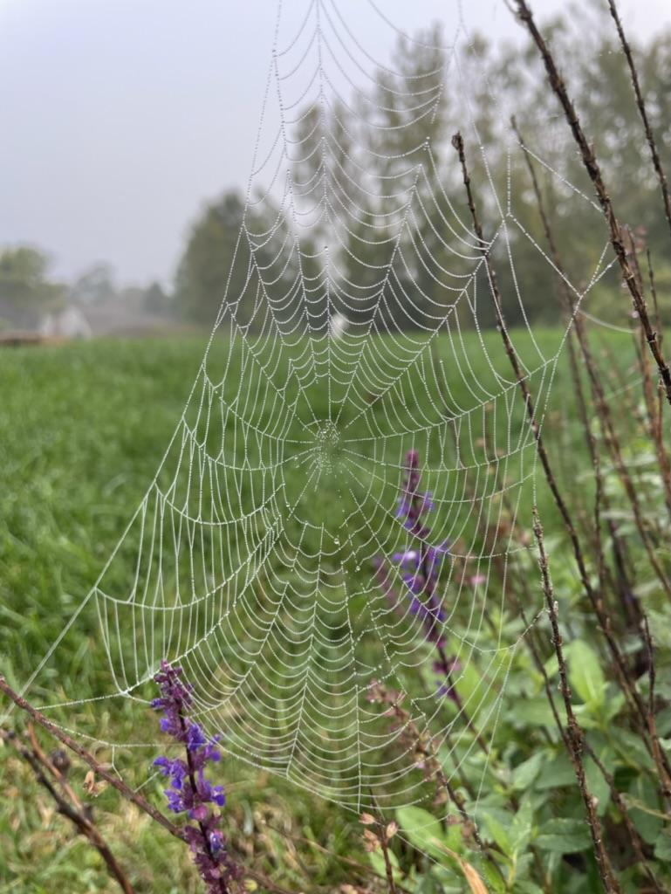
Look at this perfect web!
Charlotte (my spider friend) started spinning this web at 11:45 Sunday morning.
It took her 45 minutes to complete it.
What time was she done?
What interesting shapes do we see in her orb?
Surprisingly, most spiders eat their webs. What great recyclers!!!

Slide 3
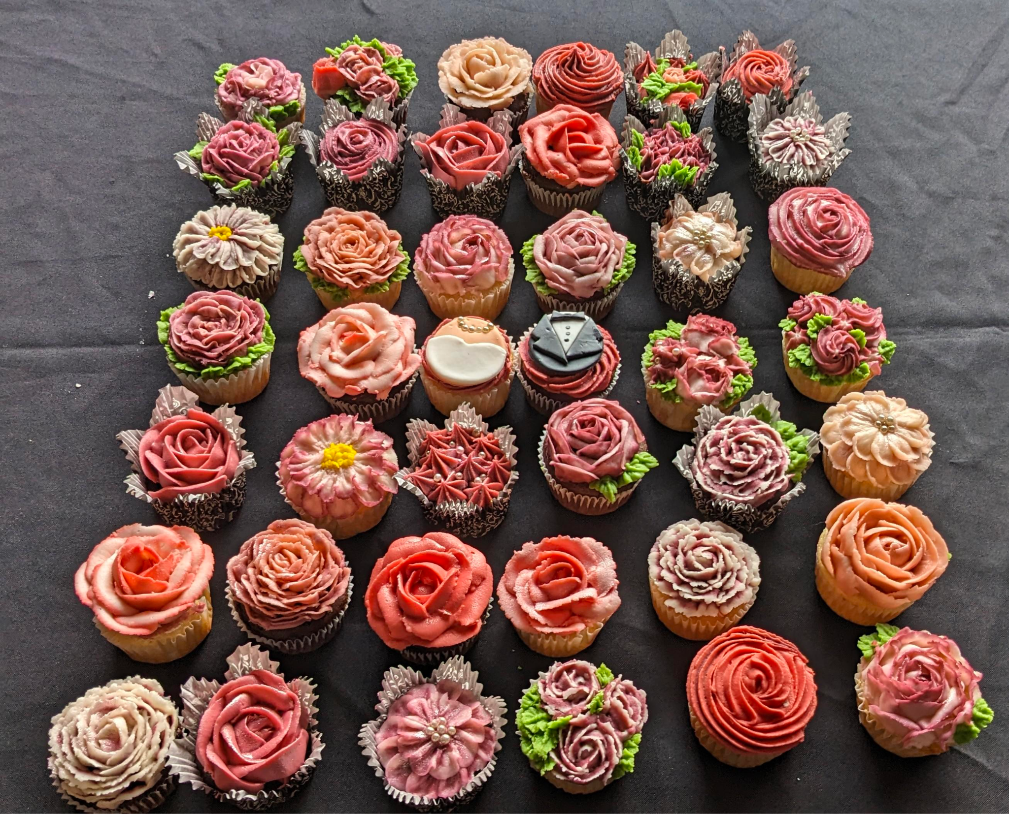
Let’s celebrate Chocolate Cupcake Day with these lovely cupcakes!
How many cupcakes are here?
How can we use arrays to help us?
Let’s represent our math thinking with an equation!

Slide 4
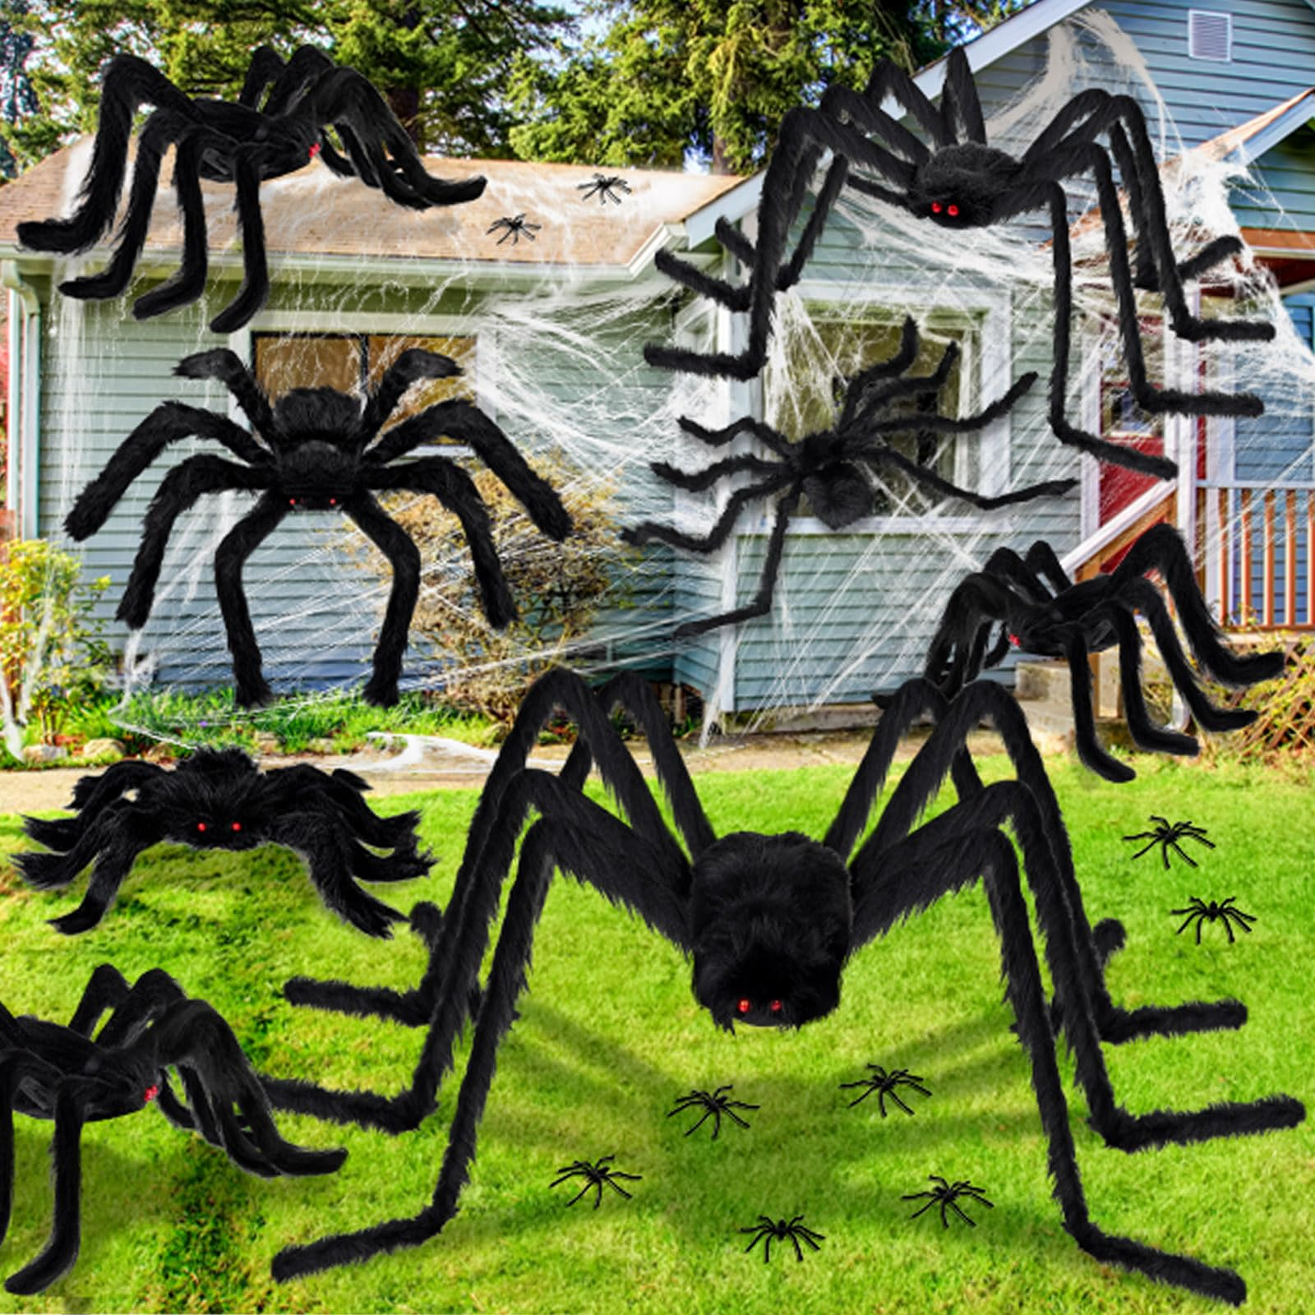
How many giant spider LEGS are on this lawn?
How many small spider LEGS?
Can we use “groups of” to help us?
How many legs altogether?

Slide 5
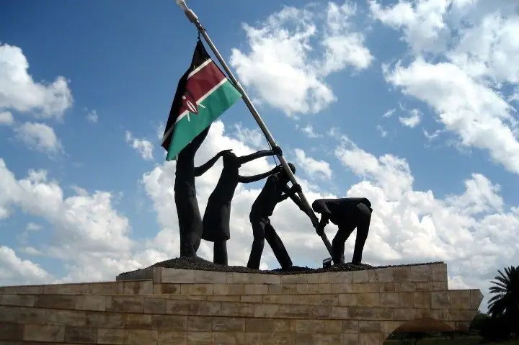
Today is Mashujaa Day in Kenya!
‘Mashujaa’ is the Swahili word for ‘Heroes,’ and because of this, Mashujaa Day is also called ‘Heroes’ Day’
Today is the 60th anniversary of Kenya’s independence!
Is 60 years a long time?
How many different expressions can we create that equal 60?

