Slide 1
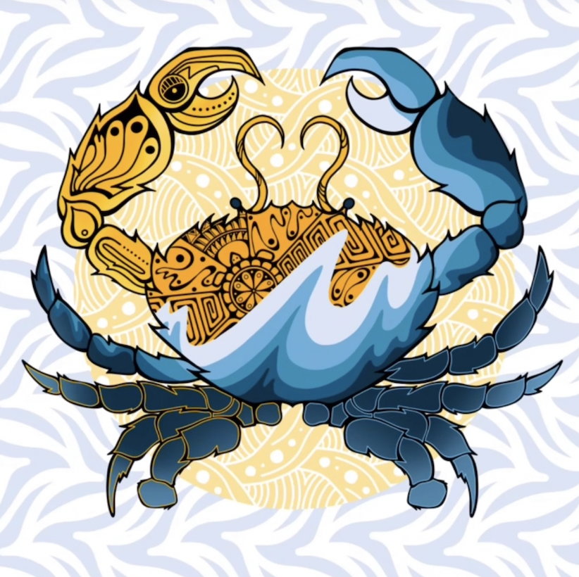
Celebrate Indigenous Peoples’ Day!
Let’s be shape detectives!
What interesting shapes can we find in “Crabflation” by Jake Ginga?
Choose a shape and sketch it.
Now sketch a shape that is the same in ONE way and different in ONE way.
Notes:
Week 6
October 10-13, 2023

Slide 2
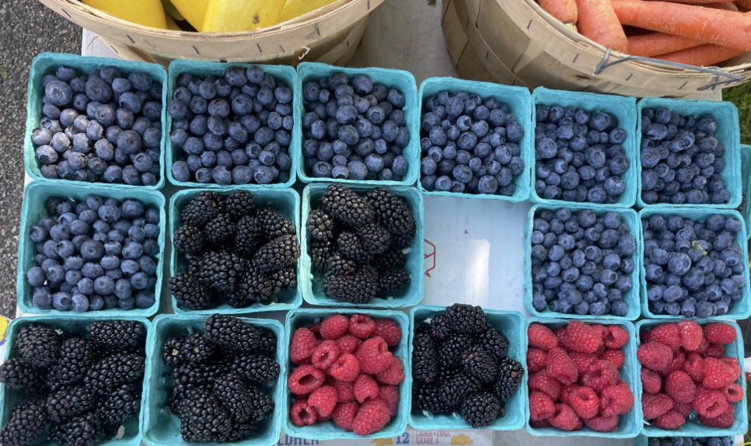
Where do we see “groups of” at the Jamaica Plain Farmers Market?
Is this an array?
Why or why not?

Slide 3
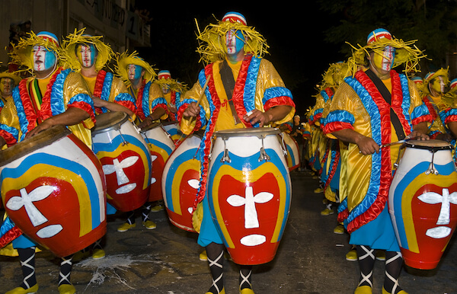
Today is Cultural Diversity Day in Uruguay!
Uruguay became an independent nation in 1828.
How long ago was that?

Slide 4
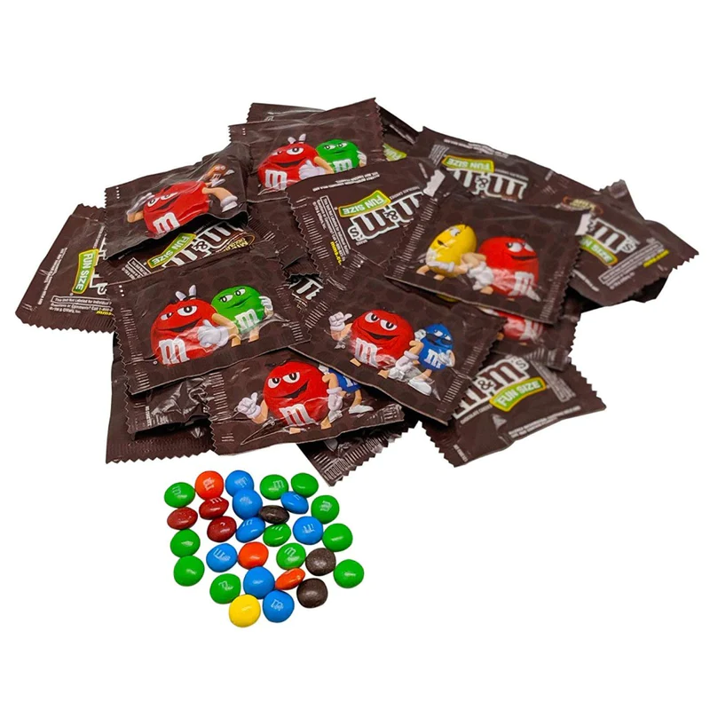
Celebrate m&m Day!
Estimate how many m&m’s are in each pack.
How many packs are here?
About how many m&m’s altogether!

