Slide 1
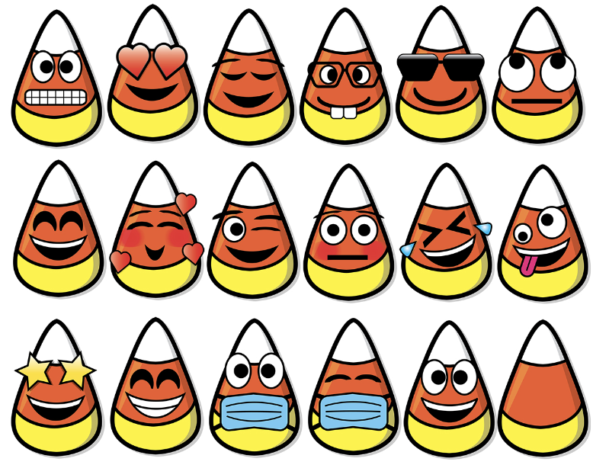
Today is National Candy Corn Day!
How many candies are here?
Can we figure it out WITHOUT counting?
Notes:
Week 9
October 30 - Nov. 3

Slide 2
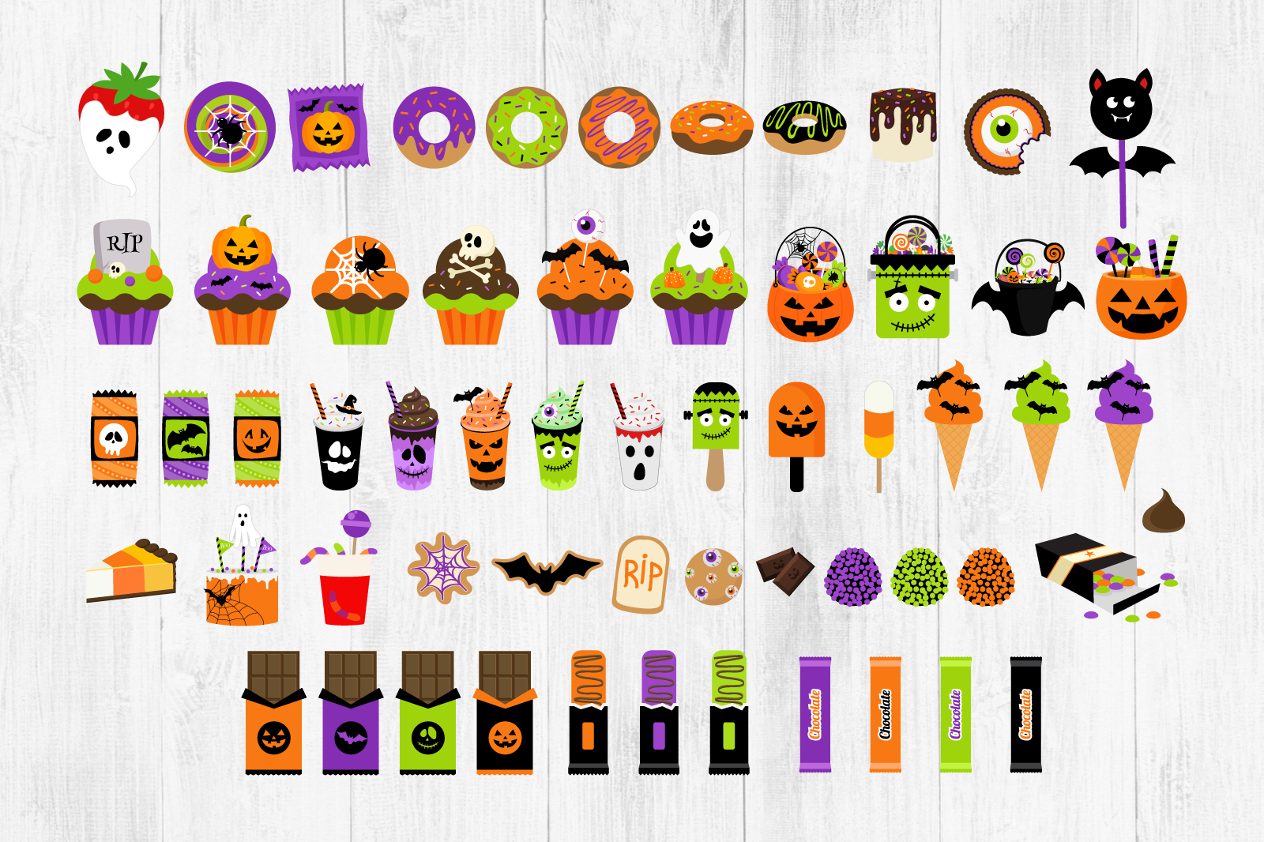
What do we notice?
What do we wonder?
Let’s create an equation to match our thinking?

Slide 3
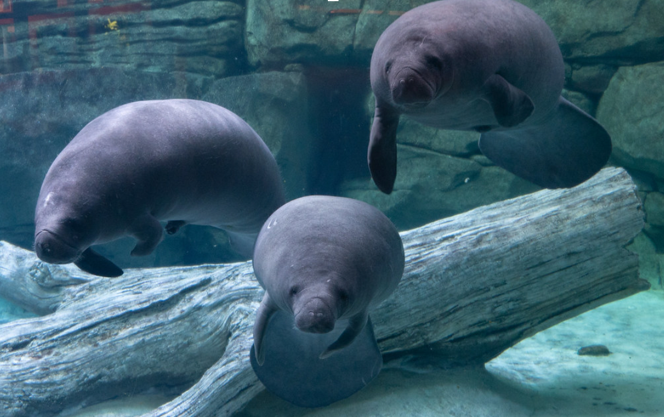
November is Manatee Appreciation Month!
Together, these three baby manatees weigh 150 kilograms.
What is possible?

Slide 4
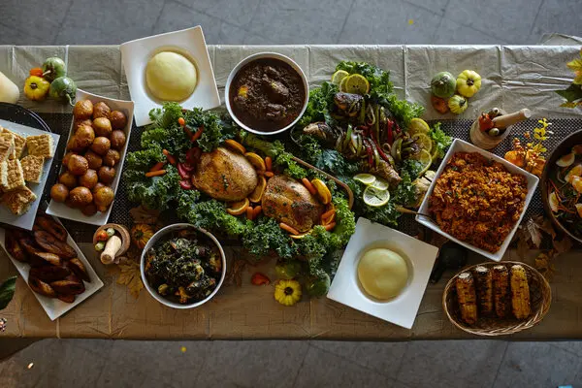
Today is Thanksgiving Day in Liberia!
Let’s talk about the shapes we see in these traditional West African dishes!

Slide 5
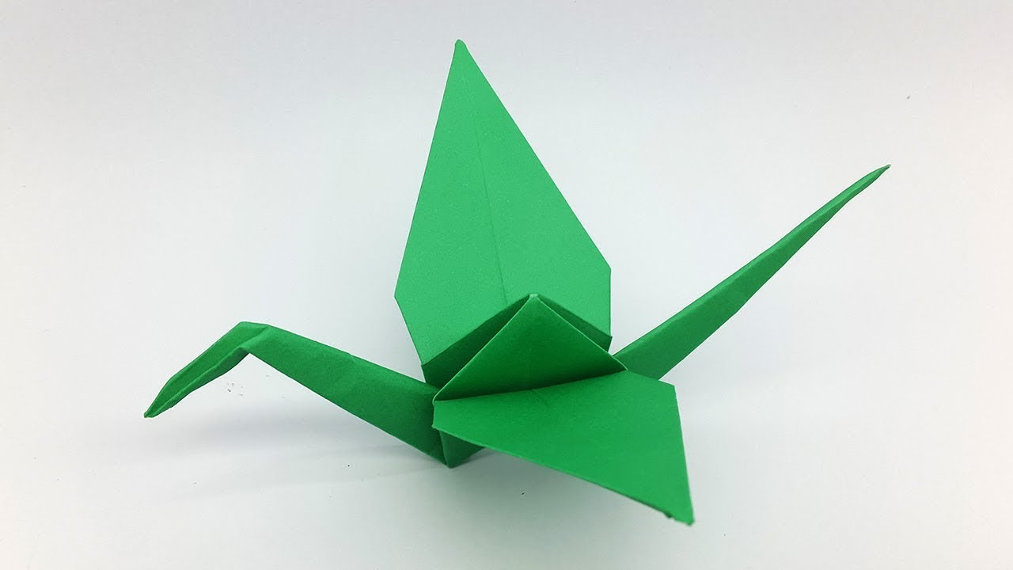
Today is Bunka no Hi, Japanese Culture Day!
How many different shapes can we identify in this origami crane?
Sketch one of the shapes, now sketch another shape that is DIFFERENT in one way.

