Slide 1
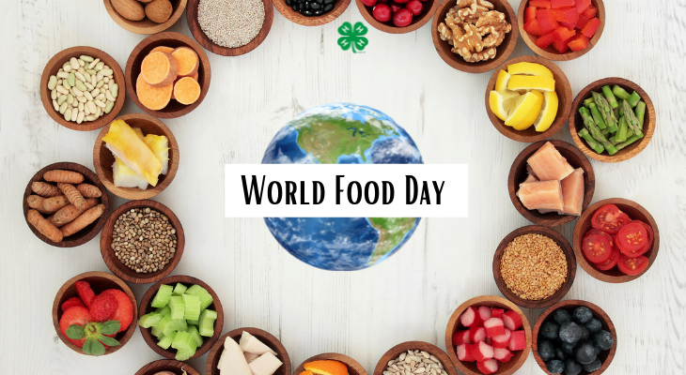
Feeding America turns $1 into 10 meals!
Feeding America works with manufacturers and retailers to donate food that would otherwise go to waste. Truckloads of food they are unable to sell are donated. That rescued food then travels to food banks throughout the country.
If they can turn $1 into 10 meals, how many meals can they make with $20?
$50? $100? $1,000?
Do we see a pattern?
Notes:
Week 7
October 16 - 20, 2023
World Food Day!

Slide 2
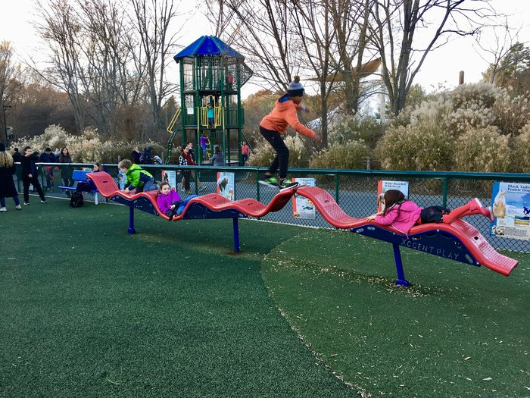
This is one of the Franklin Park Playgrounds
How LONG do we think the slide structure is?
How can we use the clues in the photo to help us estimate?
What would you measure it in?

Slide 3
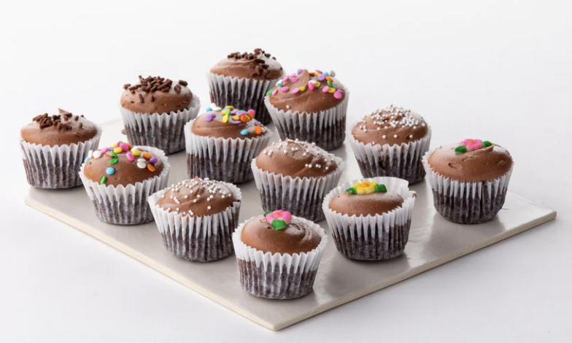
Happy Chocolate Cupcake Day!
This is ONE batch of fresh baked chocolate cupcakes!
How many cupcakes would be in 2 batches?
3 batches? 4 batches? 5 batches? 10 batches?
Do we see a pattern?

Slide 4
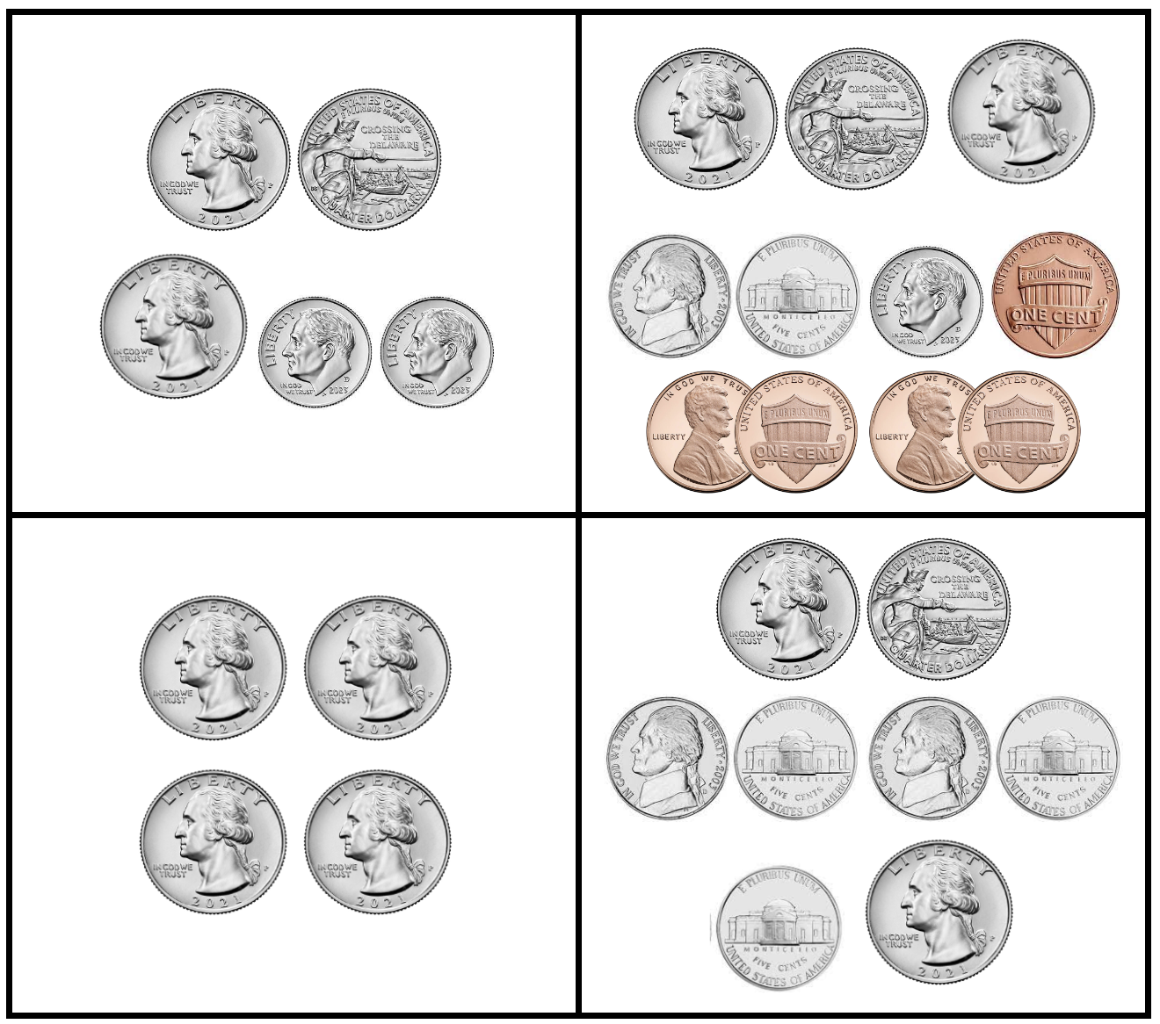
Which one doesn’t belong?

Slide 5
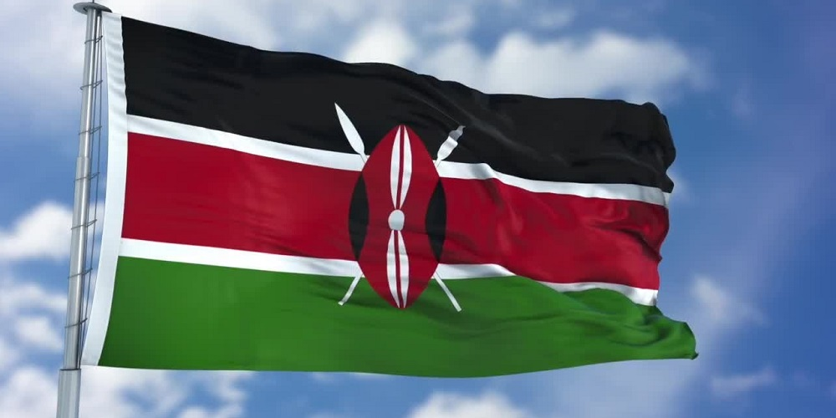
Today is Mashujaa Day in Kenya!
‘Mashujaa’ is the Swahili word for ‘Heroes,’ and because of this, Mashujaa Day is also called ‘Heroes’ Day’
Today is the 60th anniversary of Kenya’s independence!
Is 60 years a long time?
How many different expressions can we create that equal 60?

