Slide 1
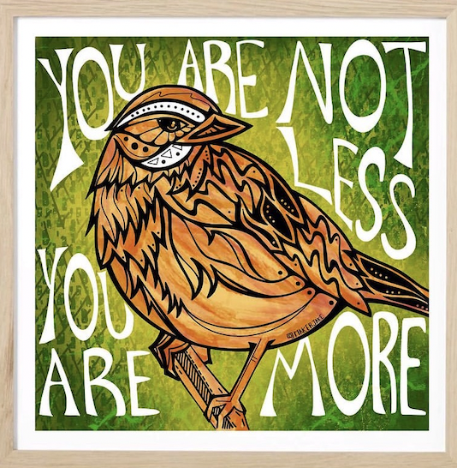
Celebrate Indigenous Peoples’ Day!
Let’s be shape detectives!
What interesting shapes can we find in “You are Not Less You are More” by Jake Ginga?
Notes:
Week 6
October 10-13, 2023

Slide 2
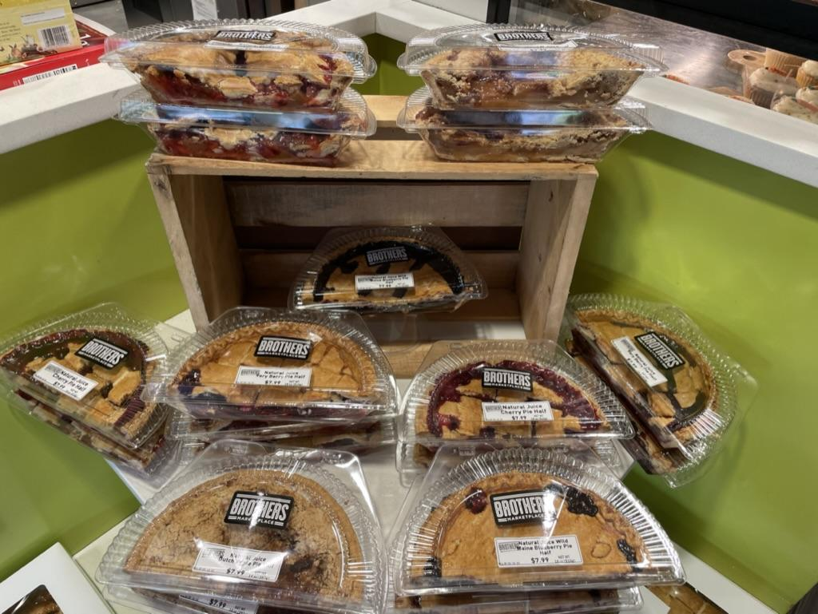
Pie! Yum!
How many half-pies do we see?
How many WHOLE pies is that?
How did you figure it out?

Slide 3
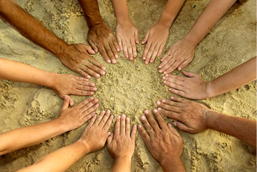
Today is the Day of Cultural Diversity In Uruguay
How many hands do we see?
How many fingers do we see?
How many PAIRS of hands?

Slide 4
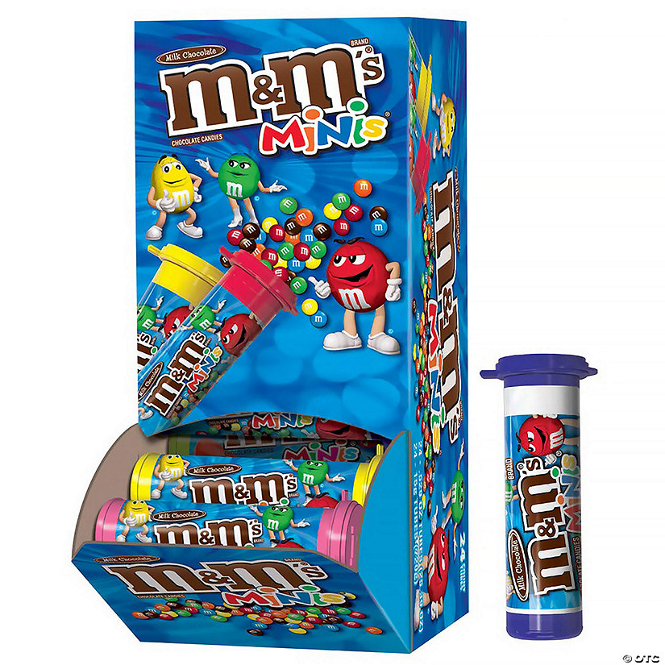
Happy m&m Day!
Estimate how many packs of mini m&m’s are in this box.
How can we use our math skills to come close?

