Slide 1
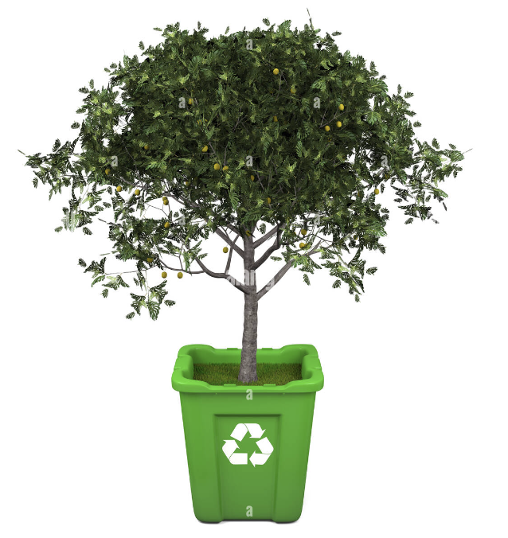
It’s International Recycling Week!
It takes 2,000 pounds of recycled paper to save 17 trees.
What do we think 2,000 pounds of paper looks like?
How many different expressions can we create that equal 17?
Notes:
Week 10
November 6-9

Slide 2
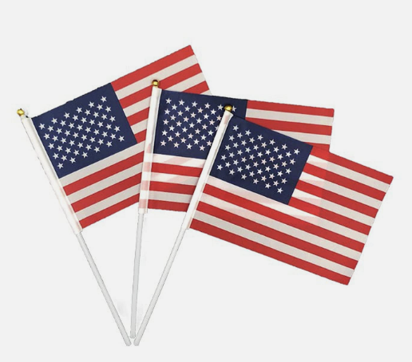
Today is Election Day!
How many stripes are on an American Flag?
How many stripes are on 3 American Flags?
How can we use mental math to solve this?

Slide 3
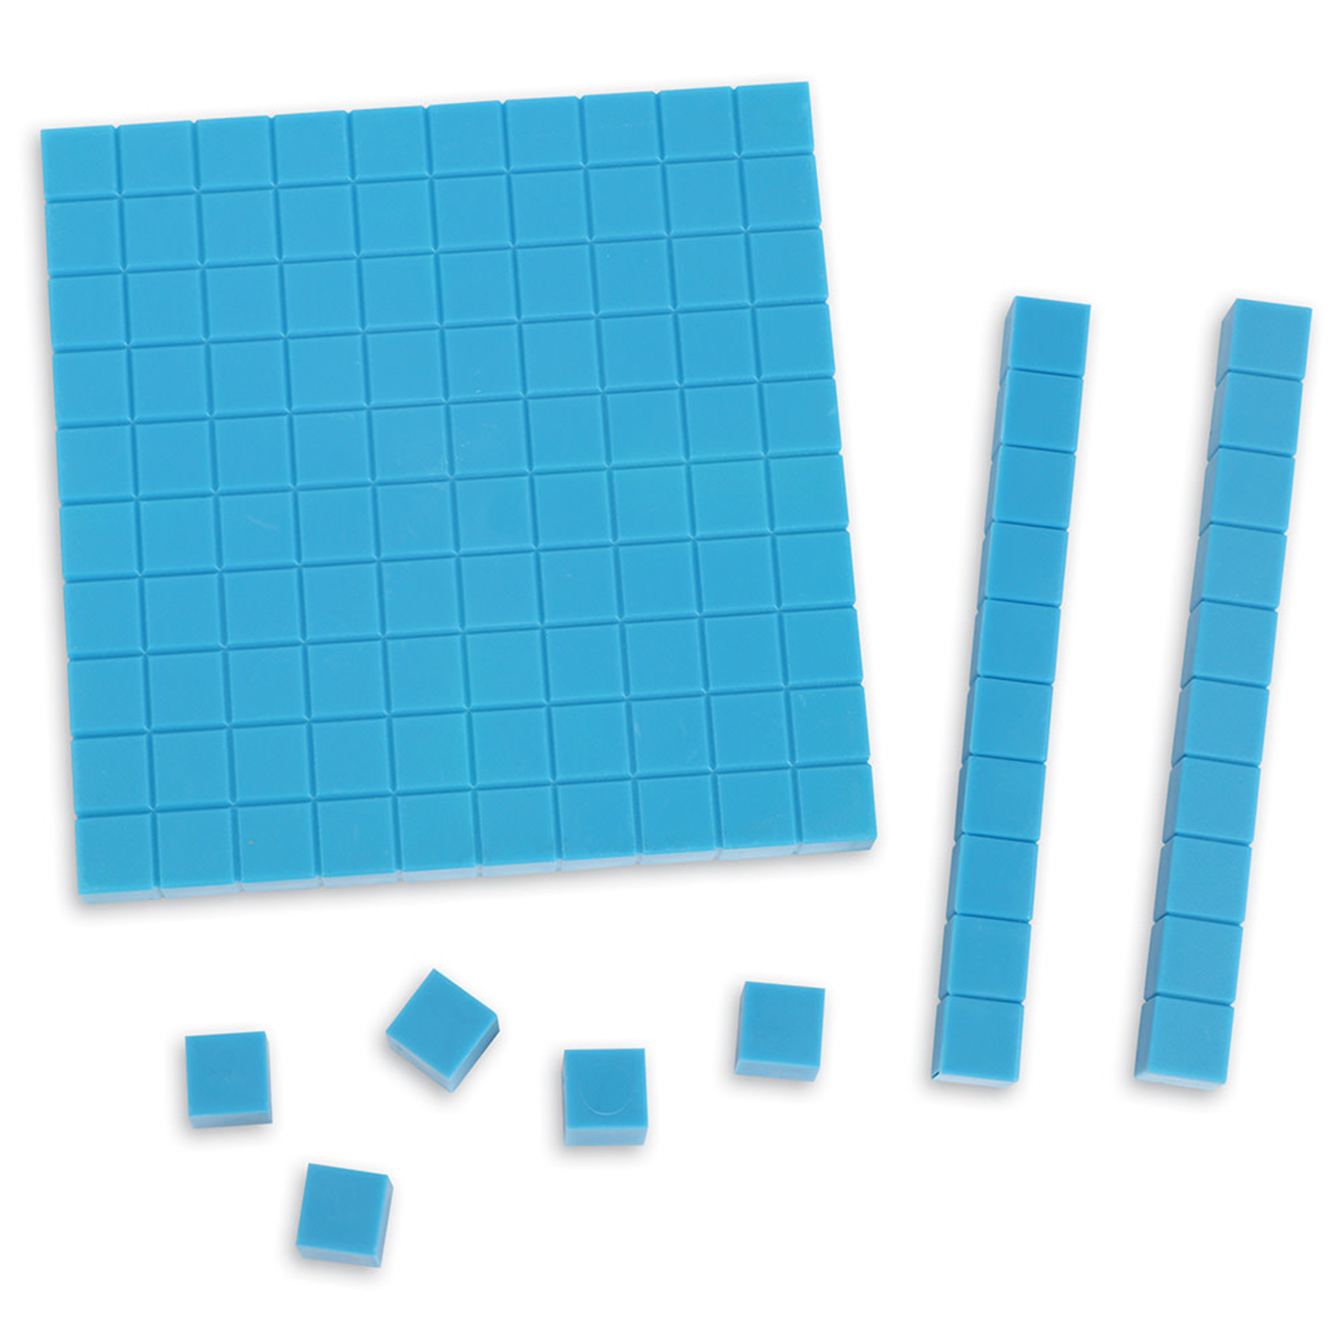
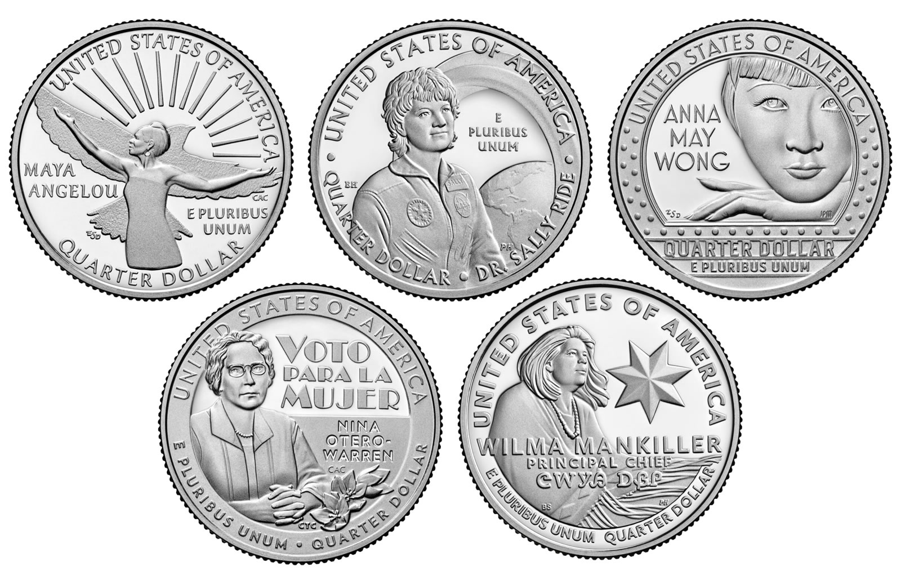
What is the same? What is different?

Slide 4
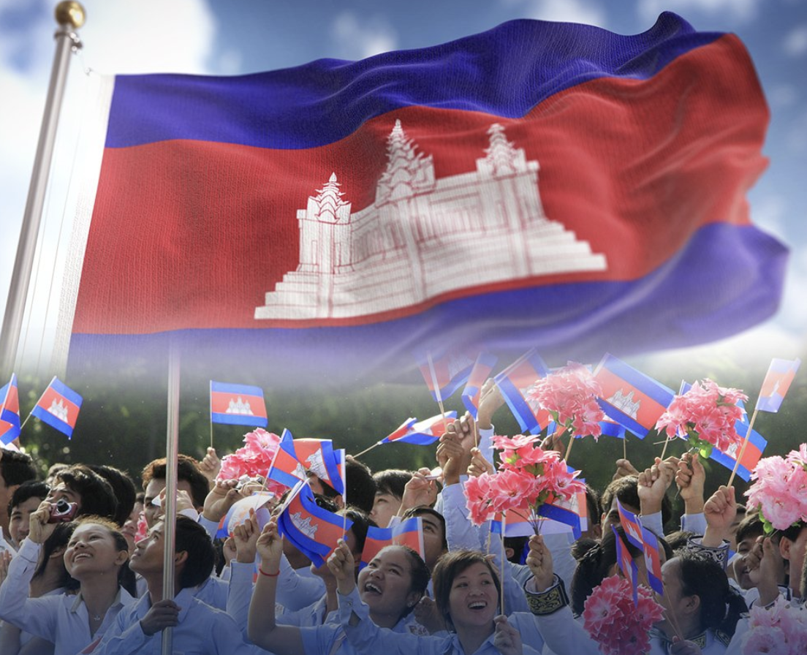
Happy Independence Day Cambodia!
Today, Cambodia celebrates 70 years of independence from France.
How many different ways can we represent the number 70?

