Slide 1
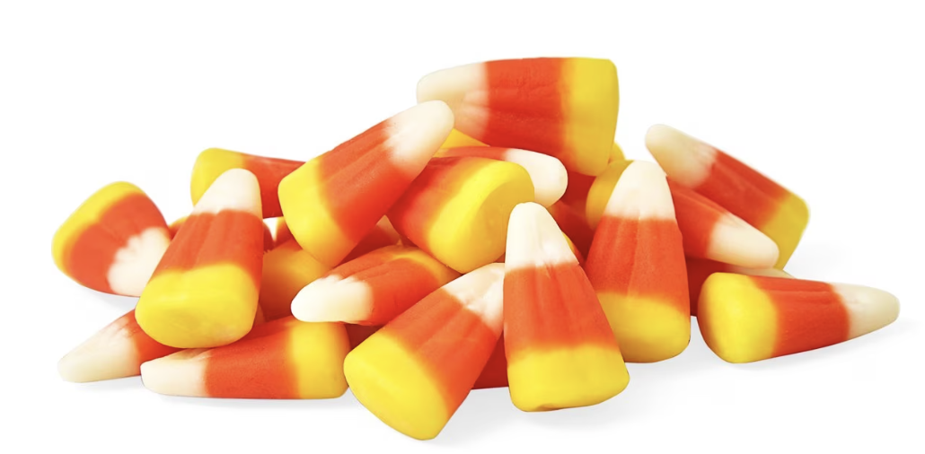
Today is National Candy Corn Day! Estimate how many candies are here!
Notes:
Week 9
October 30 - Nov. 3

Slide 2
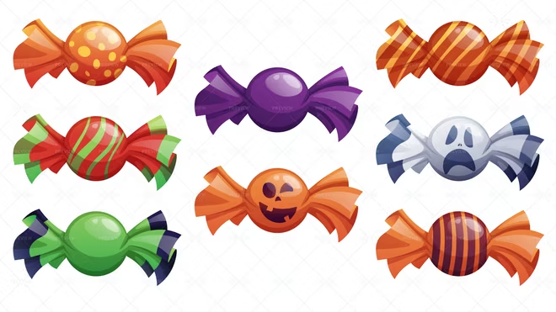
What do we notice?
How might we sort them?
Can we write an equation to match our thinking?

Slide 3
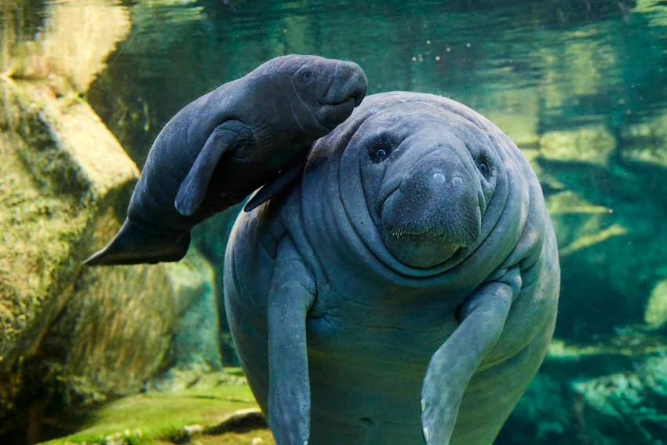
Happy Manatee Month!
This baby manatee weighs 30 kilograms!
How many different expressions can we write that equal 30?

Slide 4

Today is Thanksgiving Day in Liberia!
How many rectangles can we count on the Liberia’s national flag?
How many rectangles on two flags?

Slide 5
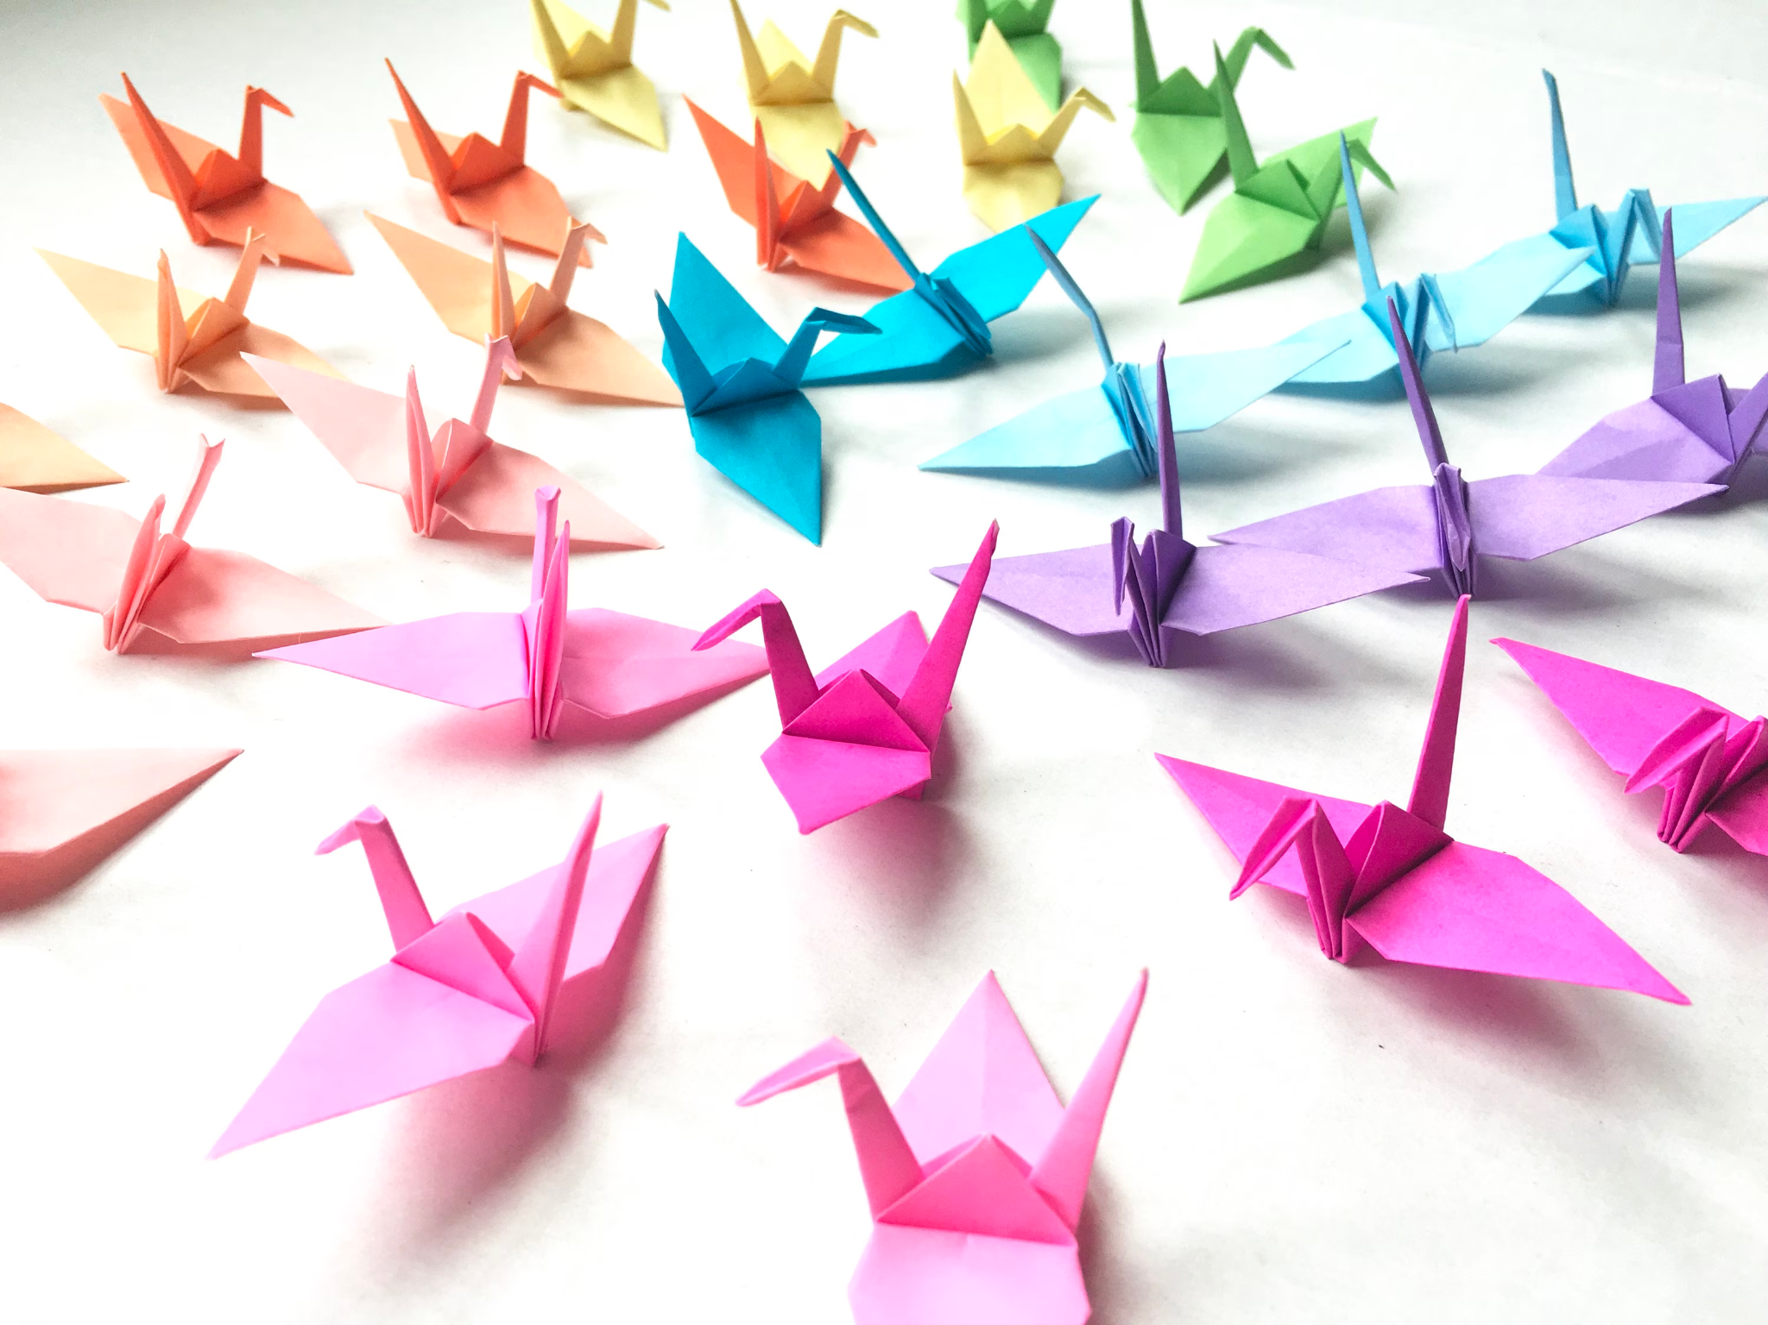
Today is Bunka no Hi, Japanese Culture Day!
How many origami cranes do we see?
How do we see them?
Let’s create an equation to match our thinking!

