Slide 1
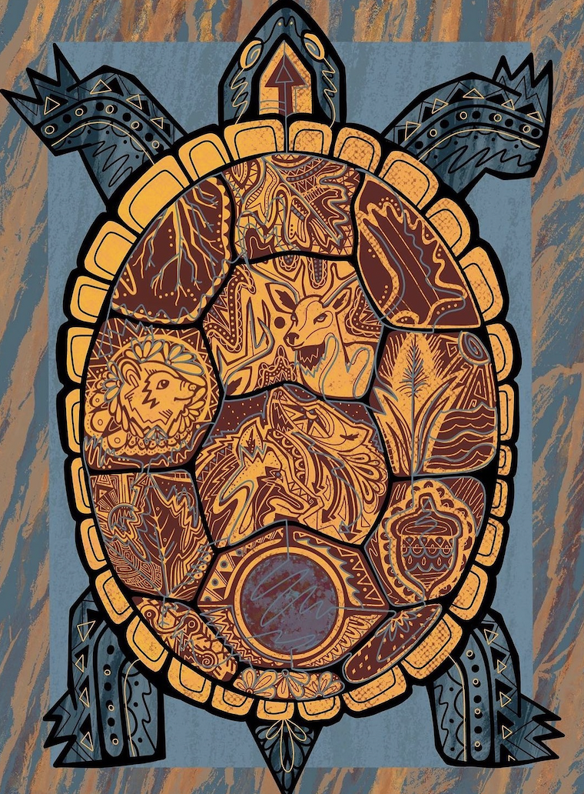
Celebrate Indigenous Peoples’ Day!
Let’s be shape detectives!
What interesting shapes can we find in “13 Moons on Turtle Back” by Jake Ginga?
Notes:
Week 6
October 10-13, 2023

Slide 2
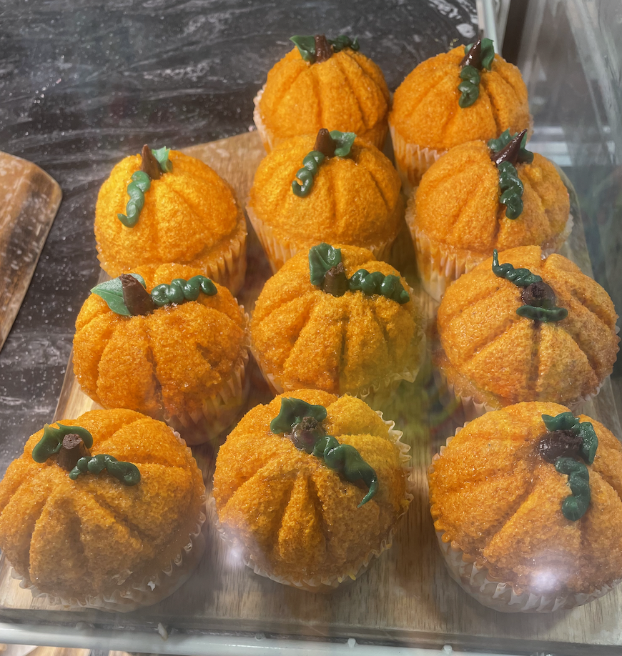
Yummy cupcakes at Brother’s Market!
How many pumpkin cupcakes do we see?
How do we see them?
Write an equation to match your thinking!
Are there any missing?

Slide 3
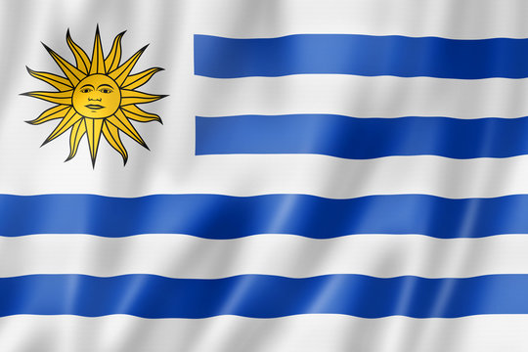
Today is the Day of Cultural Diversity in Uruguay!
What can we count in Uruguay’s flag?
Are there more blue stripes or white stripes?
What else can we count?
What shapes do we see?

Slide 4
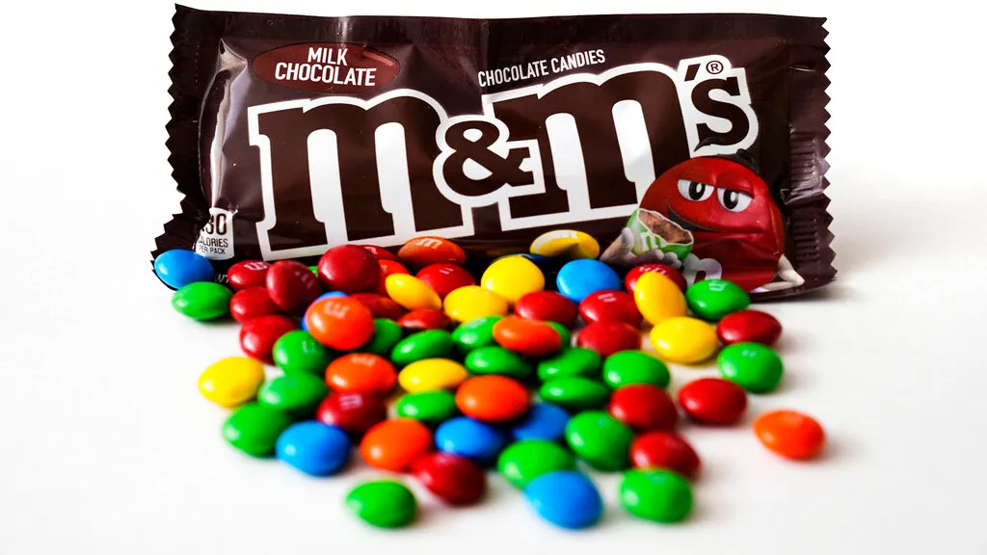
It’s National m&m Day!
Estimate how many m&m’s are in this pile. How can we come close without counting?

