Slide 1
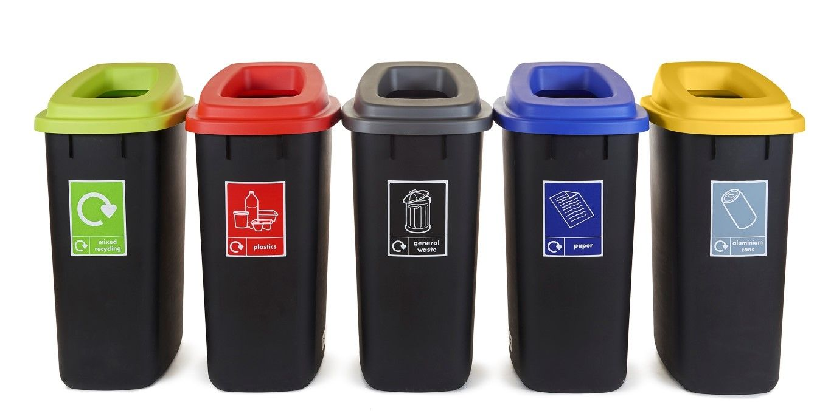
It’s International Recycling Week!
How many recycling bins are here?
Can we think of 4 items that would go into each bin?
How many recycled items would that be altogether?
Notes:
Week 10
November 6-9

Slide 2
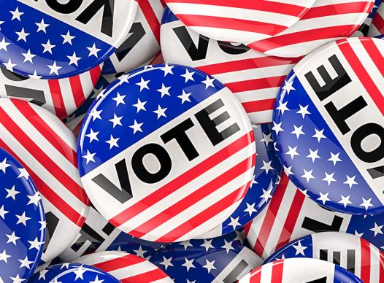
Today is Election Day!
How many stars do we see on this button?
How many stars would be on ALL of the buttons?
What is a good estimate?

Slide 3
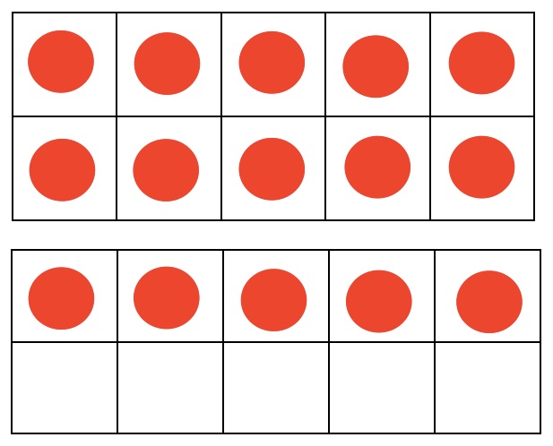

What is the same? What is different?

Slide 4
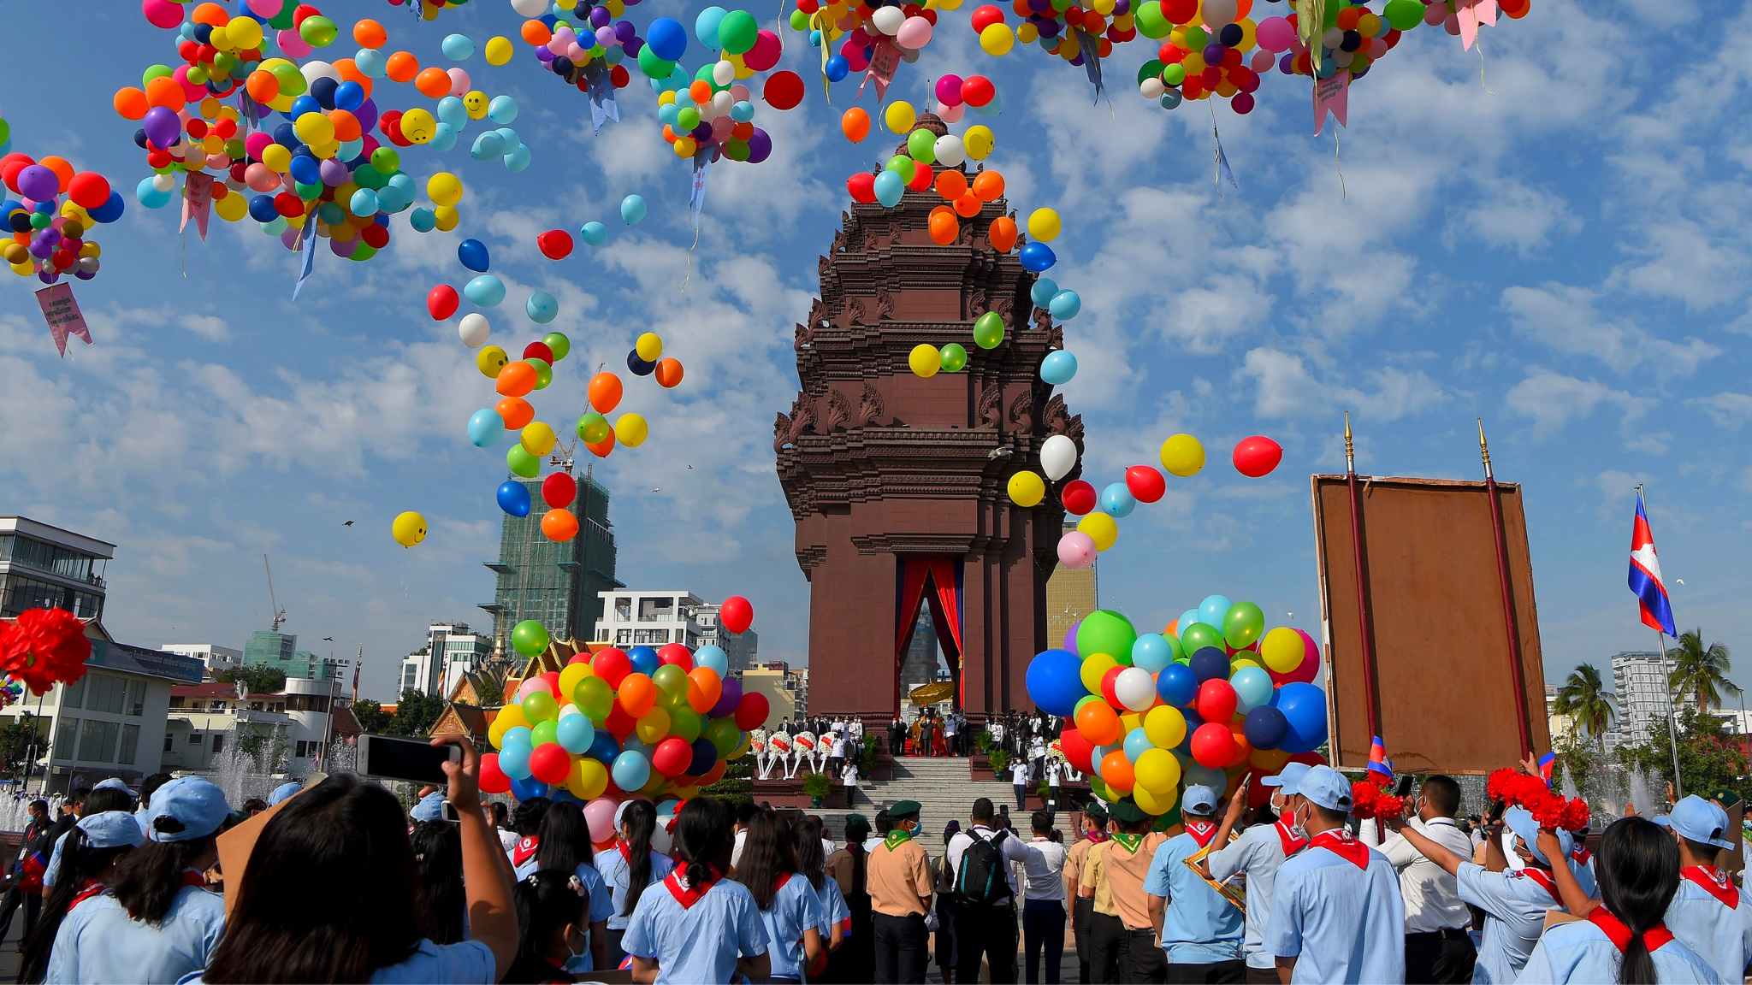
Happy Independence Day Cambodia!
Today, Cambodia celebrates 70 years of independence from France.
How many different ways can we represent the number 70?

