Slide 1
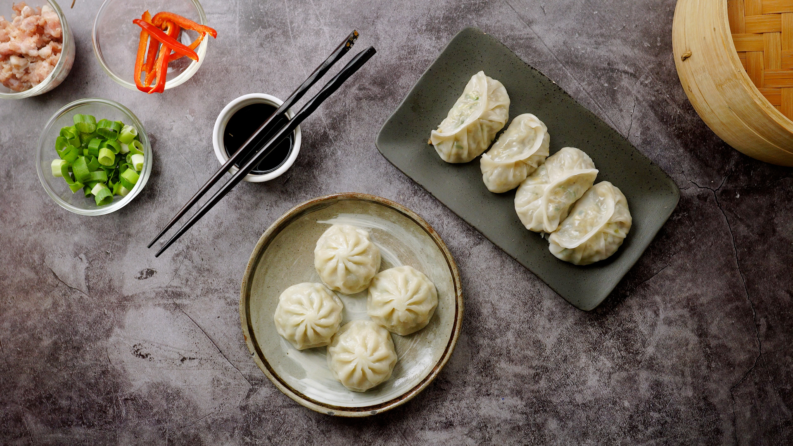
Happy Dumpling Day!
How many circles do we see?
What other shapes do we see?
Notes:
Week 4
September 26 - 29

Slide 2
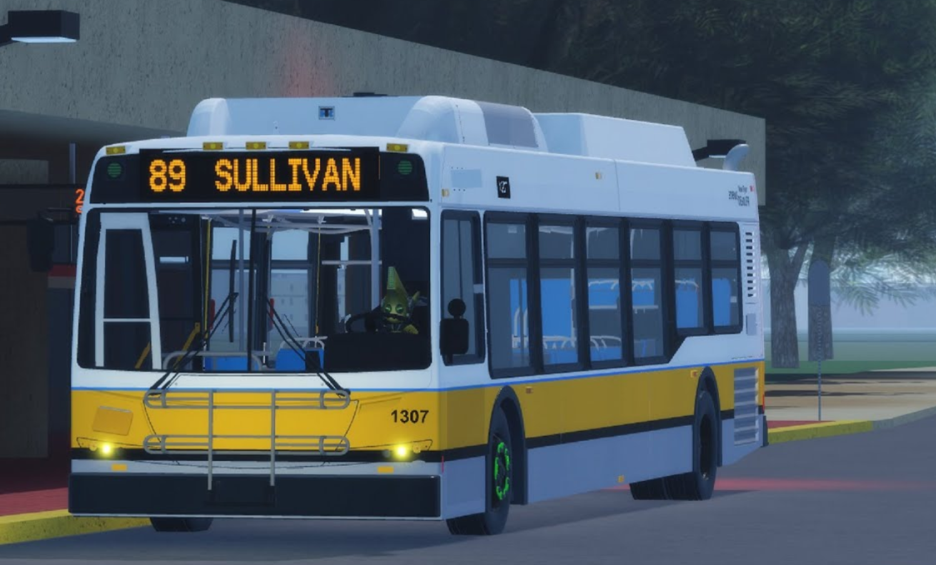
How many windows do we see on this new MBTA bus?
How many don’t we see?
Where are they?

Slide 3
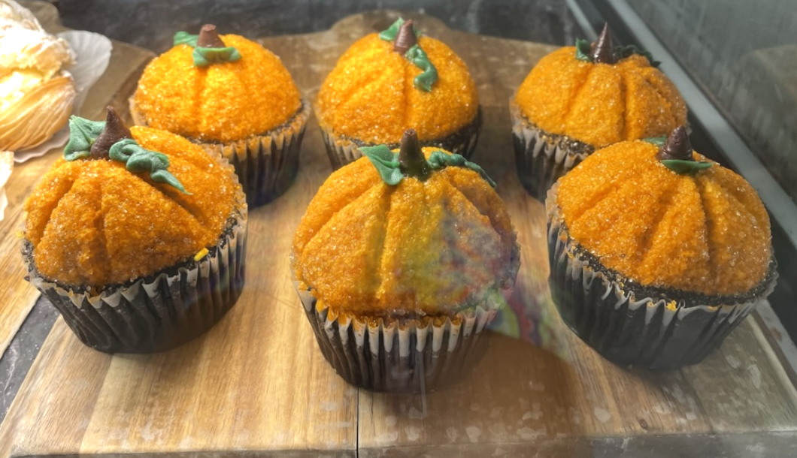
How many yummy cupcakes are on display at Brother’s Market?
How many are missing if there were 9 at the beginning of the day?

Slide 4

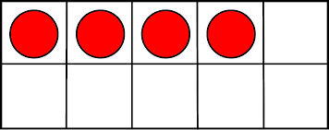
What is the same?
What is different?

