Slide 1


Slide 2
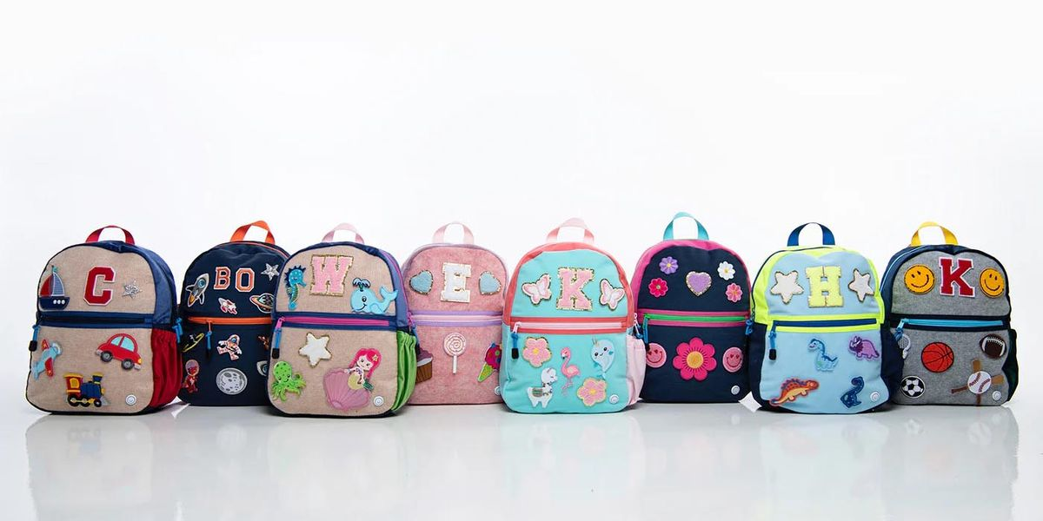
How many backpacks do we see here?
How many ways can we count them?
Notes:
Week of September 5, 2023

Slide 3
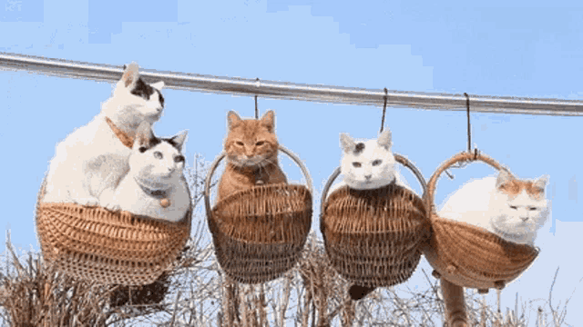
It’s Happy Cat Month!
How can we count these playful cats?

Slide 4
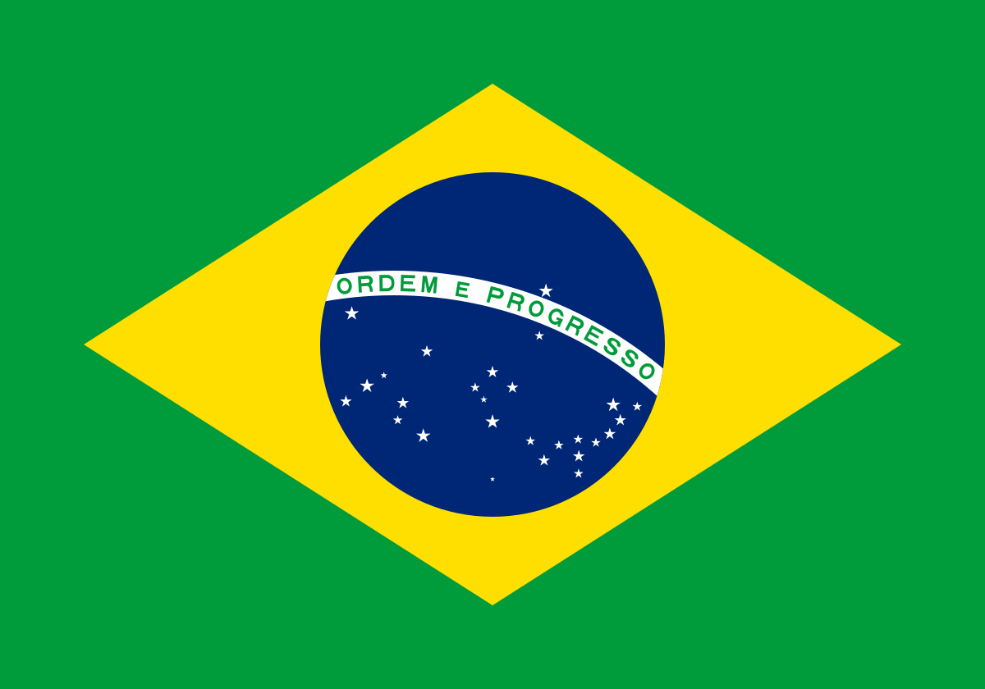
Today is Independence Day in Brazil!
Let’s talk about the shapes we see in Brazil’s flag.

Slide 5
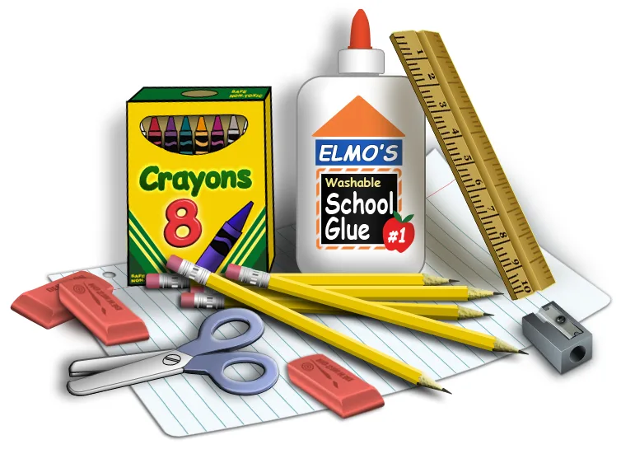
Let’s talk about these school supplies!
We can use words like
next to
under
over

