Slide 1
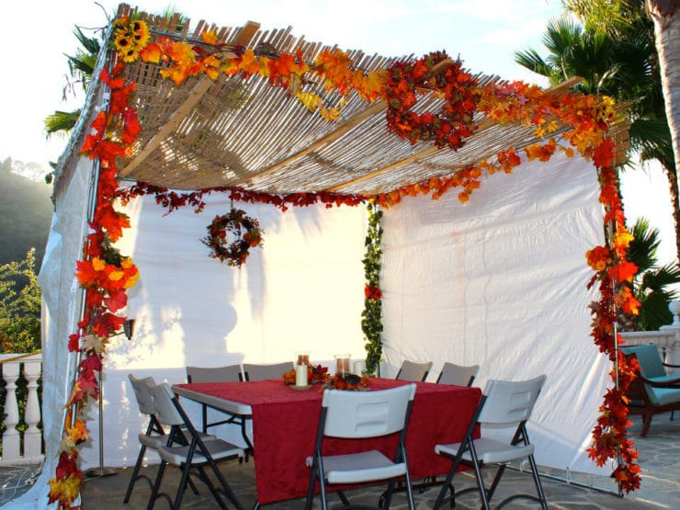
Happy Sukkot!
Estimate the dimensions of this Sukkah.
What unit of measure would you choose?
What would the VOLUME be?
Notes:
Week 5
October 2-6

Slide 2

Let’s celebrate International Architecture Day!
Estimate the number of windows on The Cologne Oval Offices in Germany.

Slide 3

What’s the same?
What’s different?

Slide 4
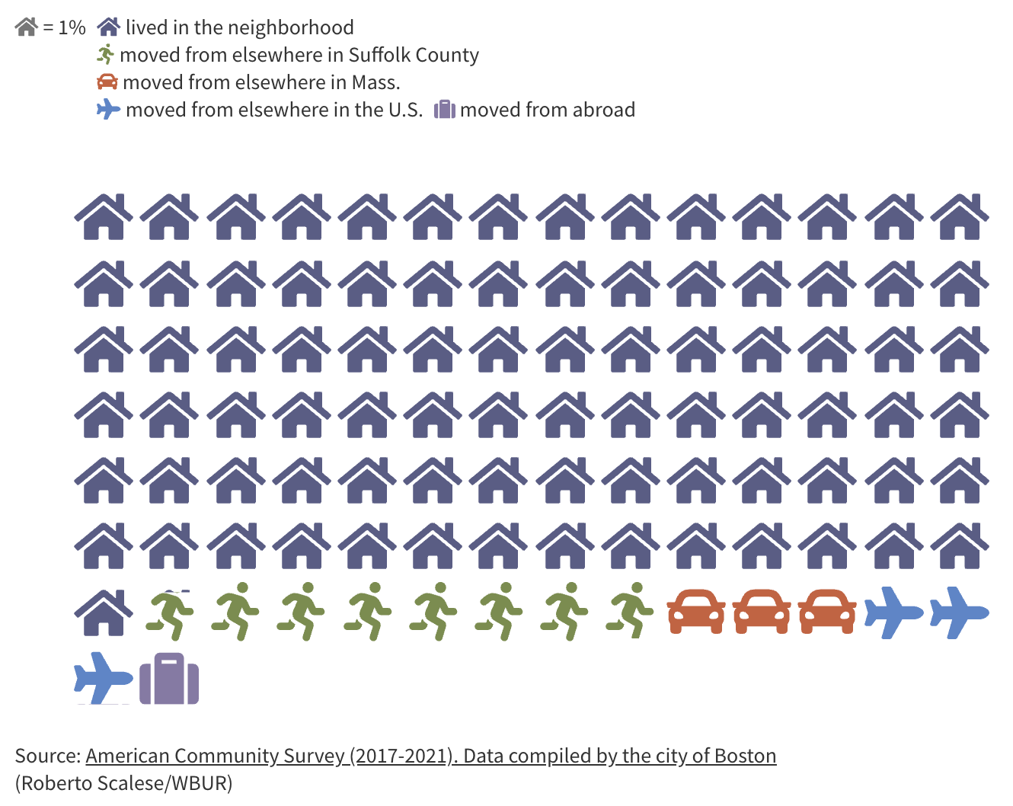
What do we notice?
What do we wonder?
Why does it matter?
Where do we think this is?
ROXBURY, MA.

Slide 5
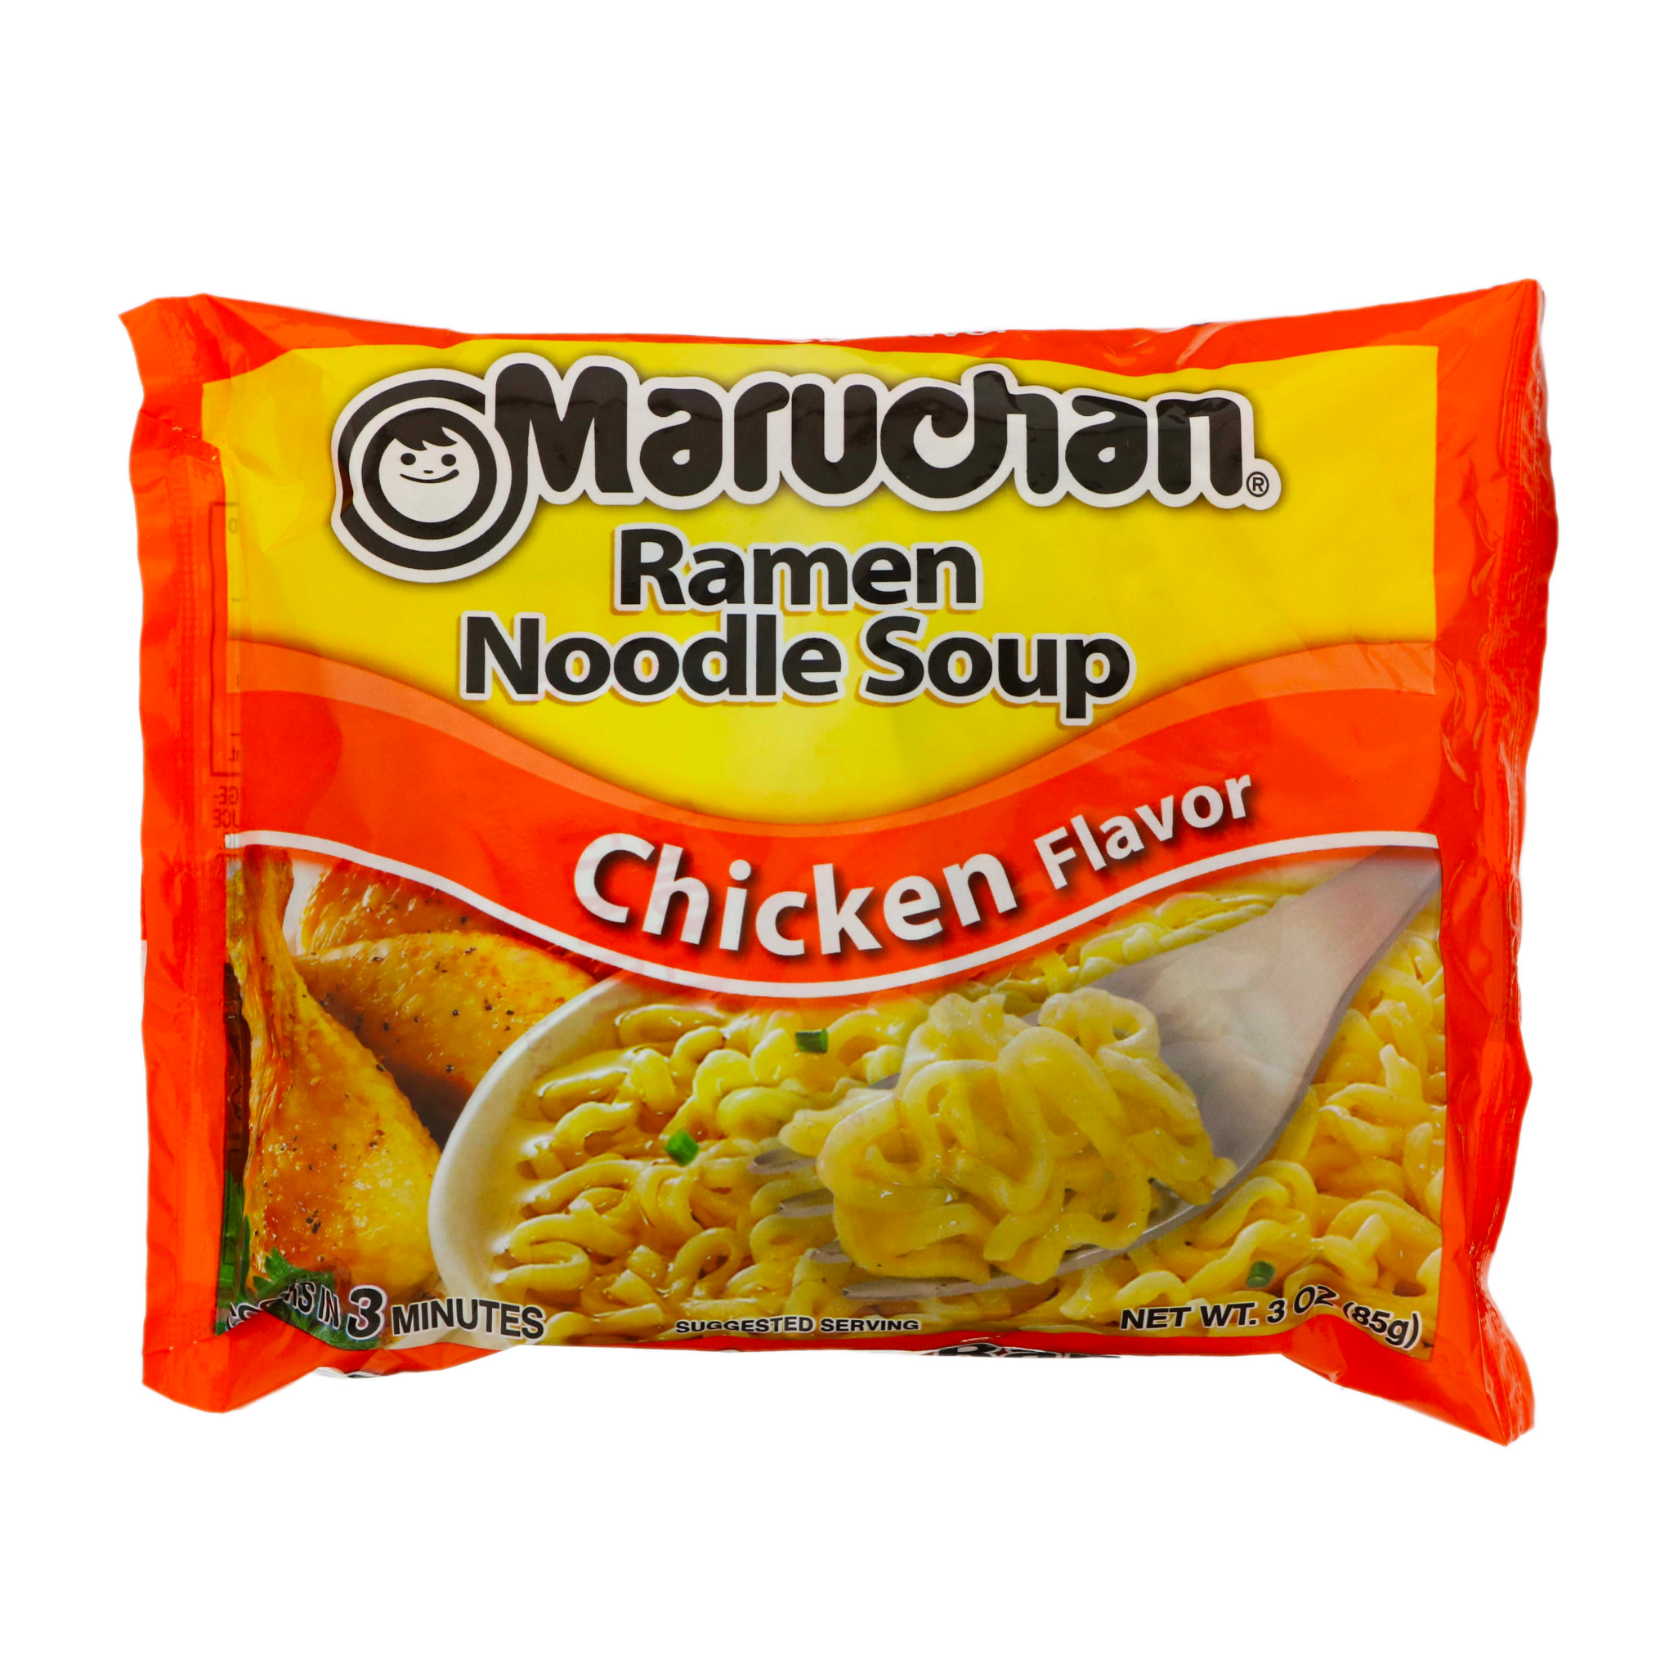
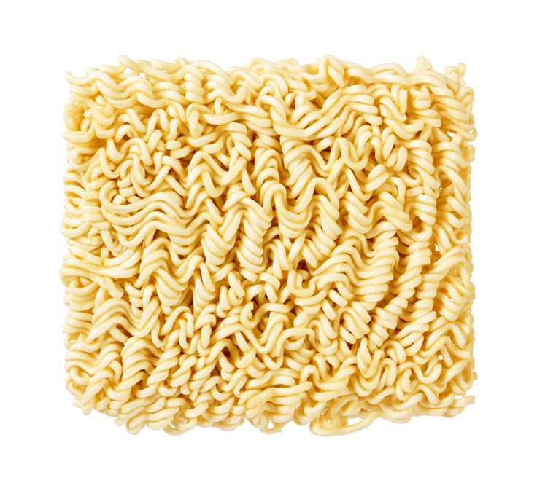
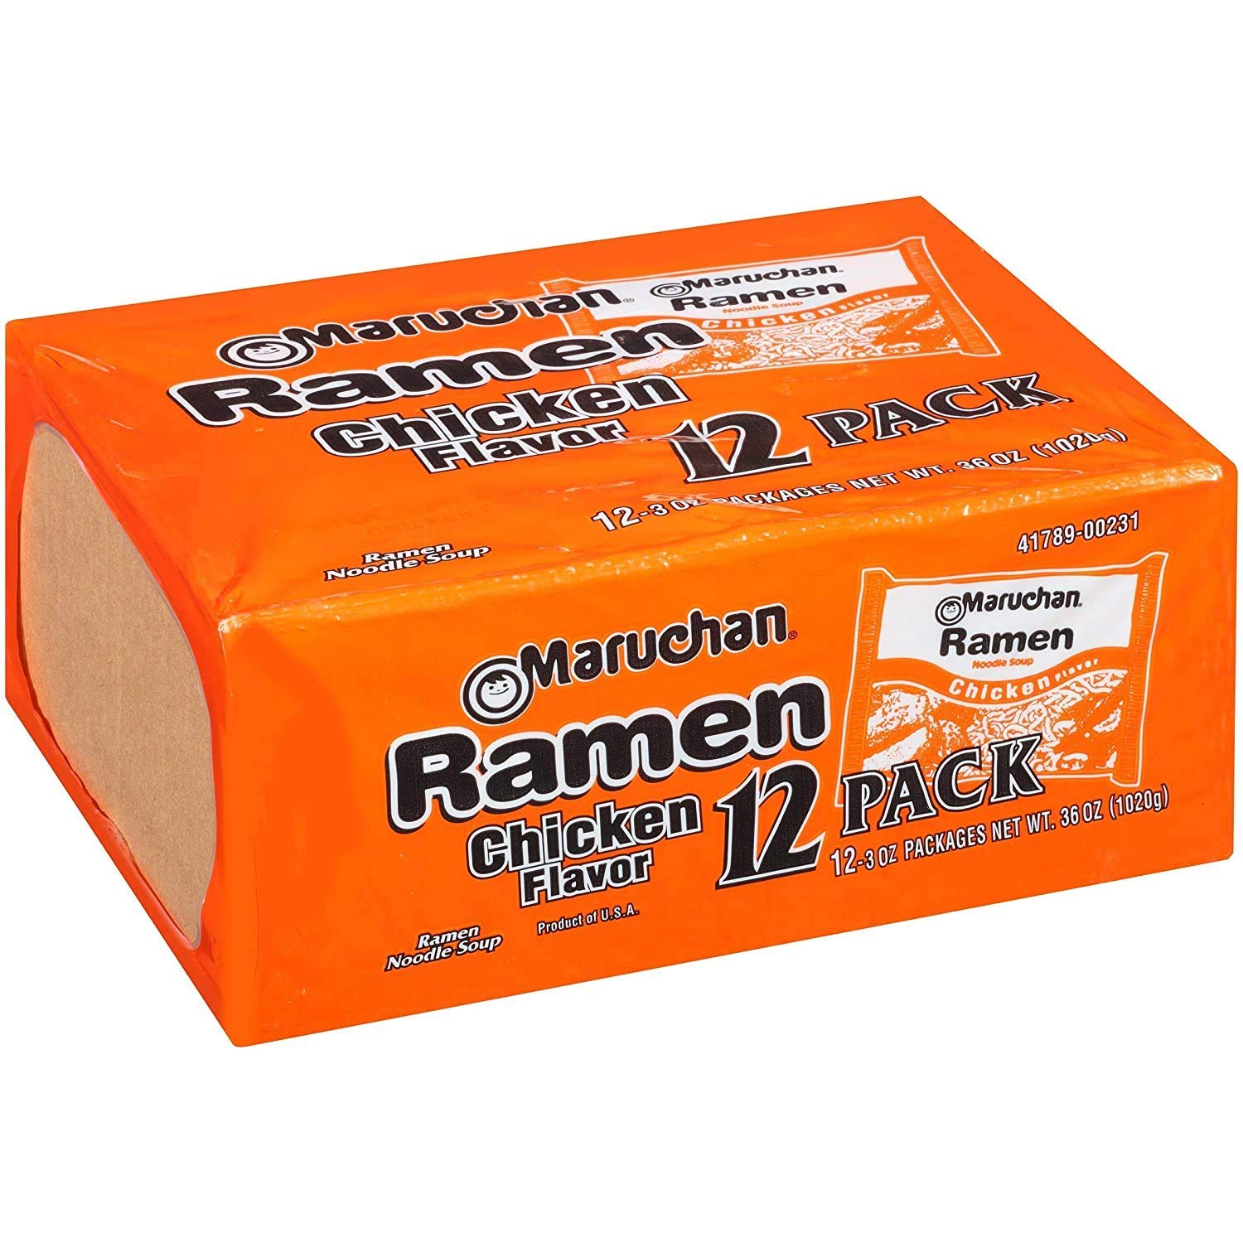
Happy Noodle Day!
Have you ever wondered how long the noodles are in a package of Ramen?
Each noodle strand is about 16 inches long. There are about 80 noodles in each block.
What would the length be for a whole box of ramen?

