Slide 1
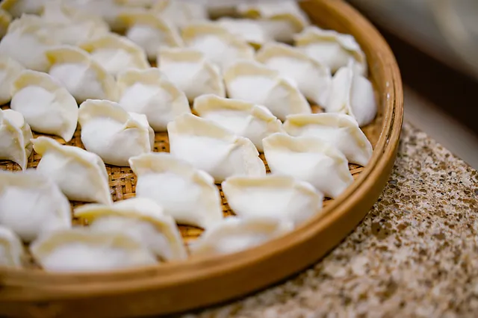
Happy National Dumpling Day!
Have you ever made dumplings? It’s SO much fun!
If each dumpling takes 45 seconds to wrap, how long does it take to complete this whole tray?
Notes:
Week 4
September 26 - 29

Slide 2
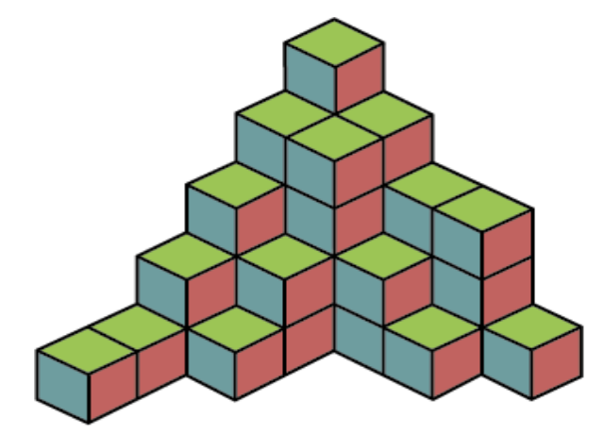
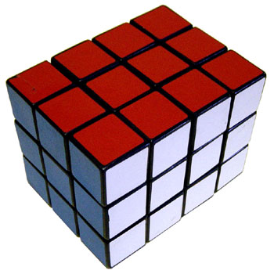
What is the same?
What is different?

Slide 3
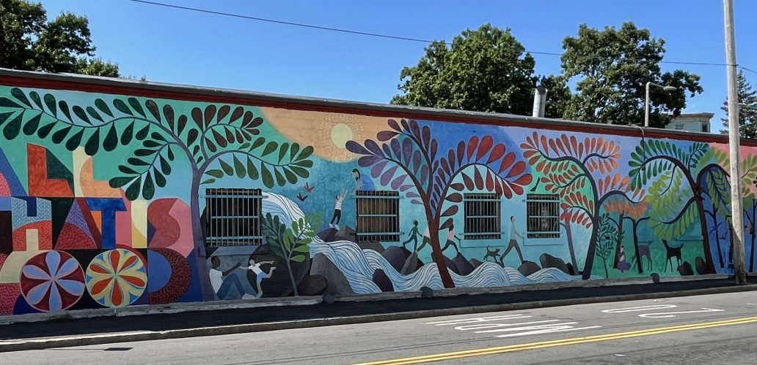
ALL THAT IS GOOD is a new mural on New England Avenue in Boston. Estimate the LENGTH of the the mural.

Slide 4
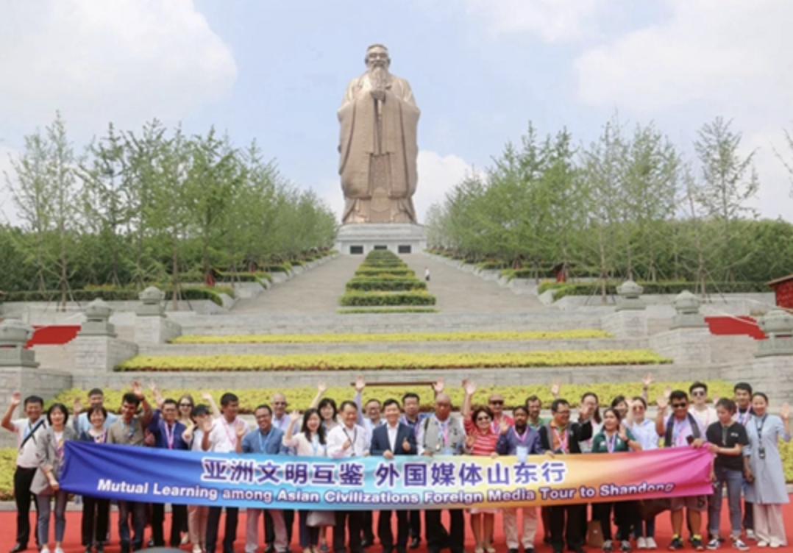
Today is Confucius Day, celebrating the birthday of the great philosopher and teacher.
The tallest statue of Confucius, in Shandong, China, stands 72 meters high. How many centimeters is that?
What are some FACTOR PAIRS of 7200?
What do we notice about the factor pairs, do we see any patterns?

