Slide 1
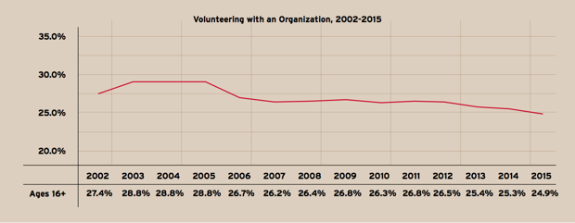
September 11th is our National Day of Service
What do we notice? What do we wonder? Why does it matter?
Notes:
Week 2
September 11-15

Slide 2
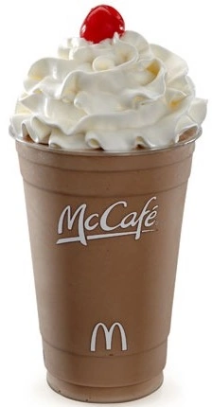
Happy Chocolate Milkshake Day!
This large McDonald’s chocolate milkshake has 800 calories.
What are some FACTOR PAIRS of 800?

Slide 3
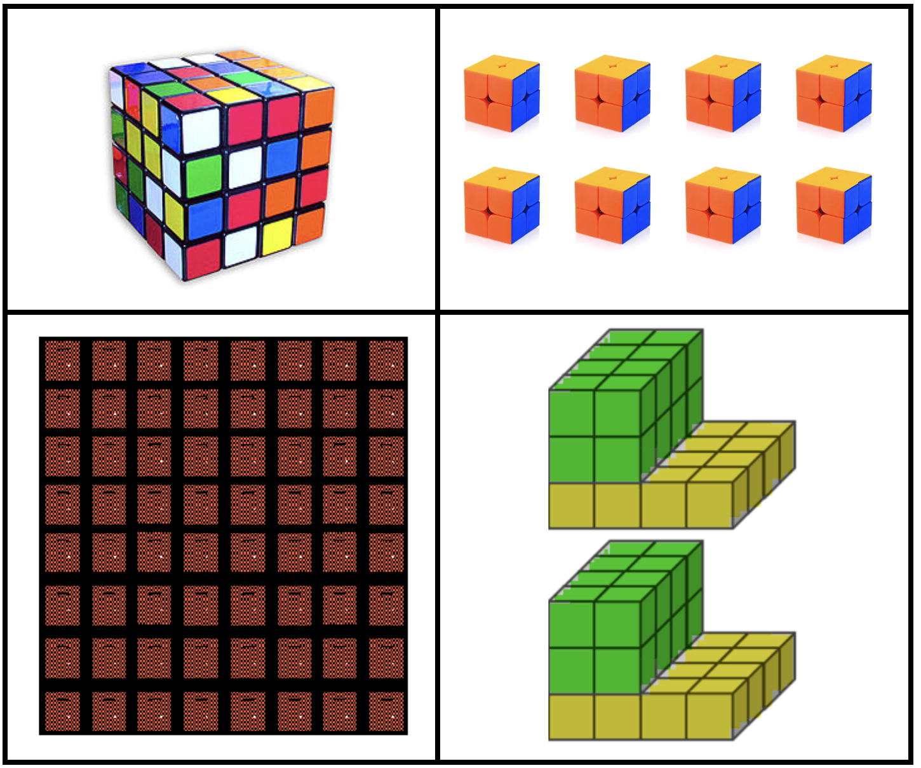
Which one doesn’t belong?

Slide 4
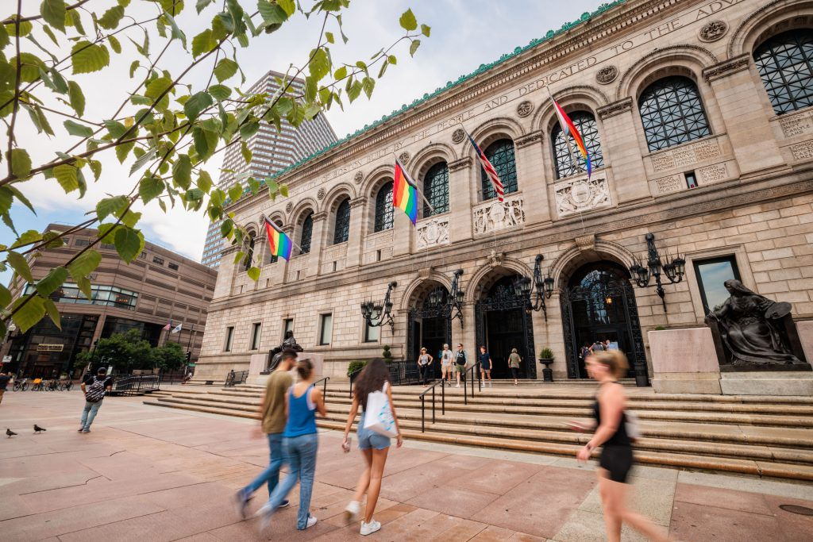
Let’s bike from Field School to the Boston Public Library via the Greenway!
The 16.1 mile trip will take us 1 hour and 29 minutes.
How many minutes will it take us to make the trip to the library and back to school? How many seconds is that?
What time should we leave if we want to stay there for 2 hours and explore, and be back for dismissal?

Slide 5
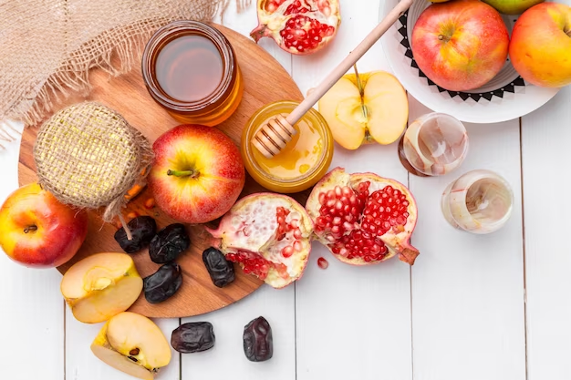
Happy Rosh Hashanah שנה טובה ומתוקה
Where do we see fractions?
Estimate the fractional parts!

