Slide 1
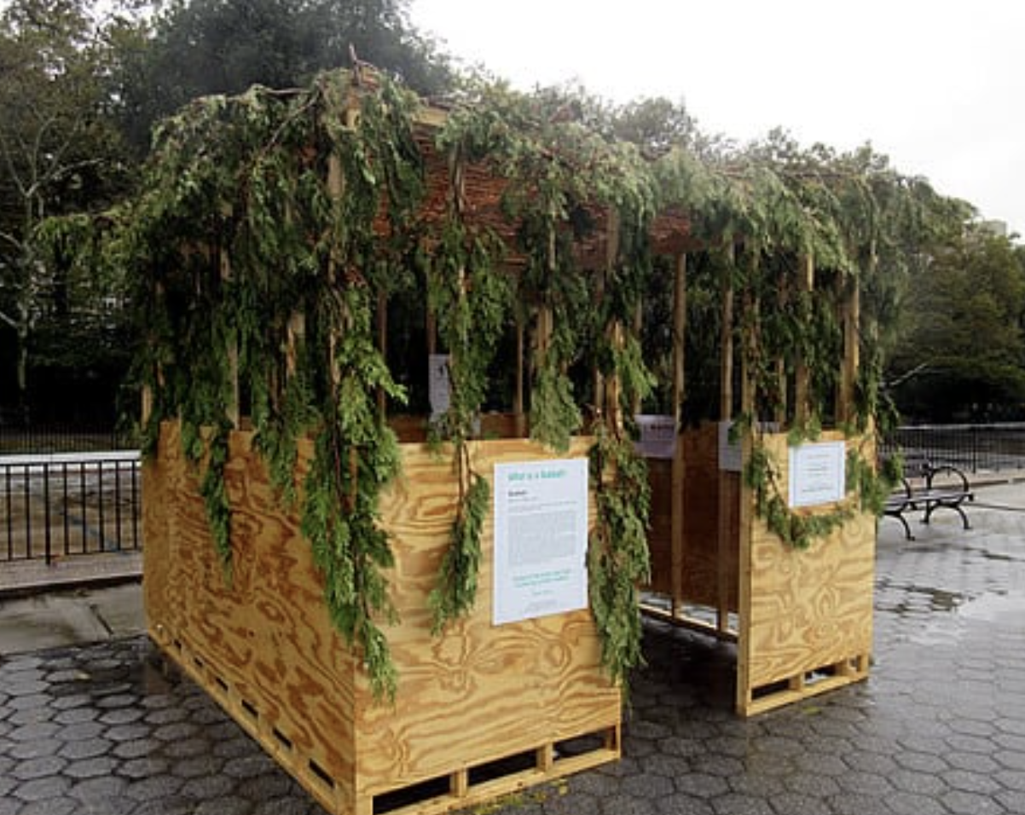
Happy Sukkot!
Estimate the dimensions of this Sukkah in New York City.
What unit of measure would you choose?
Notes:
Week 5
October 2-6

Slide 2
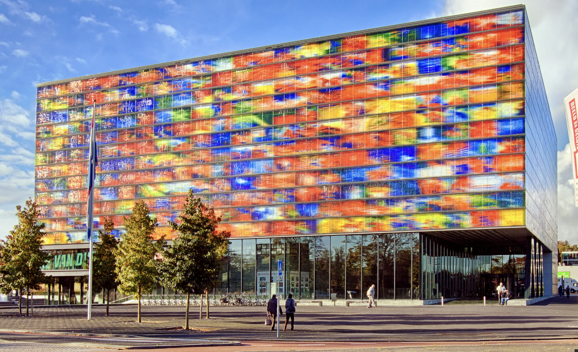
Let’s celebrate International Architecture Day!
Estimate the number of windows on The Netherlands Institute for Sound and Vision.
How can we use ARRAYS to help us?

Slide 3
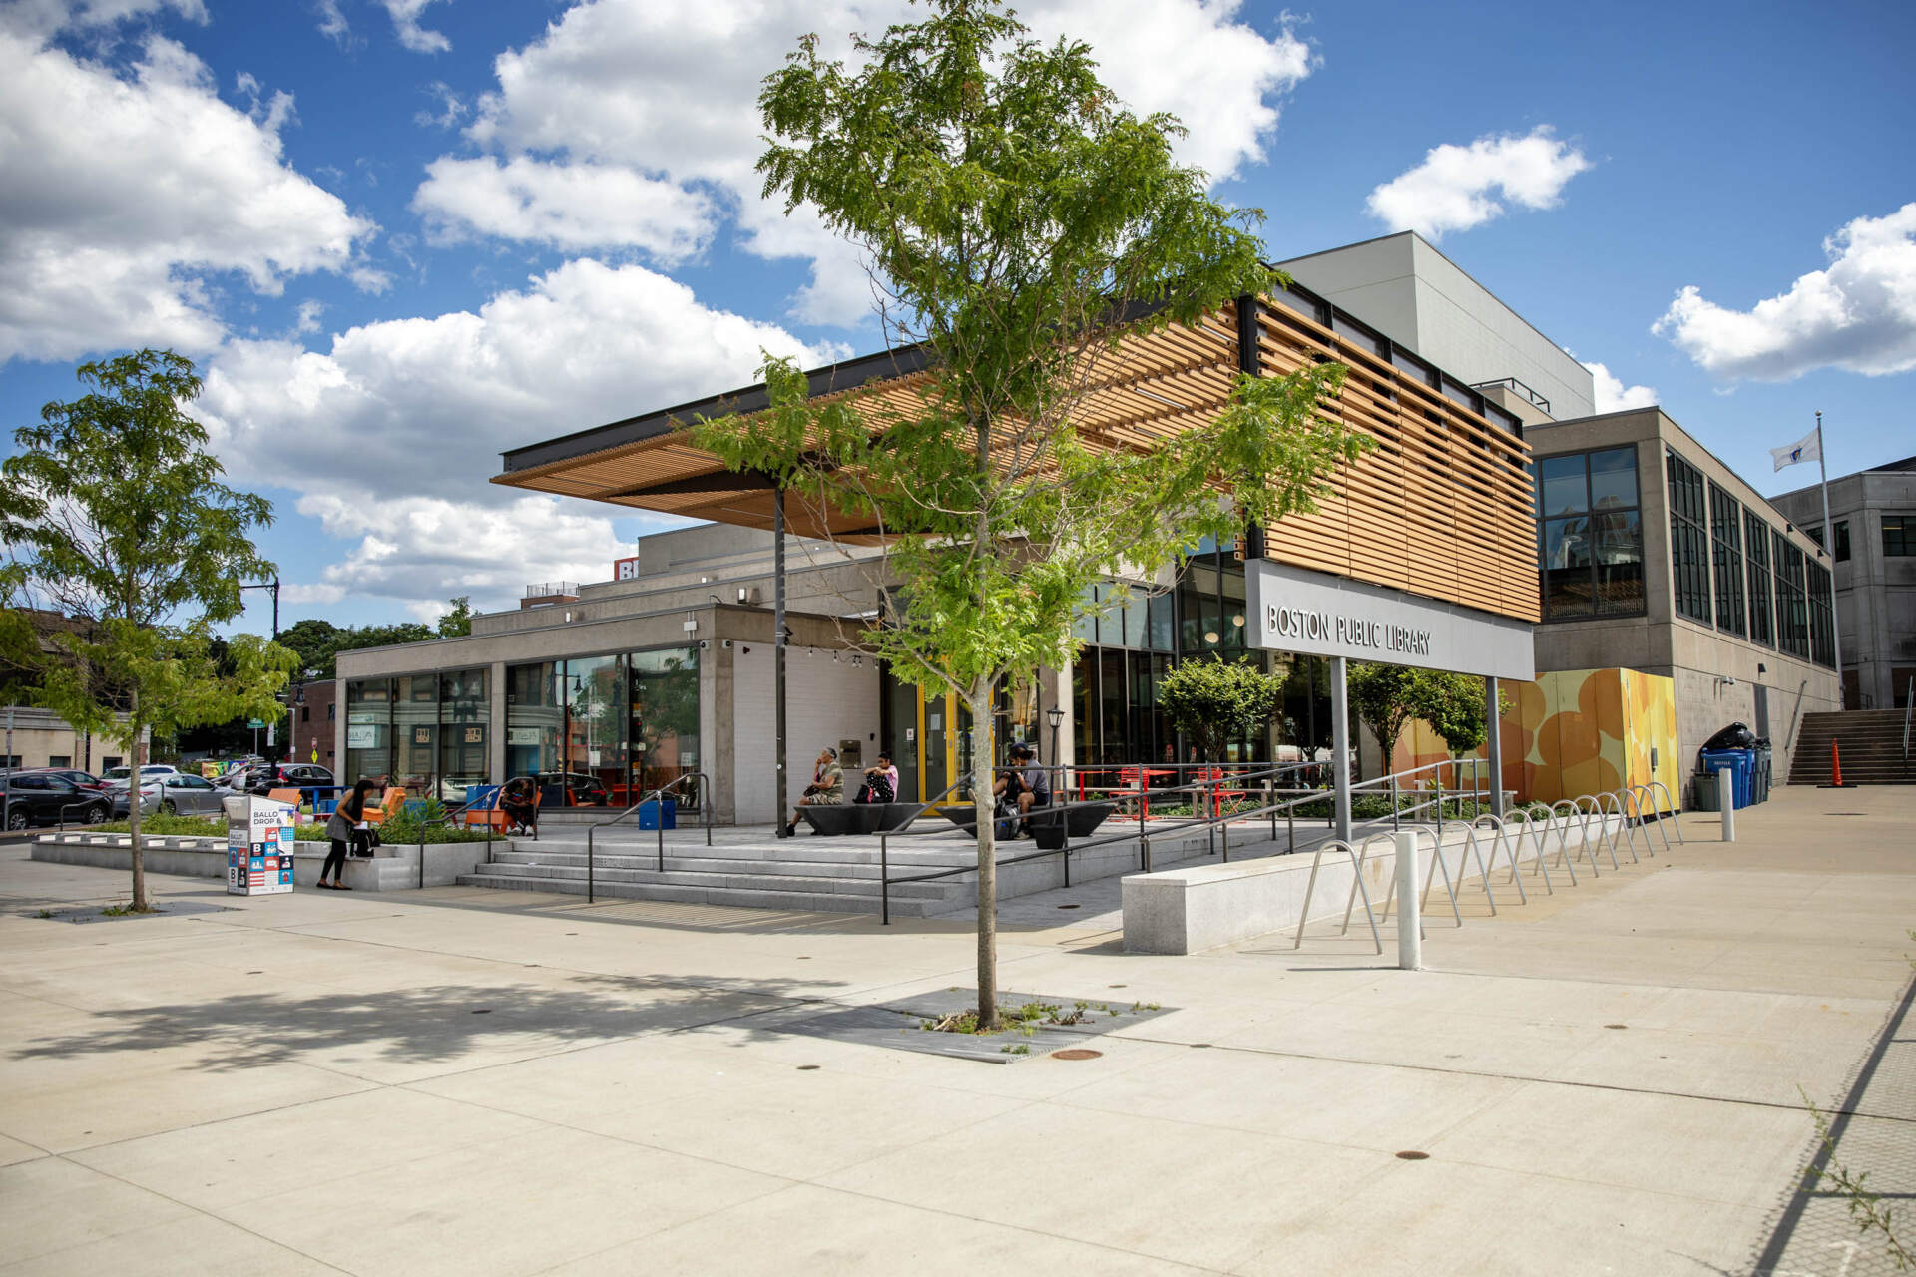
The Boston Public Library in Roxbury is one of 25 branches!
What can we say about the number 25?
How many different expressions can we write that equal 25?

Slide 4

What is the same? What is different?

Slide 5

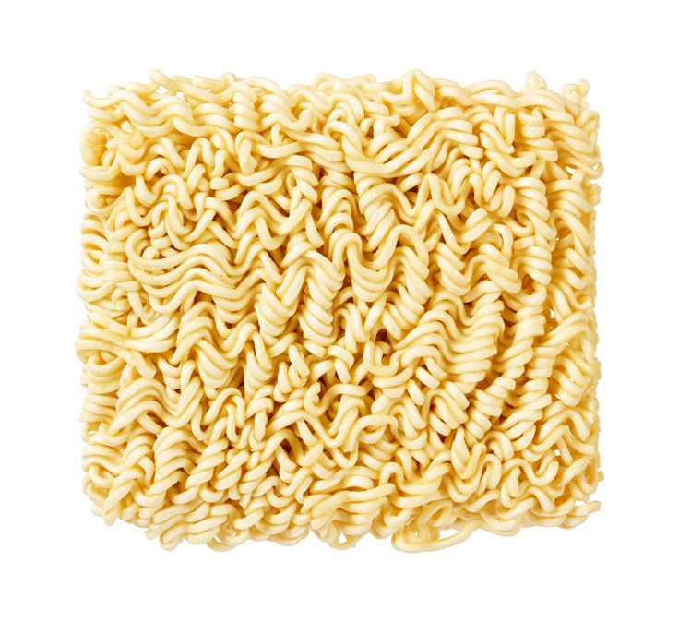
Happy Noodle Day!
Have you ever wondered how long the noodles are in a package of Ramen?
Each noodle strand is about 16 inches long. There are about 80 noodles in each block.

