Slide 1
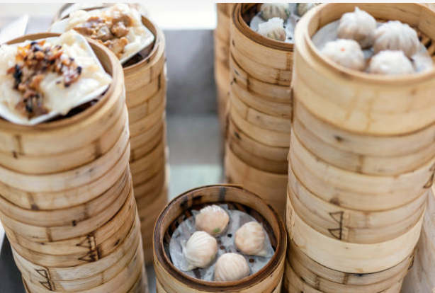
Happy National Dumpling Day!
How can we use multiplication to estimate how many dumplings are here?
Notes:
Week 4
September 26 - 29

Slide 2
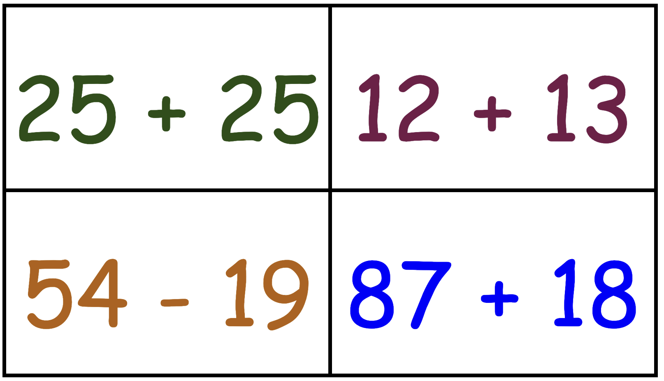
Which one doesn’t belong?

Slide 3
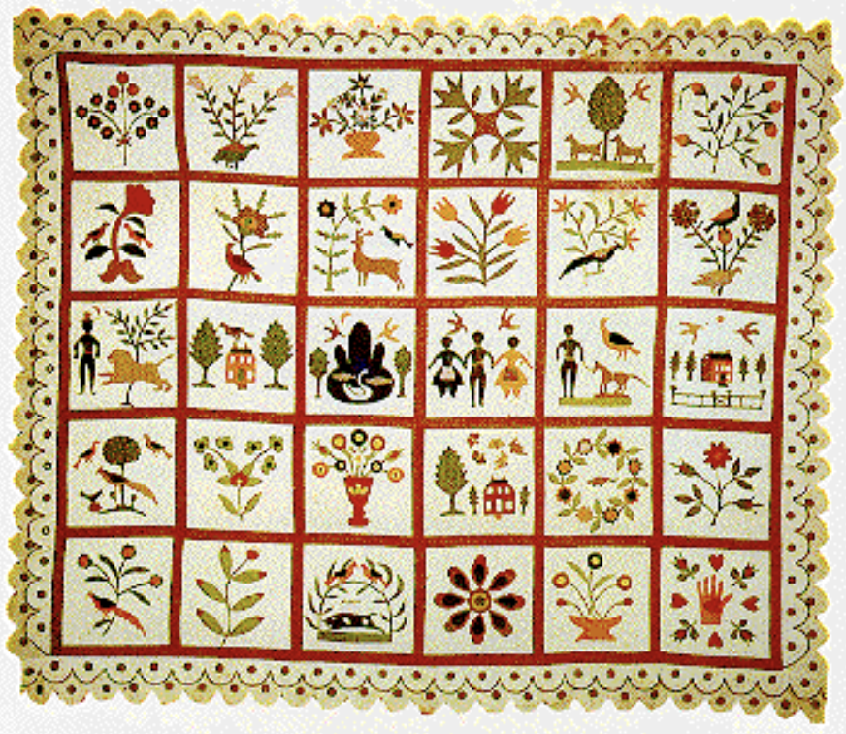
Each square in this quilt represents a part of the family history.
What can we learn from the quilt squares?
If each square takes about 4 hours to complete, how long does it take to create a quilt like this one?
How many days is that?
From The African American Quilt Display

Slide 4
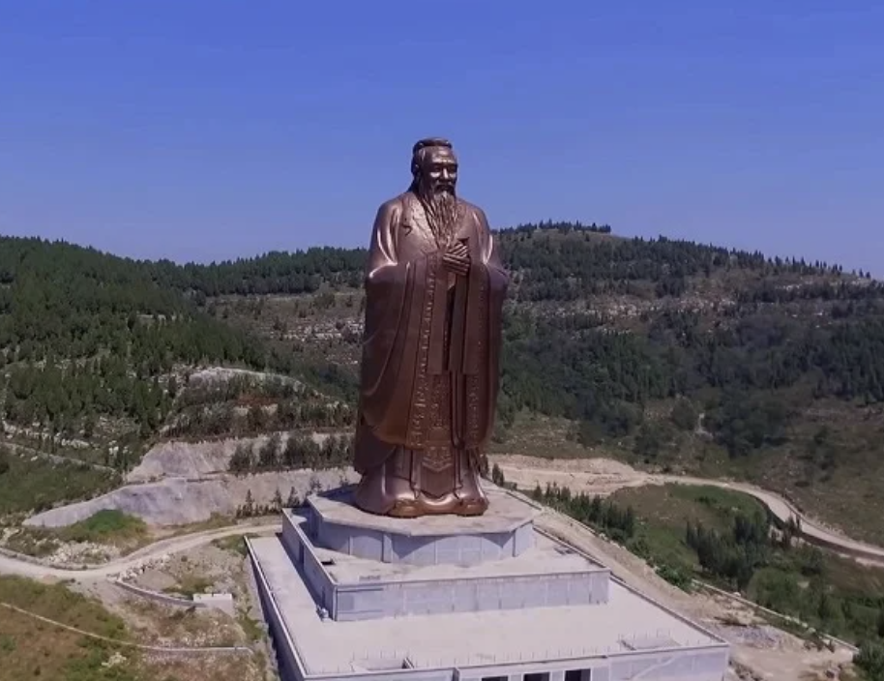
Today is Confucius Day, celebrating the birthday of the great philosopher and teacher.
The tallest statue of Confucius, in Shandong, China, stands 72 meters high.
What are some FACTOR PAIRS of 72?
What do we notice about the factor pairs, do we see any patterns?

