Slide 1
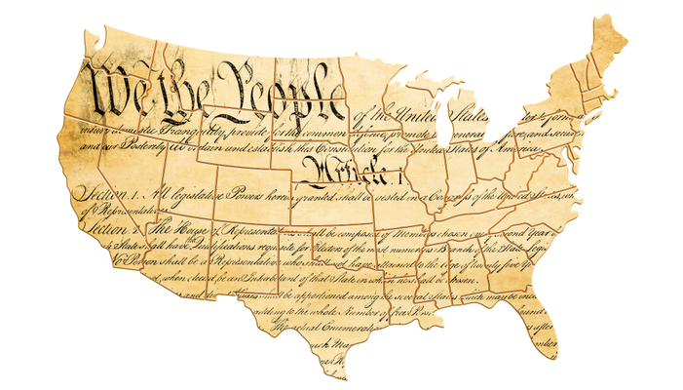
Happy Constitution Day and Citizenship Day!
This day commemorates the signing of the U.S. Constitution on September 17, 1787, and recognizes all American citizens.
In 1787 the U.S. population was 3,929,214
Today the U.S. population is 334,893,745
About how much greater is the population today?
Notes:
Week 3
Week of September 18-22

Slide 2
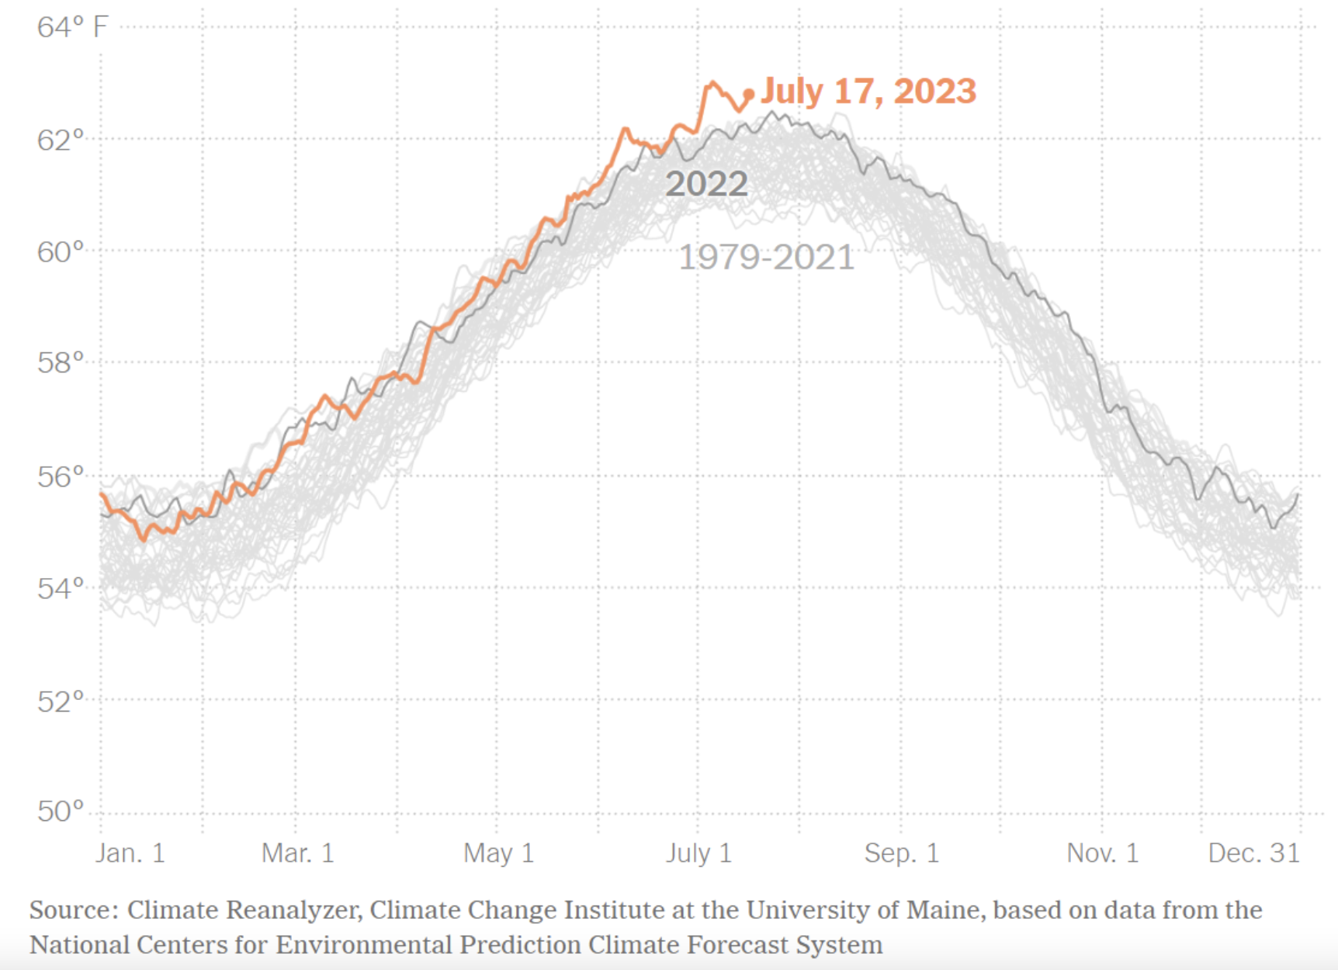

What do we notice?
What do we wonder?
Why does it matter?
What’s a good name for this data visualization?
Notes:
Daily global surface air temperatures for every year since 1979

Slide 3
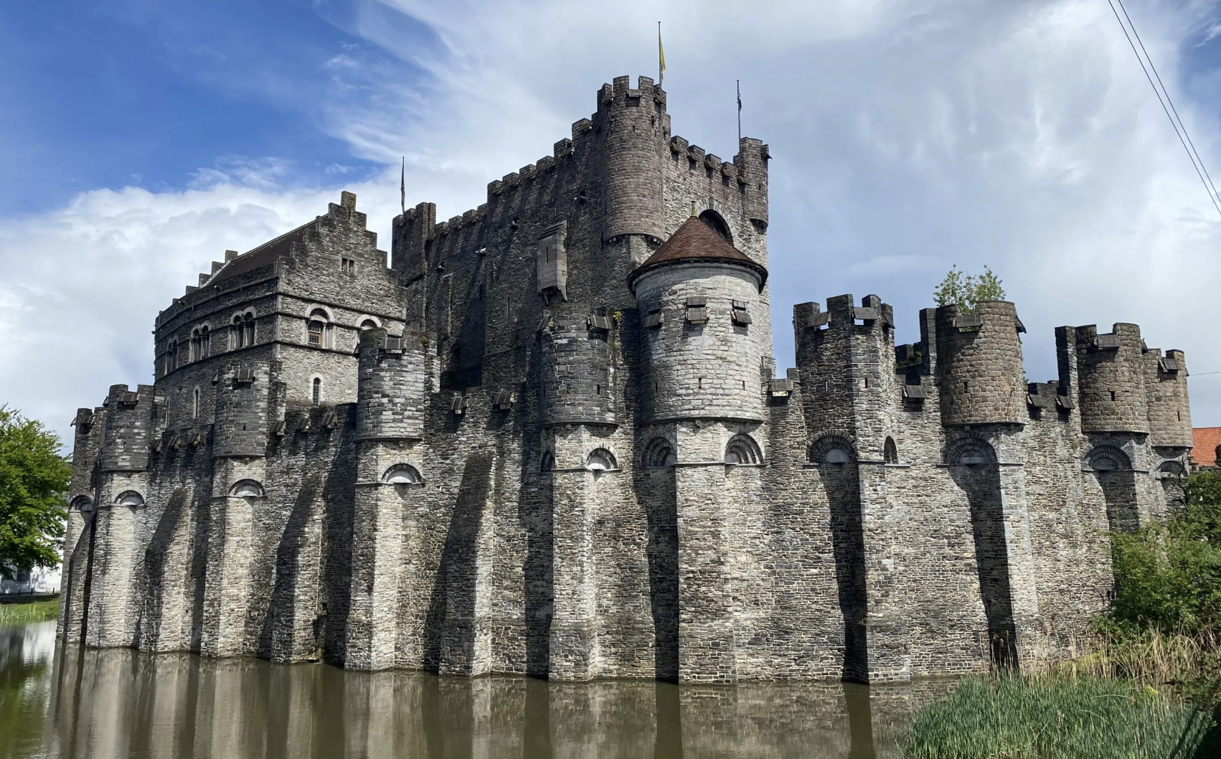
Gravensteen (Count’s Stone) Castle in Ghent, Belgium was built in 1180!
How long ago was that?
What mental math strategies can we use?

Slide 4

This beautiful milk snake sunning by the vernal pool is about 3 feet long!
How many inches is that?

Slide 5
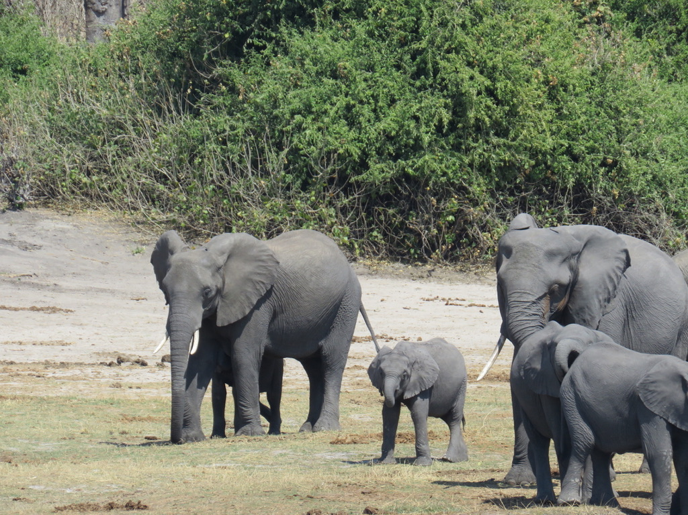
Today is National Elephant Appreciation Day!
The largest African elephants can stand in excess of 13 feet tall at the shoulder. How does an African elephant grow to be 13 feet tall and weigh over 14,000 pounds? By eating a lot! Scientists estimate that the largest elephants can eat more than 350 pounds of food in a single day.
How many pounds of food is that in one week?
Photo by Celia M.

