Slide 1
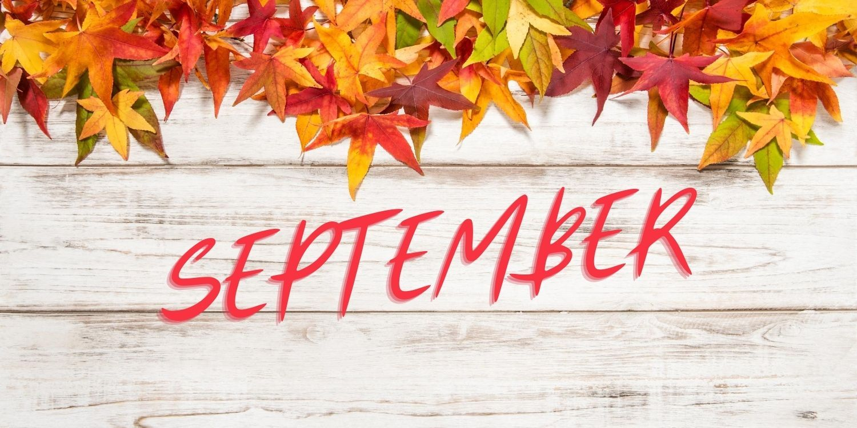

Slide 2
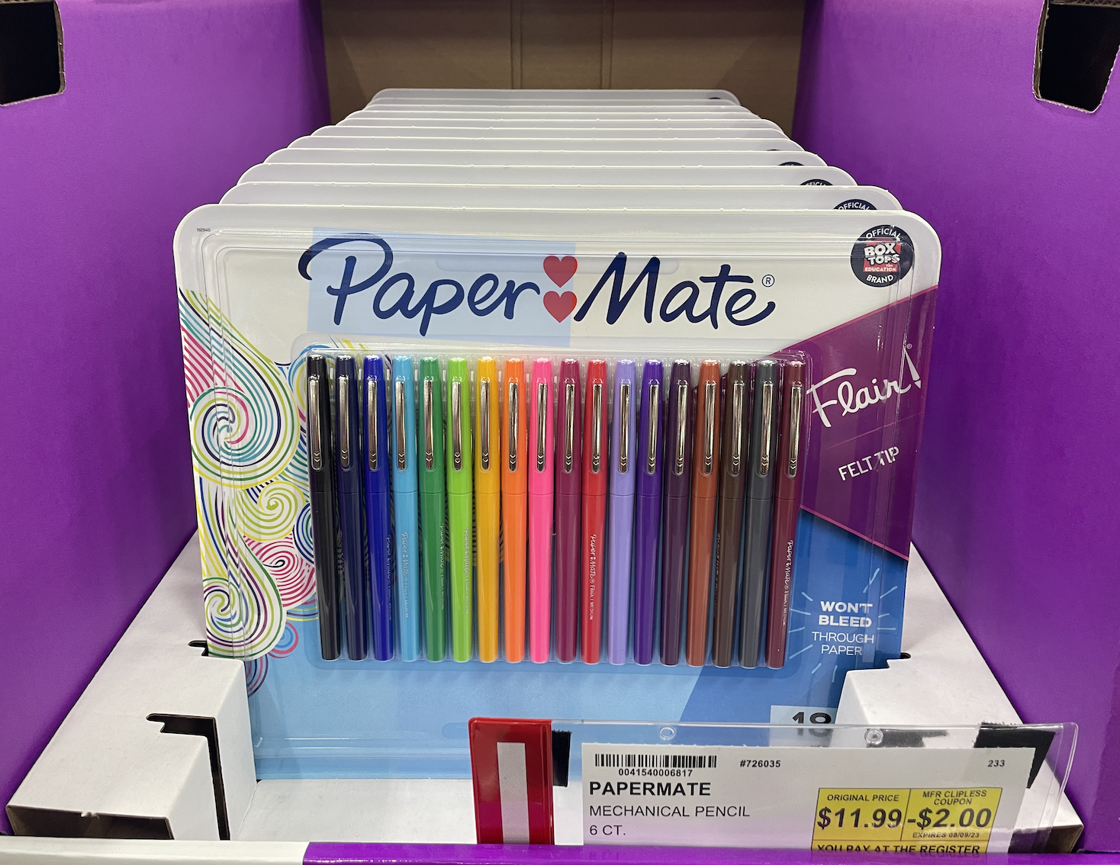
Happy Back to School!
What can we say about these pens?

Slide 3
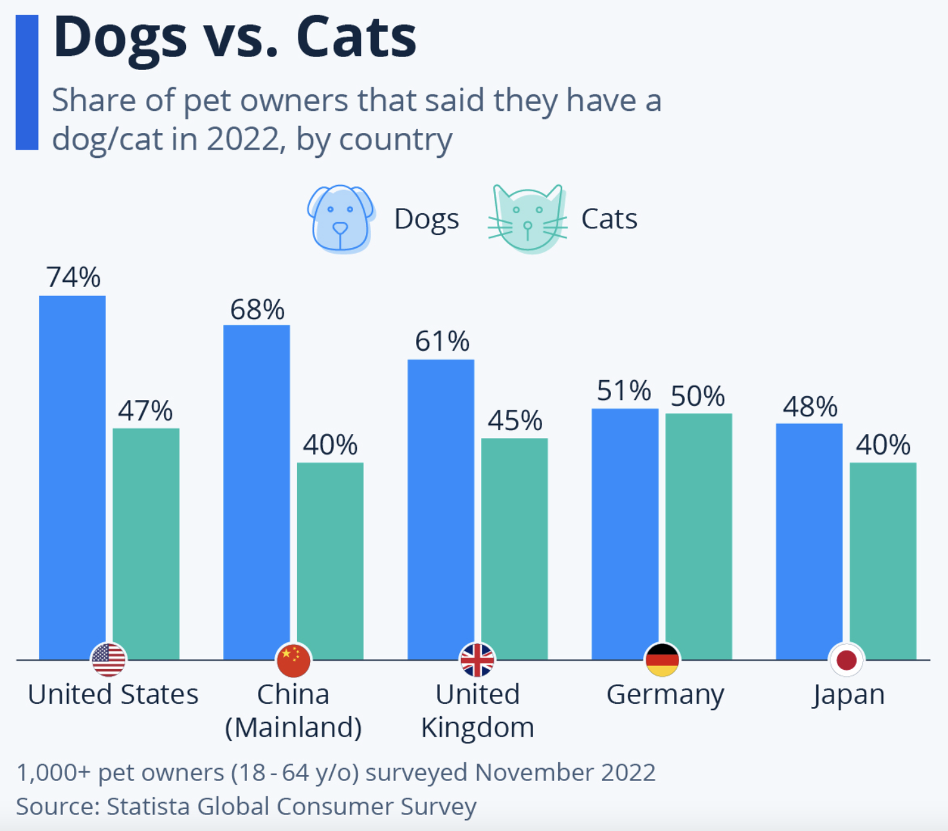
Today is Happy Cat Day!
If this graph could talk what would it say?
Why does it matter?

Slide 4
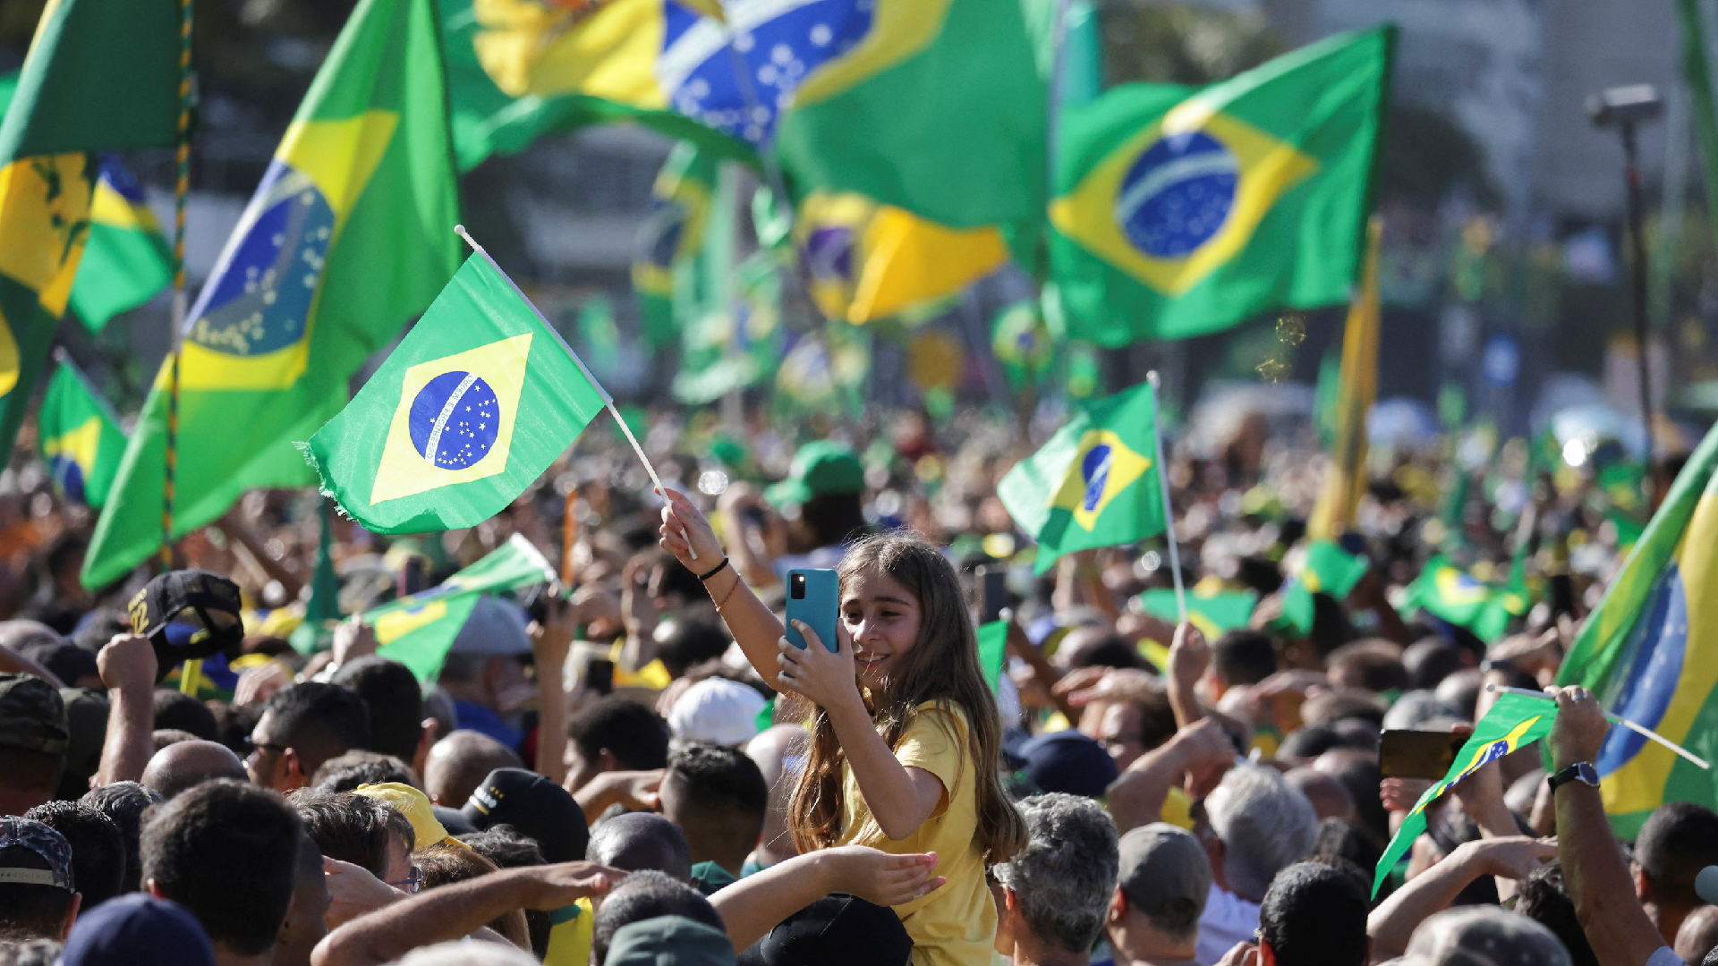
Today is Independence Day in Brazil!
Brazil declared independence from Portugal September 7, 1822.
How long ago was that?
Use mental math to figure it out!

Slide 5
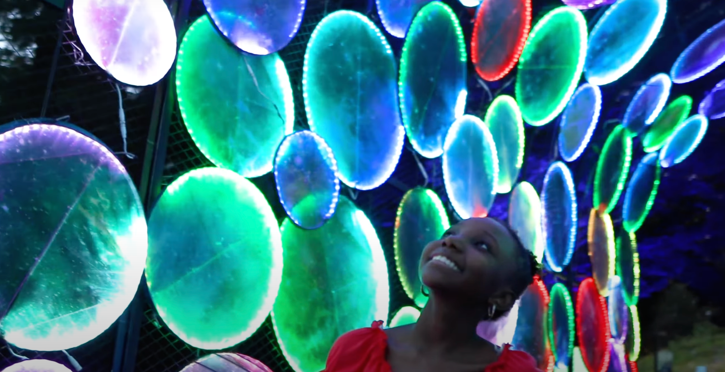
Boston Lights is back again, illuminating Franklin Park Zoo’s 72-acres with a stunning array of lanterns and lights!
Boston Lights shines a light on the importance of conserving the incredible biodiversity on our planet.
What are some factors of 72?

