Slide 1
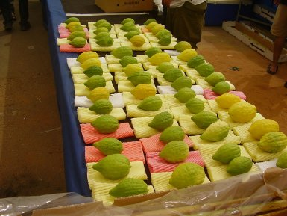
Happy Sukkot!
Look at all of these Etrogim!
An Etrog is a citrus fruit, similar to a lemon!
Where do we see arrays here?
How many etrogim are here?
Notes:
Week 5
October 2-6

Slide 2
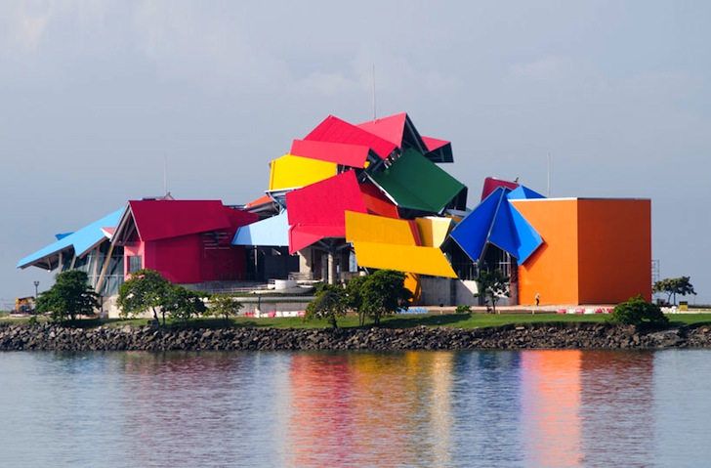
Happy International Architecture Day!
This amazing Frank Gehry structure, The BIOMUSEO, is in Panama.
What do we notice?
Let’s talk about some of the interesting shapes we see here.

Slide 3
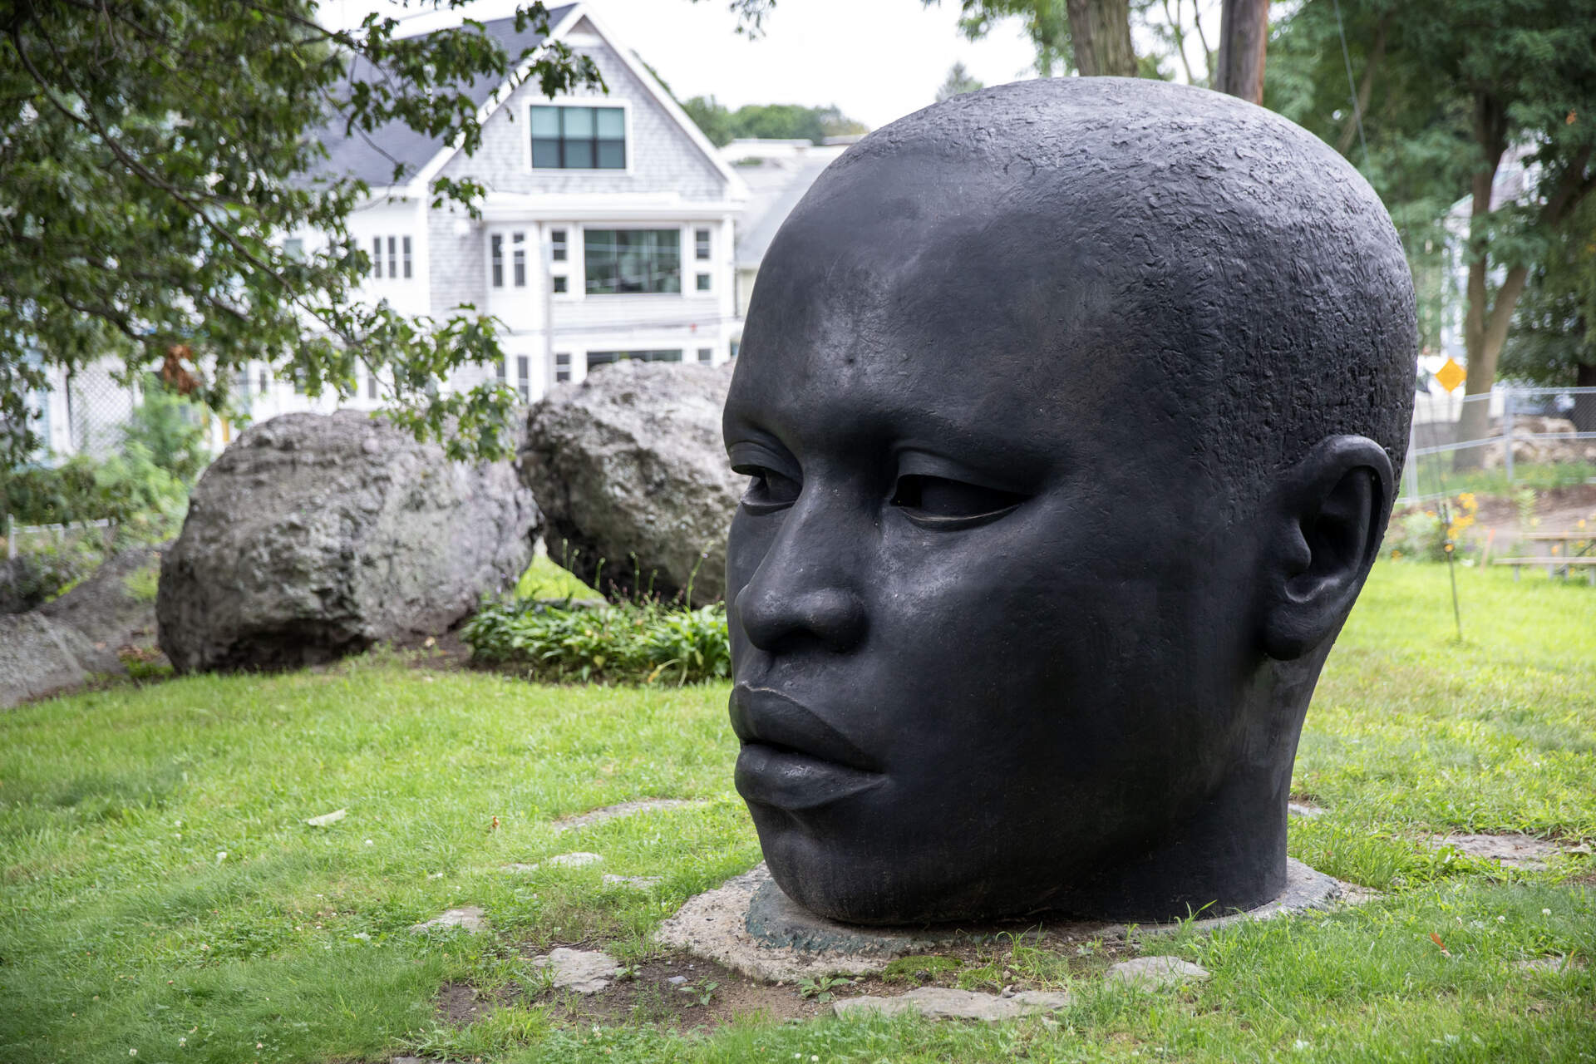
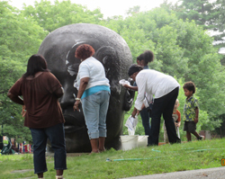
Estimate the height of "Eternal Presence" by John Woodrow Wilson at the National Center of Afro-American Artists in Roxbury.
Does this help?

Slide 4
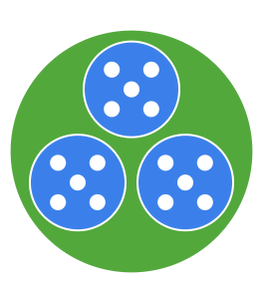
What is the same?
What is different?
3
3
3
3
3

Slide 5
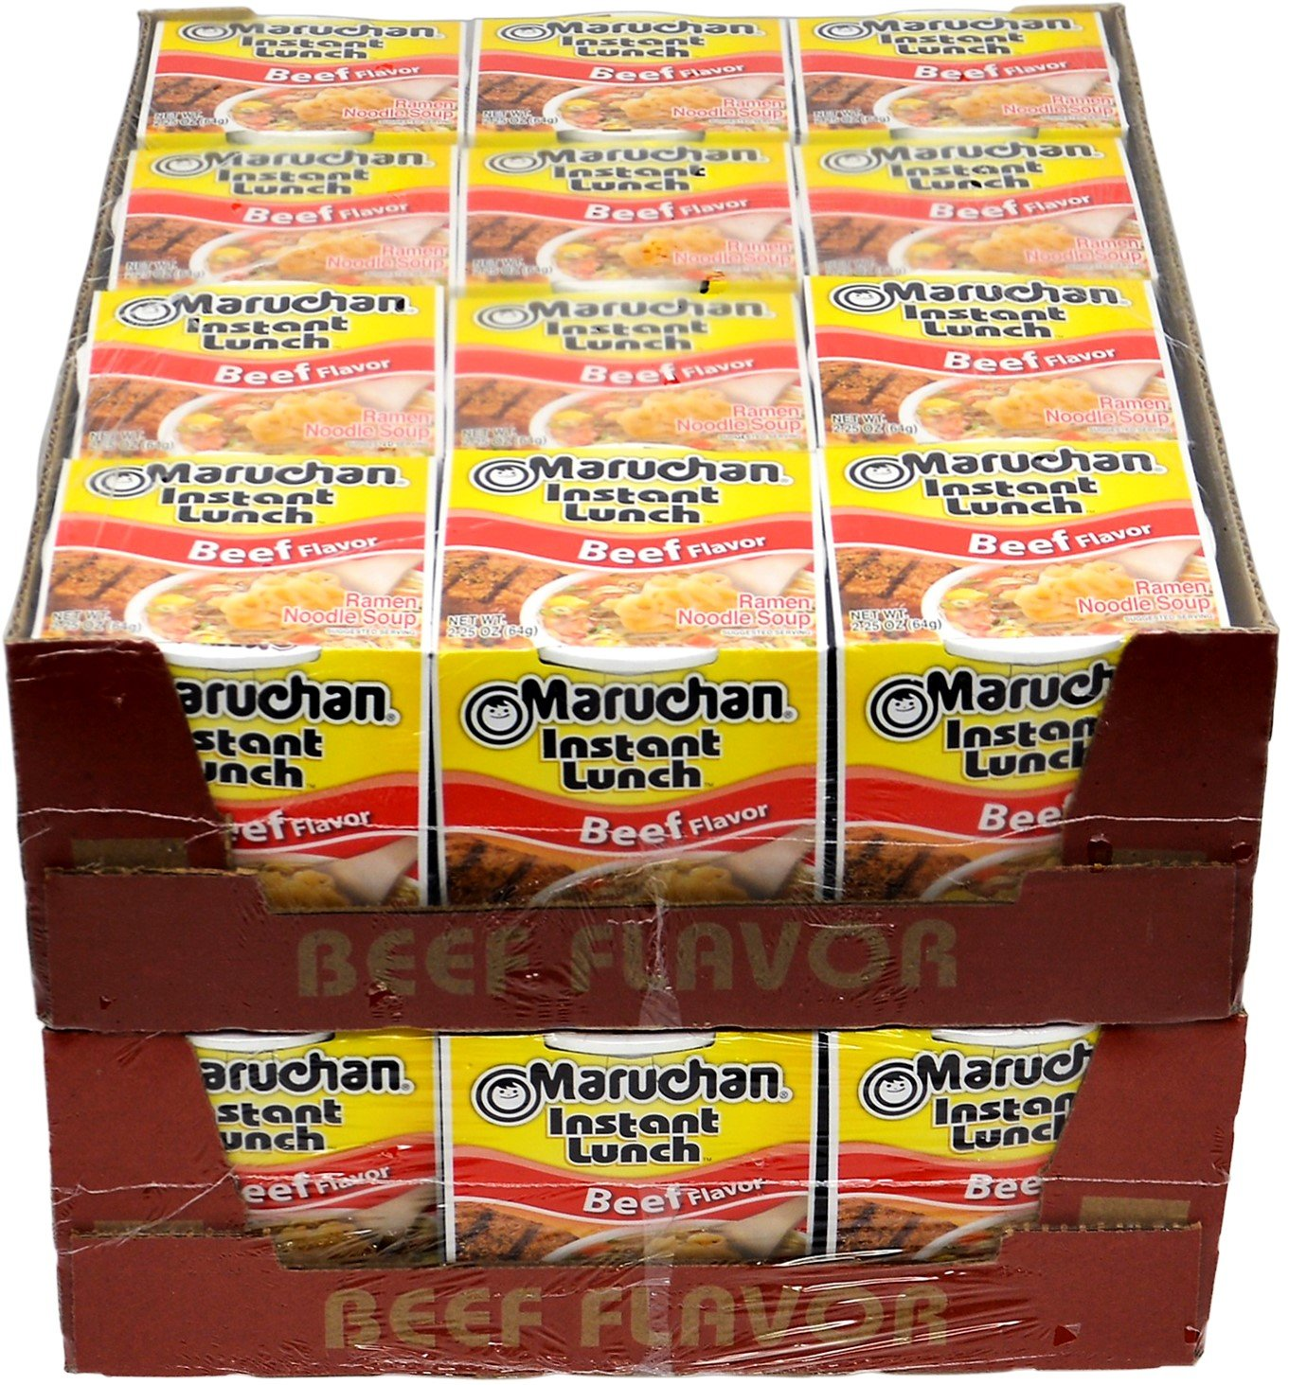
Celebrate National Noodle Day!
Where do we see arrays in this photo?
How many are ramen noodles are here?

