Slide 1
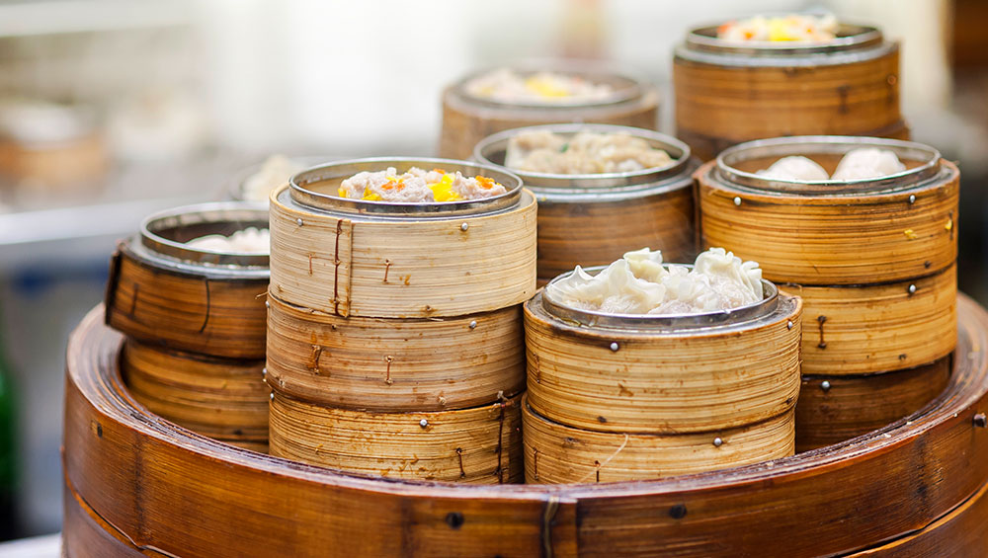
Happy National Dumpling Day!
How can we use groups of, to estimate how many dumplings are here?
Notes:
Week 4
September 26 - 29

Slide 2
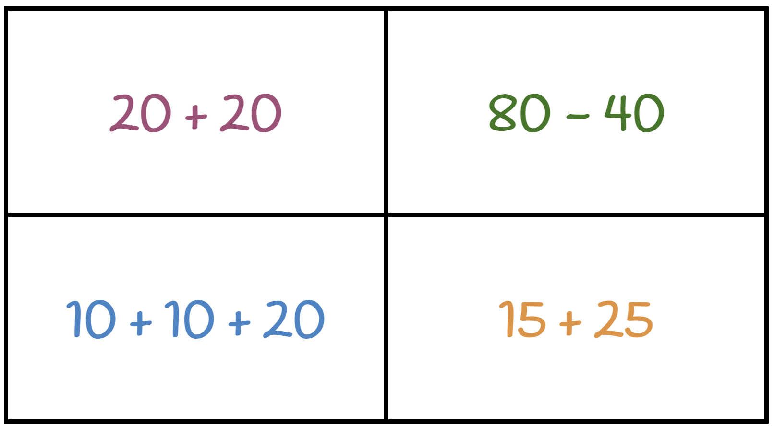
Which one doesn’t belong?
Notes:
Top left: not numbers
Top right: only double
Bottom left: not addition
Bottom right: not even numbers

Slide 3
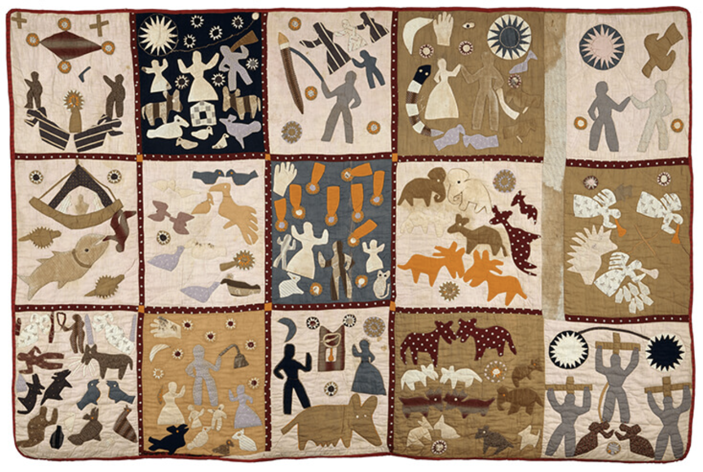
The Creation of Animals Quilt by Harriet Powers (1898) is a quilt which blends together mythical and Biblical stories.
Where do we an array?

Slide 4
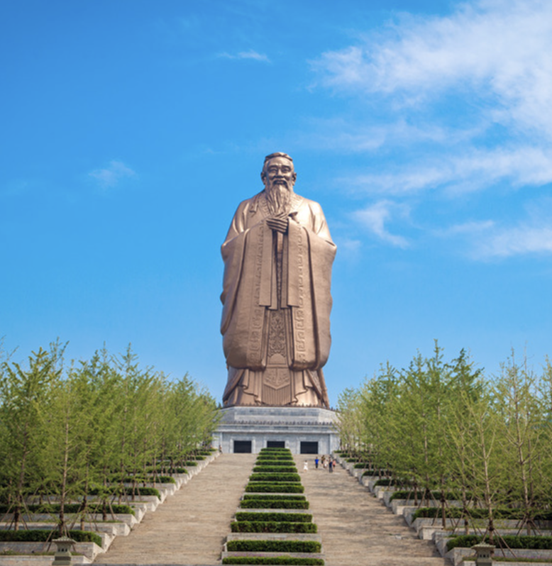
Today is Confucius Day, celebrating the birthday of the great philosopher and teacher.
The tallest statue of Confucius, in Shandong, China, stands 72 meters high.
How many different equations can we create that equal 72?

