Slide 1
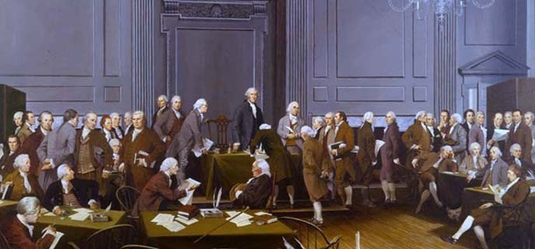
Happy Constitution Day and Citizenship Day!
55 delegates attended the Constitutional Convention, but only 39 actually signed the Constitution. How many delegates did not sign? How can we use mental math to solve this?
How many different expressions can we create that equal 39?
Notes:
Week 3
Week of September 18-22

Slide 2
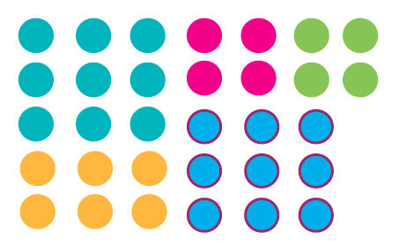
What do we notice?
What do we wonder?
Where’s the math?

Slide 3
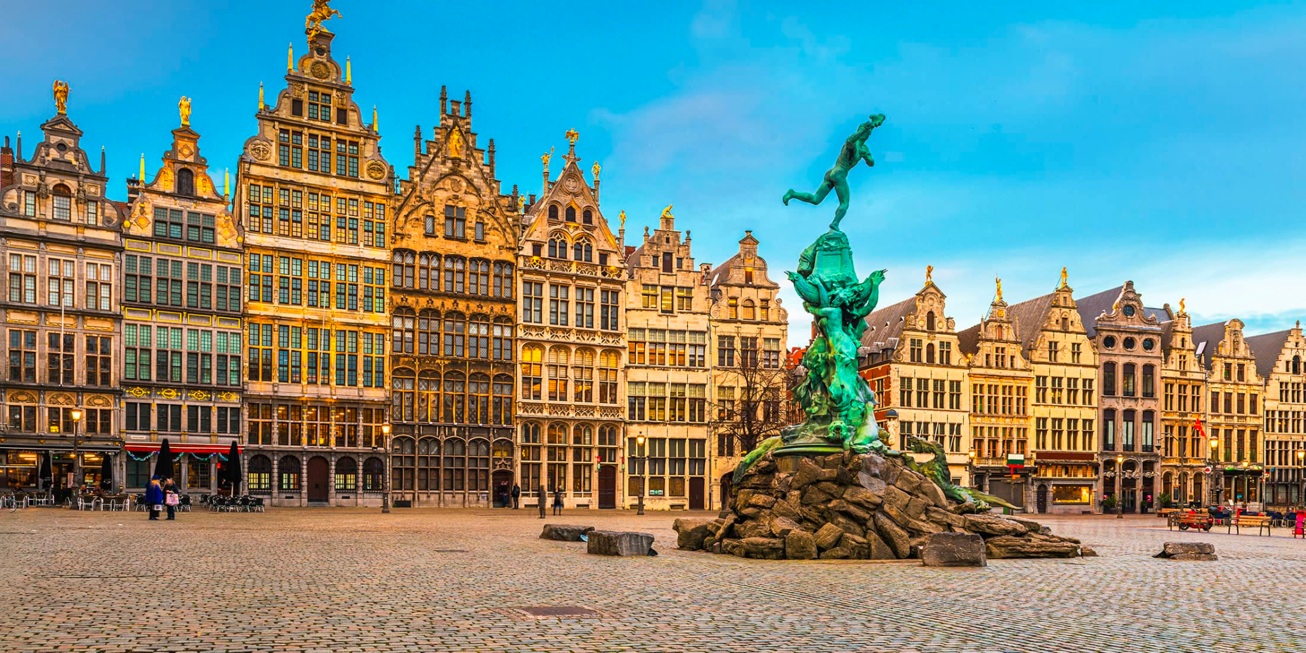
Where do we see arrays in this photo of Antwerp? How can we describe them?

Slide 4
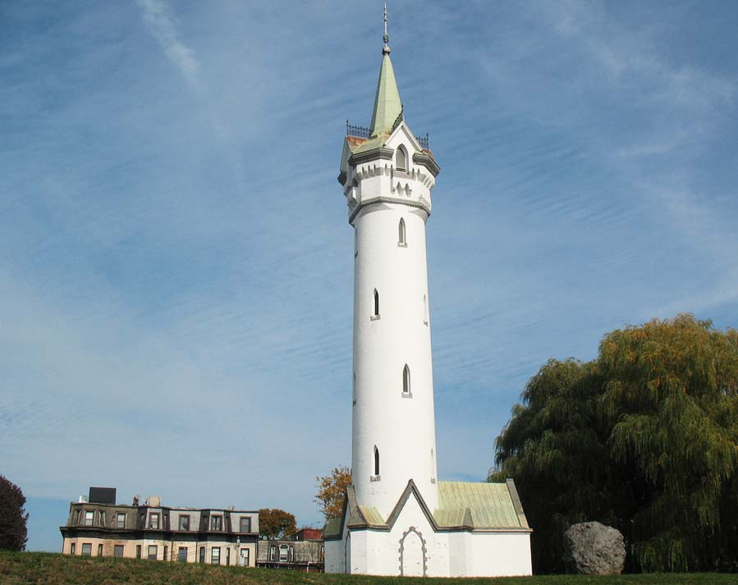
The Fort Hill Tower in Roxbury was used during the Revolutionary War!
The tower was built in 1869.
How long ago was that?
What mental math strategies can we use to solve this?

Slide 5
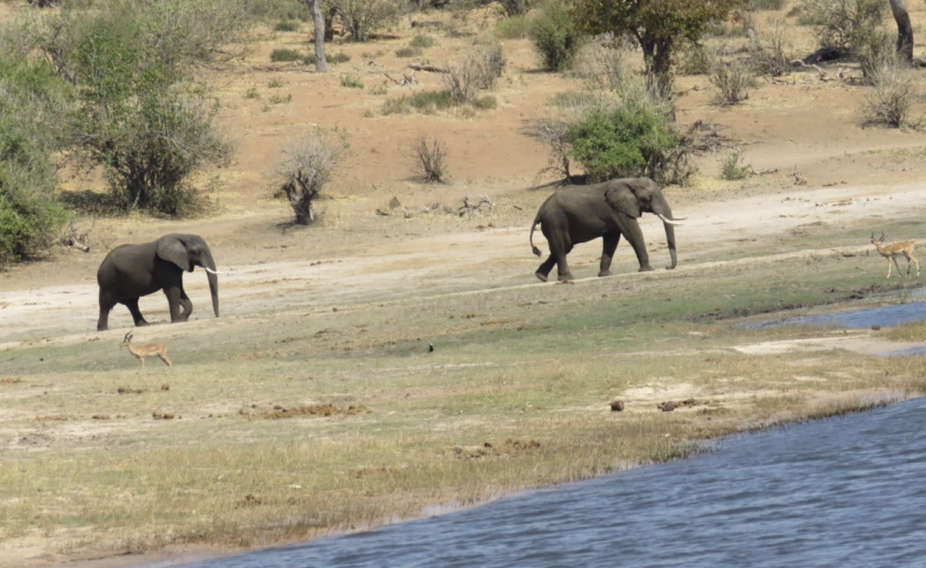
Today is National Elephant Appreciation Day!
Together these two baby elephants weigh 800 pounds.
What is possible?
Photo by Celia M.

