Slide 1
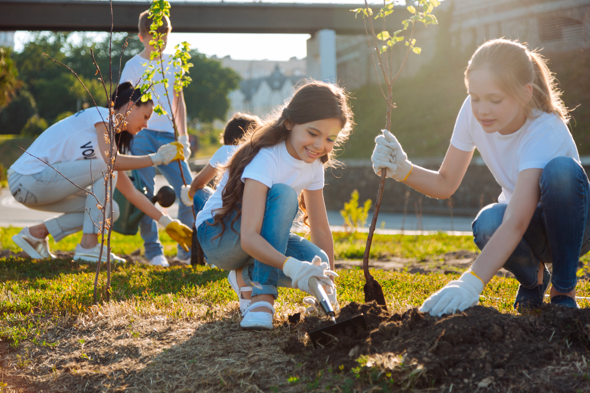
September 11th is our National Day of Service
If all of the students in our class planted 3 trees today, how many trees would we plant?
What if all of our third-grade students in the school planted 3 trees each?
Notes:
Week 2
September 11-15

Slide 2
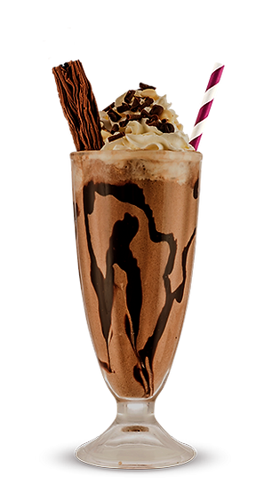
Happy Chocolate Milkshake Day!
A small chocolate milkshake has 56 grams of sugar.
If you had one shake every day for a week, how many grams of sugar would that be?

Slide 3
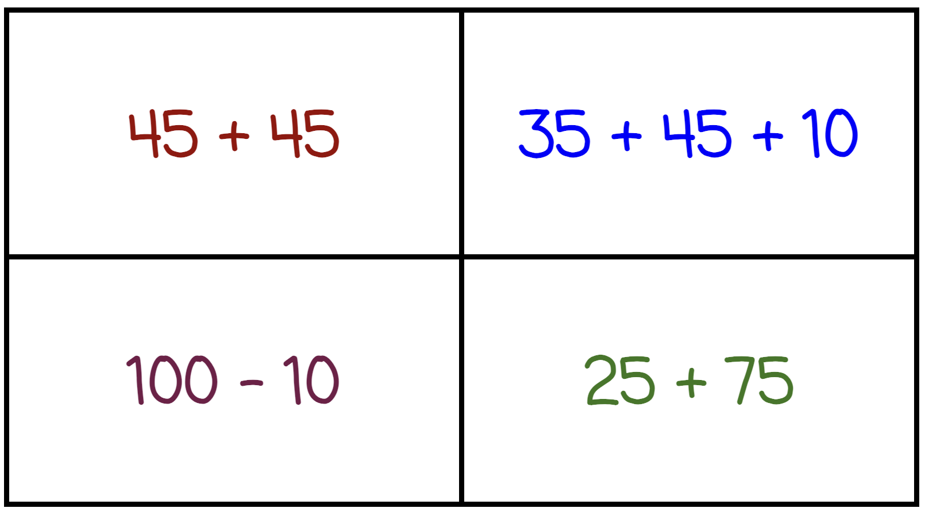
Which one doesn’t belong?
Notes:
Top left: not different addends/subtrahends (double)
Top right: not two addends/subtrahends
Bottom left: not addition
Bottom right: not 90

Slide 4

150 - 49 > 100
75 + 75 < 75 + 70
325 + 49 < 51 + 325

Slide 5
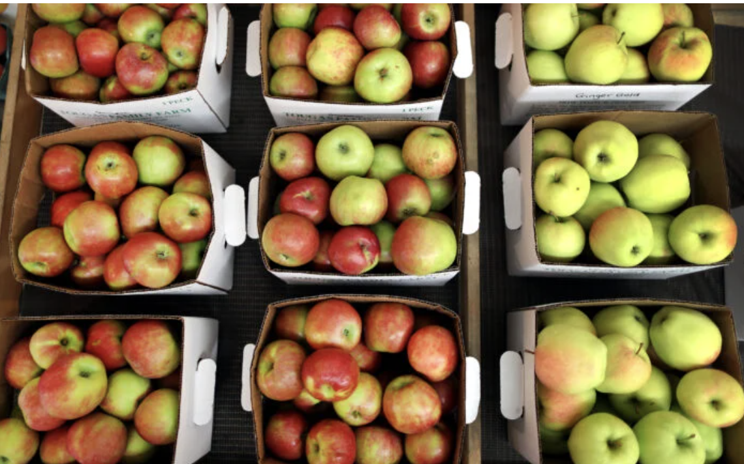
Happy Rosh Hashanah! שנה טובה ומתוקה
What do we notice?
What do we wonder?
Where’s the MATH?

