Slide 1
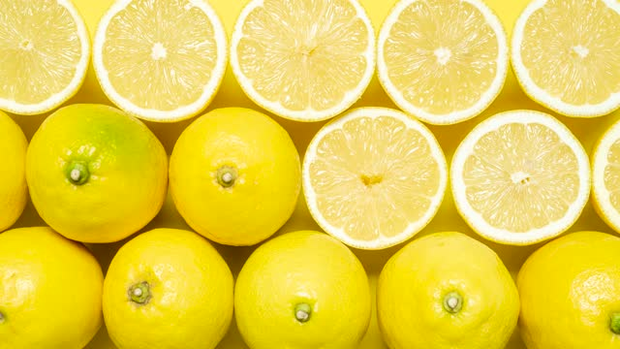
Happy Sukkot!
Look at all of these Etrogim!
An Etrog is similar to a lemon!
How many are here?
Notes:
Week 5
October 2-6

Slide 2
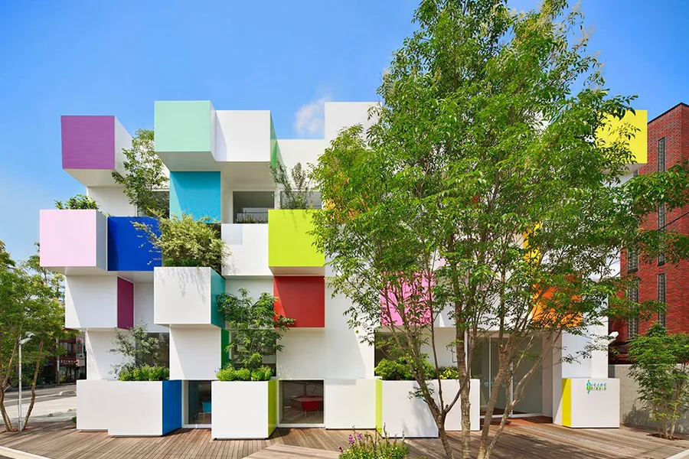
Today is National Architecture Day!
The Sugamo Shinkin Bank in Japan is a beautiful structure!
Where’s the math?
How many squares do we see?
How many don’t we see?
How many altogether?

Slide 3
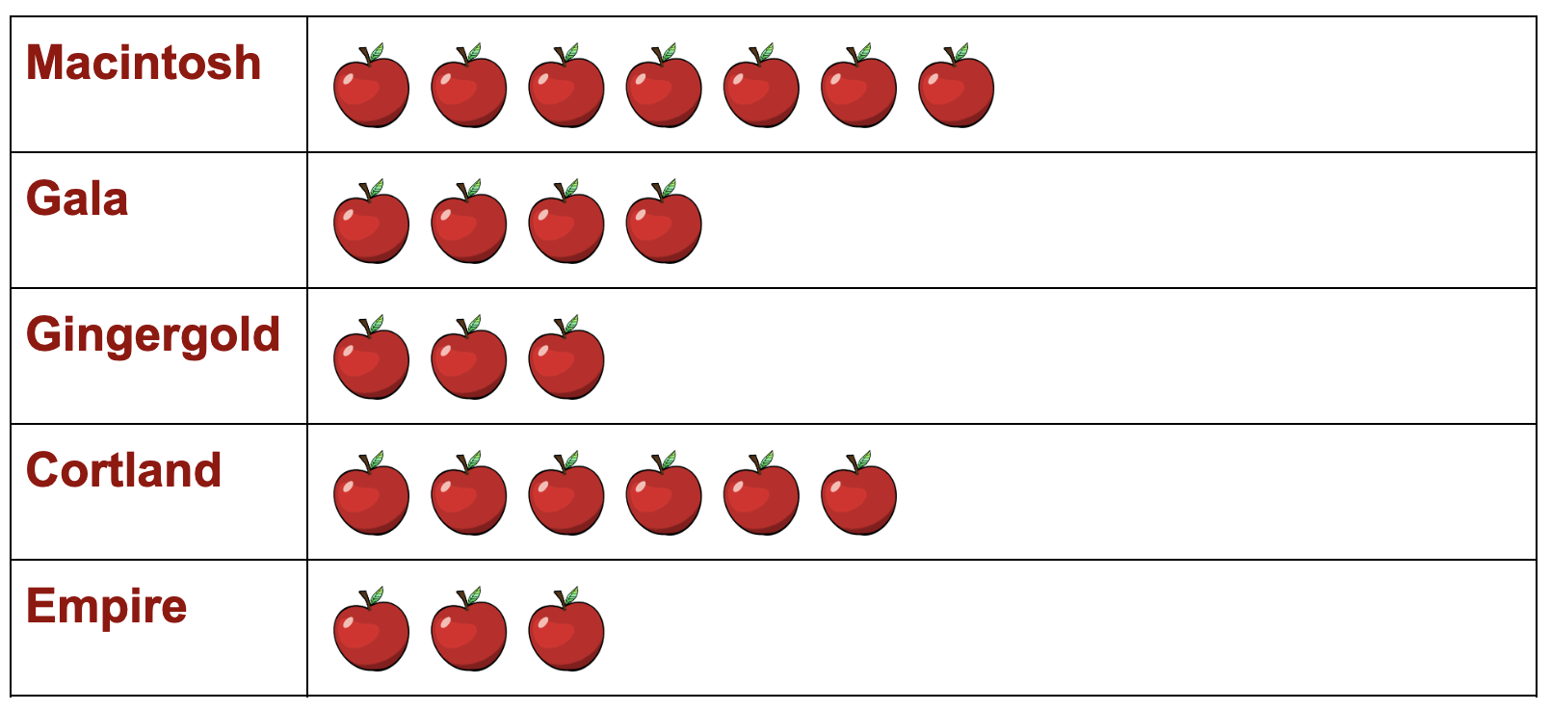
What do we notice? What do we wonder? Why does it matter?

Slide 4
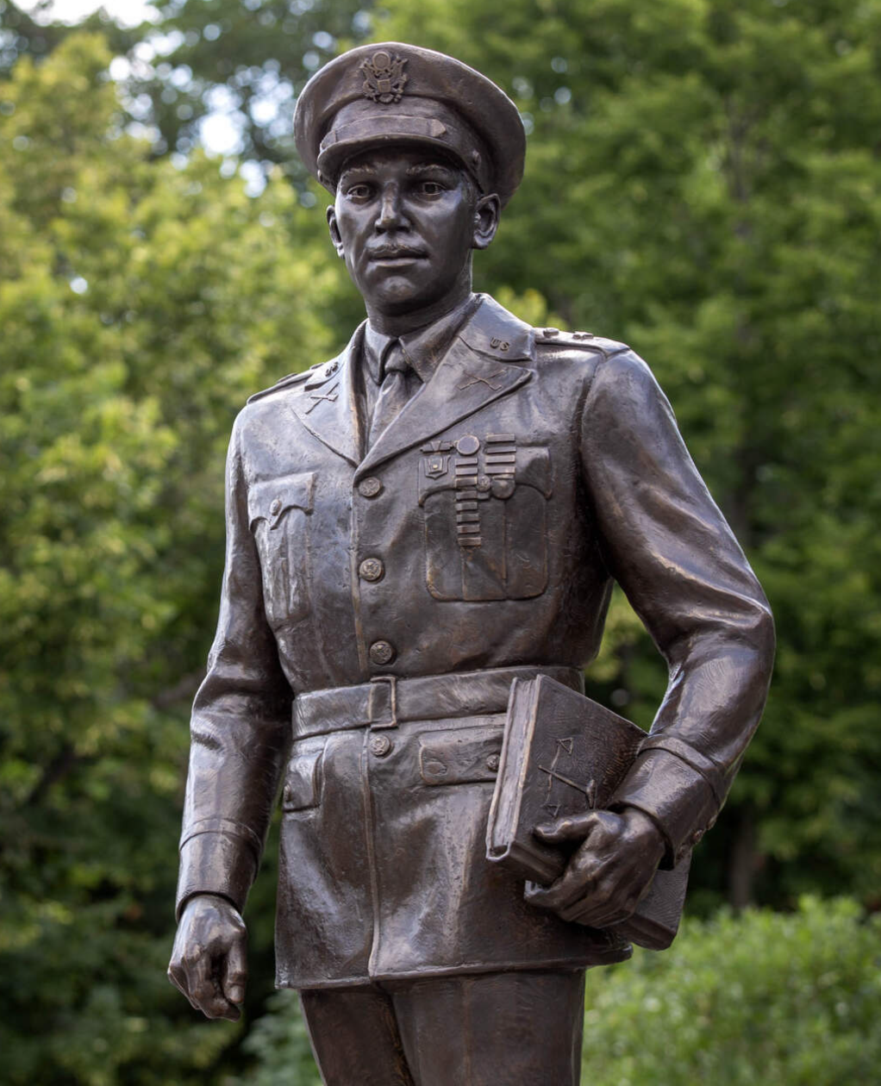
This is a LIFE-SIZE statue of General Gourdin at the Edward O. Gourdin African American Veterans Memorial Park in Roxbury.
What does LIFE-SIZE mean?
How tall do we think it is?

Slide 5
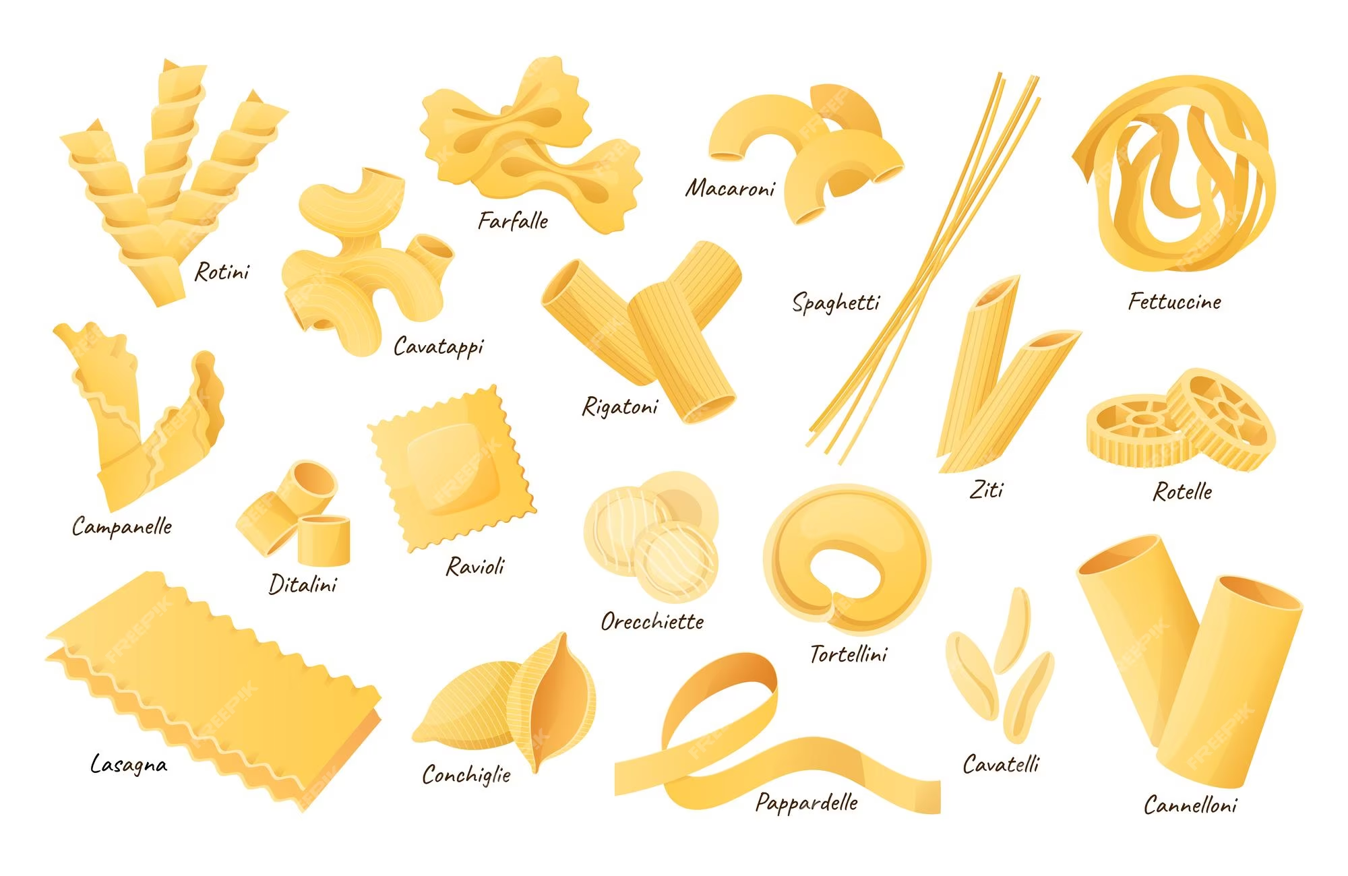
Today is National Noodle Day!
What interesting shapes do we see?
What would happen if we PARTITIONED some of the shapes?

