Slide 1
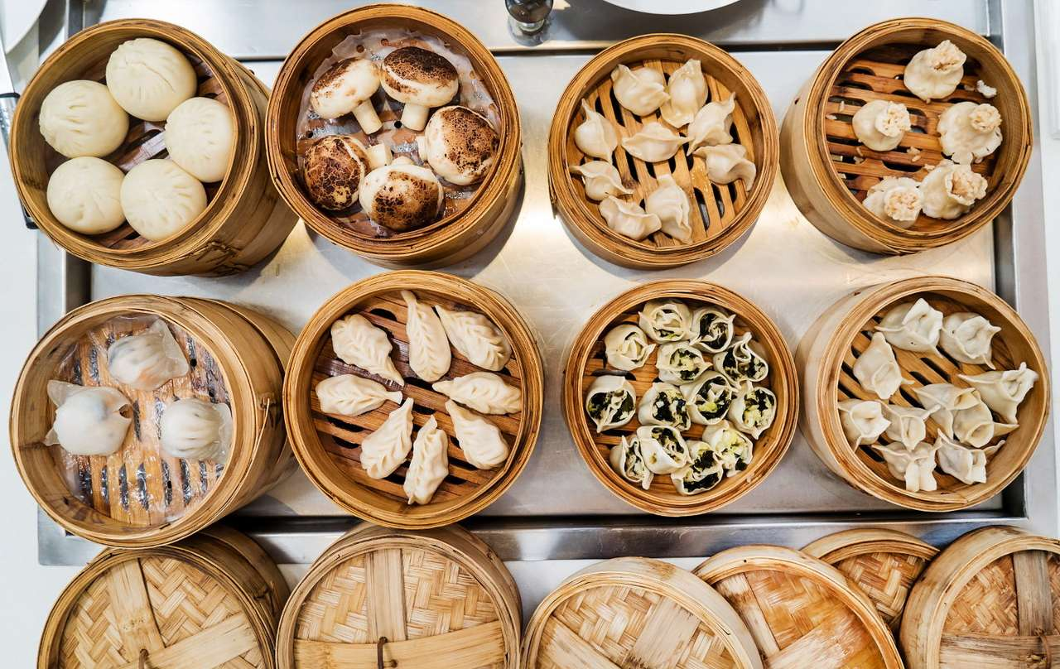
Happy National Dumpling Day!
How many delicious dumplings are in the bamboo steamers?
How can we figure this out without counting them all?
Notes:
Week 4
September 26 - 29

Slide 2
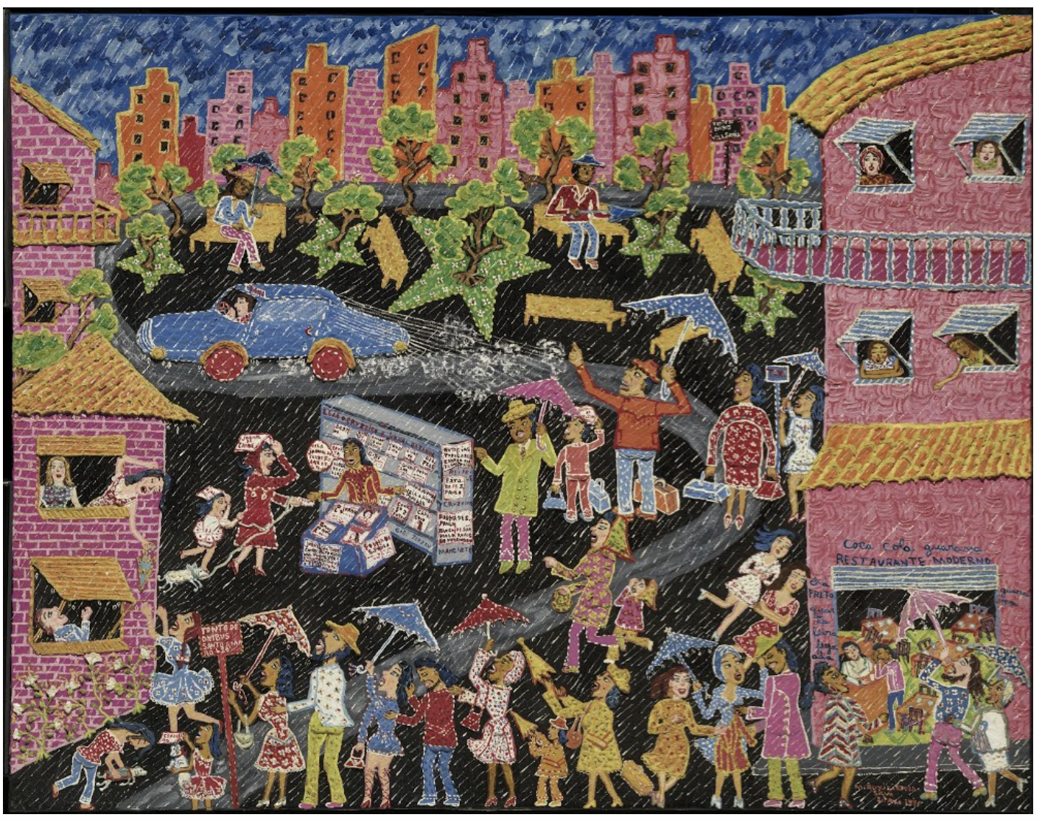
Let’s talk about the shapes we see in Maria Auxiliadora’s Chuva Sobre São Paulo (Rain over São Paulo).

Slide 3
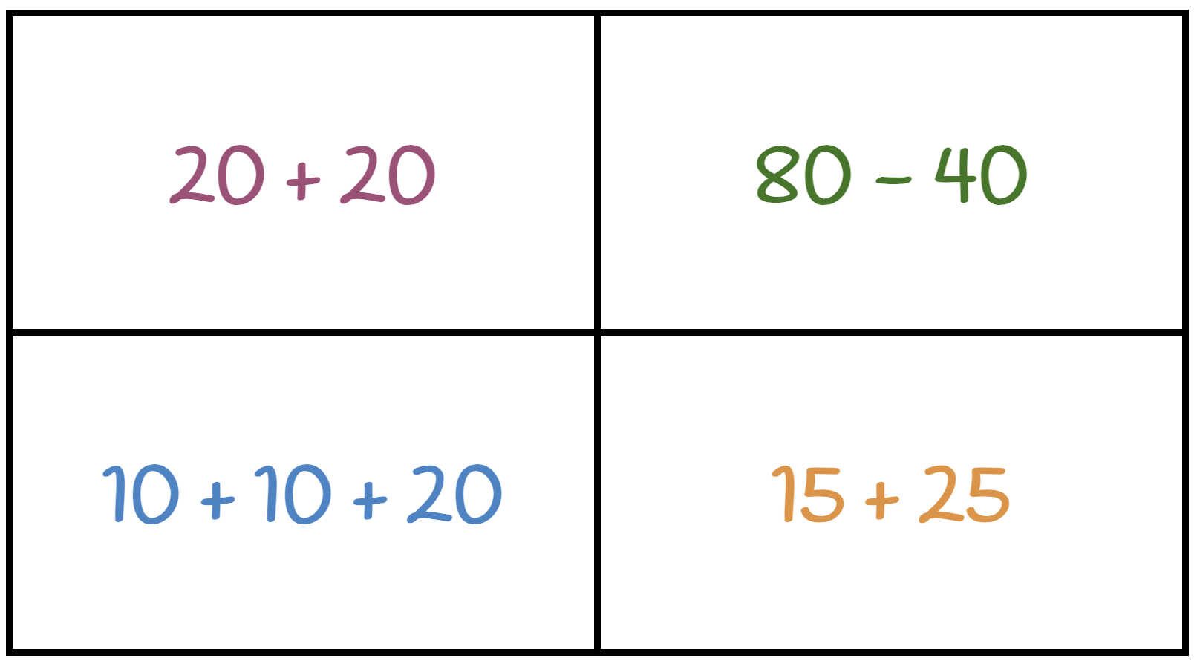
Which one doesn’t belong?

Slide 4
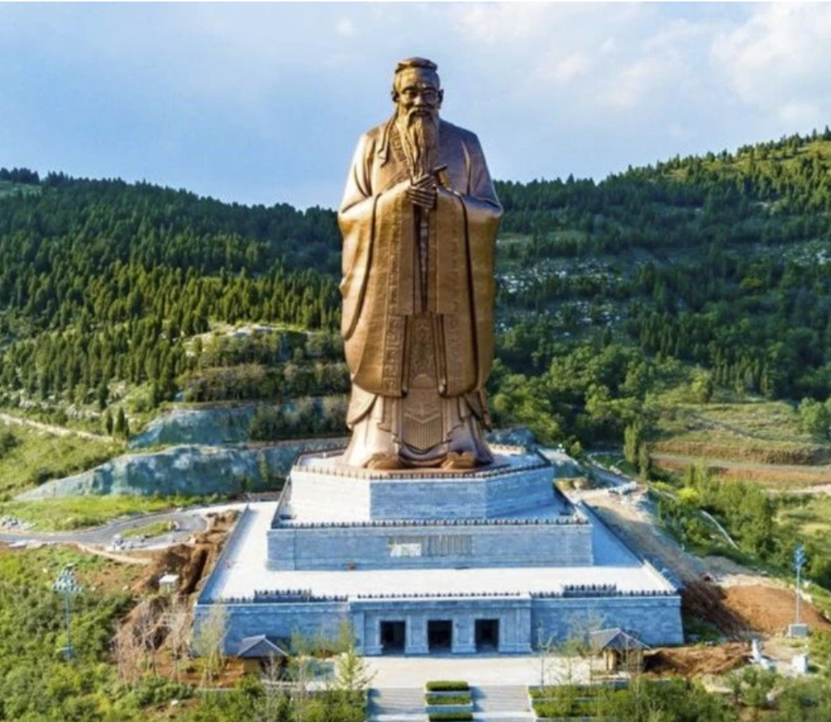
Today is Confucius Day, celebrating the birthday of the great philosopher and teacher.
The tallest statue of Confucius, in Shandong, stands 72 meters high.
How many different equations can we create that equal 72?

