Slide 1

Happy
Constitution Day and Citizenship Day!
The US Constitution was written in 1787!
Since then, it has been amended (added to!) 27 times!
What can we say about the number 27?
What does it look like?
Notes:
Week 3
Week of September 18-22

Slide 2
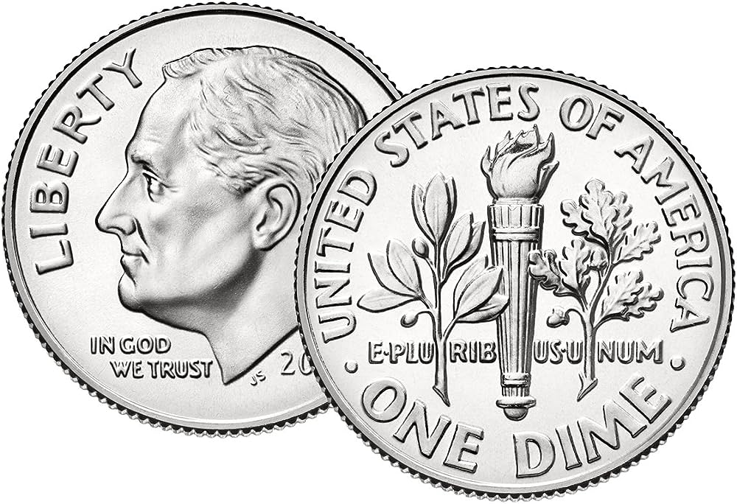
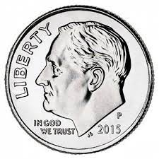
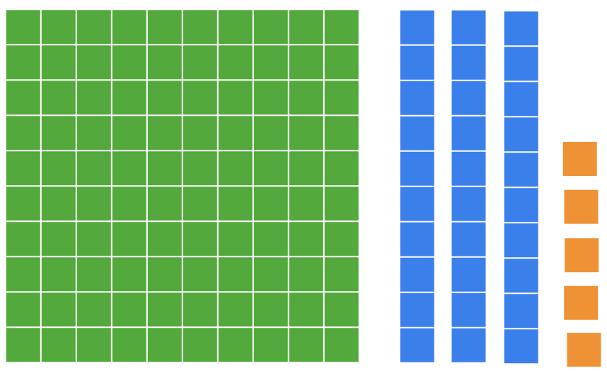
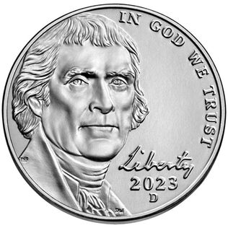
What’s the same?
What’s different?

Slide 3

What do we notice about the shapes in the atrium at the John F. Kennedy Library in Dorchester.
Choose a shape, and sketch it.
Now sketch a shape this is different in ONE way!

Slide 4
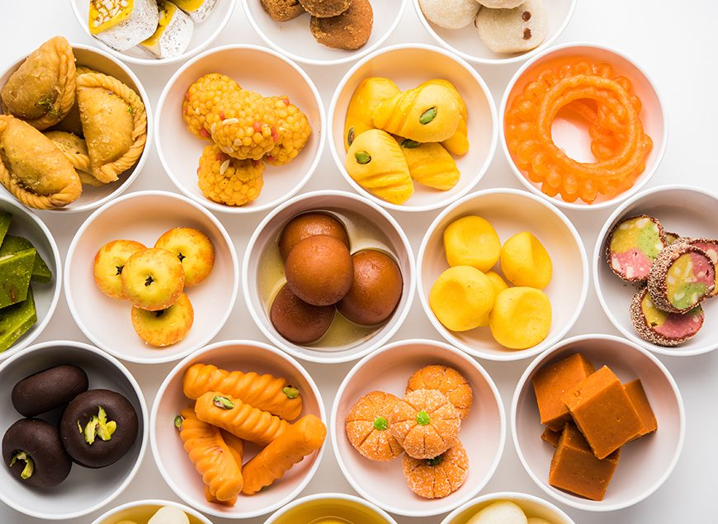
Traditional Indian Pastries…
Yum!
Where’s the math?
How many pastries are here?
Let’s create some equations to match our math thinking!

Slide 5
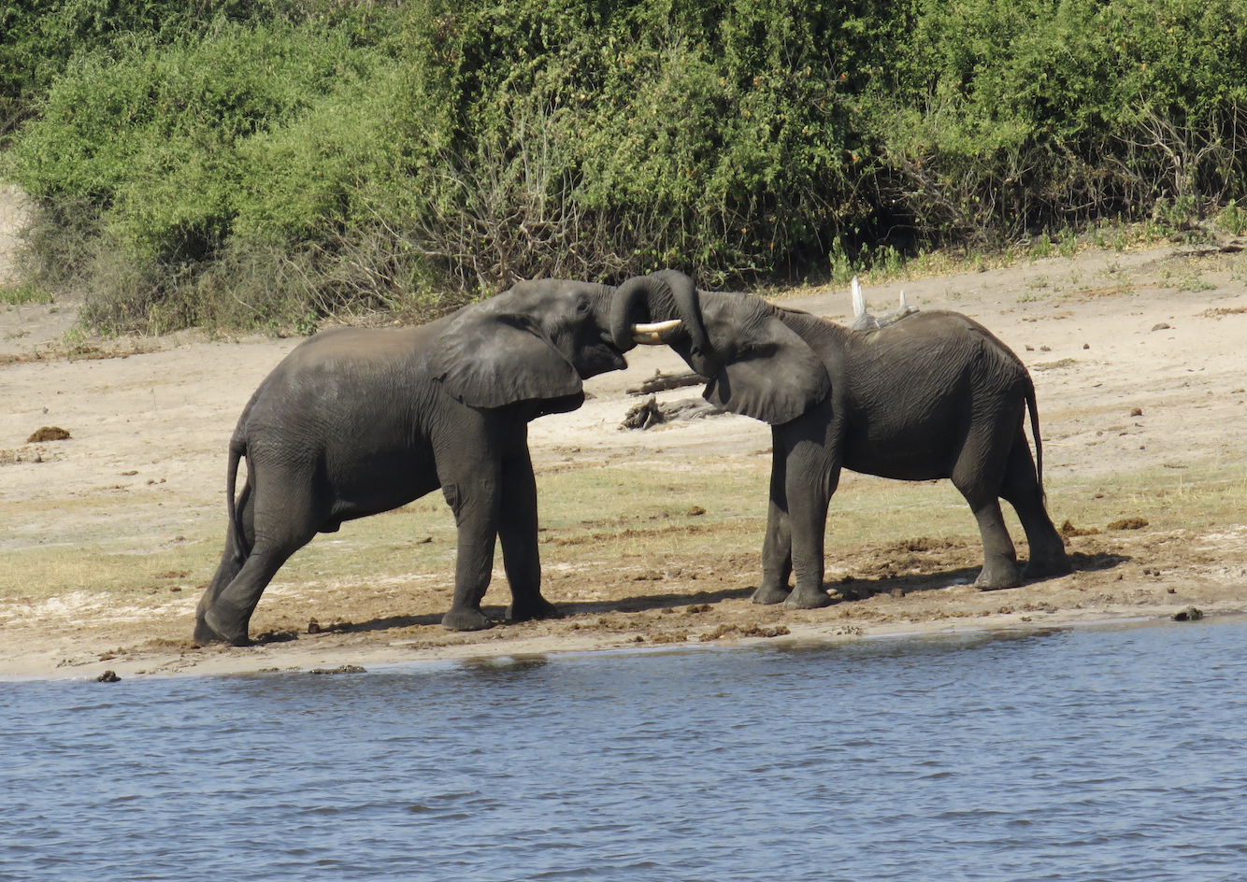
Today is National Elephant Appreciation Day!
Together these two baby elephants weigh 800 pounds.
What is possible?
Photo by Celia M.
Photo by Celia M.

