Slide 1


Slide 2
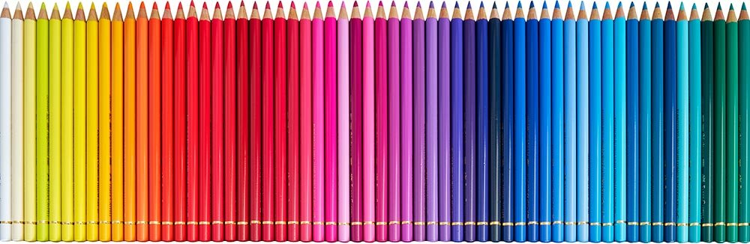
Happy Back to School!
Estimate how many pencils are here.
Are there more than 20? More than 50? How do we know?
Notes:
Week of September 5, 2023

Slide 3
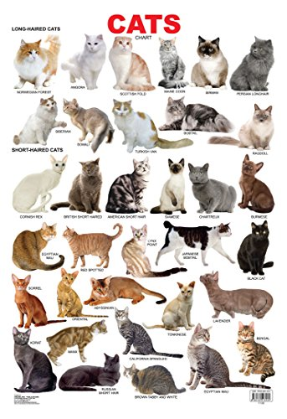
It’s Happy Cat Month!
How many cats do we see?
How many different ways do we see that quantity?

Slide 4
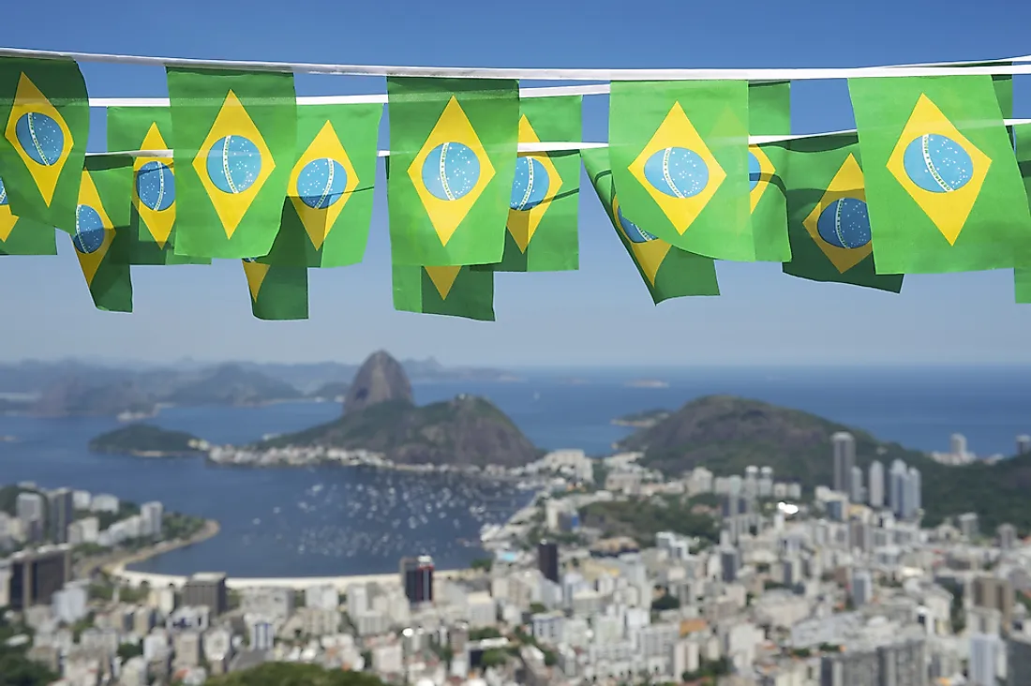
Today is Independence Day in Brazil!
There are 26 states (and 1 federal province) in Brazil!
How many different expressions can we create that equal 26?

Slide 5
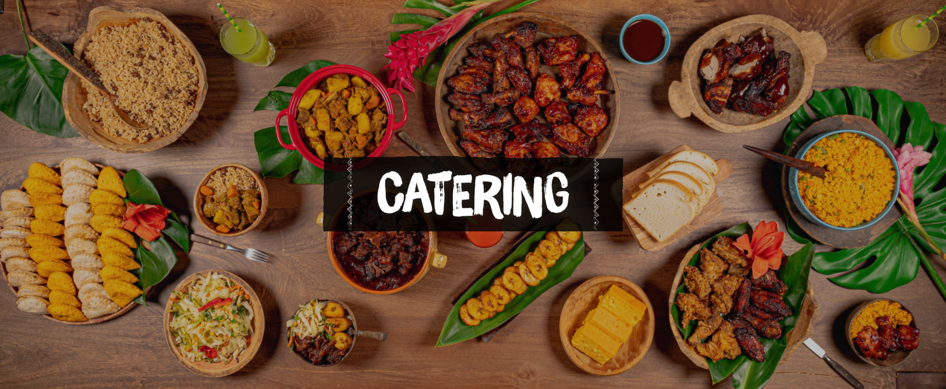
What interesting shapes do we see in this Carribean meal?

