Slide 1
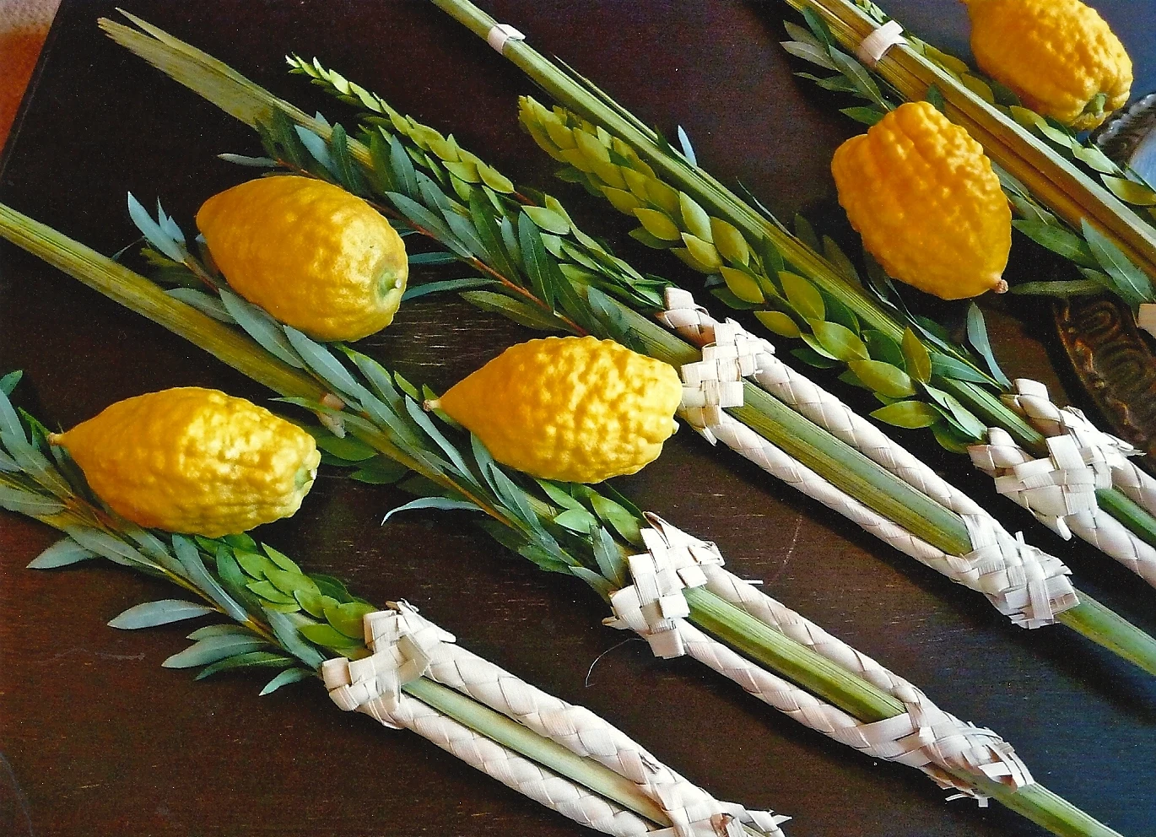
Happy Sukkot!
What can we count in this lulav and etrog photo?
Let’s create an equation to match our math thinking.
Notes:
Week 5
October 2-6

Slide 2
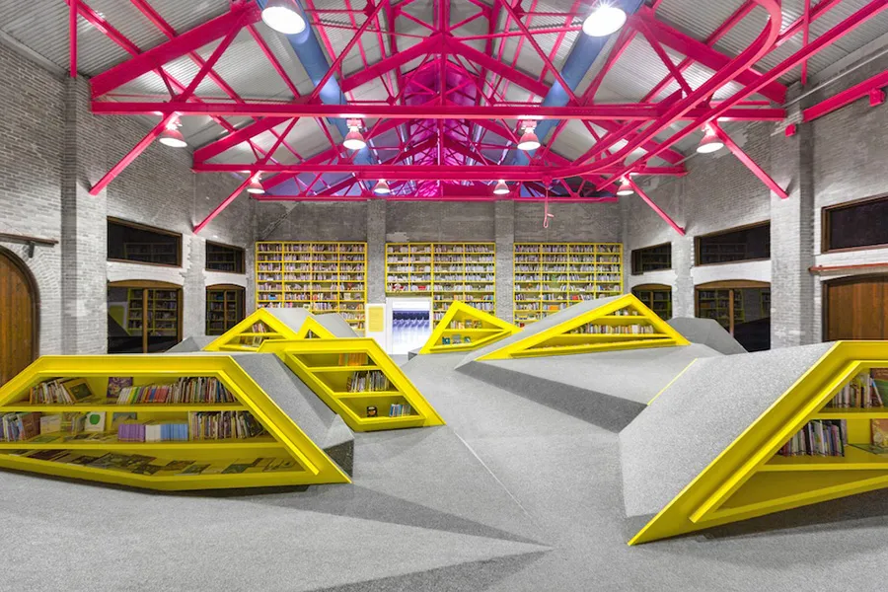
Today is International Architecture Day!
Let’s be shape detectives!
What shapes do we see in Niños Conarte, a library in Monterrey, Mexico?

Slide 3
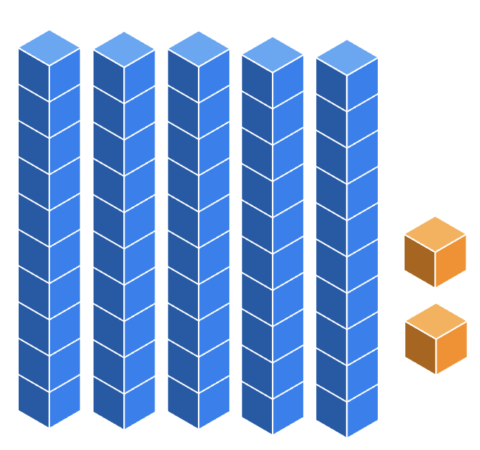
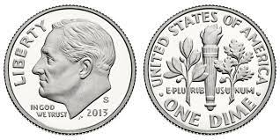
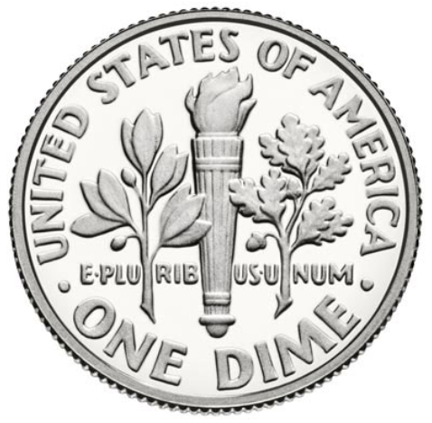
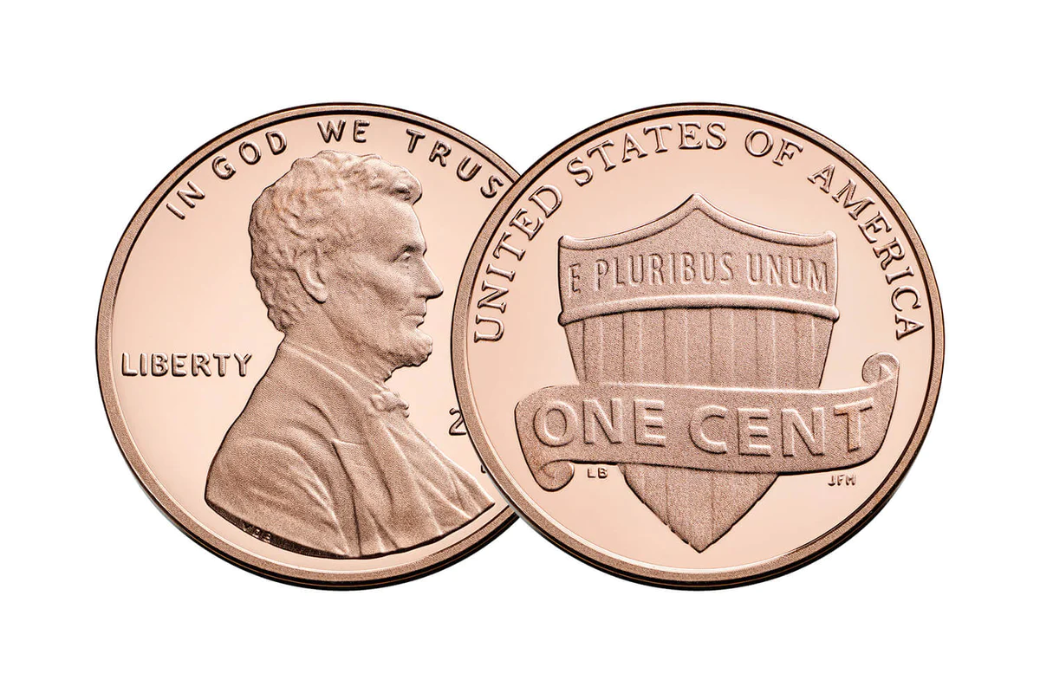
What is the same?
What is different?

Slide 4
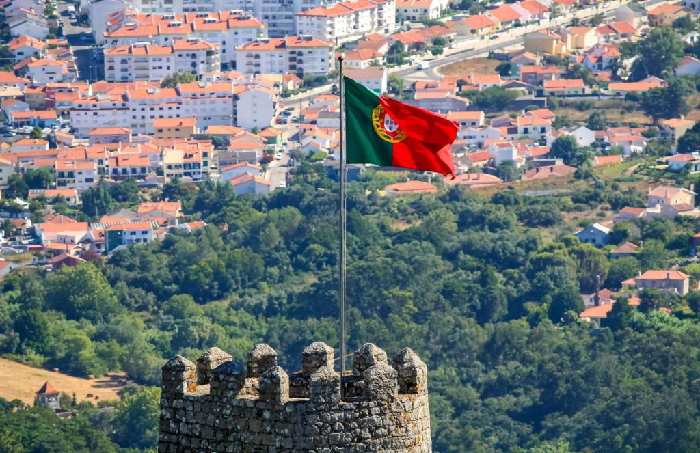
October 5th is Republic Day in Portugal!
How many different expressions can we write that equal 5?
(Think of subtraction!)

Slide 5
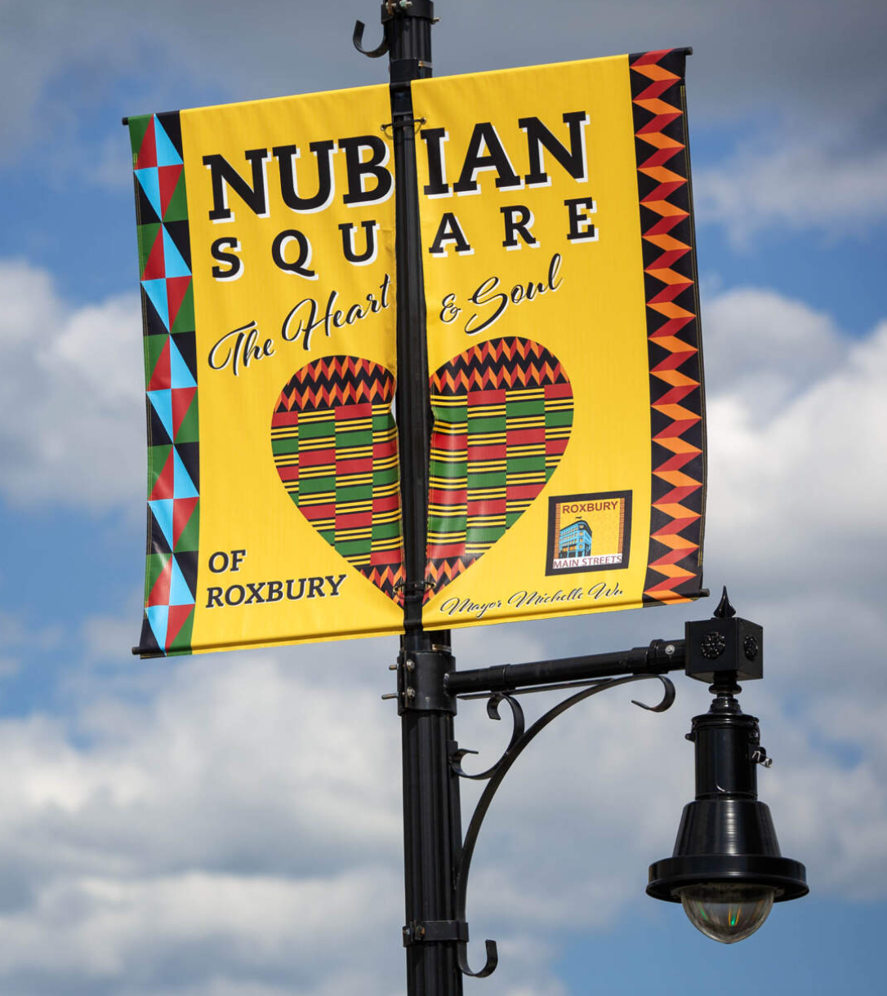
Shape detectives in Nubian Square!
What are some of the interesting shapes we see in this street banner?
What would happen if we PARTITIONED one of the shapes?

