Slide 1
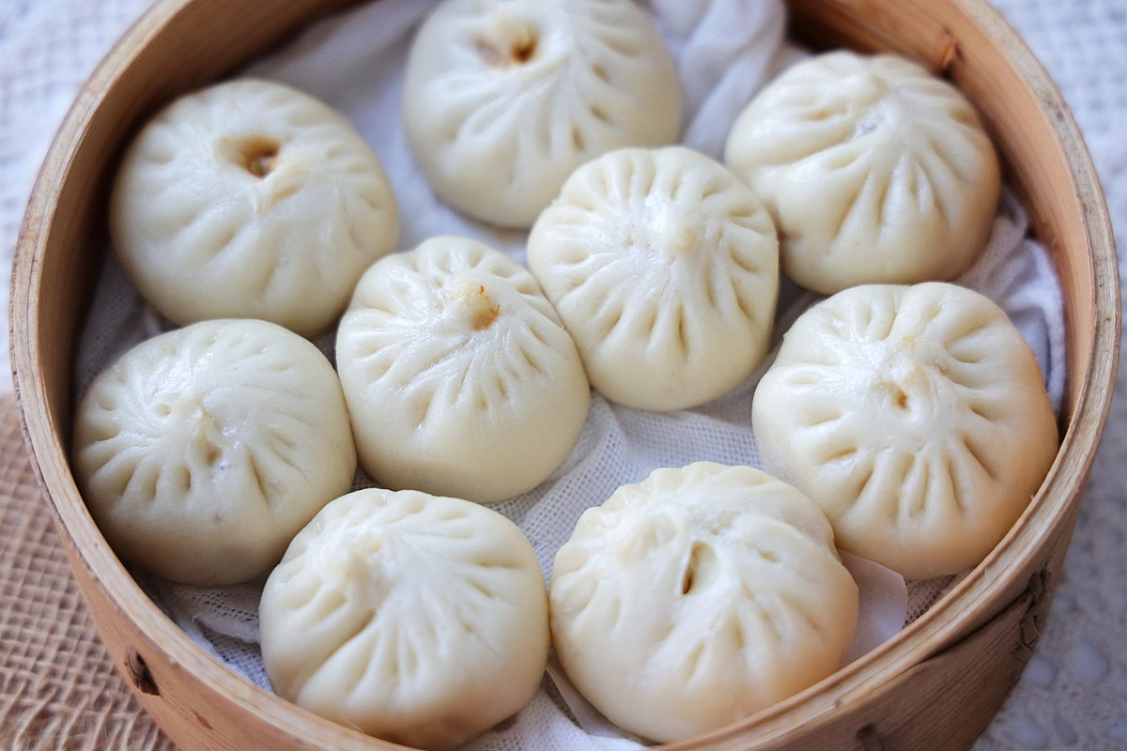
Happy Dumpling Day!
How many delicious dumplings are in the bamboo steamer?
How do we see them?
Let’s create an expression to match our thinking!
Notes:
Week 4
September 26 - 29

Slide 2
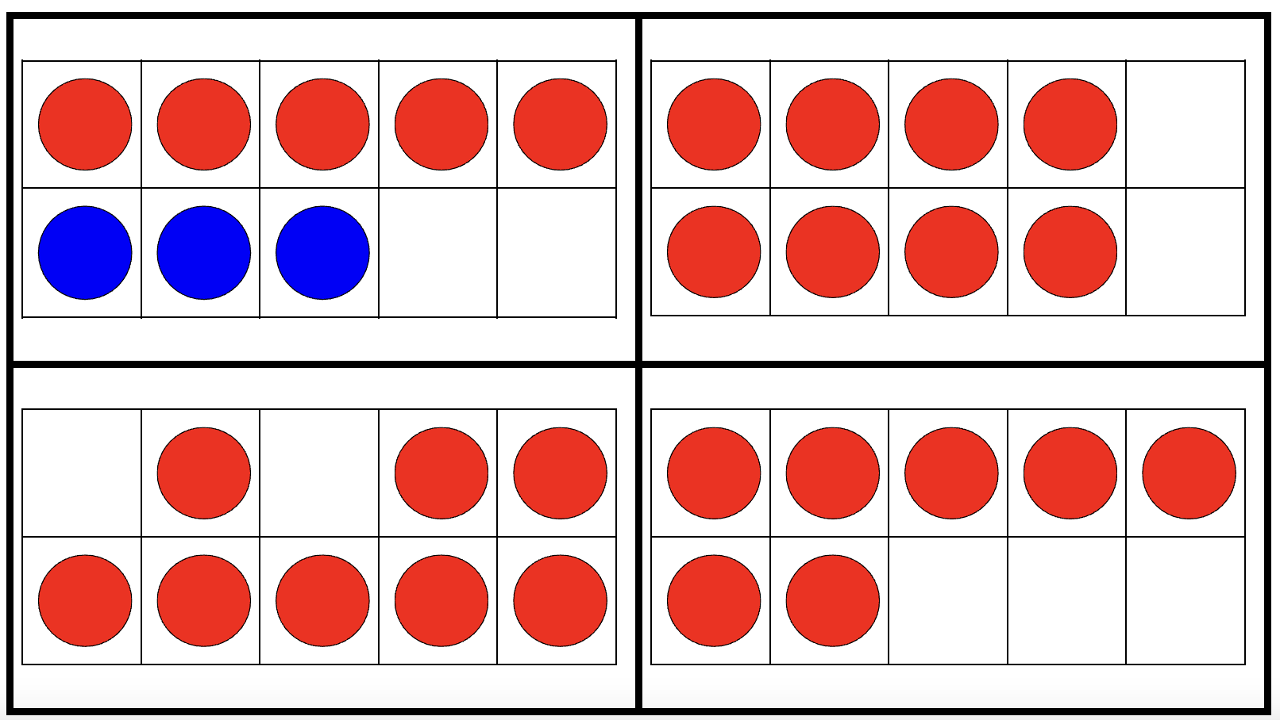
Which one doesn’t belong?
Notes:
TL: not all red
TR: double
BL: not full top row
BR: not eight

Slide 3
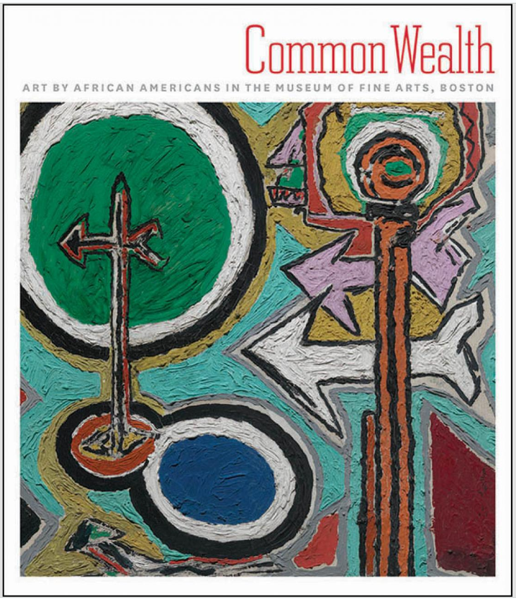
What shapes are hidden in this book cover?
What different shapes can we create with the arrows?

Slide 4
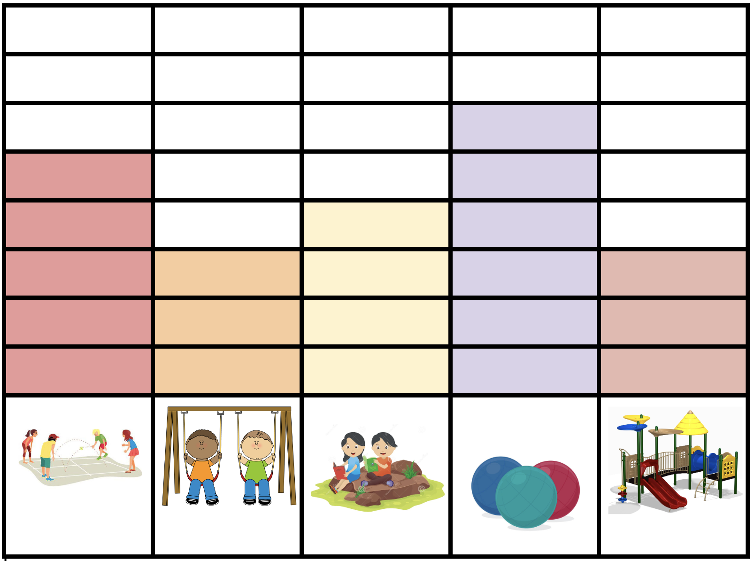
What do we notice?
What do we wonder?
What could we name this graph?

