Slide 1
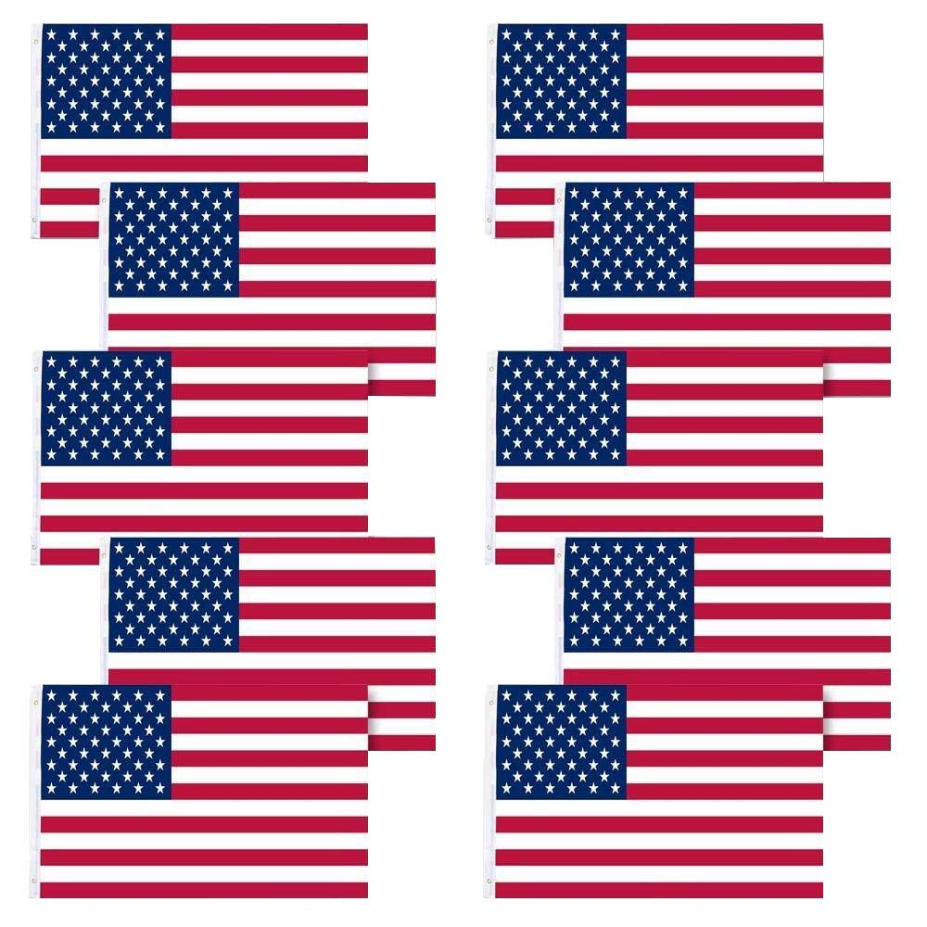
Happy
Constitution Day and Citizenship Day!
How many American Flags do we see?
How many different expressions can we think of that equal 10?
Do we know how many stripes are on each flag? Stars?
Notes:
Week 3
Week of September 18-22

Slide 2
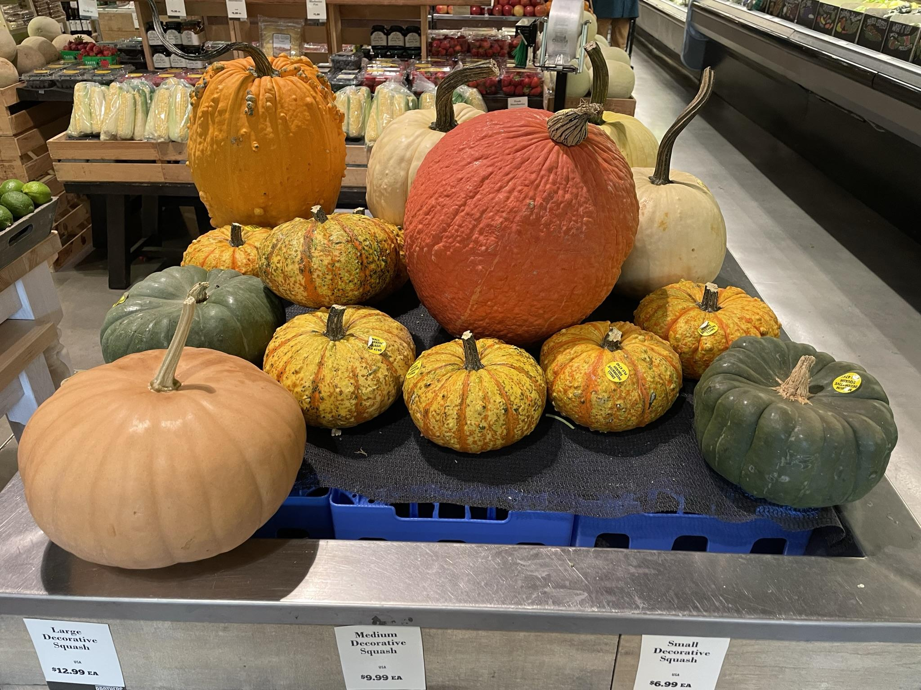
Look at all of the different pumpkins at Brother’s!
How many do we see?
How do we see them?
Can we create an expression to match our math thinking?

Slide 3

Let’s talk about the shapes we see in this photo from the John F. Kennedy Library in Dorchester.
How many different shapes can we find?

Slide 4
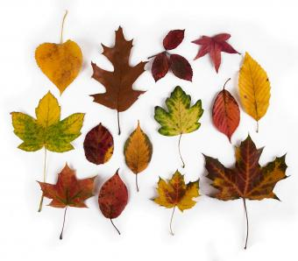
Fall Leaves!
How many are here?
Can we create an expression to match our thinking?
How might we sort them?

Slide 5
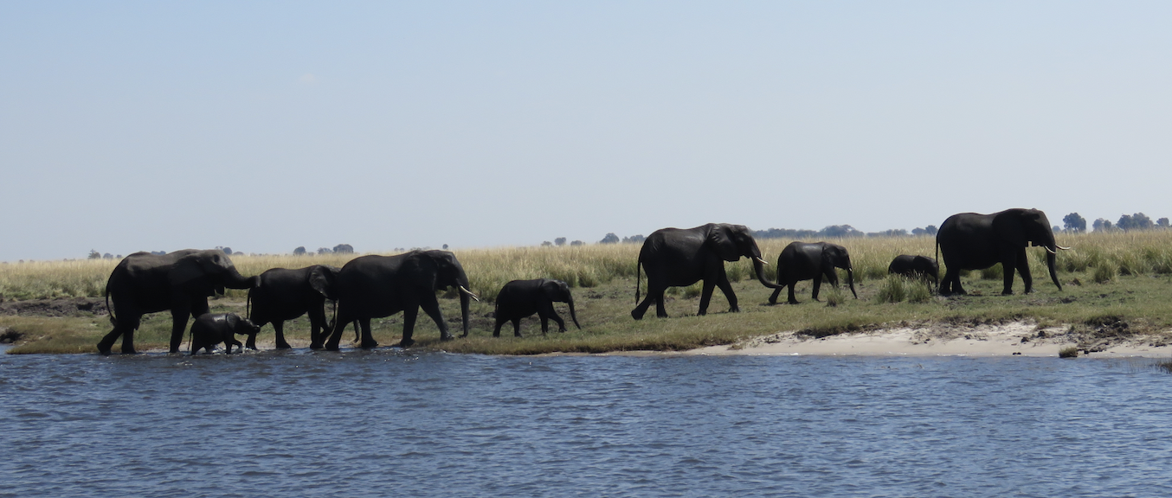
Today is National Elephant Appreciation Day!
Photo by Celia M.
How many elephants do we see? How do we see them? How many different expressions can we create to match our math thinking?
How many elephant ears? How many elephant legs?

