Slide 1
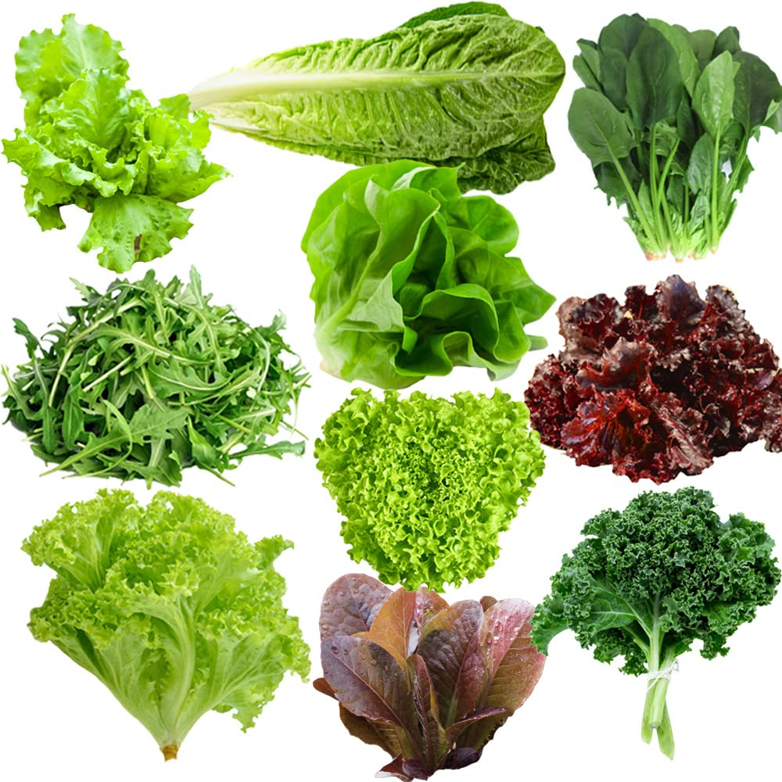
May is National Salad Month!
Here are 10 different kinds of lettuce.
How many ways can we make 10?
Notes:
Week of May 1, 2023

Slide 2
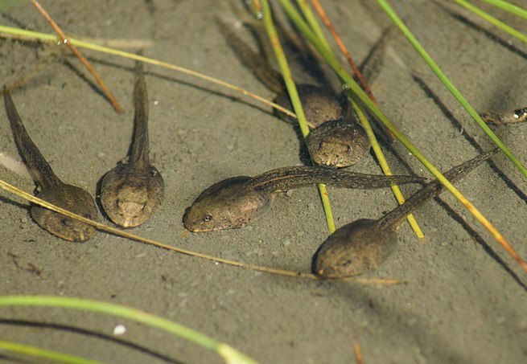
Tadpoles!
How many tadpoles are here?
If they each weigh 2 grams, how much do they weigh altogether?

Slide 3
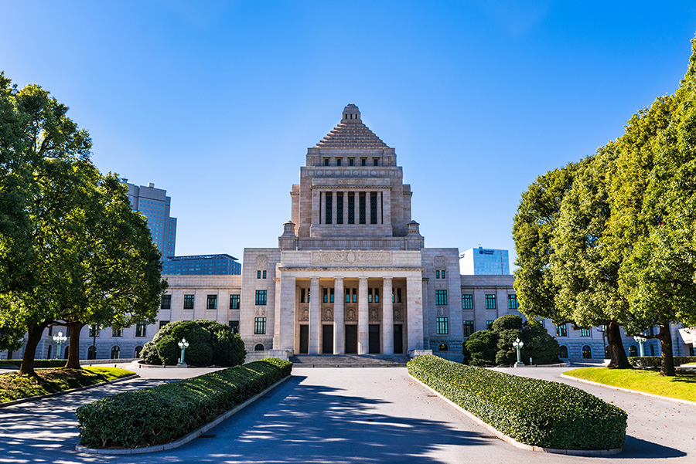
Today is Constitution Memorial Day in Japan!
Be a shape detective!
What shapes are hidden in this photo?

Slide 4
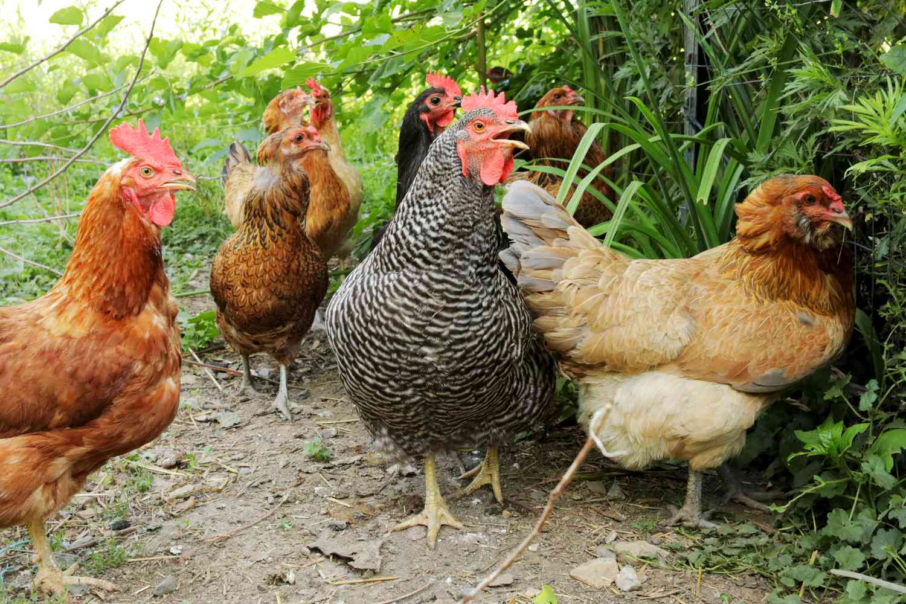
Happy International Respect for Chicken Day!
How many chickens are here?
How many chicken legs?
How many chicken eyes?

Slide 5
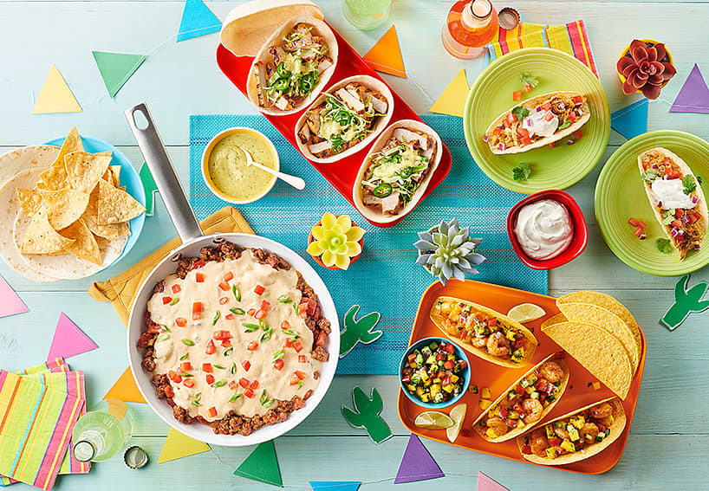
Happy Cinco de Mayo!
Where do we see triangles in this picture?
What other fun shapes do we see?

Slide 6
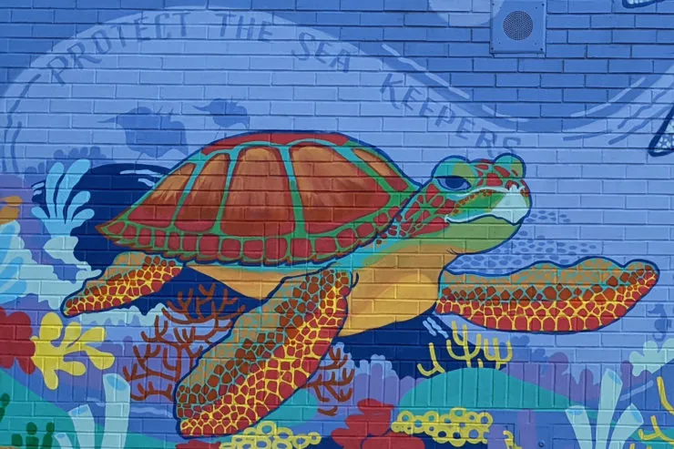
How can we count the bricks in this mural at the Donald McKay School in Boston?
Can we count by 2s?
5s?
10s?
What would be more fun?
“Sea Keepers” by Sabrina Dorsainvil
Notes:
Week of May 8, 2023

Slide 7
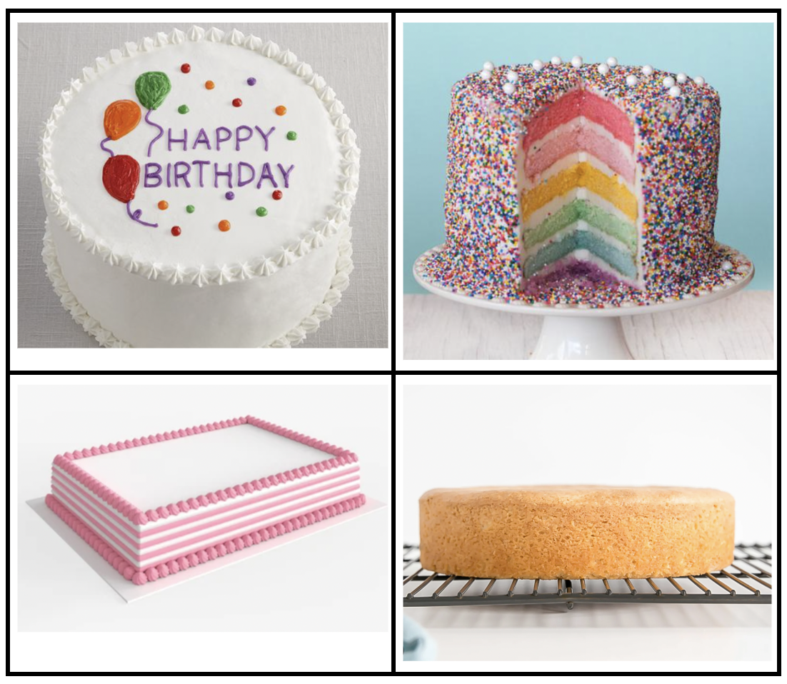
Which one doesn’t belong?
What do they all have in common?

Slide 8
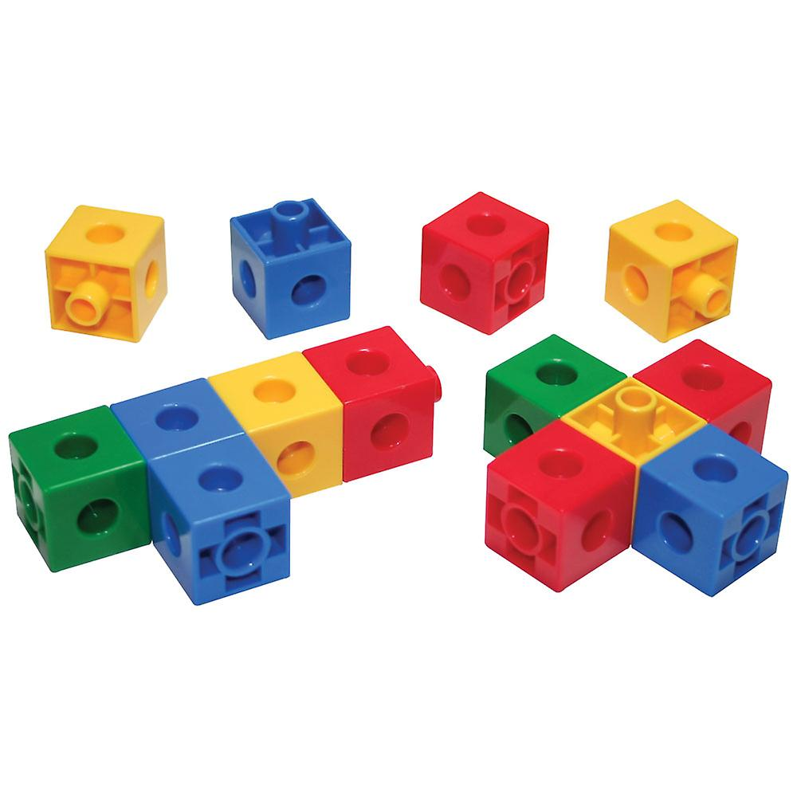
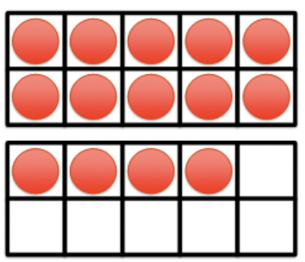
What is the same? What is different?

Slide 9
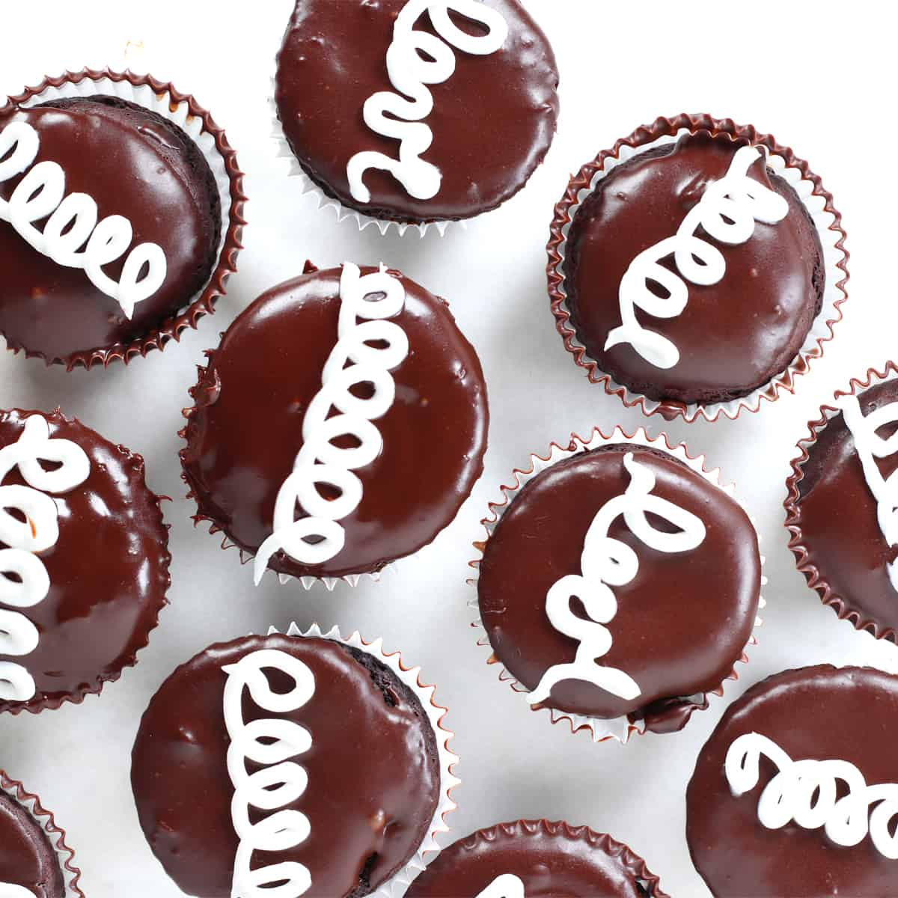
Happy Hostess Cupcake Day!
How many do we see?
How many don’t we see?
How many altogether?
Can we create a number sentence to match our thinking?

Slide 10
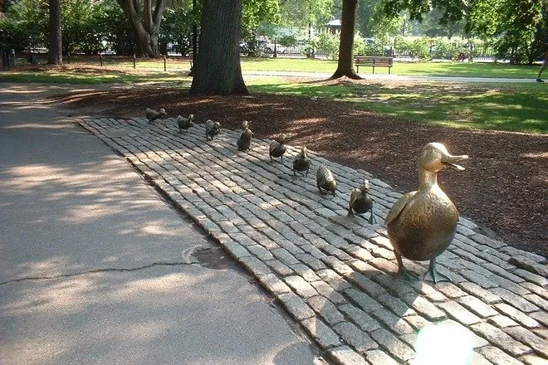
Today is National Public Garden Day!
Let’s create number sentences to match this photo of “Make Way For Ducklings” at the Boston Public Garden.

Slide 11
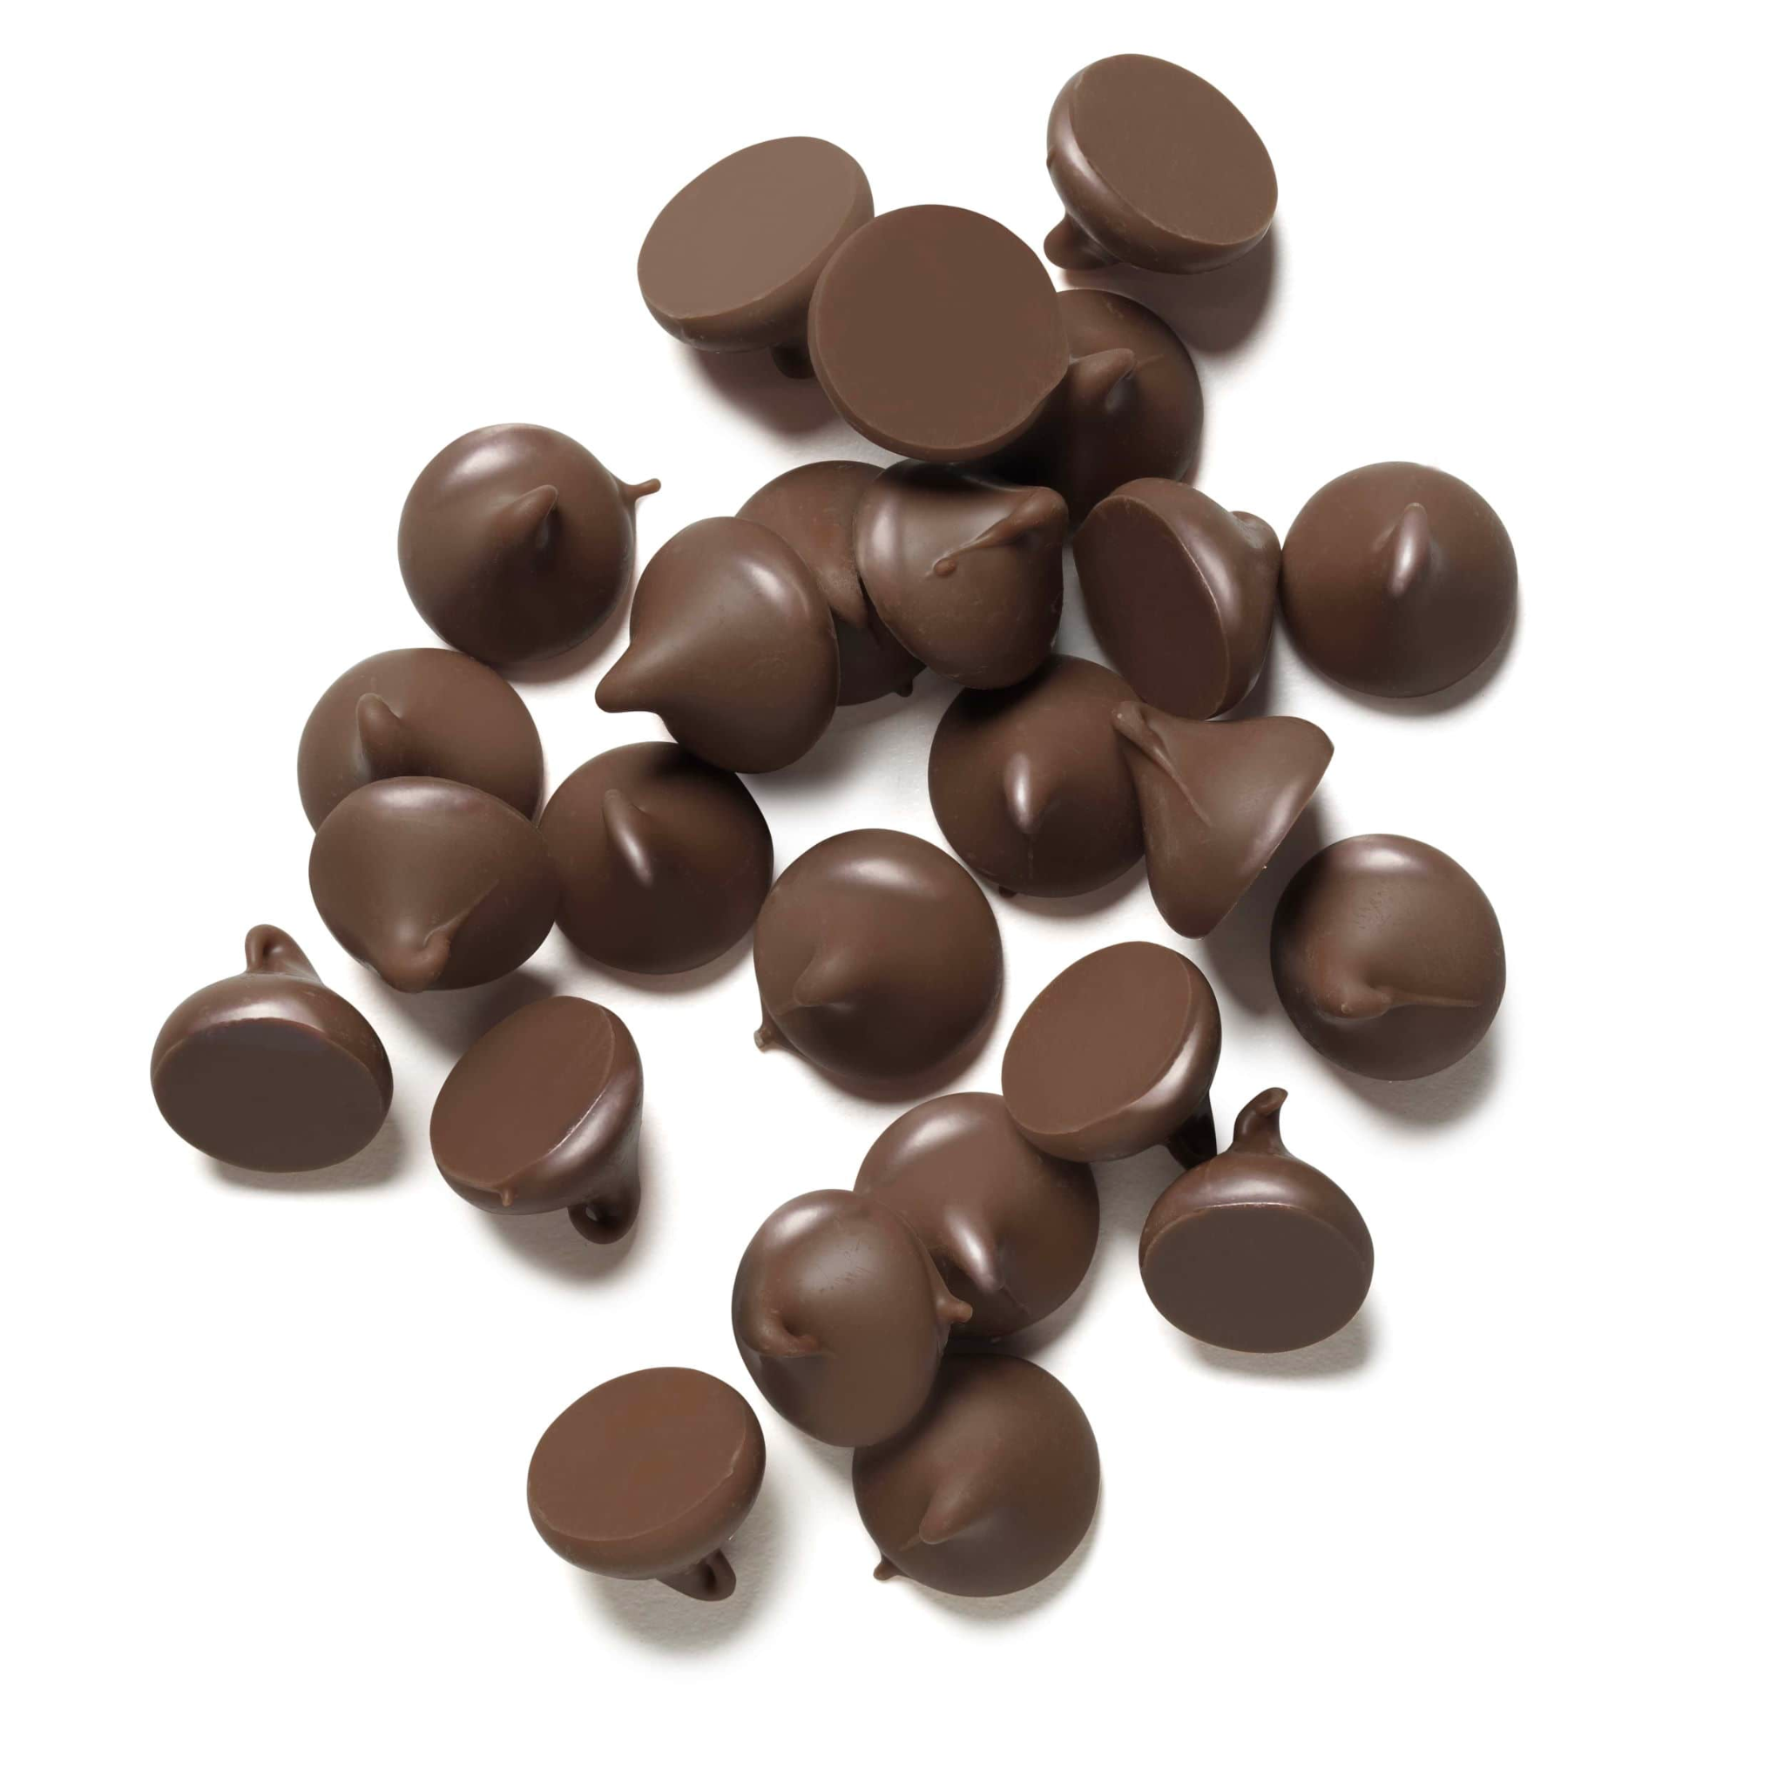
Today is National Chocolate Chip Day!
Do we think there are more than 20 chips here, or less?
How do we know?
How many different ways can we count them?
Notes:
Week of May 15, 2023

Slide 12
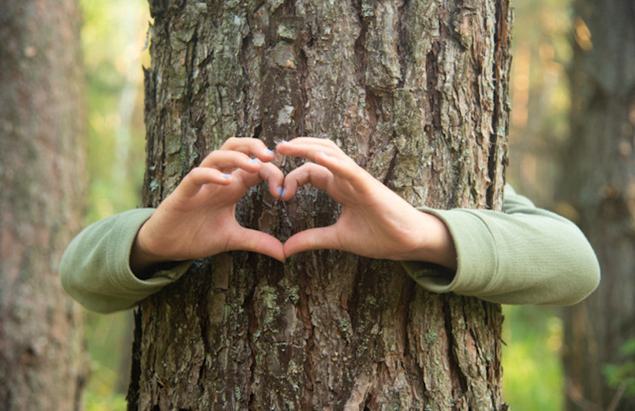
Today is LOVE a Tree Day!
How high do we think a tree is?
What if we measured the height of a tree in children!
Estimate how many kindergarten students high a tree on our playground is!

Slide 13
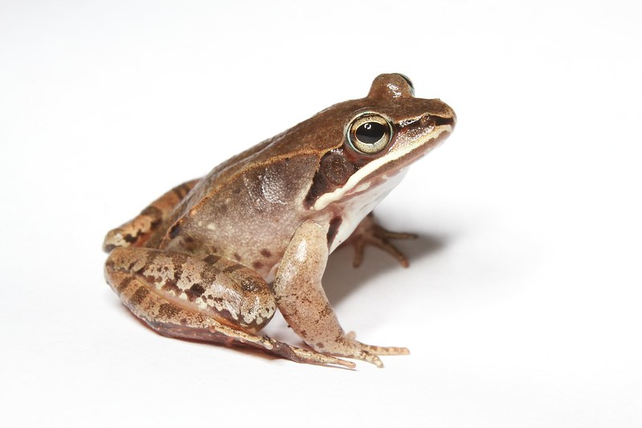
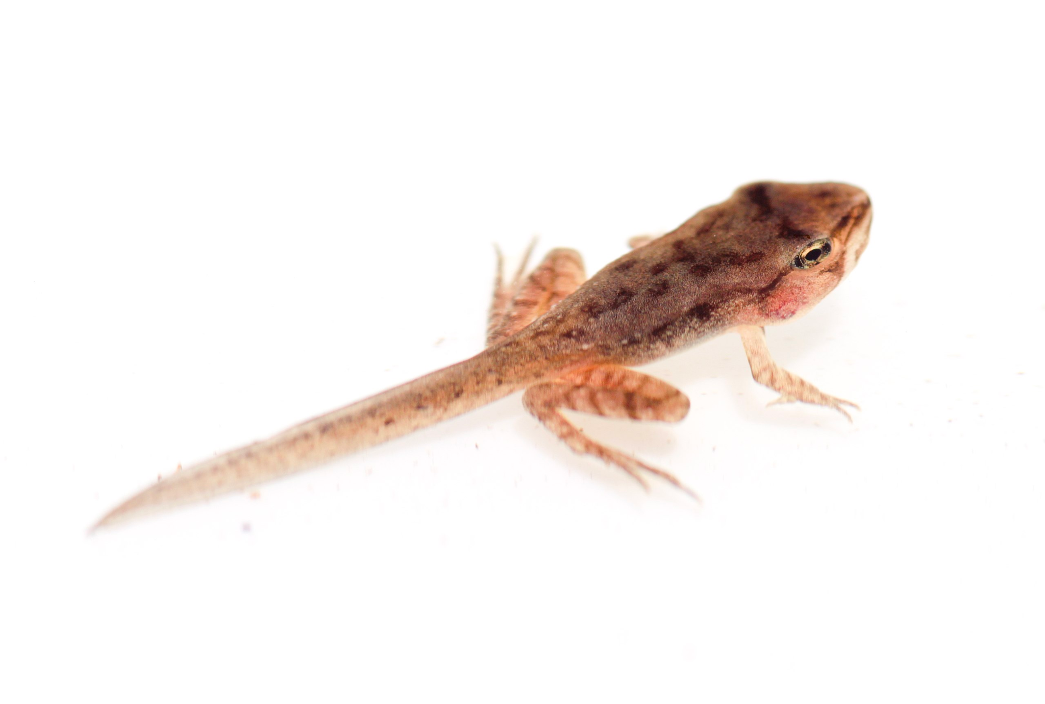
How can we compare these two amphibians?

Slide 14
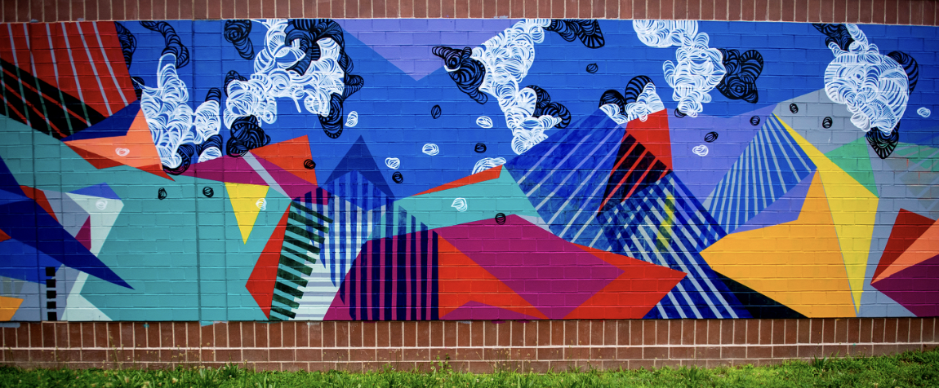
Let’s find hidden shapes in this Boston mural, “Dreaming isn’t so concrete” by Destiny Palmer.

Slide 15
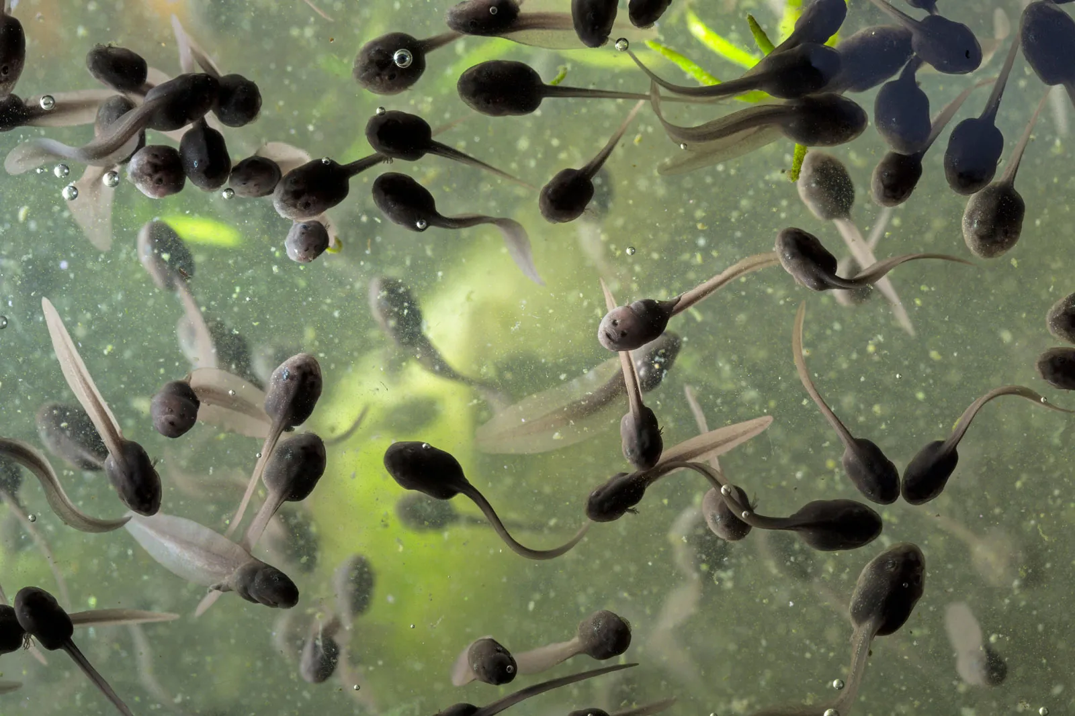
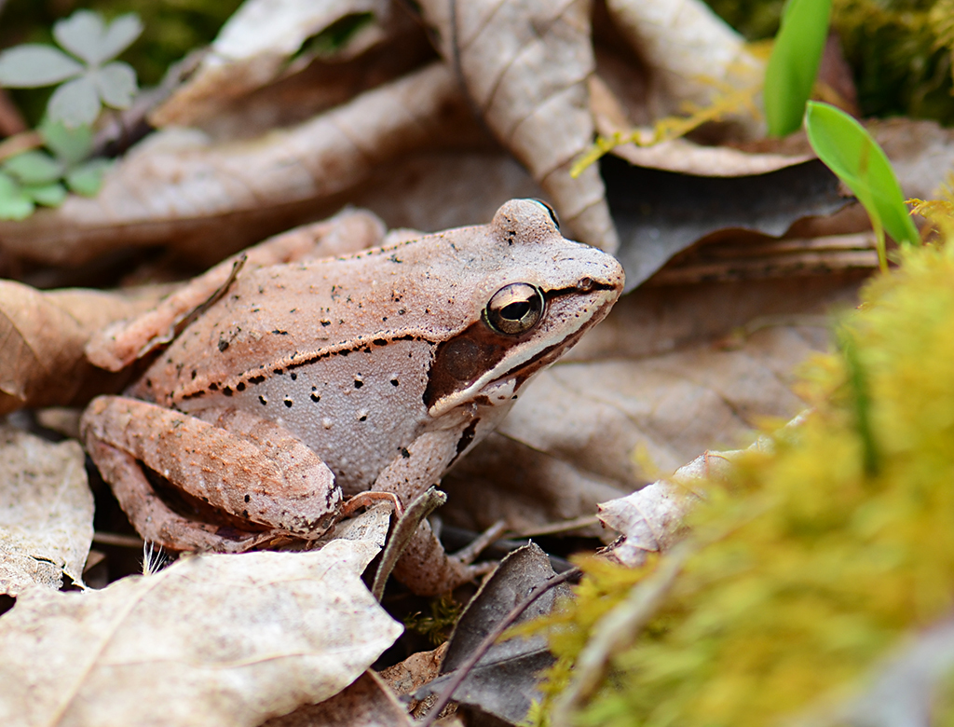
What is the same? What is different?

Slide 16
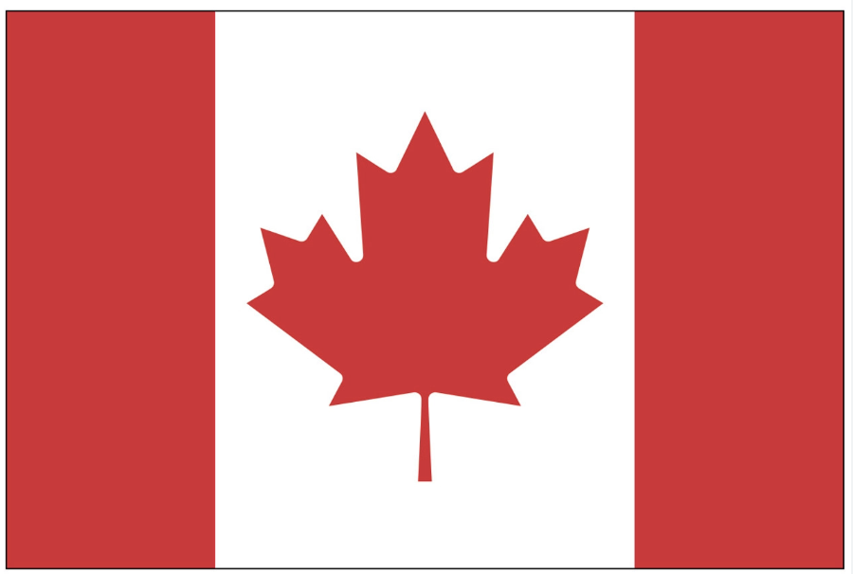
Today is Victoria Day in Canada!
What interesting shapes can we make with the Maple Leaf in the Canadian Flag?
Notes:
Week of May 22, 2023

Slide 17
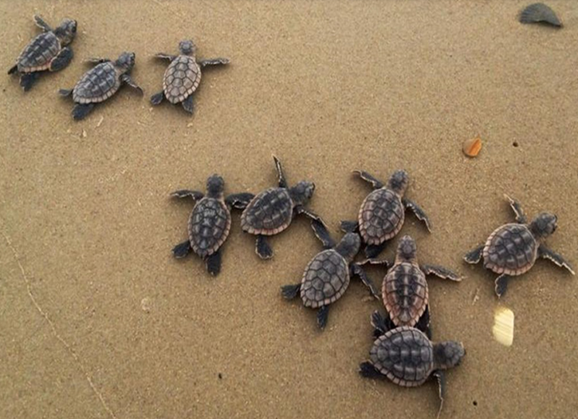
It is World Turtle Day!
How many hatchlings are on the beach?
How can we count them?
Can we create an equation to match this photo?

Slide 18
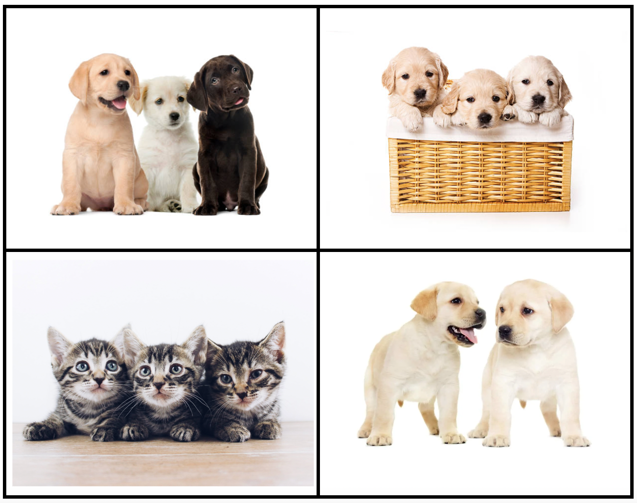
Which one doesn’t belong?
What do they all have in common?

Slide 19

Today is Independence Day in Jordan!
What do we notice about the flag of Jordan?
What fun shapes can we create from the shapes that are in the flag?

Slide 20
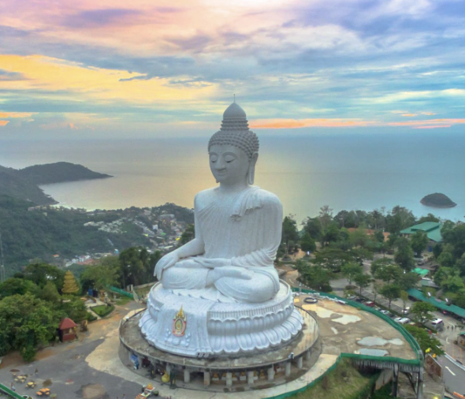
Happy Buddha Day!
The Great Buddha of Phuket is one of Thailand’s biggest statues!
How does it compare to how tall you are?

