Slide 1
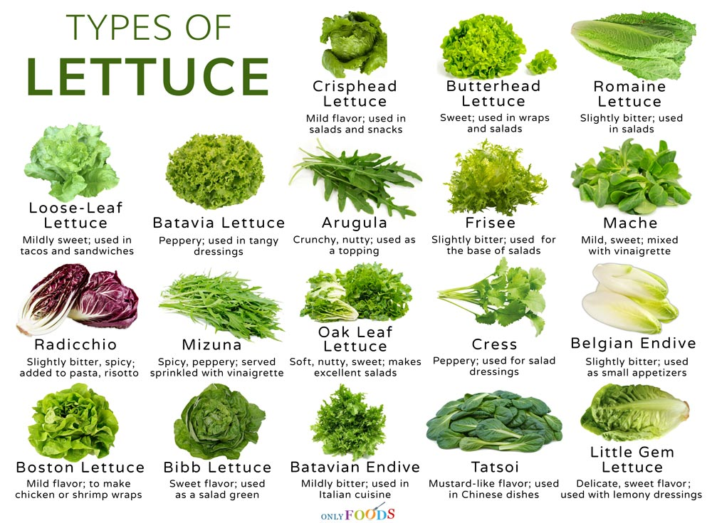
Happy Lettuce Month!
How many types of lettuce are here?
Create an expression that matches this lettuce poster!
Notes:
Week of May 1, 2023

Slide 2
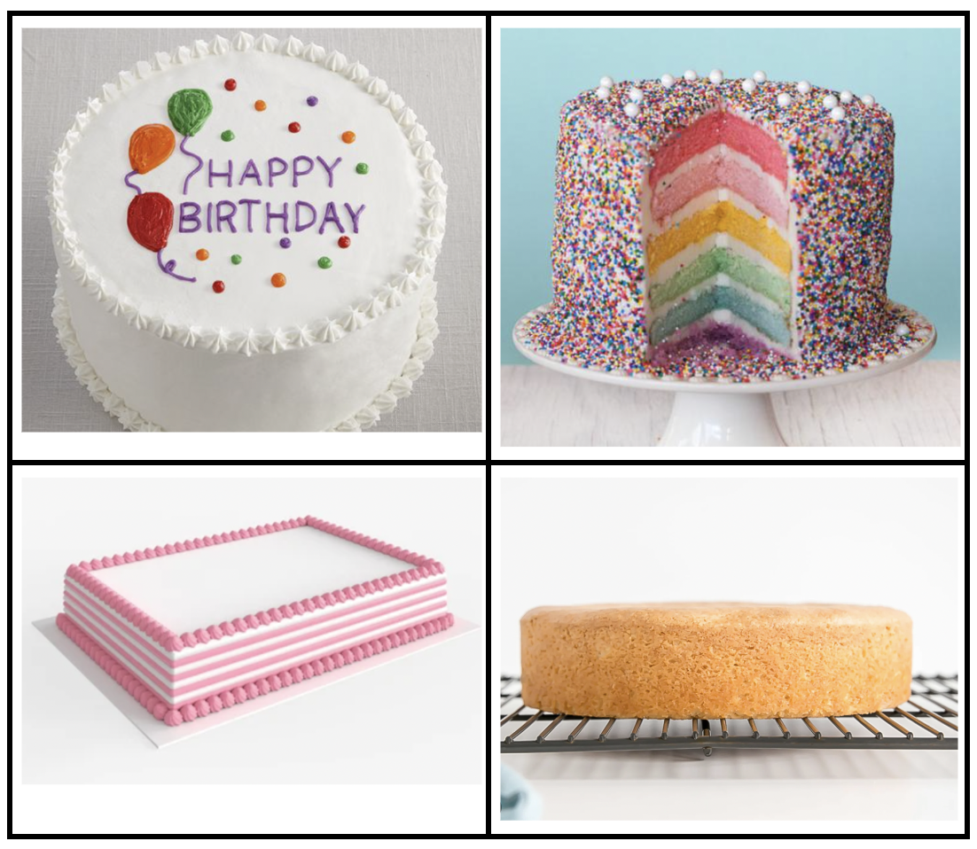
Which one doesn’t belong?
What do they all have in common?

Slide 3
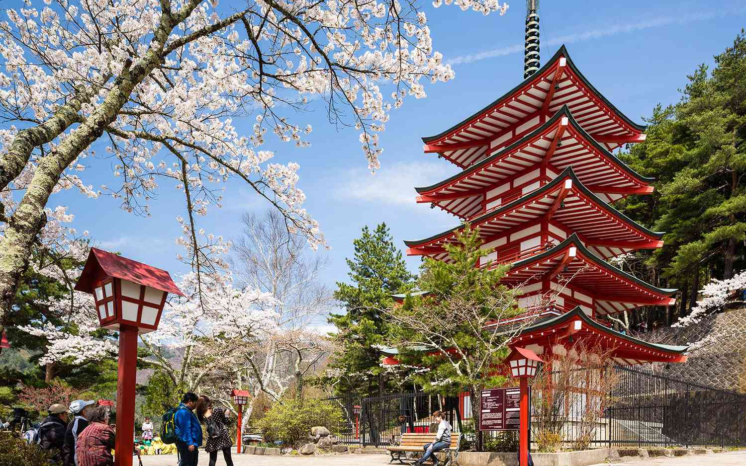
Today is Constitution Memorial Day in Japan!
Be a shape detective!
What shapes are hidden in this photo?

Slide 4
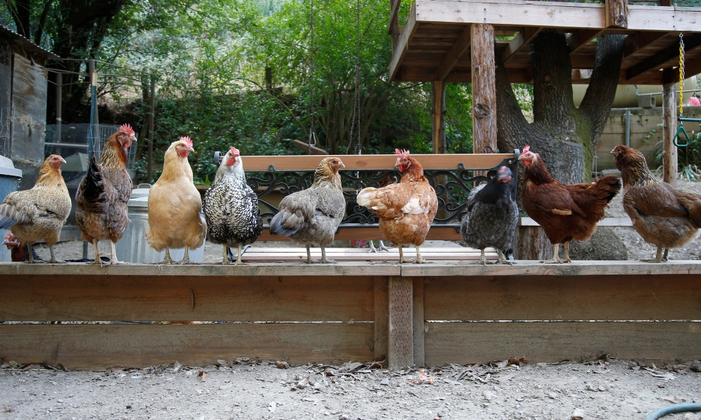
Happy International Respect for Chicken Day!
How many chickens are here?
If each chicken weighs 11 pounds, how much do they weigh altogether?
How can we solve this?

Slide 5
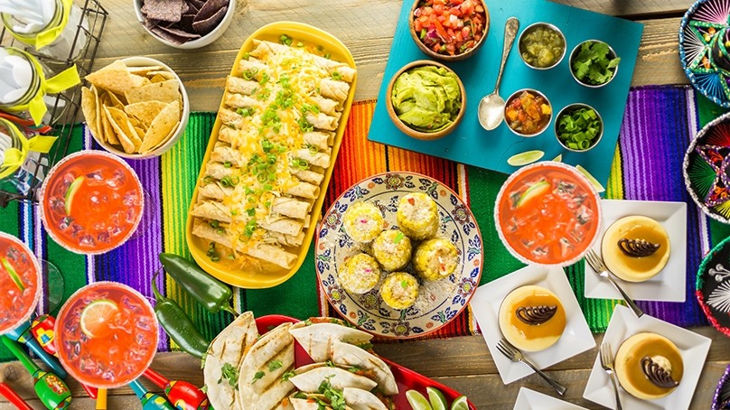
Happy Cinco de Mayo!
Where do we see triangles in this picture?
What other fun shapes do we see?

Slide 6
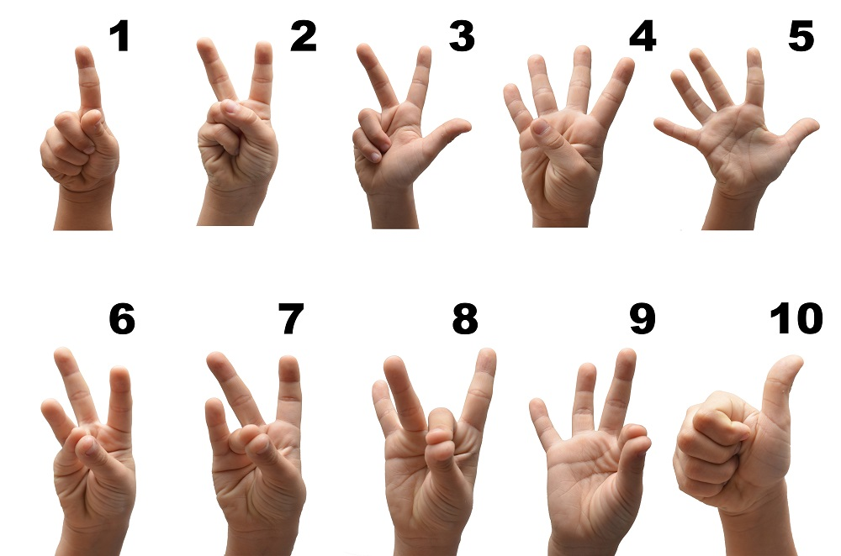
It’s Sign Language Week!
What do you notice?
What do you wonder about the numbers 1-10?
What might 20 look like?
Notes:
Week of May 8, 2023

Slide 7
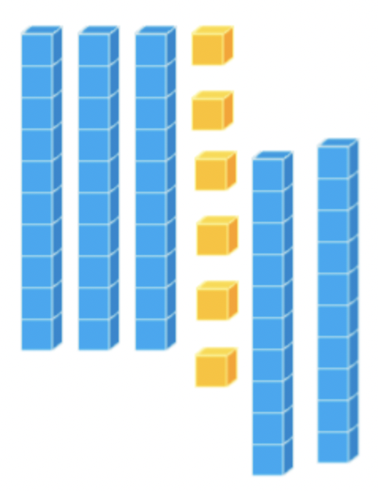
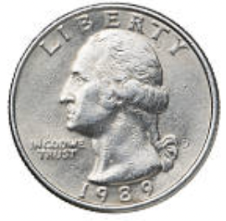
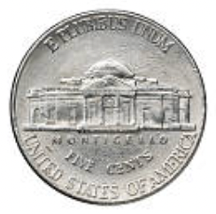
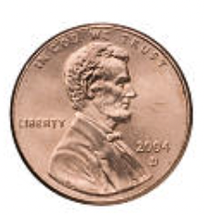
What’s the same? What’s different?

Slide 8
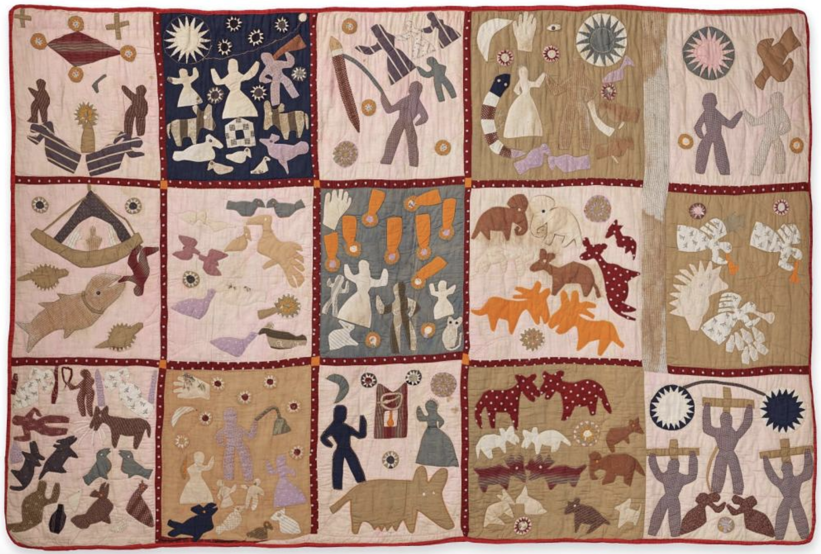
What do we notice about this Harriet Powers quilt at the MFA?
What MATH do we see?

Slide 9
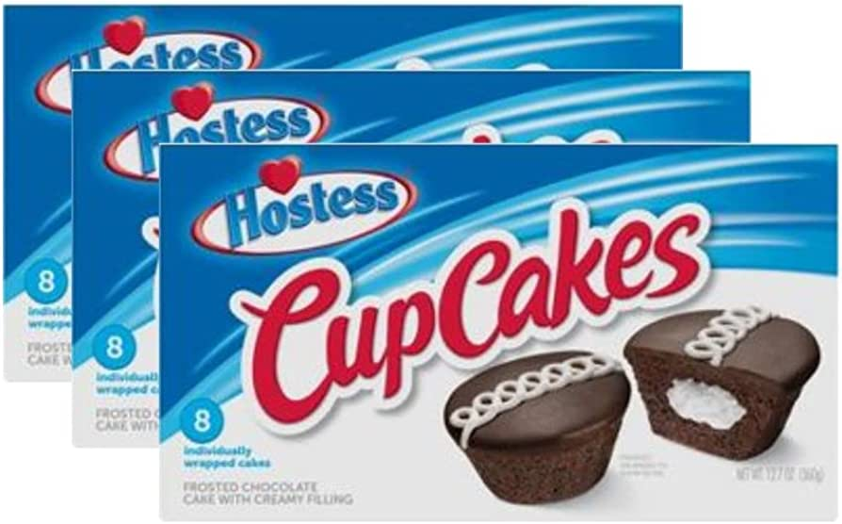
Happy Hostess Cupcake Day!
How many cupcakes in each box?
How many cupcakes are in all three boxes?

Slide 10
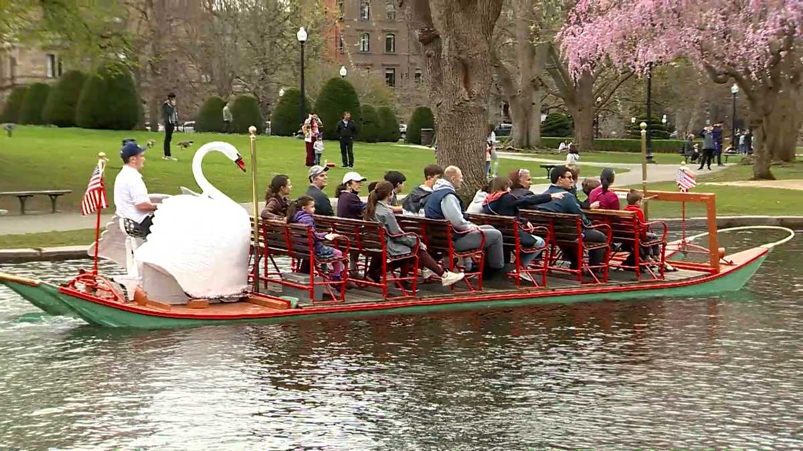
Today is National Public Gardens Day!
How many benches are on this swan boat?
If 4 people can sit on each bench, how many people can ride on one swan boat?

Slide 11
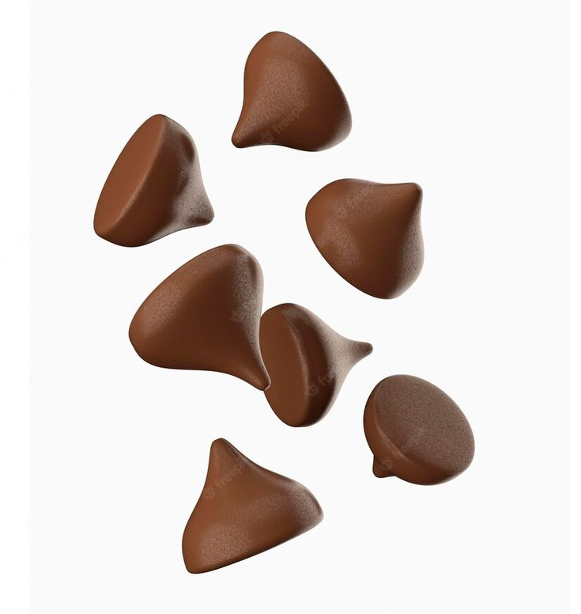
Happy Chocolate Chip Day!
How many chips are here?
If each of these chocolate chips weighs 3 grams, how much do they weigh altogether?
Notes:
Week of May 15, 2023

Slide 12
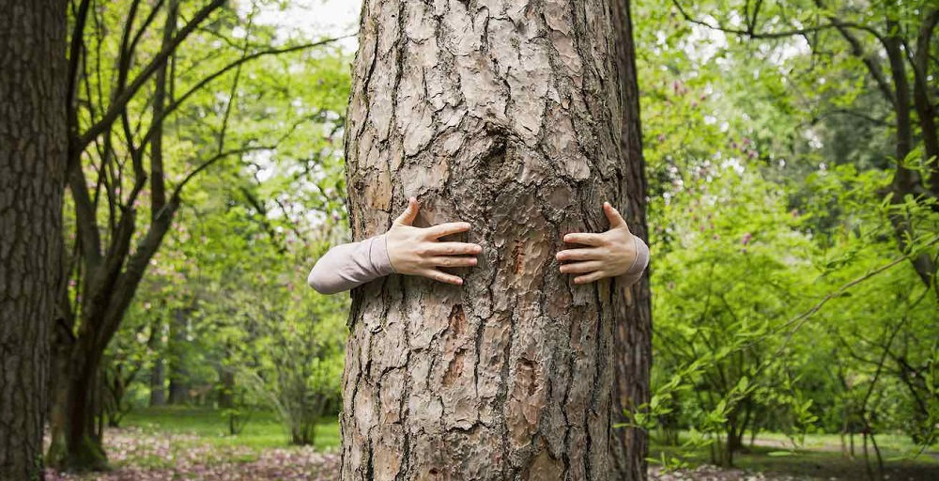
Happy Love a Tree Day!
How would you measure around a tree?
Do your arms fit around your favorite tree?

Slide 13
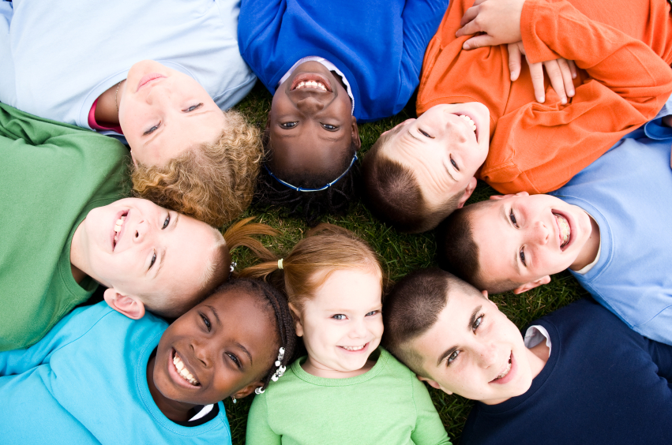
Happy National Smile Day!
Did you know that children smile about 400 times a day!!!
How many different ways can we represent the number 400?

Slide 14
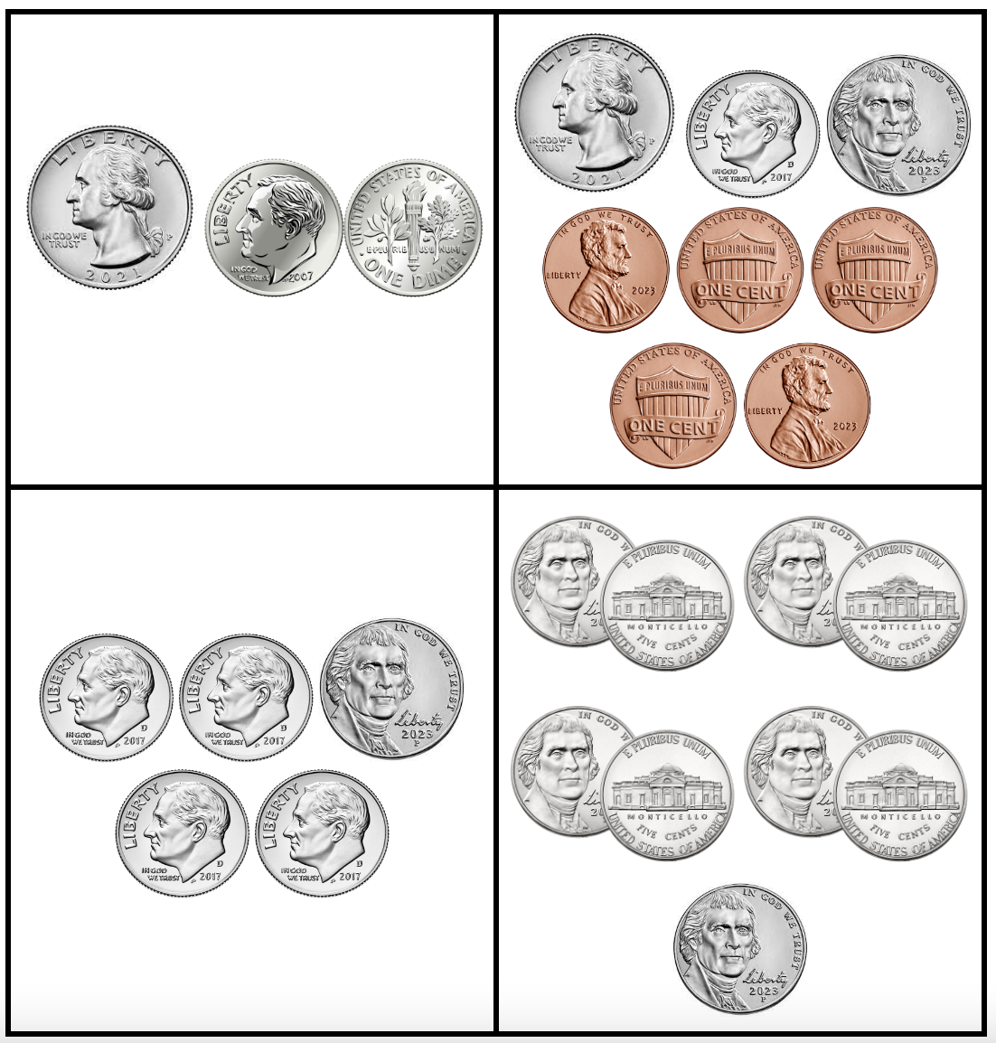
Which one doesn’t belong?
What do they all have in common?

Slide 15
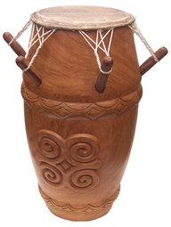
What is the same?
What is different?

Slide 16
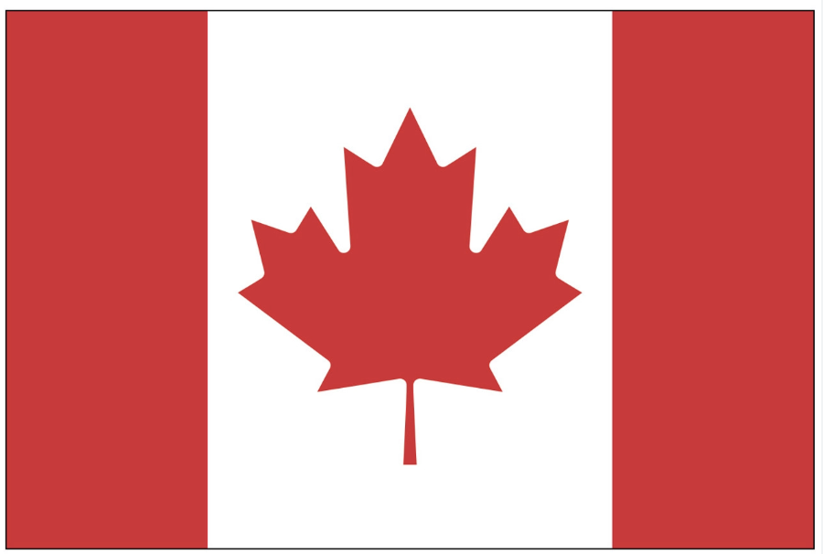
Today is Victoria Day in Canada!
What interesting shapes can we make with the Maple Leaf in the Canadian Flag?
Notes:
Week of May 22, 2023

Slide 17
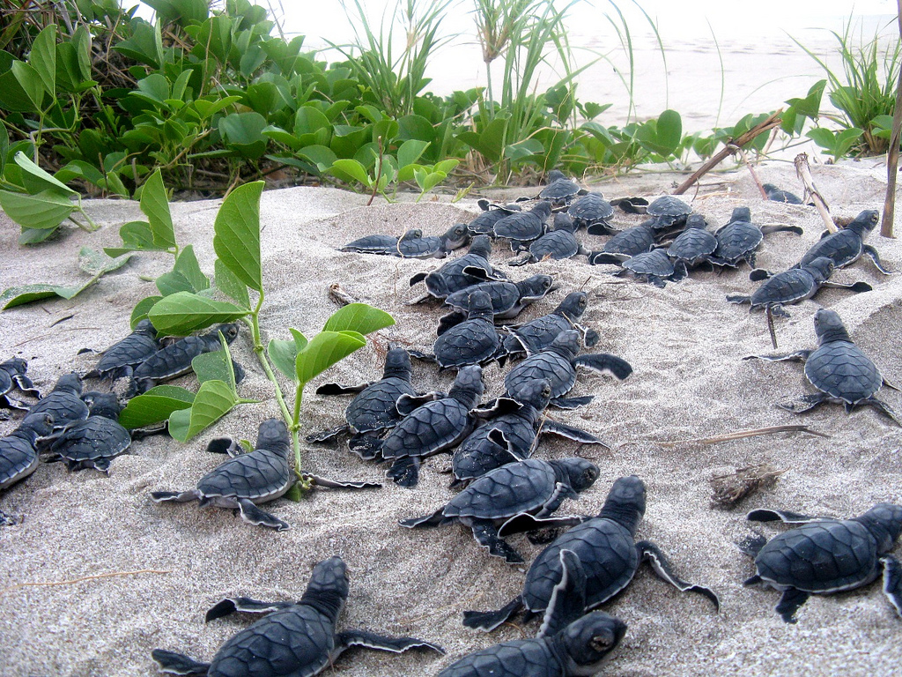
Today is World Turtle Day!
Estimate how many hatchlings are making their way to the ocean!
Are there more than 20?
How do you know?

Slide 18
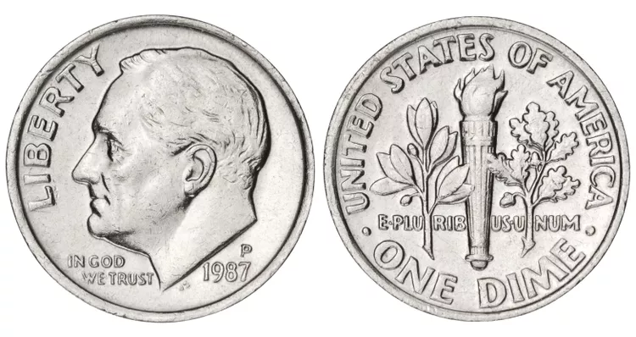
What is the same?
What is different?

Slide 19

Today is Independence Day in Jordan!
What do we notice about the flag of Jordan?
What fun shapes can we create from the shapes that are in the flag?

Slide 20
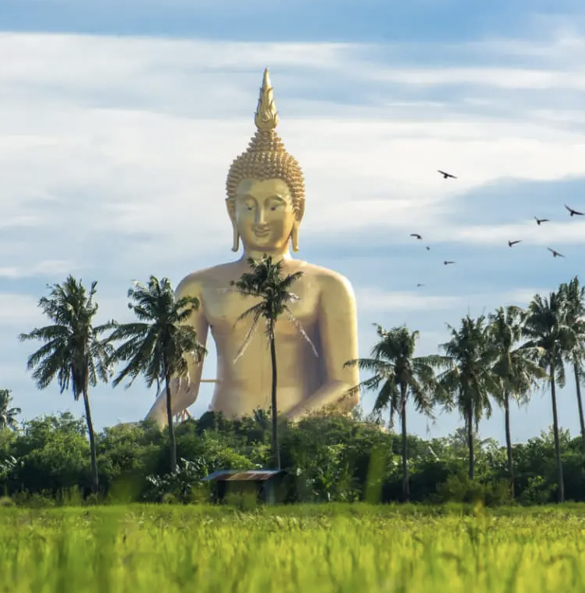
Happy Buddha Day!
Phra Buddha Maha Nawamin is the tallest Buddha statue in Thailand!
How does it compare to how tall you are?

