Slide 1


Slide 2
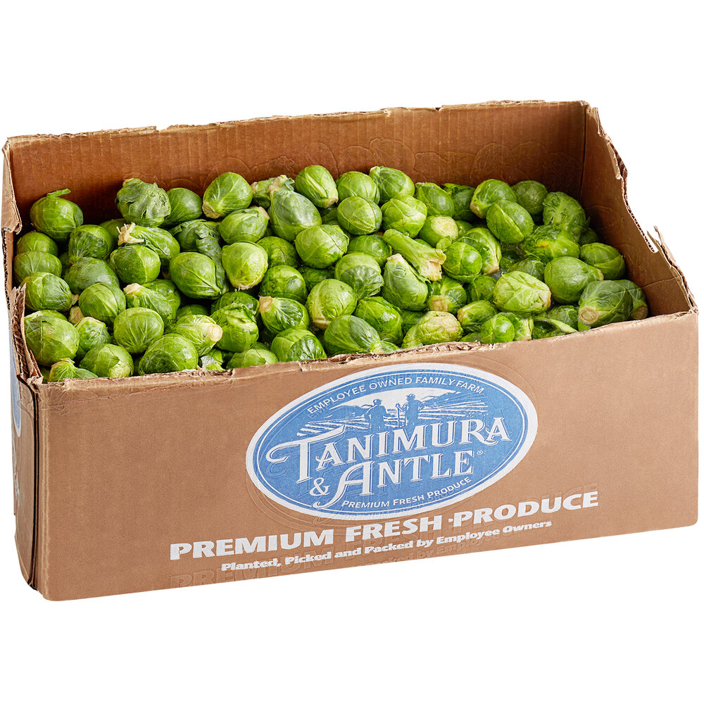
April is National Brussel Sprout Month!
Estimate how many brussel sprouts are in this crate.
If there are about 23 sprouts per pound, and this crate weighs 25 pounds, how many sprouts are here?
How can we use mental math to solve this?
Notes:
Week of April 3, 2023

Slide 3
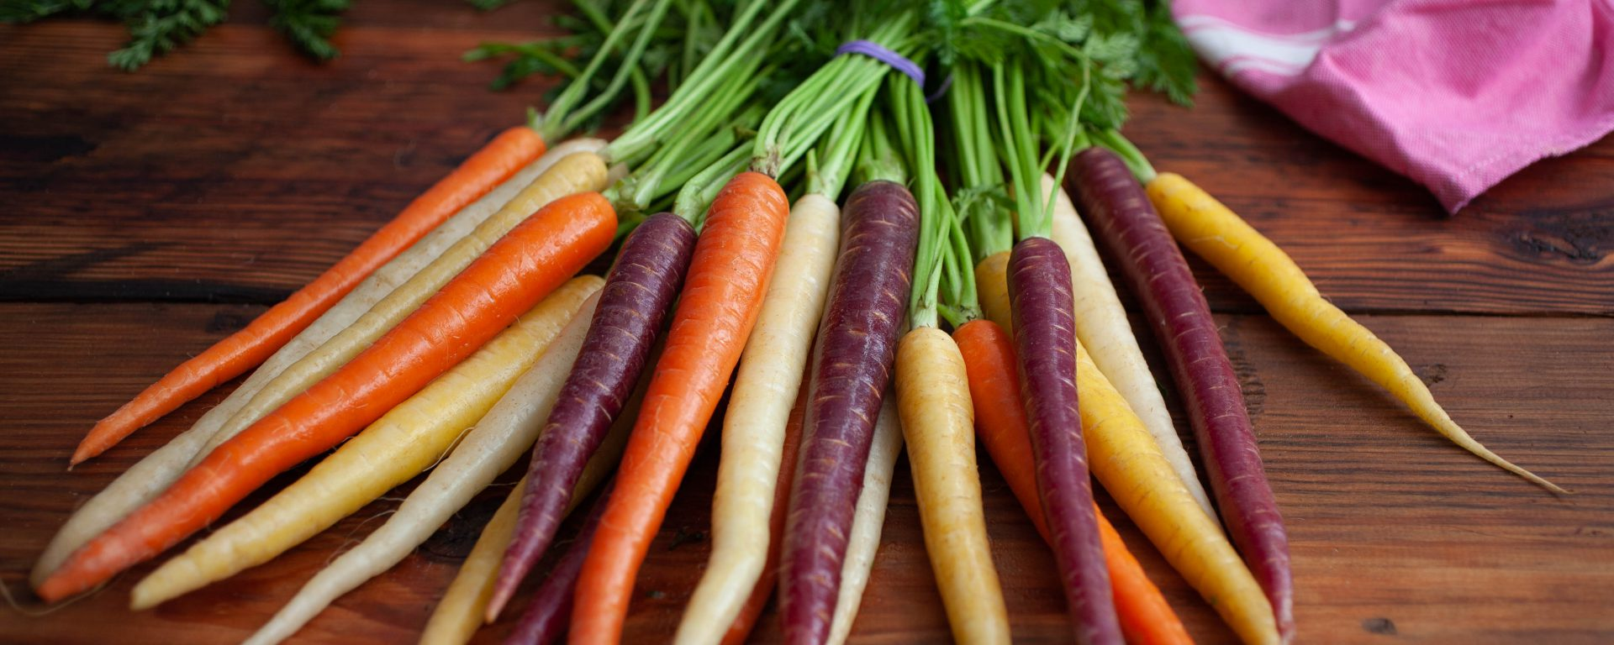
It’s International Carrot Day!
If each of these carrots weighs 6 ounces, how much does the bunch weigh?
How can we use mental math to solve this?

Slide 4
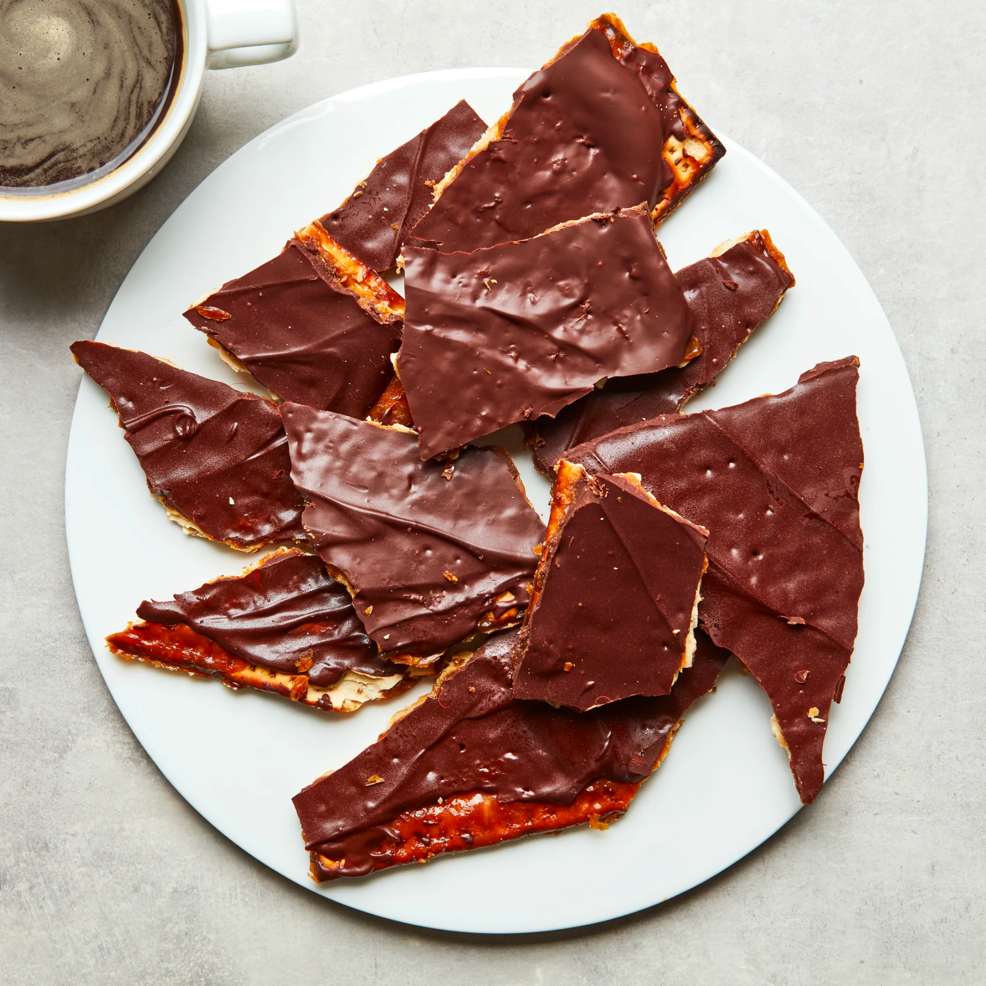
Happy Passover
What shapes do we see in this plate of matzo crunch?
Sketch one of the shapes and partition it.
What shape to you have now?

Slide 5
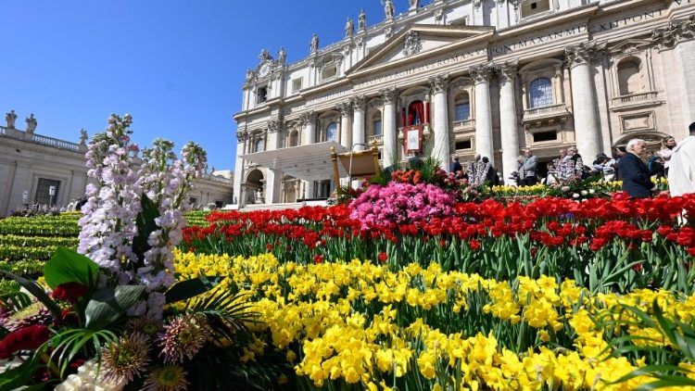
Happy Easter!
The independent state of Vatican City came into existence on February 11, 1929.
How long ago was that?
What are some strategies we can use to figure it out?

Slide 6
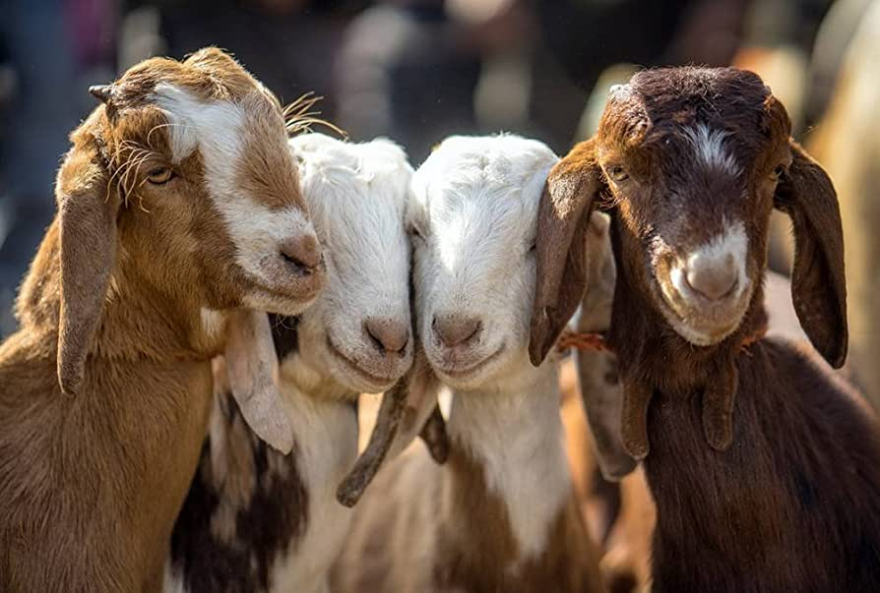
It’s National Farm Animal Day!
Meet Cabra, Chevre, Shanyang, and Bakaree!
Together they weigh close to 600 pounds.
What is possible?

Slide 7

Breathe Life 3 by Rob Gibbs is 3 stories high.
Estimate that height.
Fun Fact: The children in this mural are signing “breathe life.”

Slide 8

Standing at a staggering 138-feet (42-meters) tall, the India Gate is one of the most recognizable landmarks in India.
How MANY TIMES taller is it than you?

Slide 9
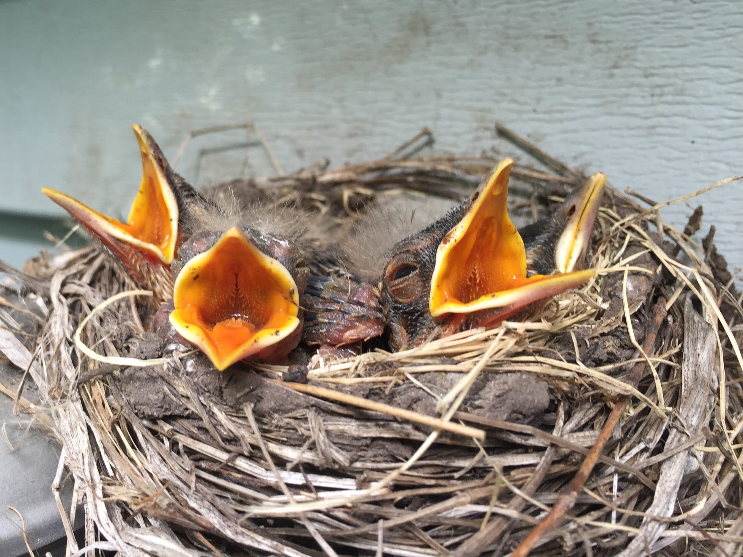
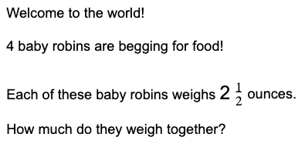
Happy
Spring!

Slide 10
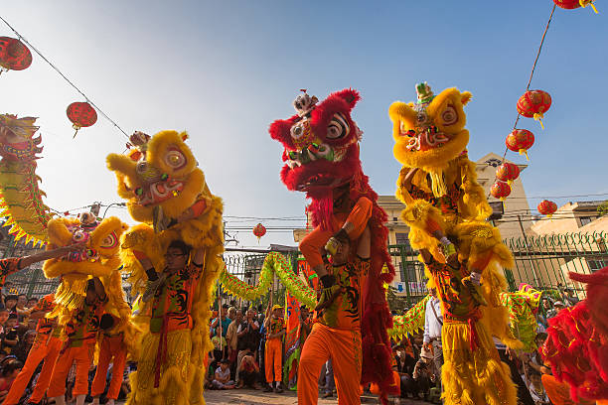
Today is the Hung King Festival in Vietnam!
Vietnam declared independence from France in 1945.
How long ago was that?
How can we use mental math to figure it out?

