Slide 1


Slide 2
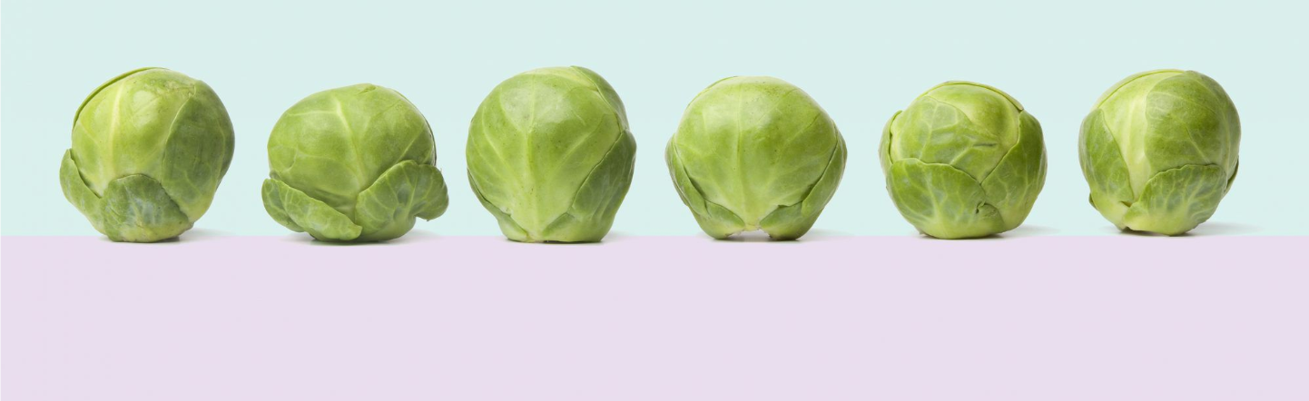
April is National Brussel Sprout Month!
What tool would you use to measure a sprout?
Estimate how long one would be!
If each of these sprouts measured 3 centimeters,
how long is this row of brussel sprouts?
2.NBT.A2
Notes:
Week of April 3, 2023

Slide 3
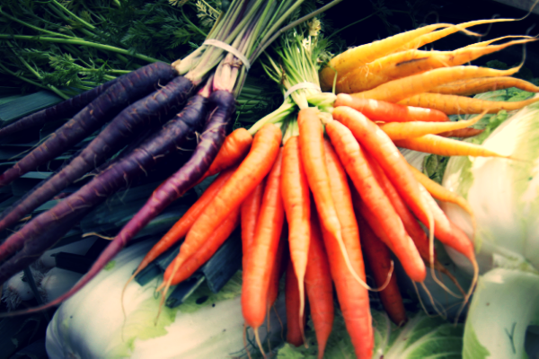
Today is International Carrot Day
Estimate how many carrots are in these bunches.
There are 38 carrots altogether,
What is possible?

Slide 4
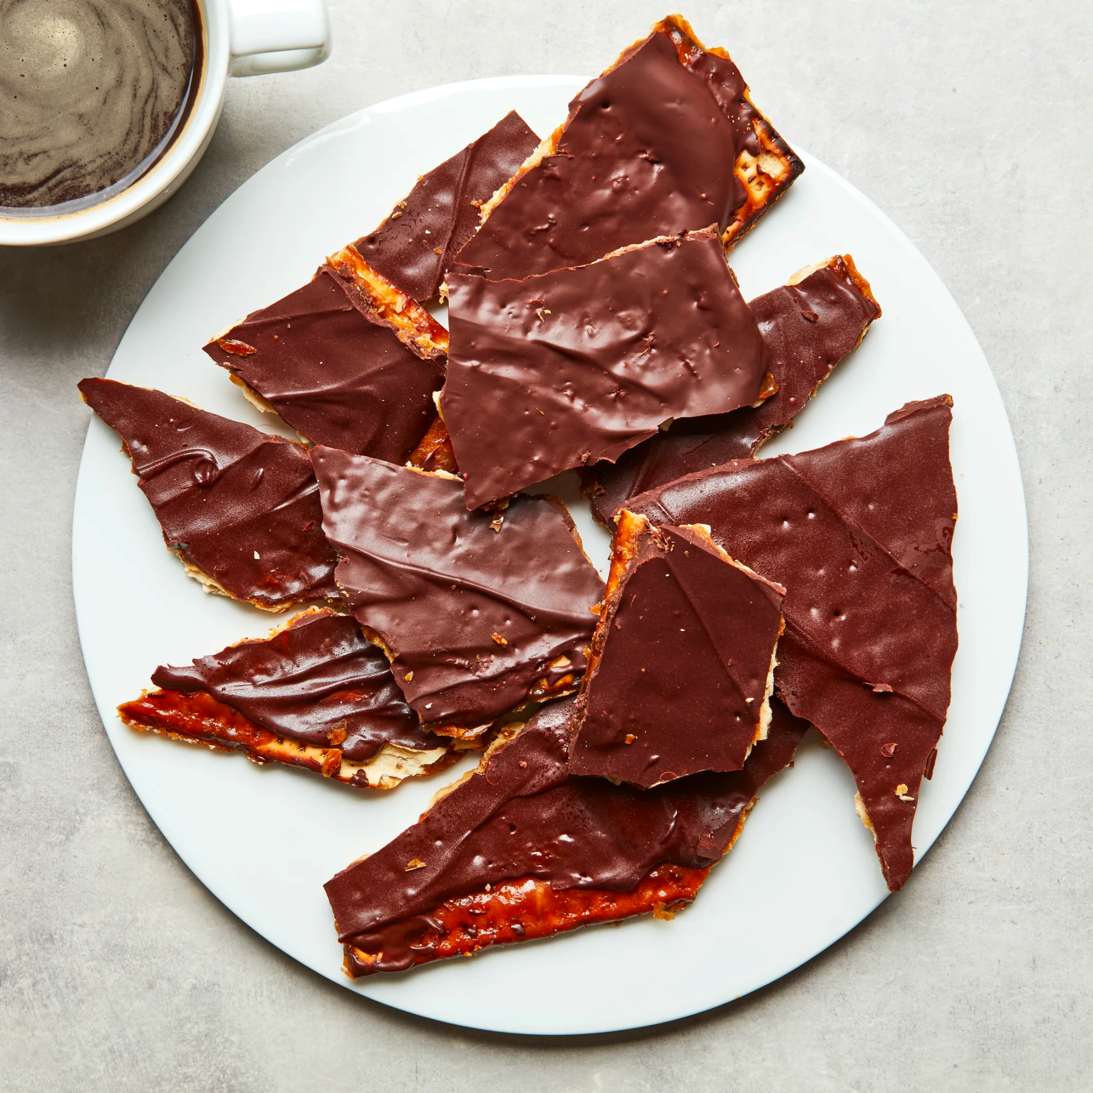
Happy Passover
What shapes do we see in this plate of matzo crunch?
Sketch one of the shapes and partition it.
What shape to you have now?

Slide 5
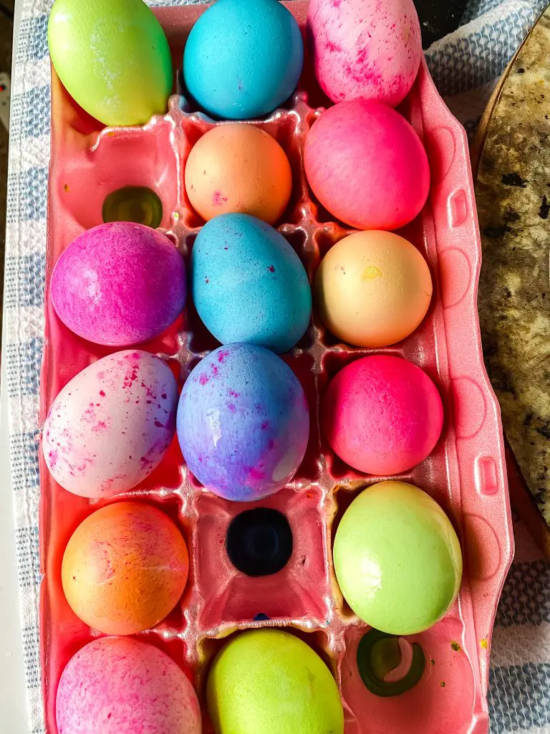
Happy Easter!
How many different equations can we think of to represent this photo?

Slide 6
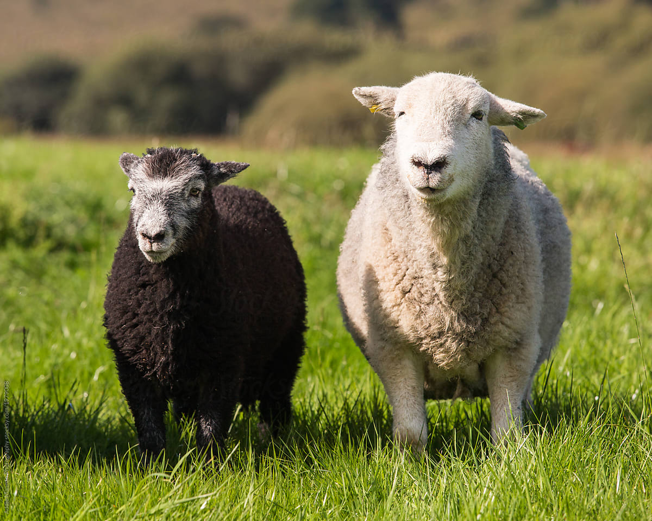
Today is National Farm Animal Day
Meet Lily and Louie!
Together, these two sheep weigh 345 pounds.
What is possible?
Notes:
Week of April 10, 2023

Slide 7
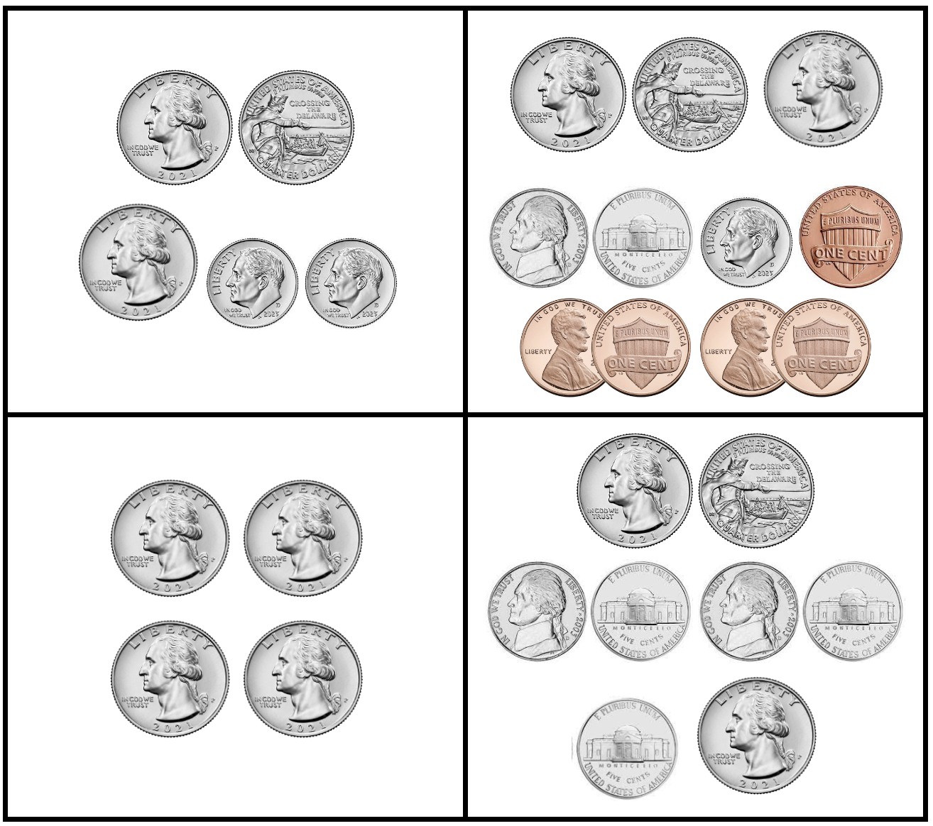
Which one does not belong?
What do they all have in common?

Slide 8
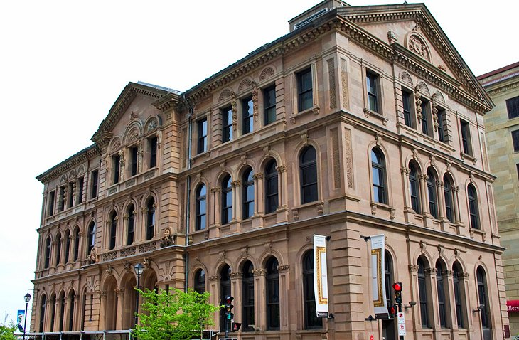
In downtown Halifax, the Art Gallery of Nova Scotia is the largest art museum in the Atlantic provinces.
How can we use “groups of” to determine how many windows are here?

Slide 9
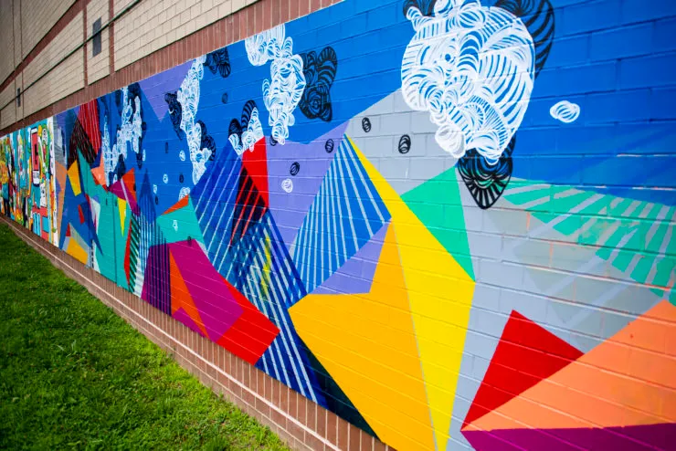
Let’s talk about some of the interesting shapes we see in this Mattapan mural!
“Dreaming Isn’t So Concrete” by Destiny Palmer

Slide 10
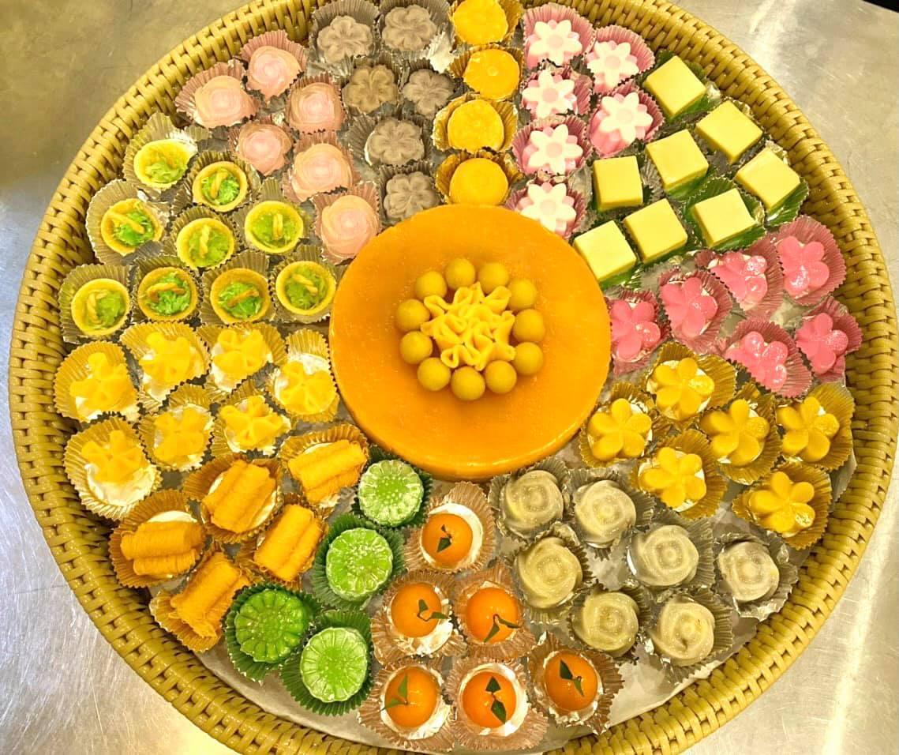
It’s New Year in Cambodia!
How many traditional Cambodian sweets are here?
Create an equation to match your mathematical thinking!

Slide 11
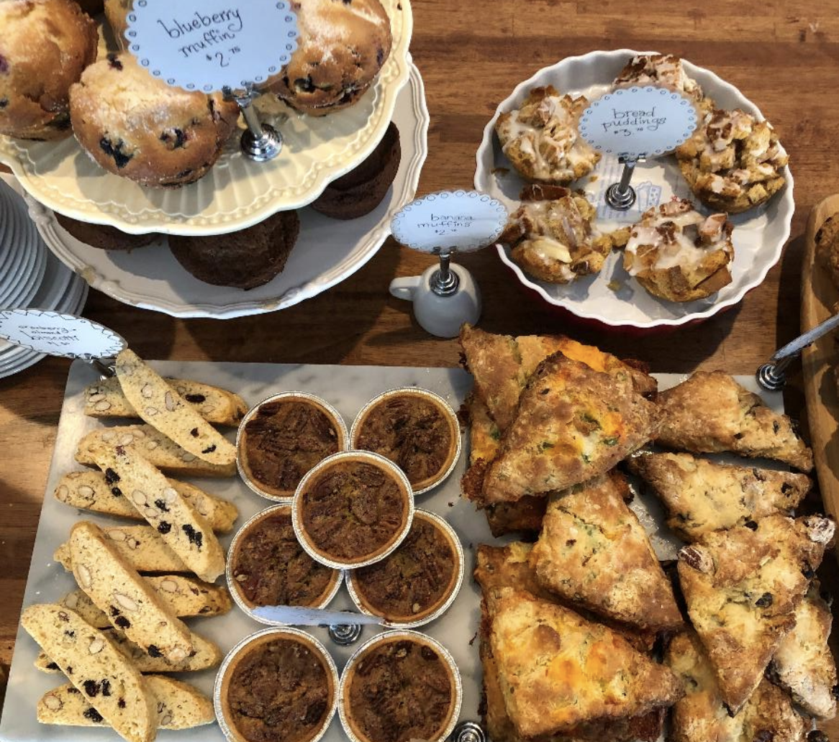
Where’s the MATH in these treats at the Homestead Bakery in Dorchester?
What shapes do we see?
How many treats are here?
What equations can we create to represent our math thinking?
Notes:
Week of April 24, 2023

Slide 12
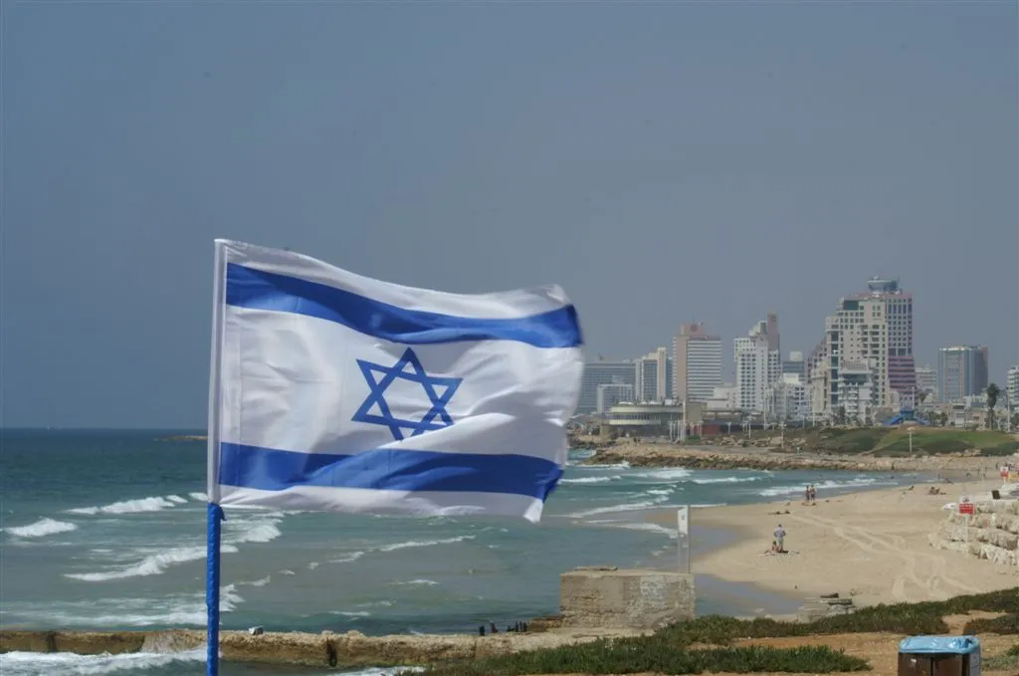
Today is Independence Day in Israel
Israel became an independent state in 1948.
How long ago was that?
How do you know?

Slide 13
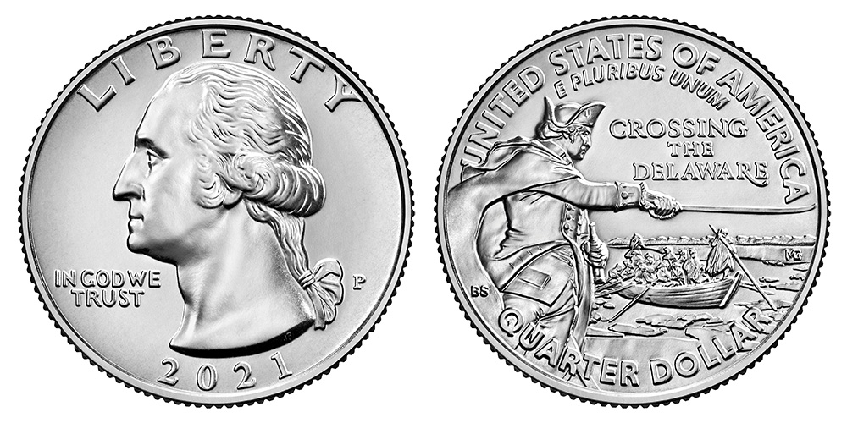
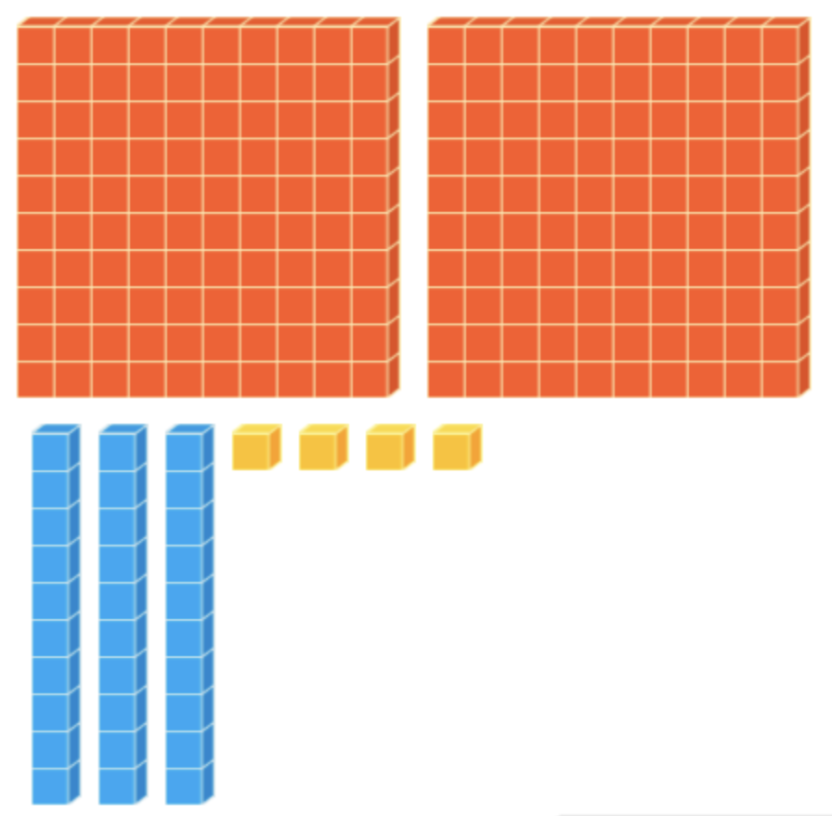
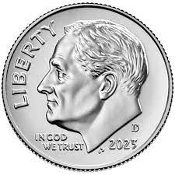
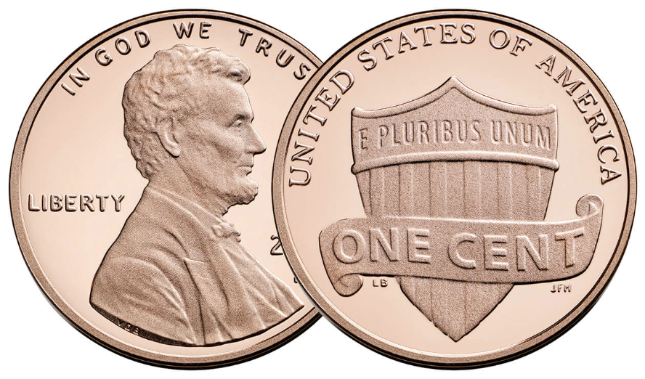
What is the same?
What is different?

Slide 14
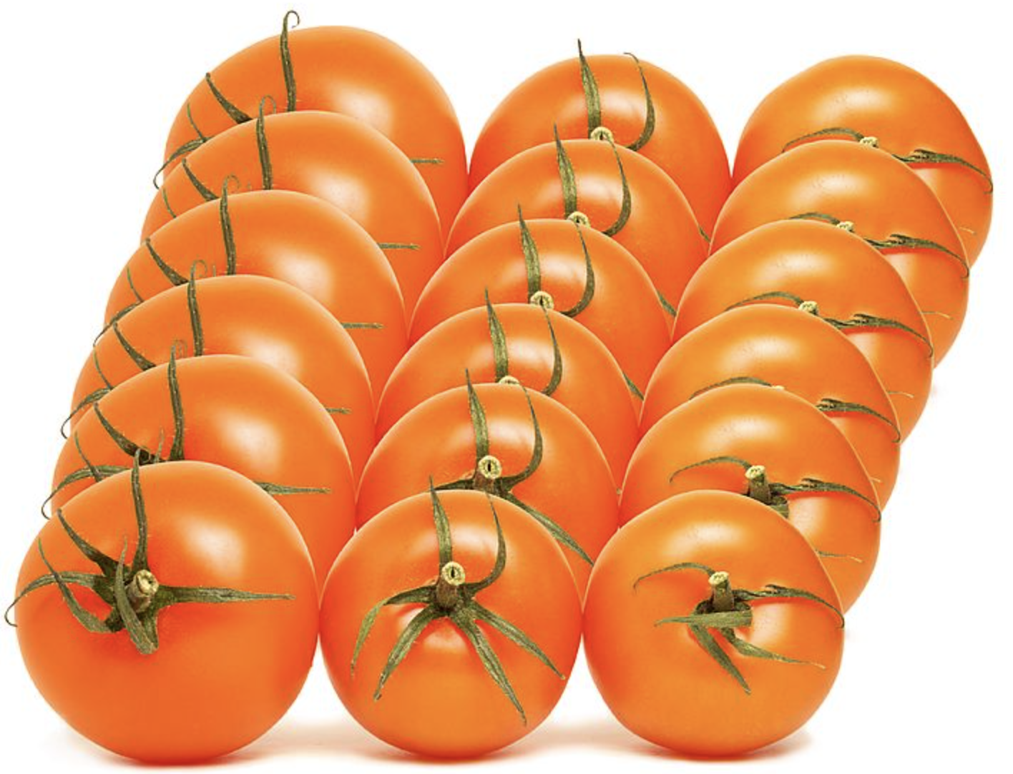
Fresh tomatoes!
How can we use
“groups of”
to determine how many are here?

Slide 15
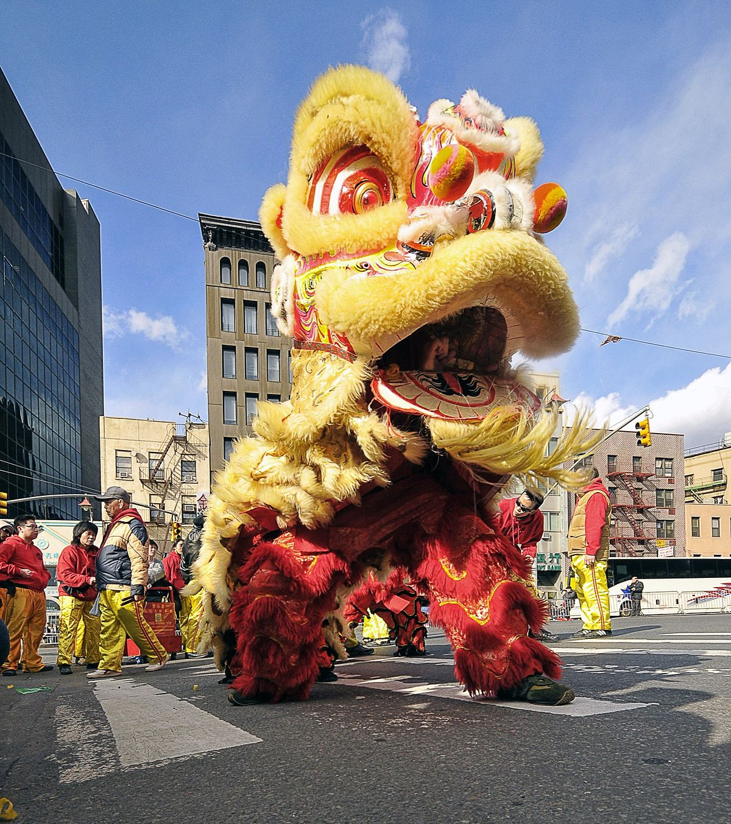
Today is the Hung King Festival in Vietnam!
What would you use to measure the HEIGHT of this lion?
Estimate the height in meters.
Estimate the height in feet.

