Slide 1
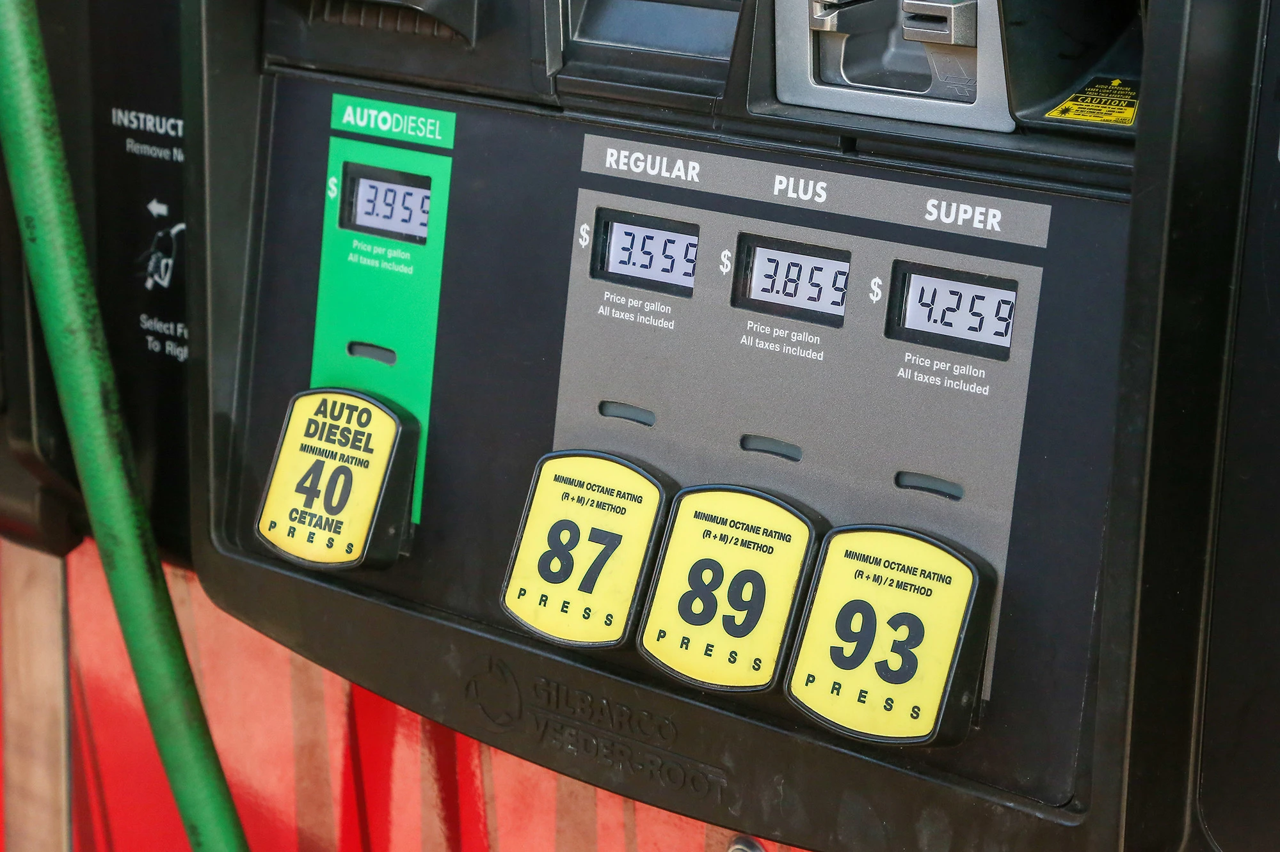
About how much will it cost to fill a 15 gallon gas tank with “super” gasoline?
What are some good estimation strategies?
5.NBT.B7
Notes:
Week of February 27, 2023

Slide 2
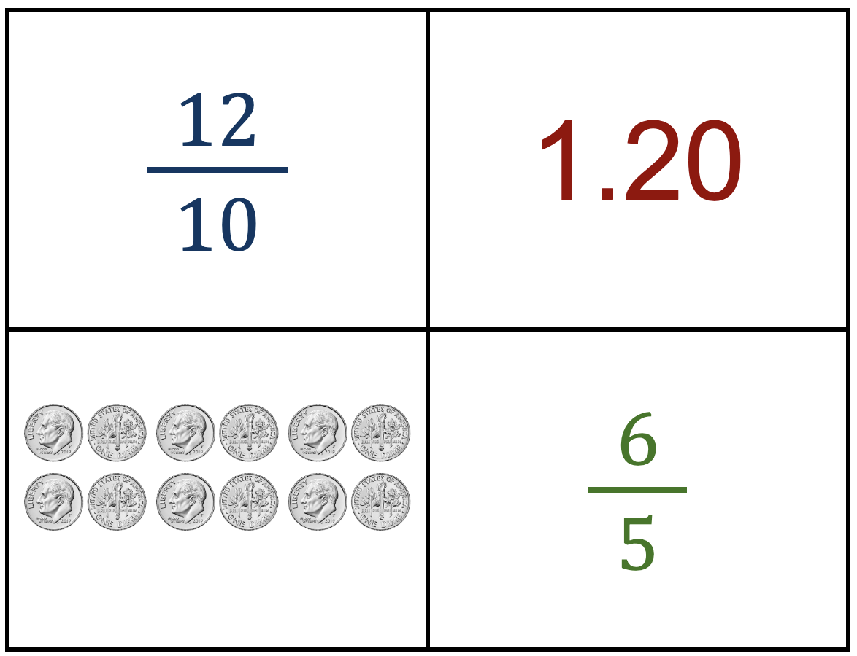
Which one does not belong?
5.NBT.NF

Slide 3
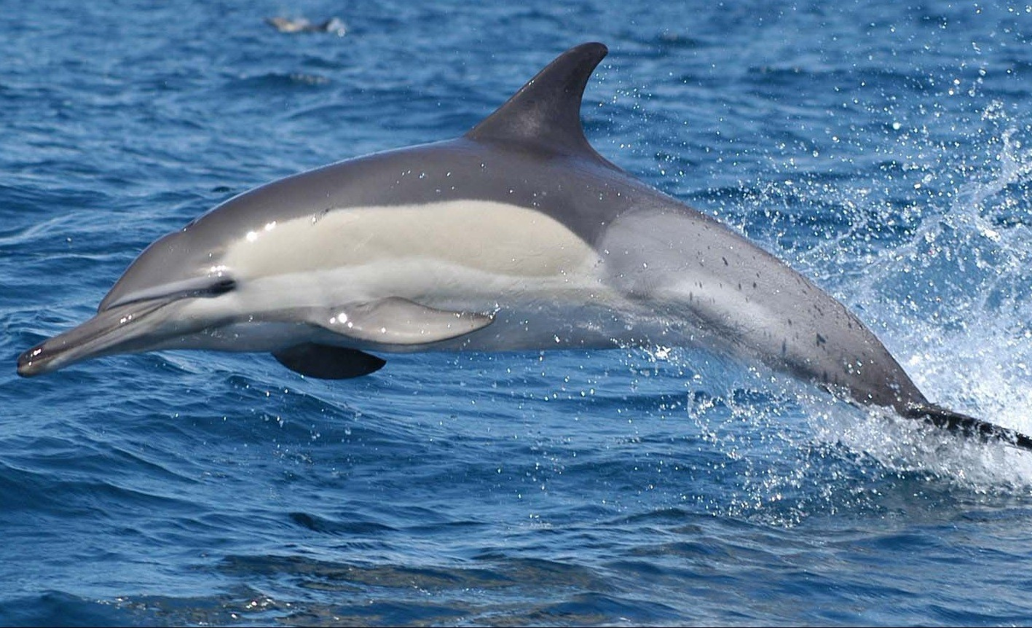
March is Dolphin Awareness Month!
The Atlantic Humpback Dolphin is endangered, there are only about 1,500 living in the wild.
What are some factor pairs of 1,500?
How do we know we have them all?
5.NBT.B5
Notes:
March 2023

Slide 4
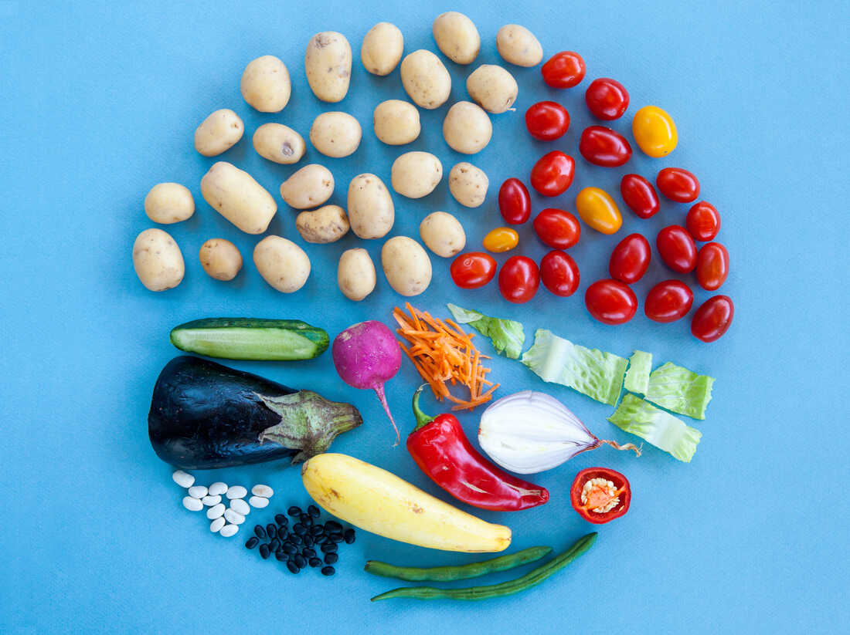
March is also National Veggie Month!
Where do we see fractions in this photo?
Estimate the areas of the fractional parts!
5.NF.A

Slide 5
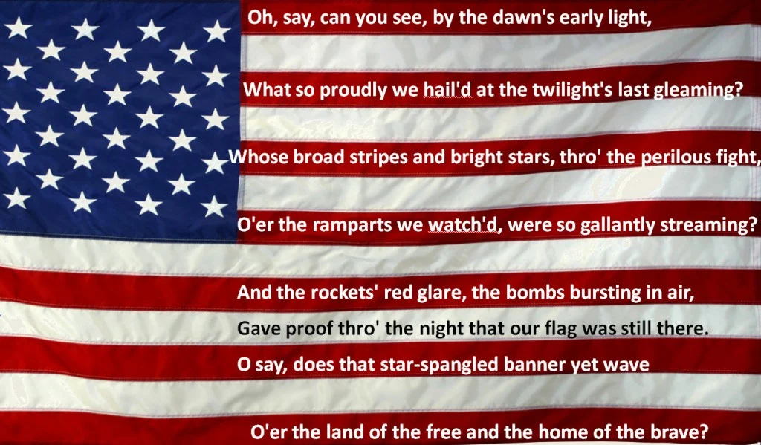
Today is National Anthem Day!
The Star Spangled Banner was written by Francis Scott Key During the War of 1812 on September 13, 1814.
How long ago was that?
The first documented time the Star Spangled Banner was played at the beginning of a sporting event was during a Civil War era baseball game in 1862.
How long ago was that?
The tradition of playing the Star Spangled Banner at sporting events became popular at the 1918 World Series.
How long ago was that?
That was 13 years before it officially became our country’s national anthem.
When did the Star Spangled Banner officially become our national anthem?
5.NBT

Slide 6
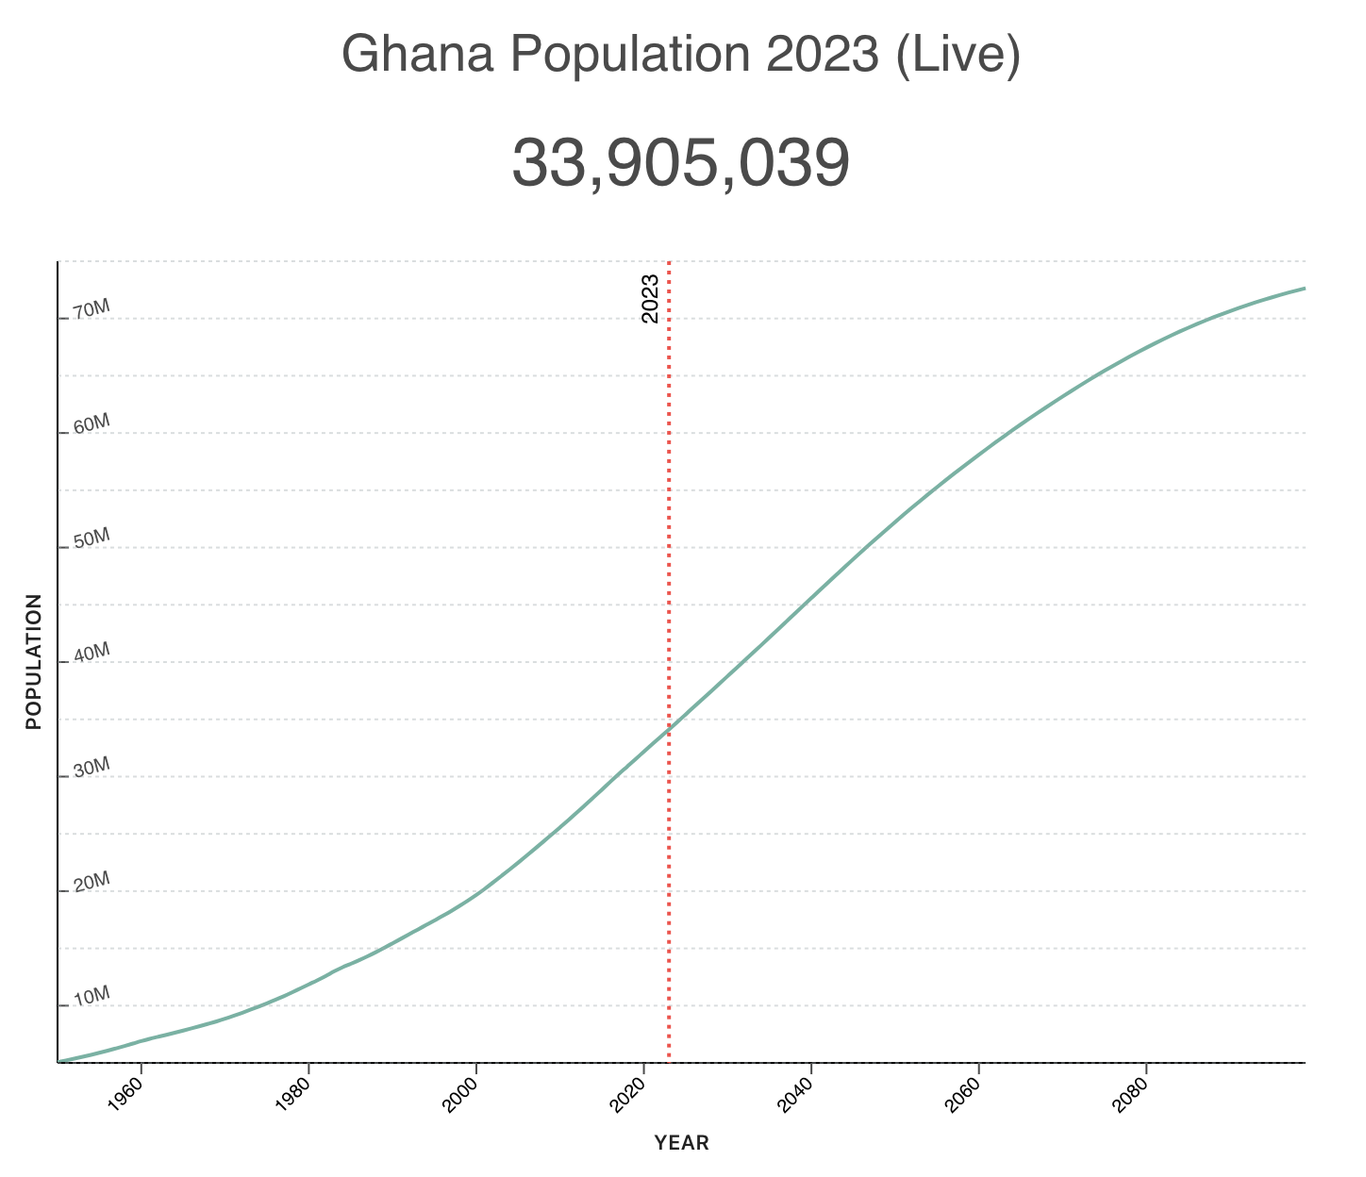

Happy Independence Day Ghana!
Ghana, formerly the Gold Coast, is the first country south of the Sahara to gain independence on March 6, 1957. The feat also inspired other African countries to fight for Independence.
What’s going on in this graph?
Why does it matter?
5.MD.B
Notes:
Week of March 6, 2023
Ghana Independence Day

Slide 7
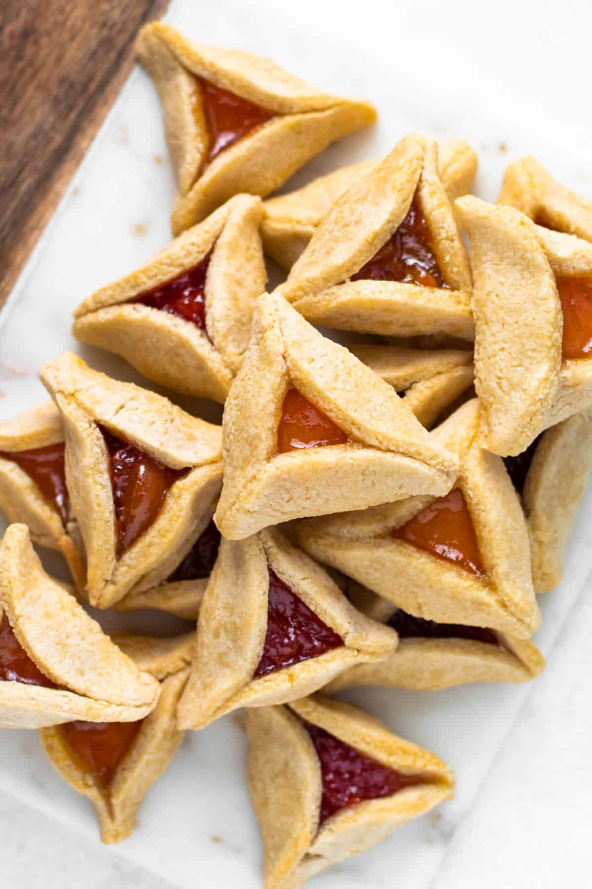
Happy Purim!
It’s time to bake the Hamantaschen!
We need to TRIPLE the recipe!
2/3 cup confectioners' sugar
2¼ cups flour
¾ teaspoon salt
½ pound unsalted butter
3 large egg yolks, divided
¼ cup tablespoons ice cold water
¾ cup apricot jam
So, what do we need for ingredients?
5.NF.B4
Notes:
March 7, 2023
Purim

Slide 8
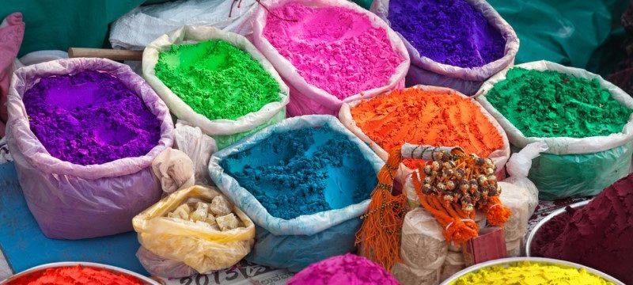
Happy Holi!
Each of these colors comes in a box that has a VOLUME of 384 in.³
What is possible?
5.MD.B5
Notes:
March 8, 2021
Holi

Slide 9
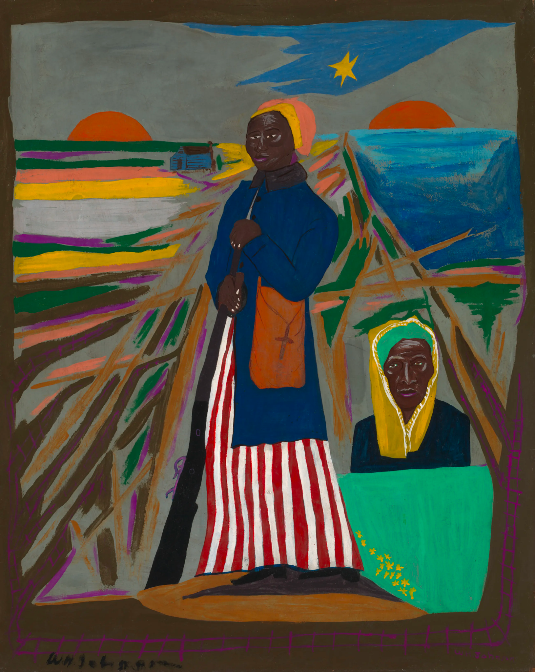
Today is Harriet Tubman Day!
Harriet Tubman was one amazing woman!
It was a 142 miles journey from slavery to freedom. They could only walk at night when the moon was bright and the night was long, covering about 20 miles per night. How many nights per month is that?
About how many days of travel is that? How long would the journey take?
William H. Johnson, Harriet Tubman, ca. 1945
5.MD.A1

Slide 10
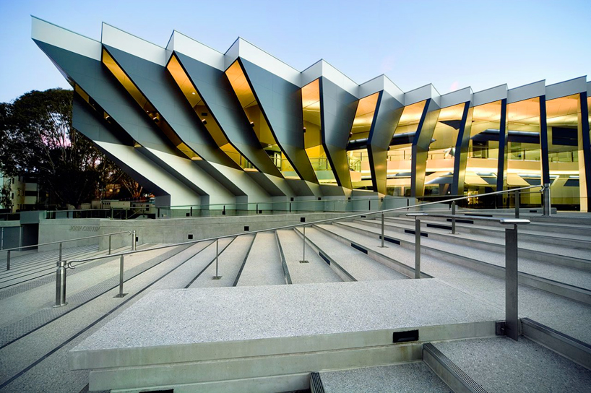
Today is Canberra Day in Australia!
What do we notice about the architecture here at The John Curtin School of Medical Research in Canberra?
What do we wonder?
Let’s estimate the sizes of the angles we see.
How can we prove our estimates are reasonable?
5.G
Notes:
Week of March 13, 2023
Canberra Day, Australia

Slide 11
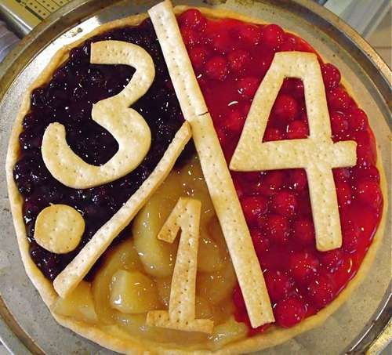
Happy Pi Day!
It’s the BEST, most mathematically delicious day of the year!
What is pi?
What fraction does each flavor represent?
About what fraction of the pie is covered by numbers?
5.NF
Notes:
March 14, 2023
Pi Day

Slide 12
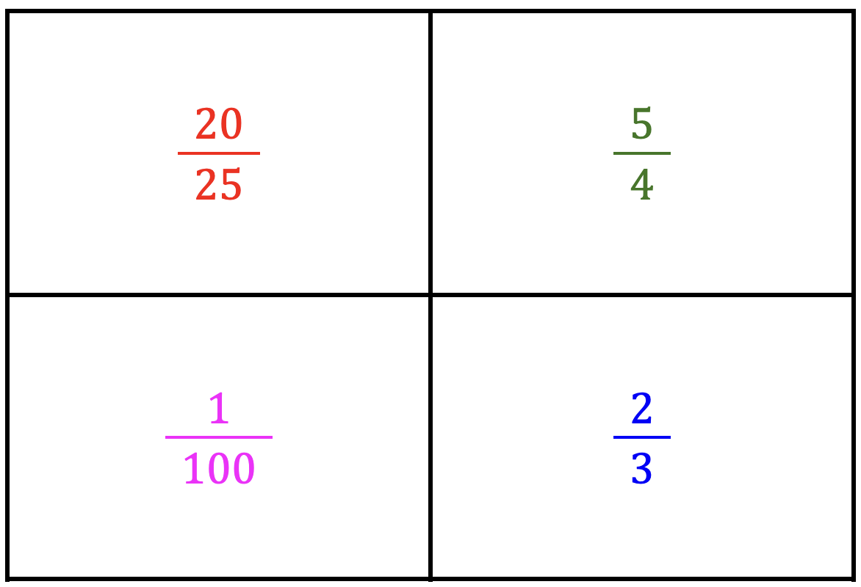
Which one doesn’t belong?
5.SMP.3

Slide 13
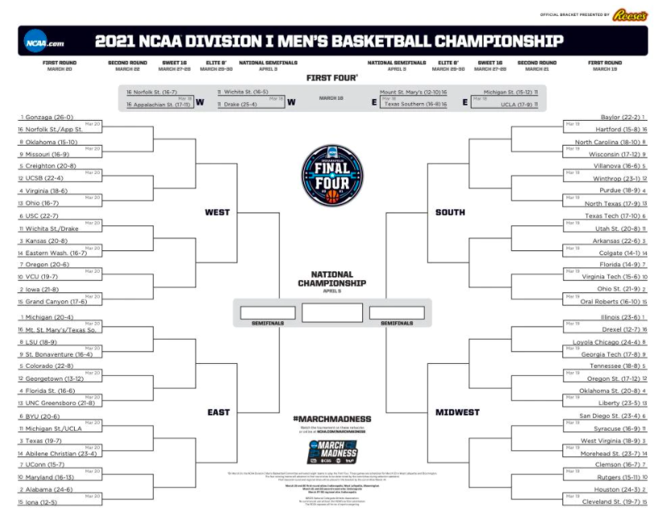
It’s March Madness!
We start with 64 teams from 4 regions.
How many different number sentences can you write to model the competition from 64 teams down to the final 4?
5.NBT.B5

Slide 14
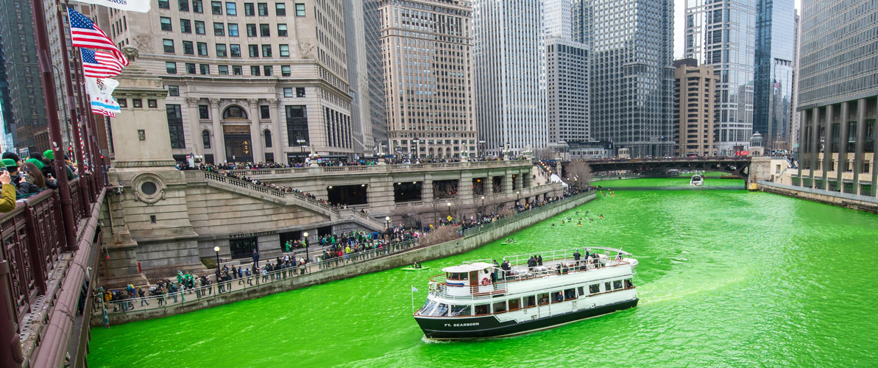
Happy St. Patrick’s Day!
5.NBT.B7
The Plumber’s Union in Chicago dyes their river green every St. Patrick’s Day.
25.5 pounds of vegetable-based dye colors the river for 5 hours. How much dye do they need to color the river for 1 day? 2 days? 3 days? 4 days? A week?
3.OA.D8
Check out this 1 minute video!

Slide 15

Happy International Day of Happiness!
Research shows that children smile an average of 400 times per day, compared to the typical adult who smiles only 20 times per day.
How many times GREATER is 400 than 20?
What are some FACTOR pairs of 400?
How will we know when we have them all?
5.NBT.B5
Notes:
Week of March 20, 2023
International Day of Happiness!

Slide 16
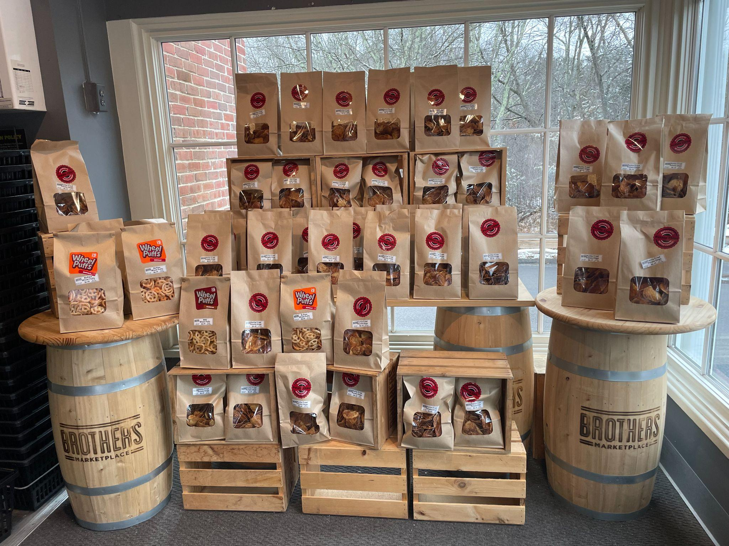
What do we notice?
What do we wonder?
How can we make the CLOSEST estimate?
Each bag of chips is $6.49. The puffs are $4.99.
How much would the whole display cost?
5.NBT.B7

Slide 17
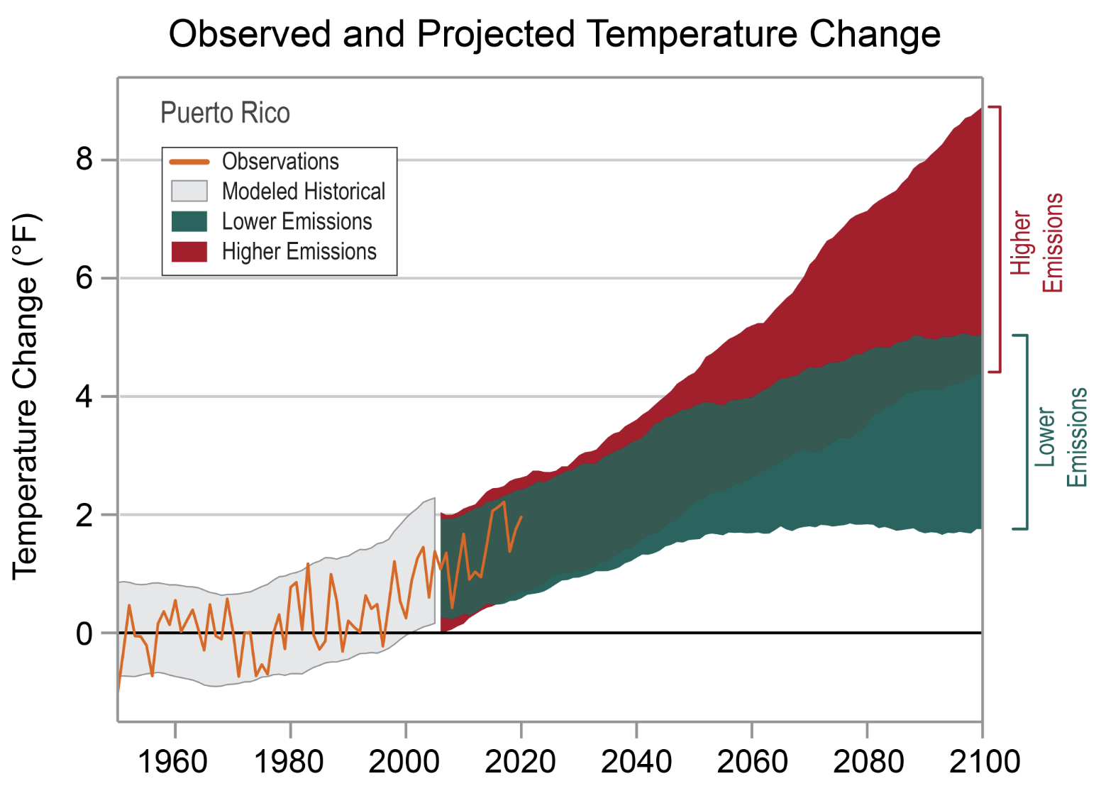

Today is Emancipation Day in
Puerto Rico!
What is going on in this graph?
Why does it matter?
5.SMP.3
Notes:
March 22, 2023
Puerto Rico Emancipation Day

Slide 18
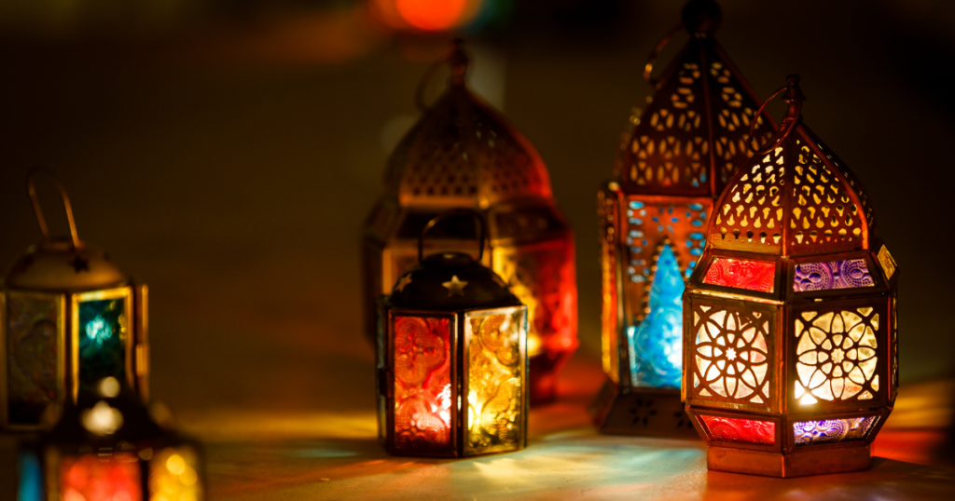
Ramadan Kareem رمضان كريم/مبارك
Ramadan is the 9th month of the Islamic calendar, which is based on a 12-month lunar year of approximately 354 days. Because the lunar year is 11 days shorter than the solar year, each lunar month moves 11 days earlier each year.
How many solar years will it take for the lunar months to complete a full cycle and return to the same season?
5.MD.A1
Notes:
March 23, 2023
Ramadan
It takes 33 solar years for the lunar months to complete a full cycle and return to the same season.

Slide 19
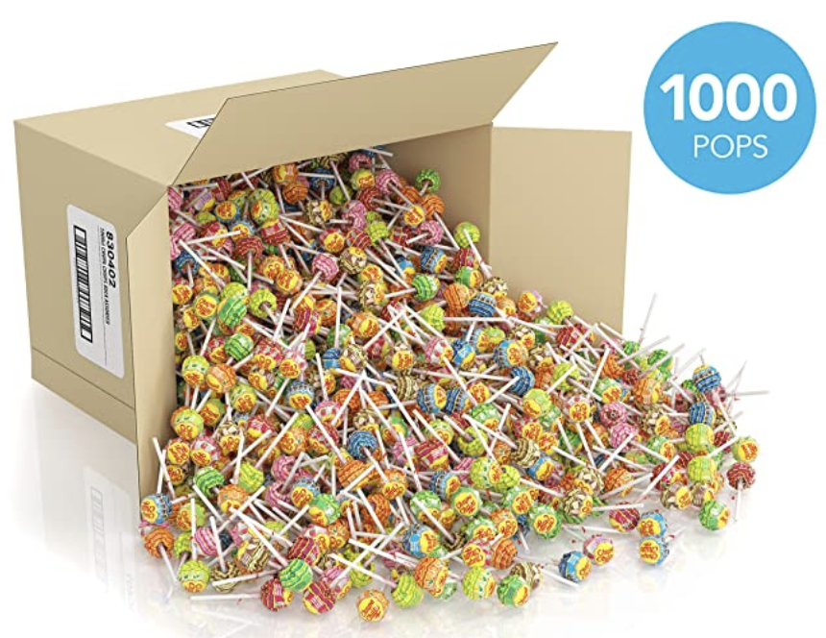
How many DIFFERENT ways can we EQUALLY share all of these lollipops?
How will we know when we have recorded all of the possibilities?
5.NBT.B6

Slide 20
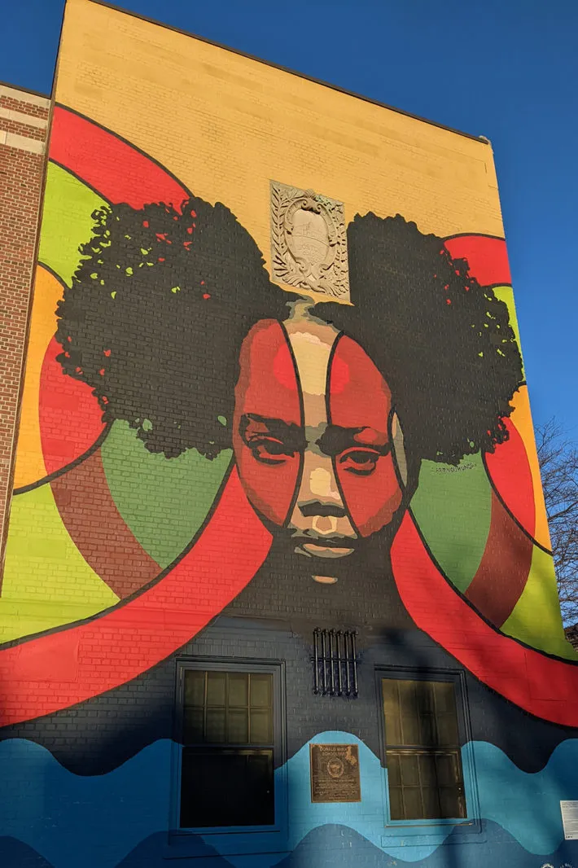
What do we notice?
What do we wonder?
If the window is 56” high and 34” wide, what could the dimensions of the mural be?
About how many times smaller are your eyes?
“Intersectional Environmentalism: Generational Uproot” by Nneka Jones.
5.NBT.A
Notes:
Week of March 27, 2023

Slide 21
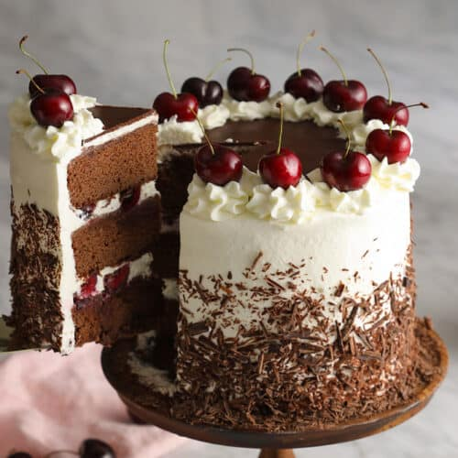
Happy Black Forest Cake Day!
About what fraction of the cake is that slice?
What fraction is left?
If we were to share the cake (what is left of it!) EQUALLY among 3 hungry people, what FRACTION OF THE WHOLE would that be?
5.NF.A
Notes:
March 28, 2023

Slide 22
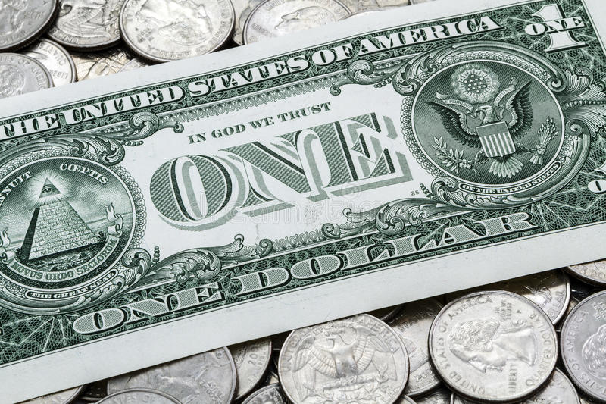
Would you rather get…
75¢ every day for the rest of your life
or
$5.00 a week for the rest of your life?
5.SMP.3
Notes:
Week of March 27, 2023

Slide 23
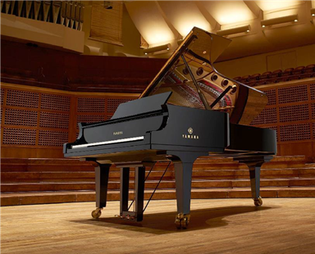
Today is World Piano Day!
The piano can be considered both a string and a percussion instrument.
There are 230 strings in a grand piano.
Each string holds around 168 pounds of tension.
How much tension is that altogether?
Is that more than a ton or less?
5.NBT.B5

Slide 24
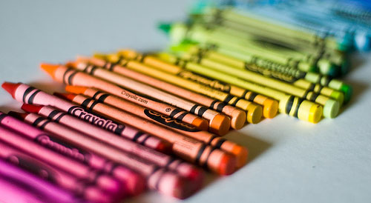
Today is Crayola Crayon Day!
The average student uses up 730 crayons by age 10 and spends an average of 30 minutes a day coloring!
How many minutes is that in a year? How many hours is that?
5.MD.A1

