Slide 1
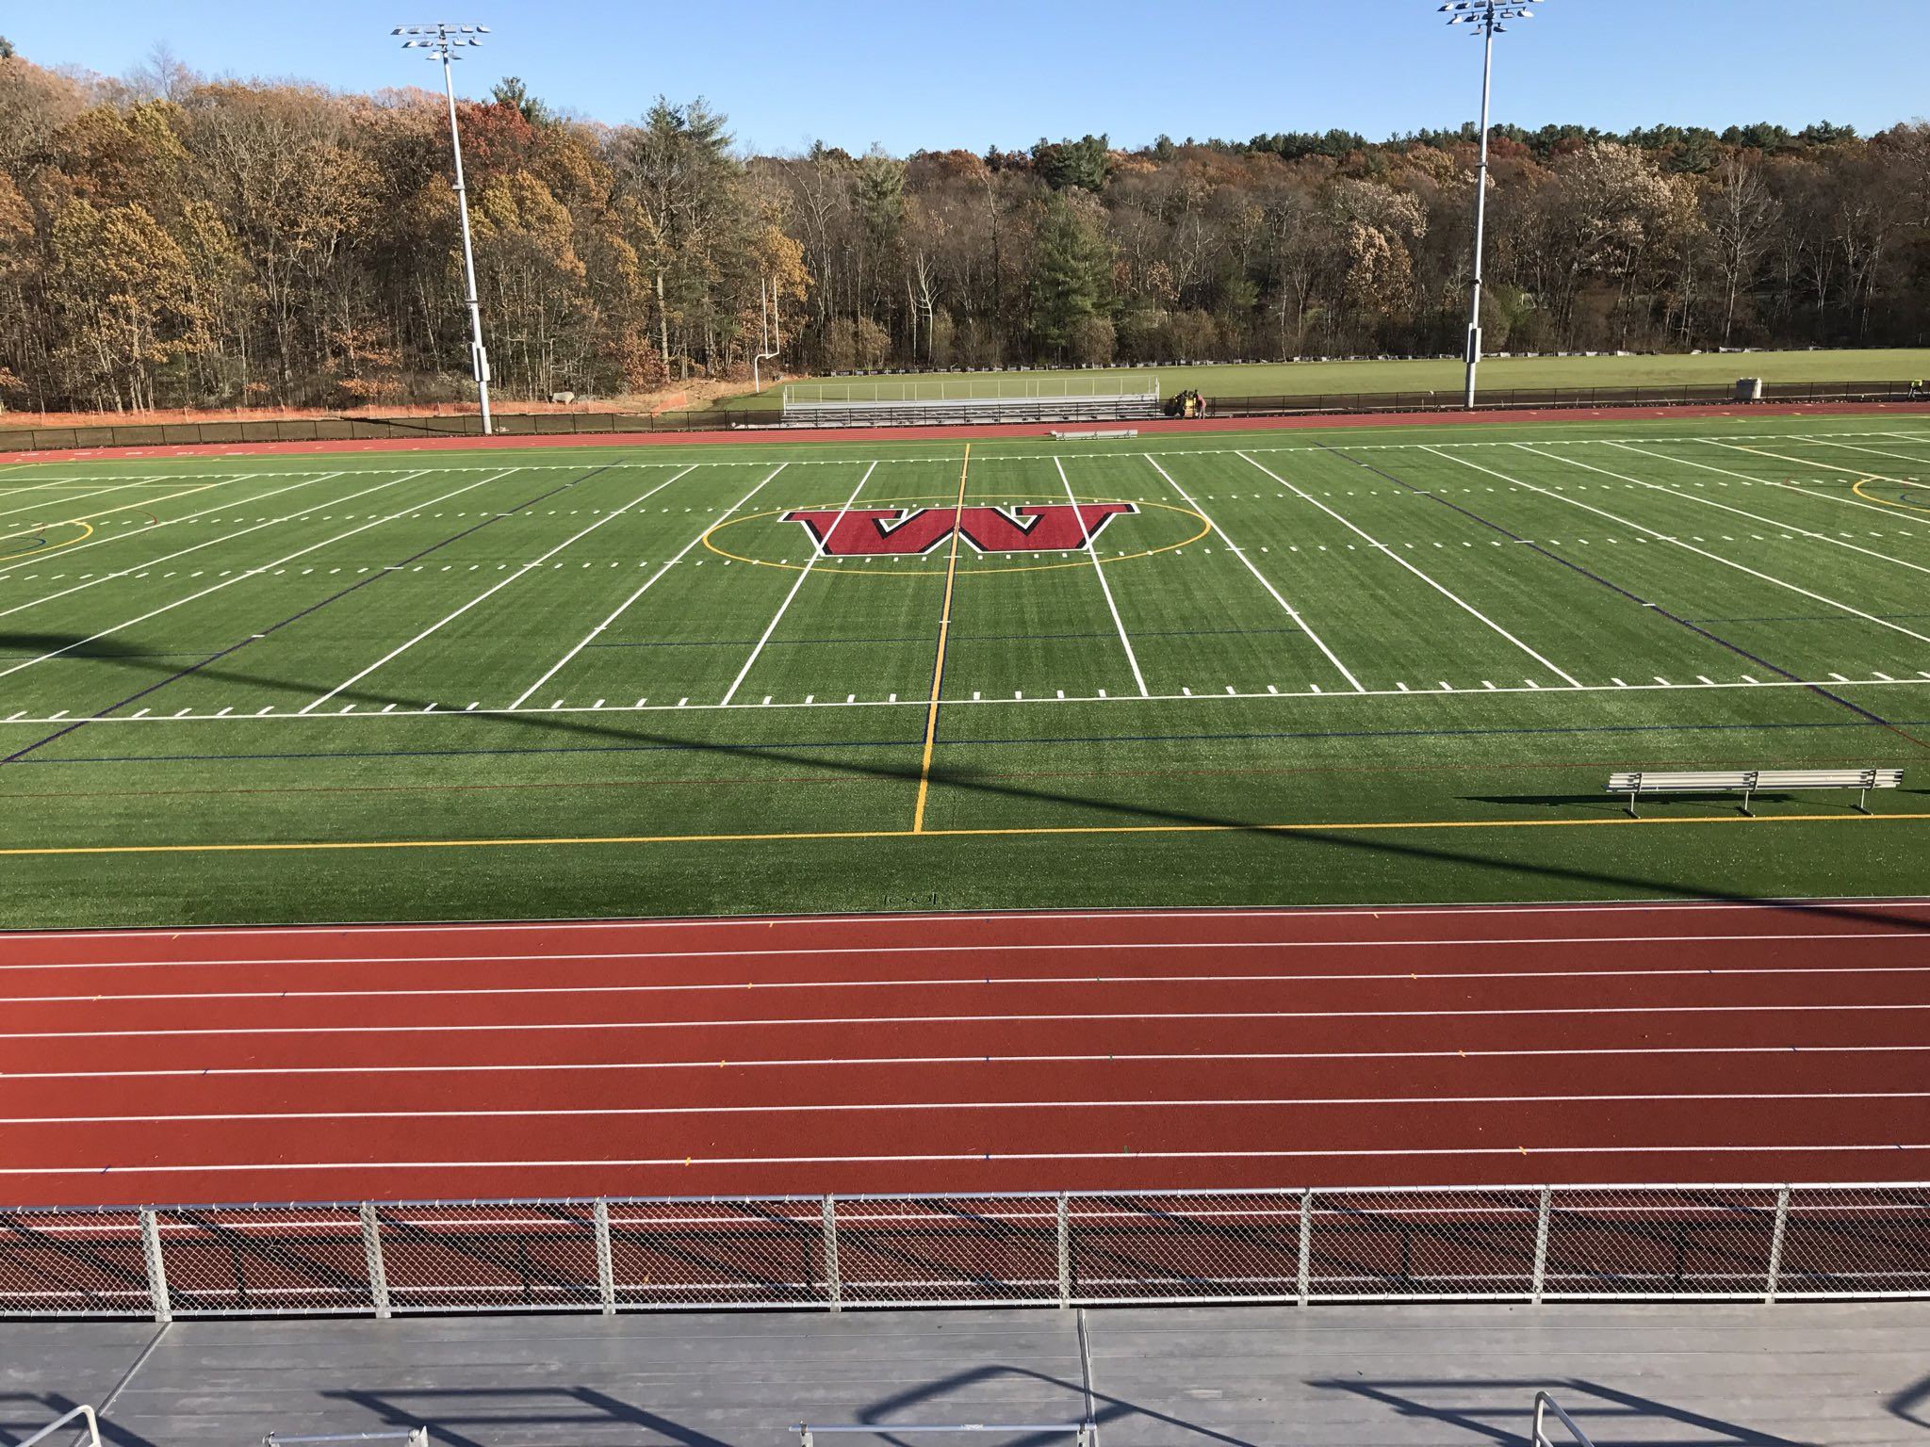
Would you rather …
Run the track at the high school (400 meters) twelve times
or
run a 5K road race?
4.MD.A3
Notes:
Week of February 27, 2023

Slide 2
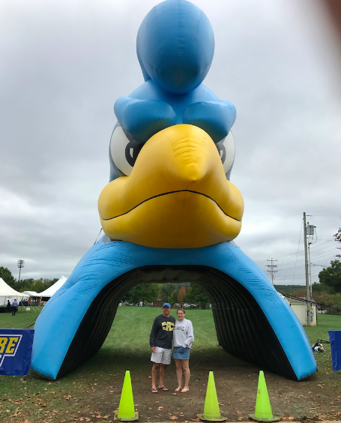
Go Blue Hens!
Estimate the height of the University of Delaware Blue Hen.
Mark (in the blue shirt)
is about 6 feet tall.
What is a too low estimate?
What is a too high estimate?
How many feet? How many inches?
4.MD.A1

Slide 3
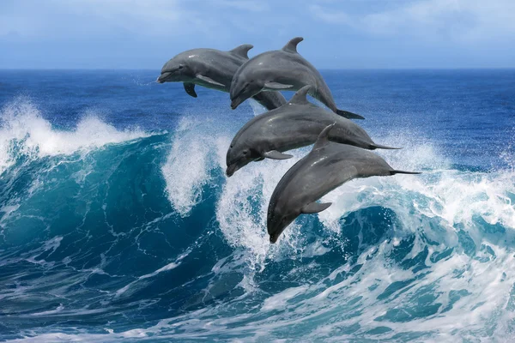
March is Dolphin Awareness Month!
An average adult bottlenose dolphin weighs between 150-200 kg.
Together these four dolphins weigh 725 kg.
What is possible?
4.MD.A1
Notes:
March 2023

Slide 4
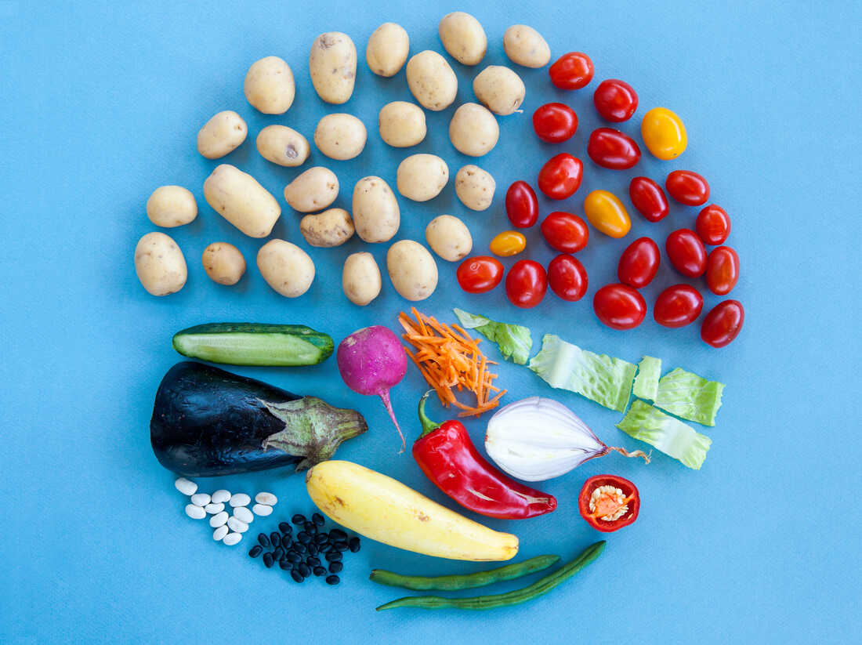
March is also National Veggie Month!
Where do we see fractions in this photo?
Estimate the areas of the fractional parts!
4.NF.A2

Slide 5
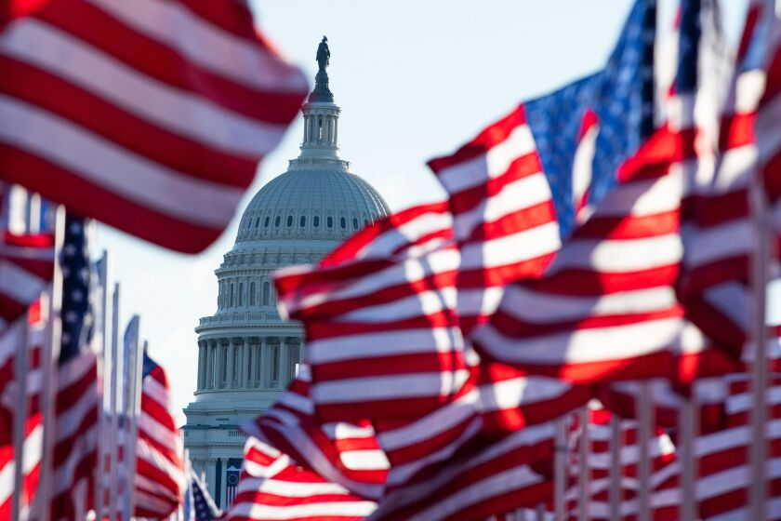
Today is National Anthem Day!
The Star Spangled Banner was written by Francis Scott Key During the War of 1812 on September 13, 1814.
How long ago was that?
The first documented time the Star Spangled Banner was played at the beginning of a sporting event was during a Civil War era baseball game in 1862.
How long ago was that?
The tradition of playing the Star Spangled Banner at sporting events became popular at the 1918 World Series.
How long ago was that?
That was 13 years before it officially became our country’s national anthem.
When did the Star Spangled Banner officially become our national anthem?
4.OA.A3

Slide 6
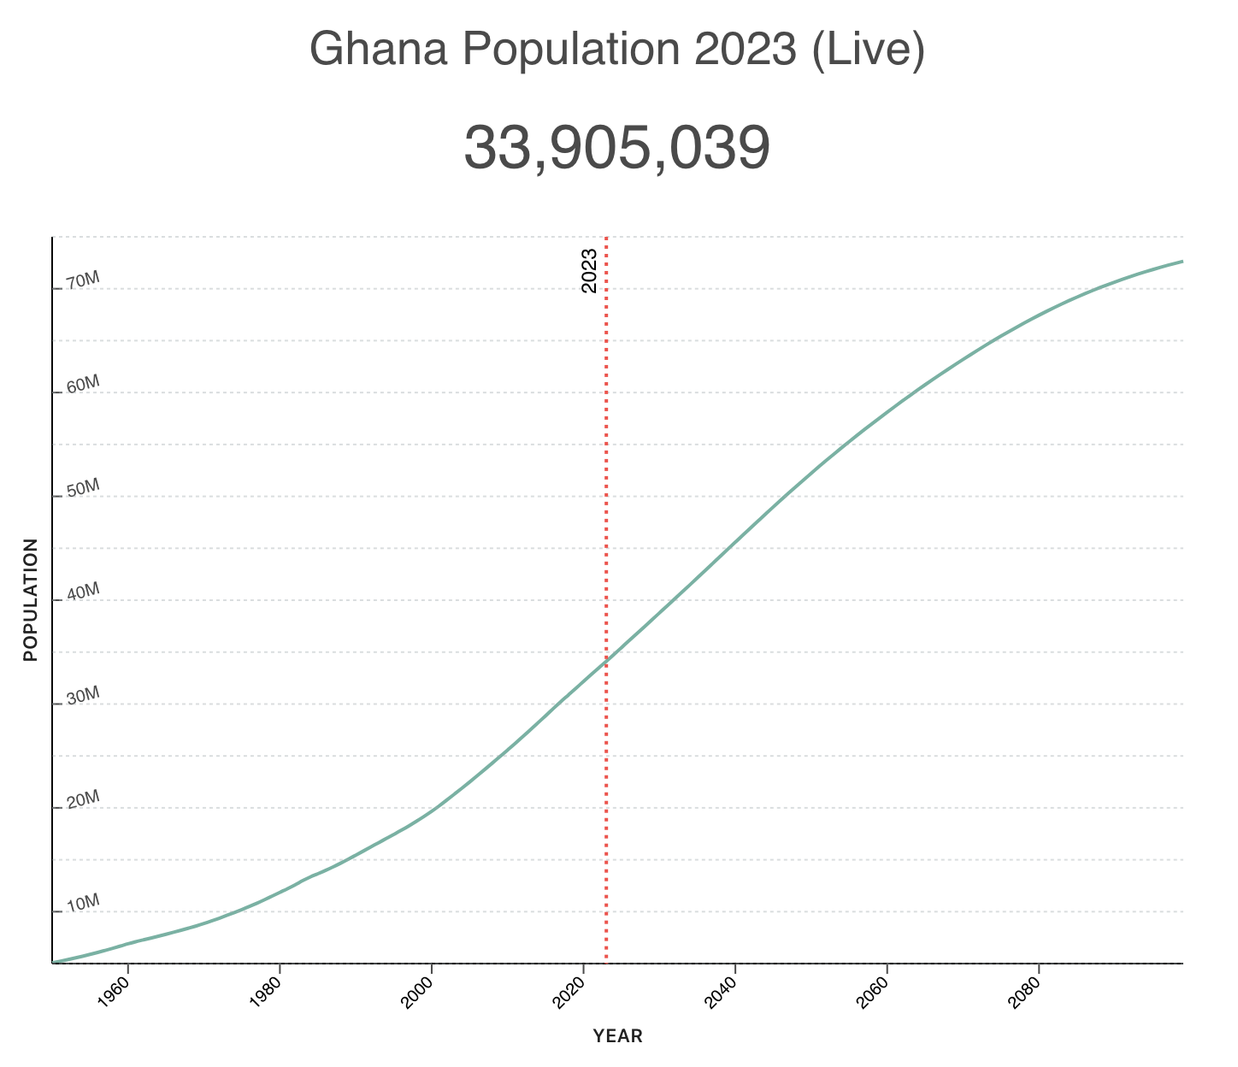

Happy Independence Day Ghana!
Ghana, formerly the Gold Coast, is the first country south of the Sahara to gain independence on March 6, 1957. The feat also inspired other African countries to fight for Independence.
What’s going on in this graph?
Why does it matter?
4.SMP.3
Notes:
Week of March 6, 2023
Ghana Independence Day

Slide 7
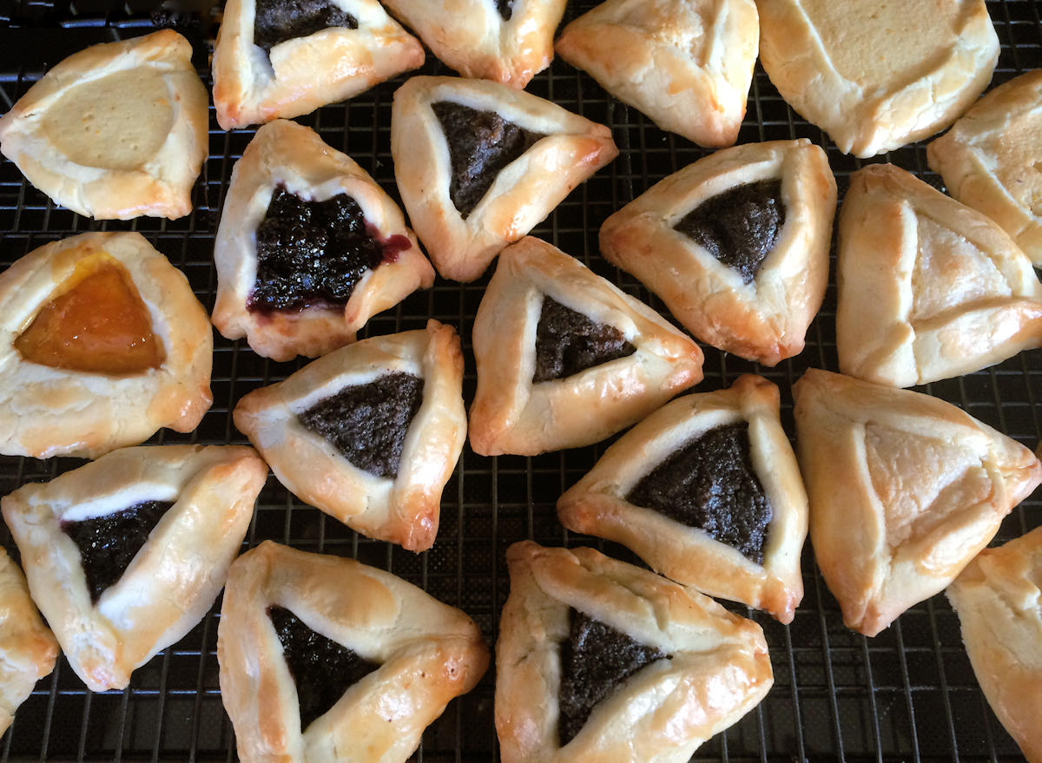
Happy Purim!
It’s time to bake the Hamantaschen!
We need to DOUBLE the recipe!
2/3 cup confectioners' sugar
2¼ cups flour
¾ teaspoon salt
½ pound unsalted butter
3 large egg yolks, divided
¼ cup tablespoons ice cold water
¾ cup apricot jam
How much of each ingredient do we need?
4.NF.B4
Notes:
March 7, 2023
Purim

Slide 8
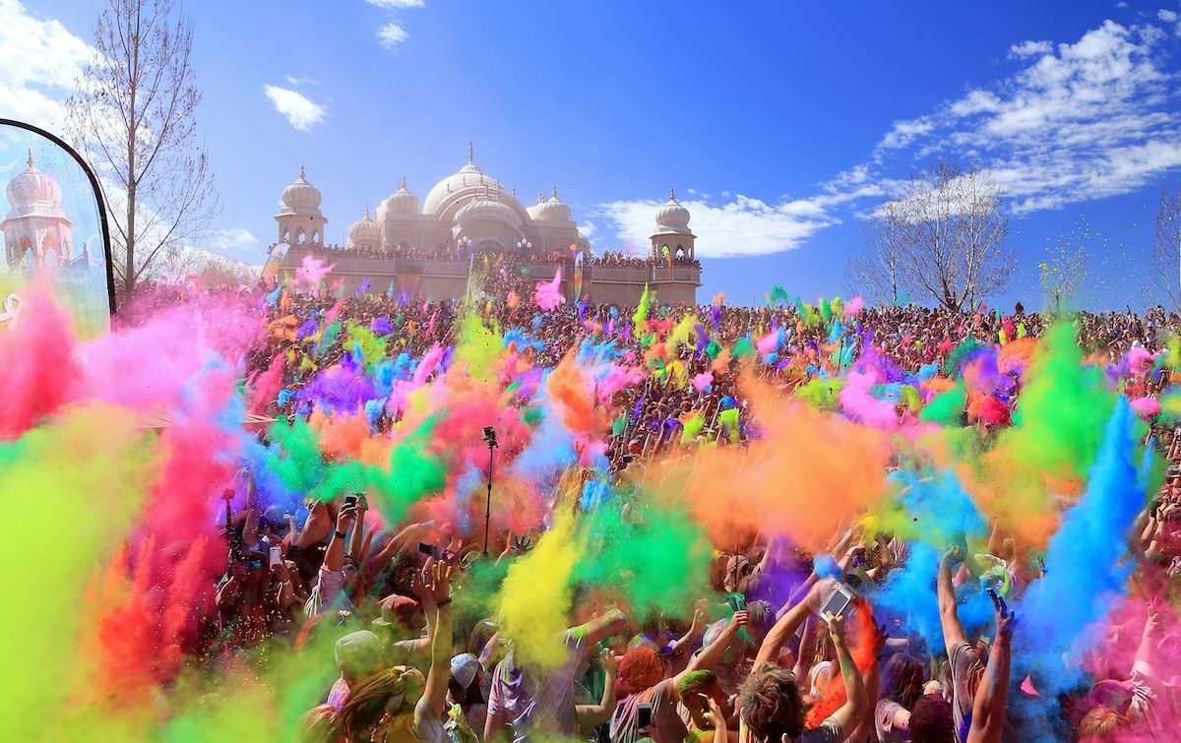
Happy Holi!
Estimate the distance from here to the Temple.
What strategies can we use to estimate?
4.MD.A
Notes:
March 8, 2021
Holi

Slide 9
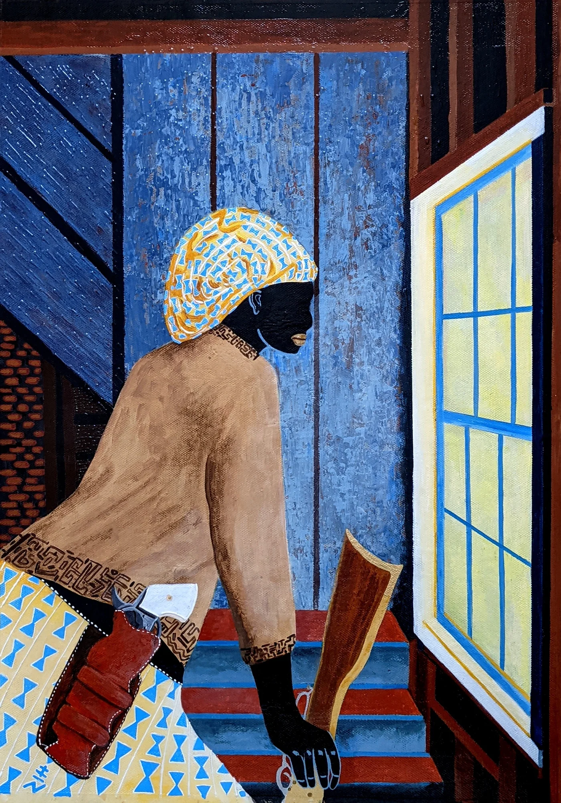
Today is Harriet Tubman Day!
Harriet Tubman was one amazing woman!
It was a 142 miles journey from slavery to freedom. They could only walk at night when the moon was bright and the night was long, covering about 20 miles per night. How many nights per month is that?
About how many days of travel is that? How long would the journey take?
4.OA.A3
Vincent Keele “Harriet Moses”

Slide 10
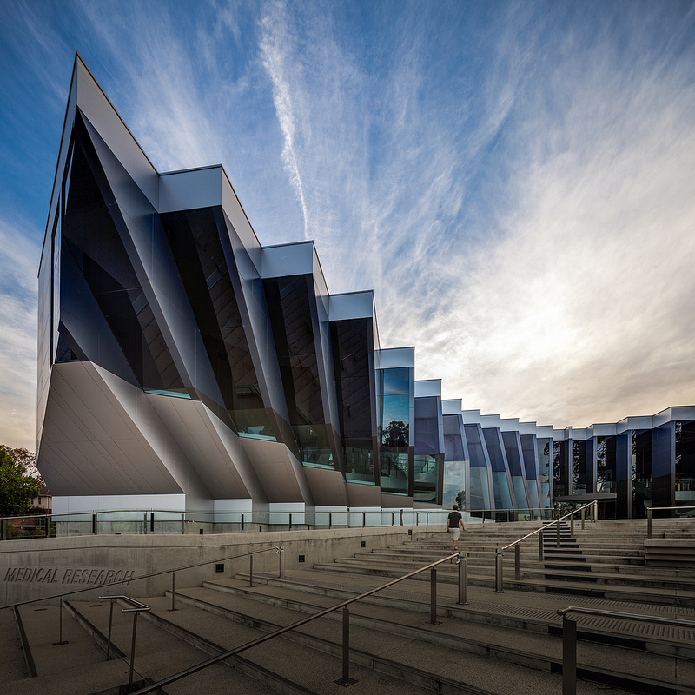
Today is Canberra Day in Australia!
What do we notice about the architecture here at The John Curtin School of Medical Research in Canberra?
What do we wonder?
Let’s estimate the sizes of the angles we see.
How can we prove our estimates are reasonable?
4.MD.C6
Notes:
Week of March 13, 2023
Canberra Day, Australia

Slide 11
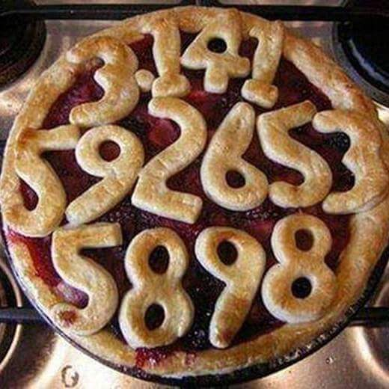
Happy Pi Day!
It’s the BEST, most mathematically delicious day of the year!
What is pi?
About what fraction of the pie is covered by numbers?
4.NF.A
Notes:
March 14, 2023
Pi Day

Slide 12
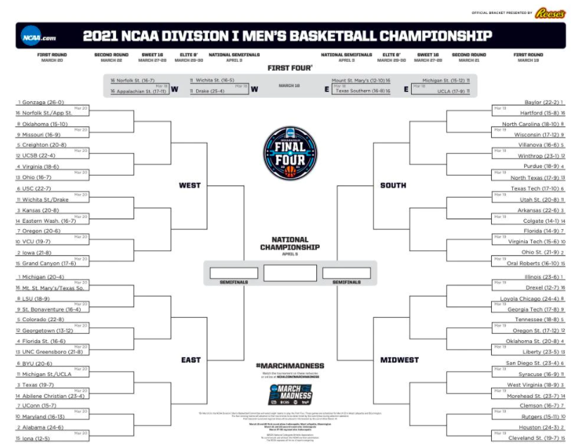
It’s March Madness Season!
We start with 64 teams from 4 regions.
How many different number sentences can you write to model the competition from 64 teams down to the final 4?
4.OA.B4
4.MD.B

Slide 13
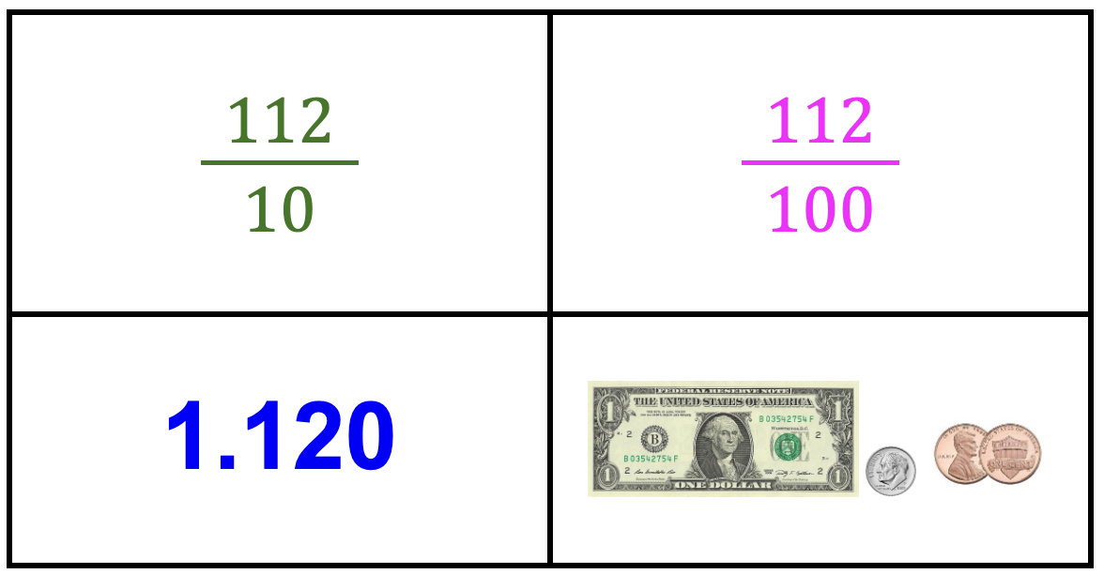
Which one doesn’t belong?
4NF.C

Slide 14
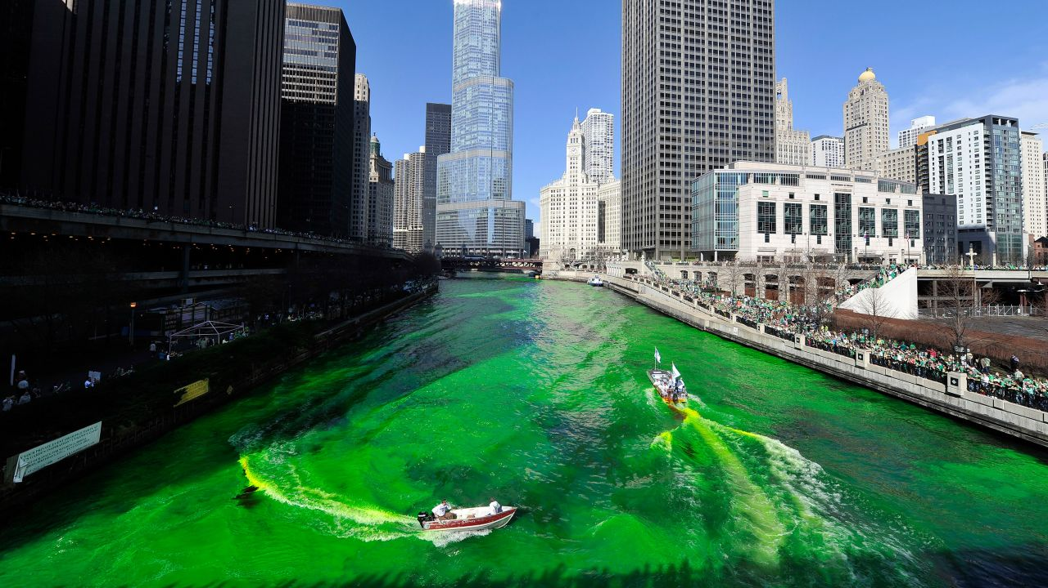
Happy St. Patrick’s Day!
The Plumber’s Union in Chicago dyes their river green every St. Patrick’s Day.
25 pounds of vegetable-based dye colors the river for 5 hours.
How much dye do they need to color the river for whole day?
2 days?
3 days? 4 days?
Check out this 1 minute video!
3.OA.D8
4.OA.A3

Slide 15
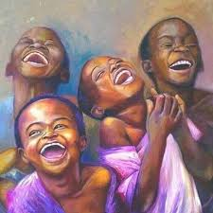
Happy International Day of Happiness!
Research shows that children smile an average of 400 times per day, compared to the typical adult who smiles only 20 times per day.
How many times GREATER is 400 than 20?
What are some FACTOR pairs of 400?
How will we know when we have them all?
4.NBT.A1
Tish Jones “Black Lines Matter”
Notes:
Week of March 20, 2023
International Day of Happiness!

Slide 16
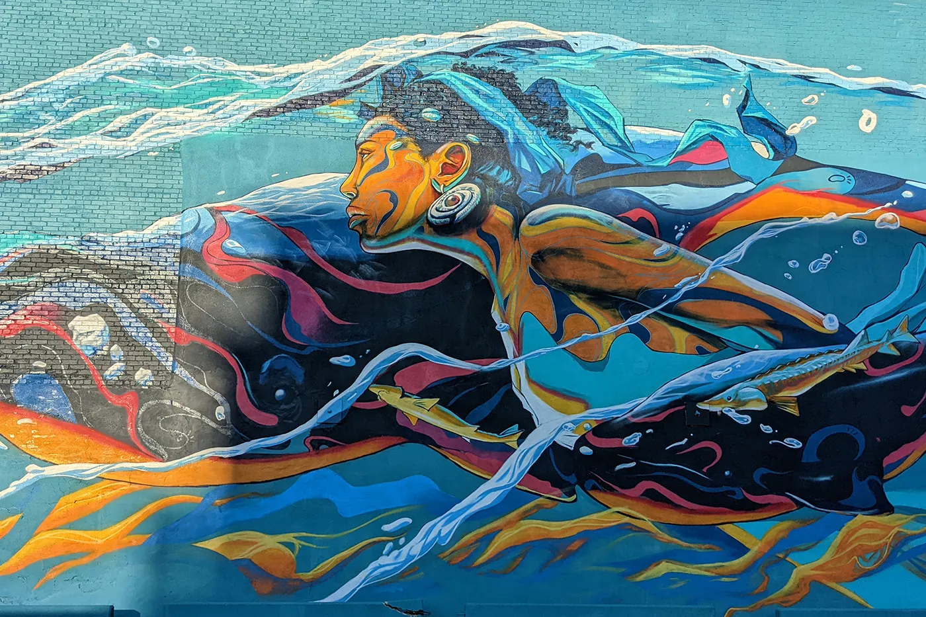
What do we notice?
What do we wonder?
How many bricks?
How can we come close?
Taj Francis
“Guiding Giants”
4.NBT.B5

Slide 17
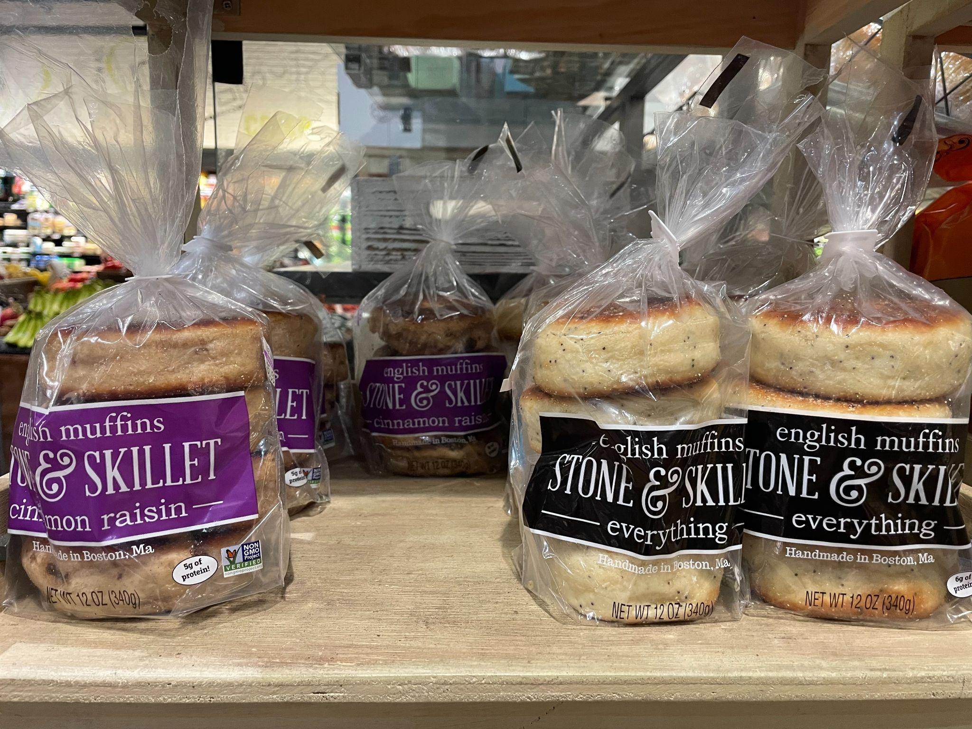
What do we notice?
What do we wonder?
Can we represent this photo as a multiplication sentence?
4.OA.A2

Slide 18
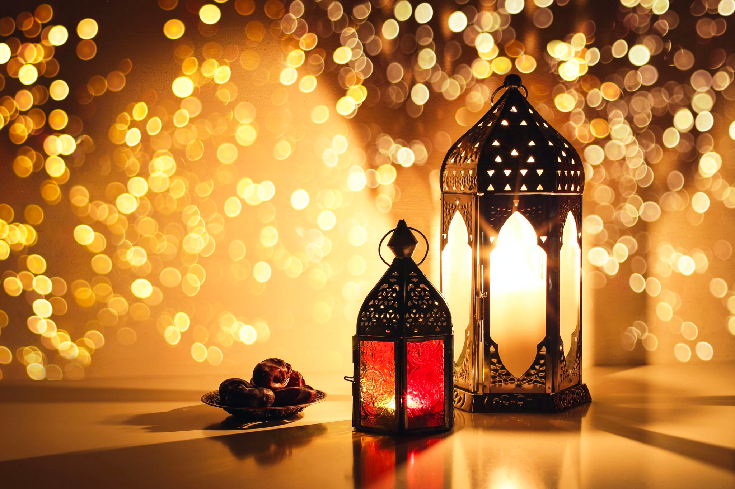
Ramadan Kareem رمضان كريم/مبارك
The month of Ramadan begins the Evening of March 22, 2023 - and ends the Evening of April 21, 2023.
How many days is that?
How many hours?
How many minutes?
4.MD.A1
Notes:
March 23, 2023
Ramadan

Slide 19
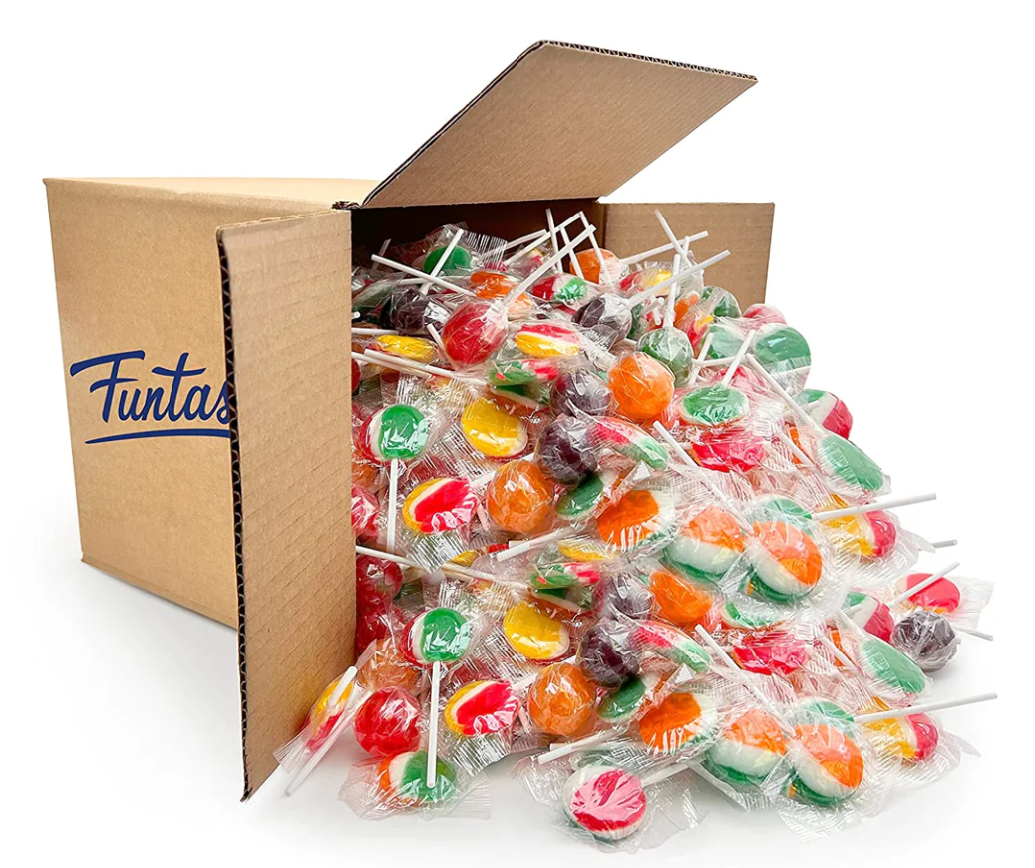
How many different ways can we EQUALLY share this box of 120 lollipops?
How will we know when we have all of the possibilities?
4.OA.B4

Slide 20
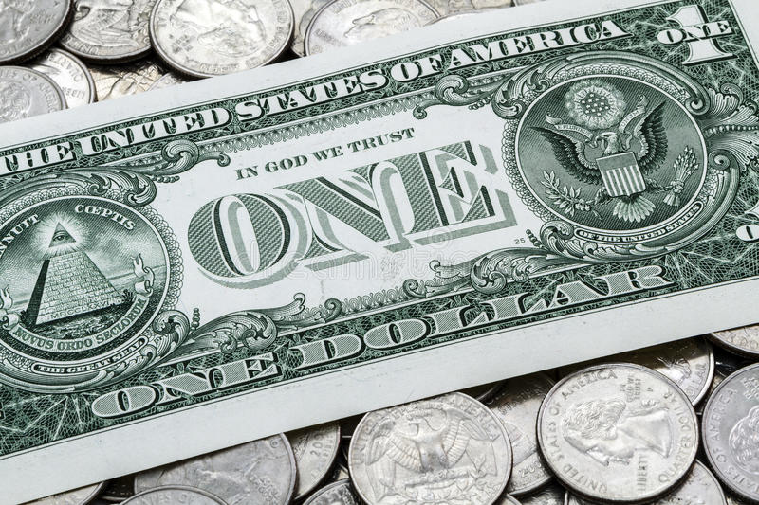
Would you rather get…
75¢ every day for the rest of your life
or
$5.00 a week for the rest of your life?
4.MD.A2
Notes:
Week of March 27, 2023

Slide 21
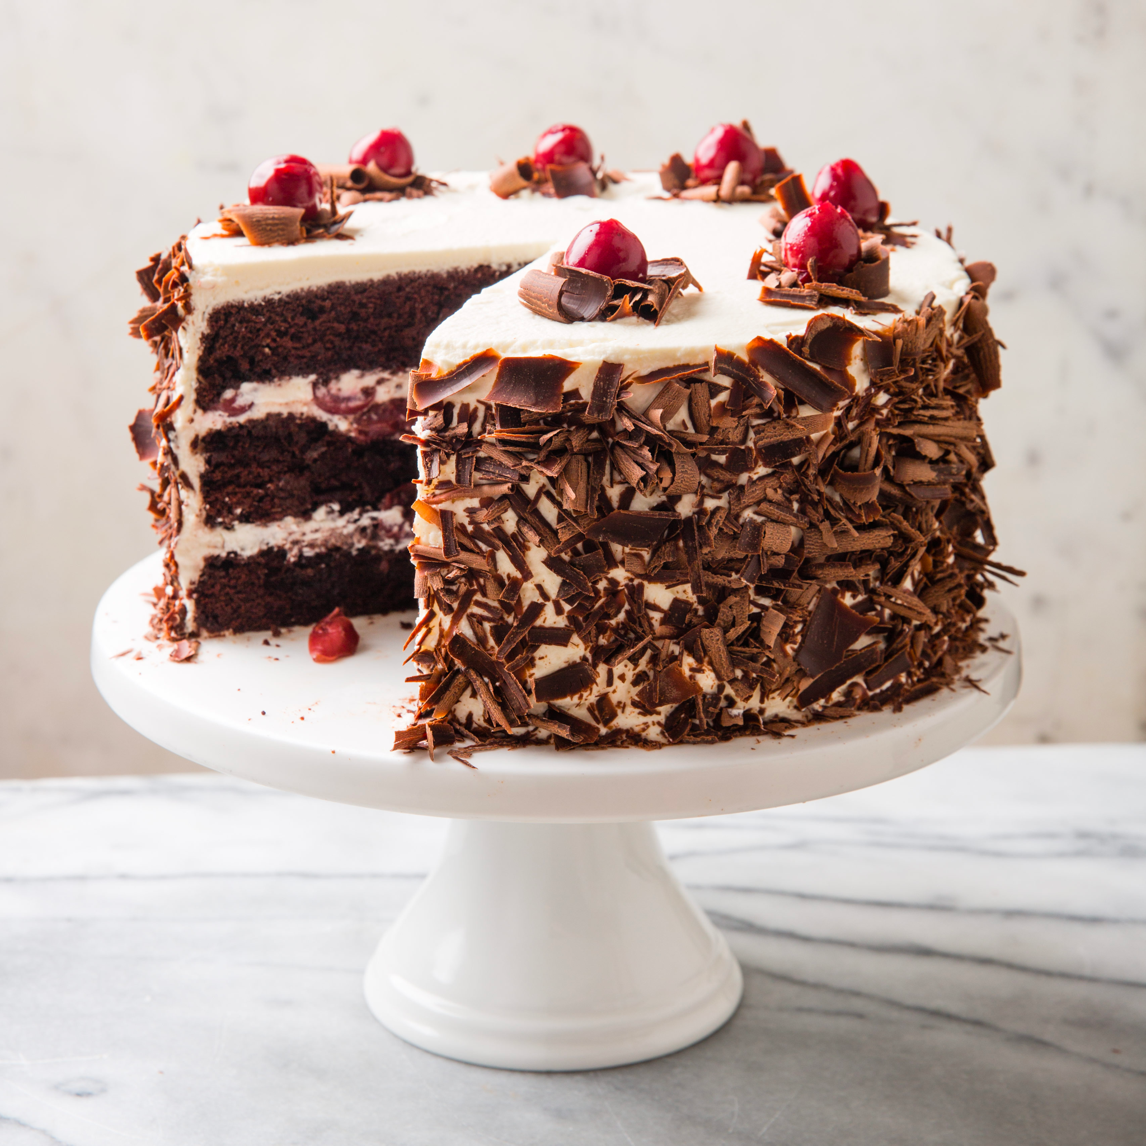
Happy Black Forest Cake Day!
About what fraction of the cake is missing?
Approximately what fraction of the cake remains?
How do you know?
4.NF.A2
Notes:
March 28, 2023

Slide 22
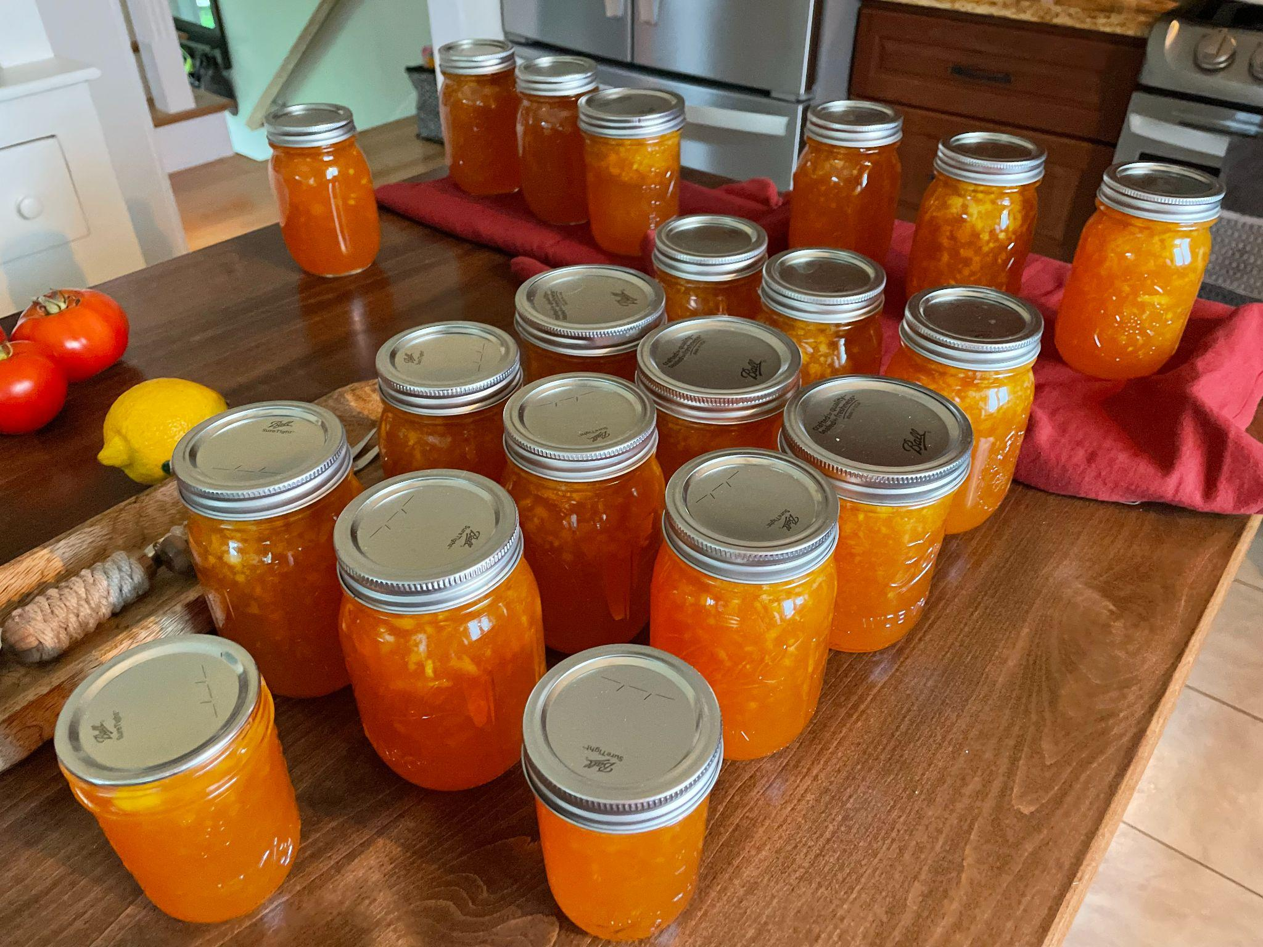
Each one of these jars of jam takes 2 ½ cups of peaches to make.
How many cups of peaches did we use?
How many quarts? Gallons?
4 cups = 1 quart
8 cups = half gallon
16 cups = 1 gallon
4.NF.B4, MD.A1

Slide 23
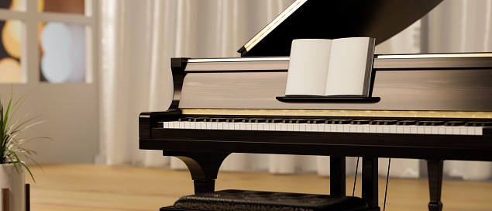
There are 230 strings in a grand piano.
Each string holds around 168 pounds of tension.
How much tension is that altogether?
Today is World Piano Day!
The piano can be considered both a string and a percussion instrument.
4.NBT.B5

Slide 24
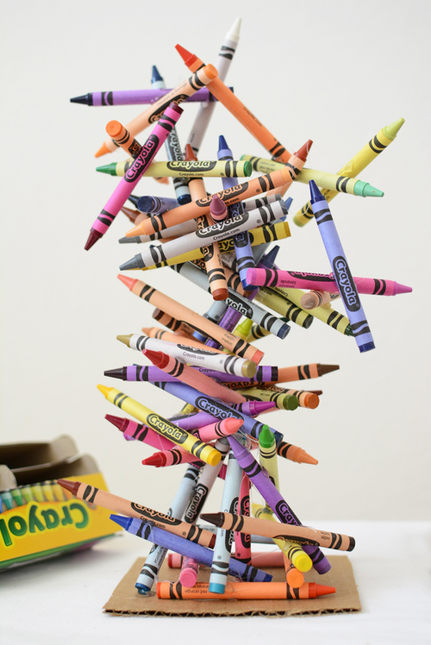
It’s Crayola Crayon Day!
The average student uses up 730 crayons by age 10 and spends an average of 30 minutes a day coloring!
How many minutes is that in a year?
How many hours is that?
4.MD.A2

