Slide 1
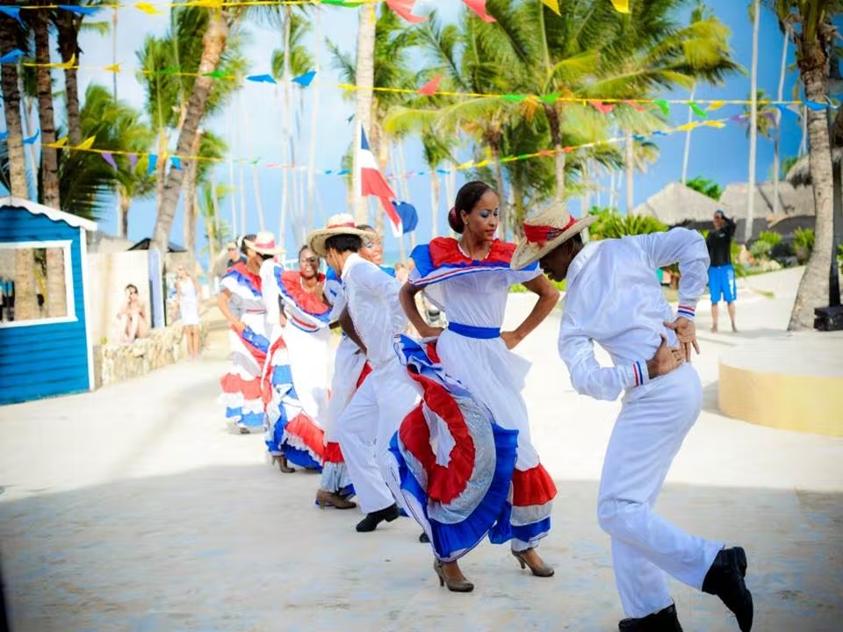
Happy Independence Day to the Dominican Republic!
The Dominican War of Independence made the Dominican Republic a state on February 27, 1844.
About how long ago was that?
How can we figure out exactly how long ago 1844 was? What strategies can we use?
2.NBT.A7
Notes:
Week of February 27, 2023
Dominican Republic Independence Day

Slide 2
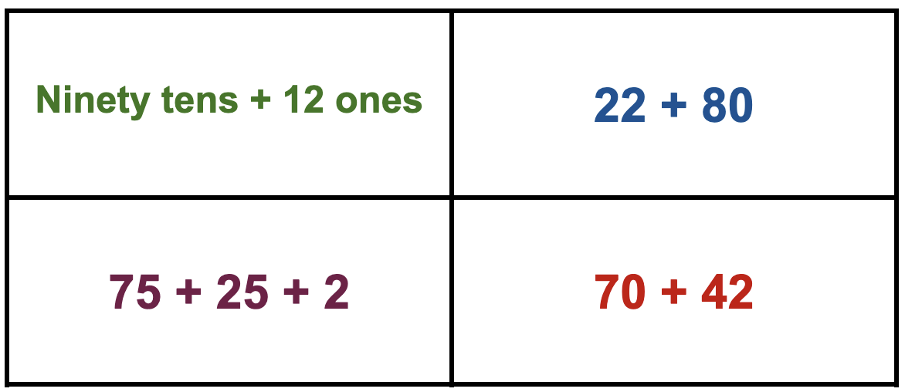
Which one does not belong?
2.NBT.B5

Slide 3
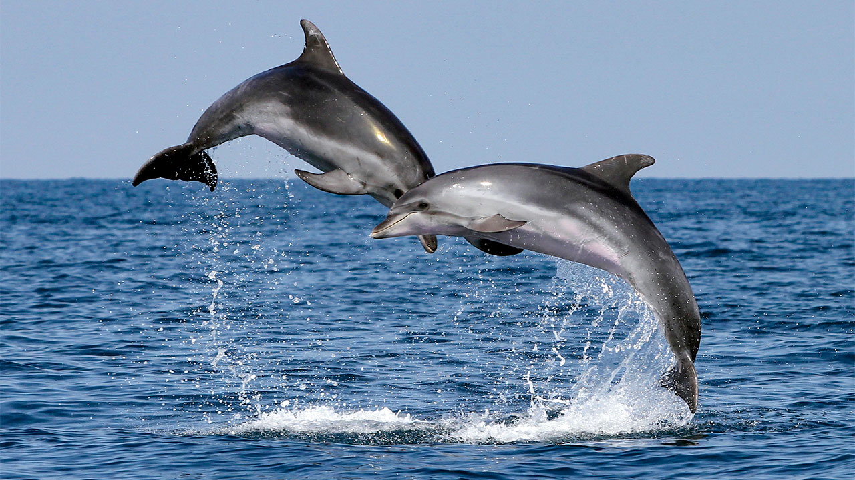
March is Dolphin Month!
There are 38 different species of dolphins!
How many different expressions can we create that equal 38?
2.OA.A1

Slide 4
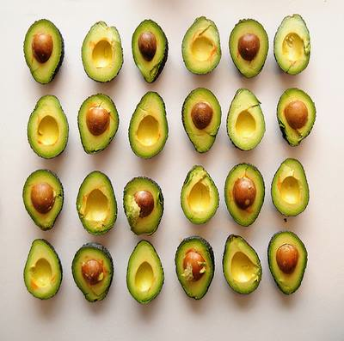
Happy
Veggie Month!
What do we notice?
What do we wonder?
How many different ways do we see the quantity?
How can we see “groups of?”
2.OA.C4

Slide 5
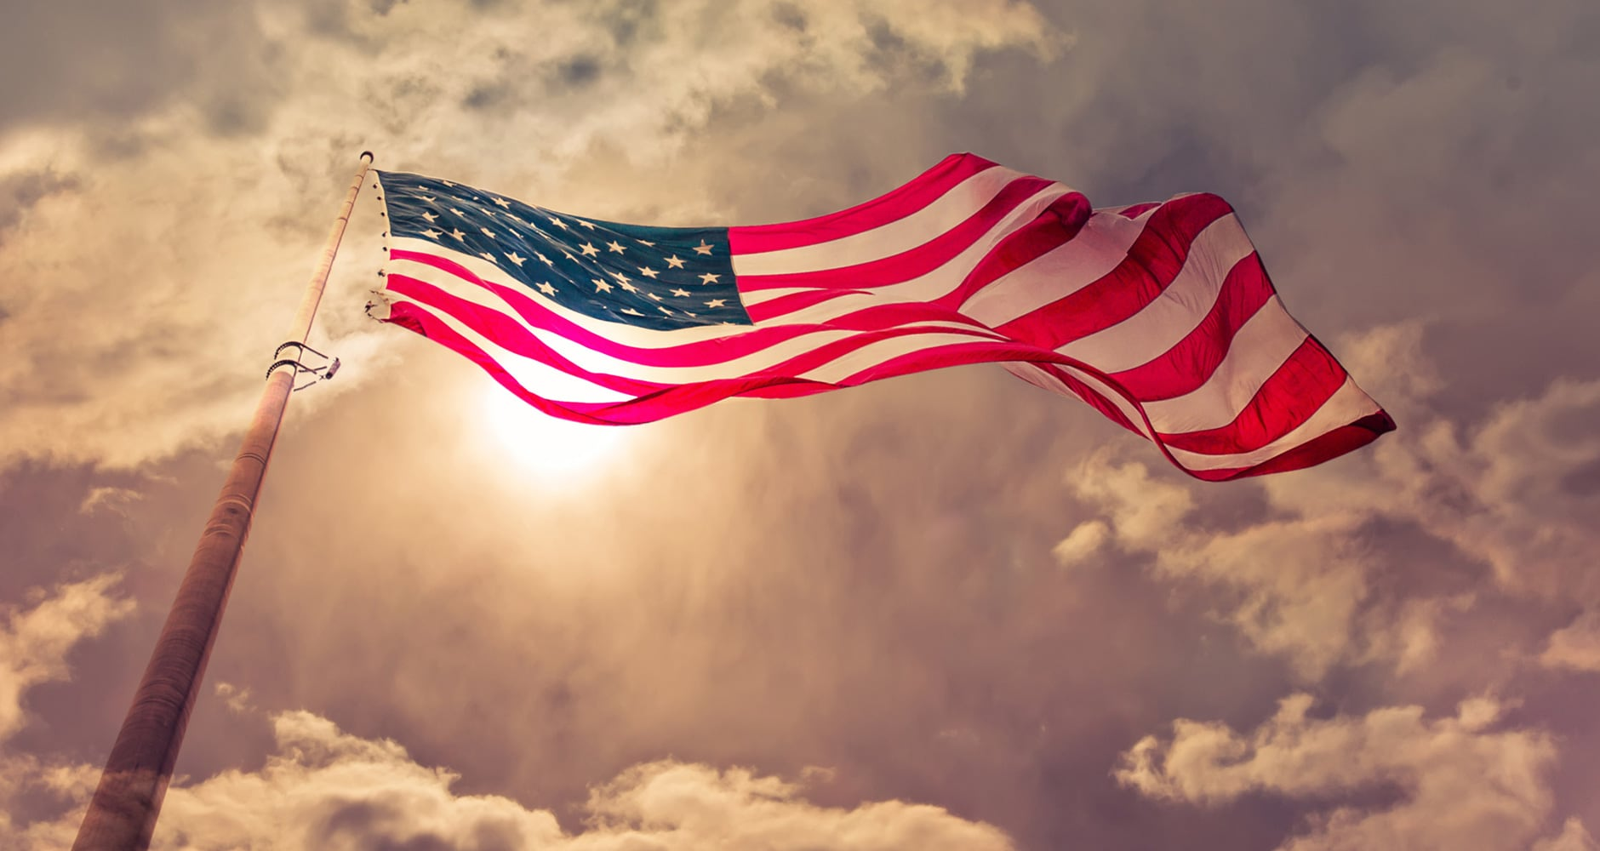
It’s National Anthem Day!
On March 3, 1931, President Herbert Hoover signed a congressional order into law making “The Star-Spangled Banner” America’s national anthem!
How long ago was that?
How can we solve this?
2.NBT.B7

Slide 6
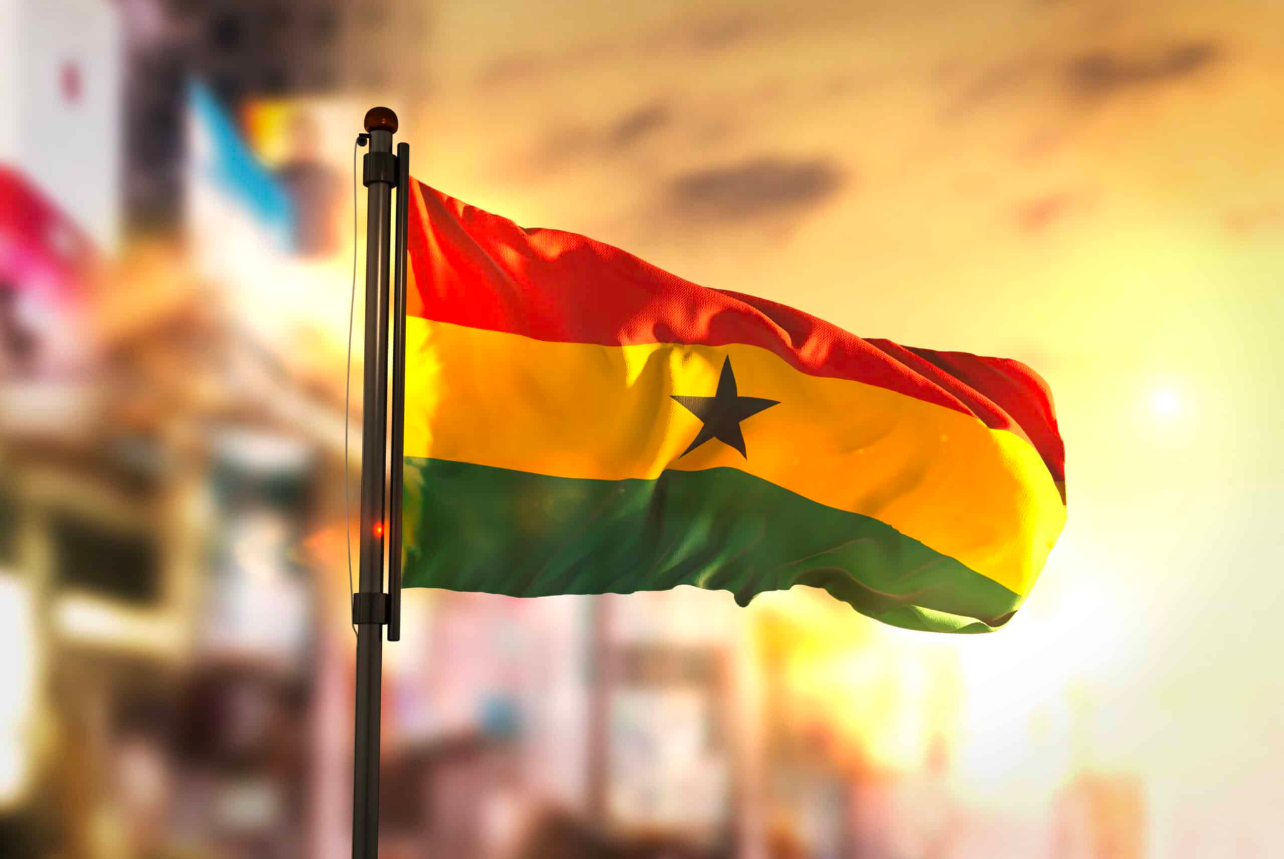
Happy Independence Day to Ghana!
Ghana, formerly the Gold Coast, is the first country south of the Sahara to gain Independence 66 years ago.
What year was that?
What strategies can we use to solve this?
2.OA.B7
Notes:
Week of March 6, 2023

Slide 7
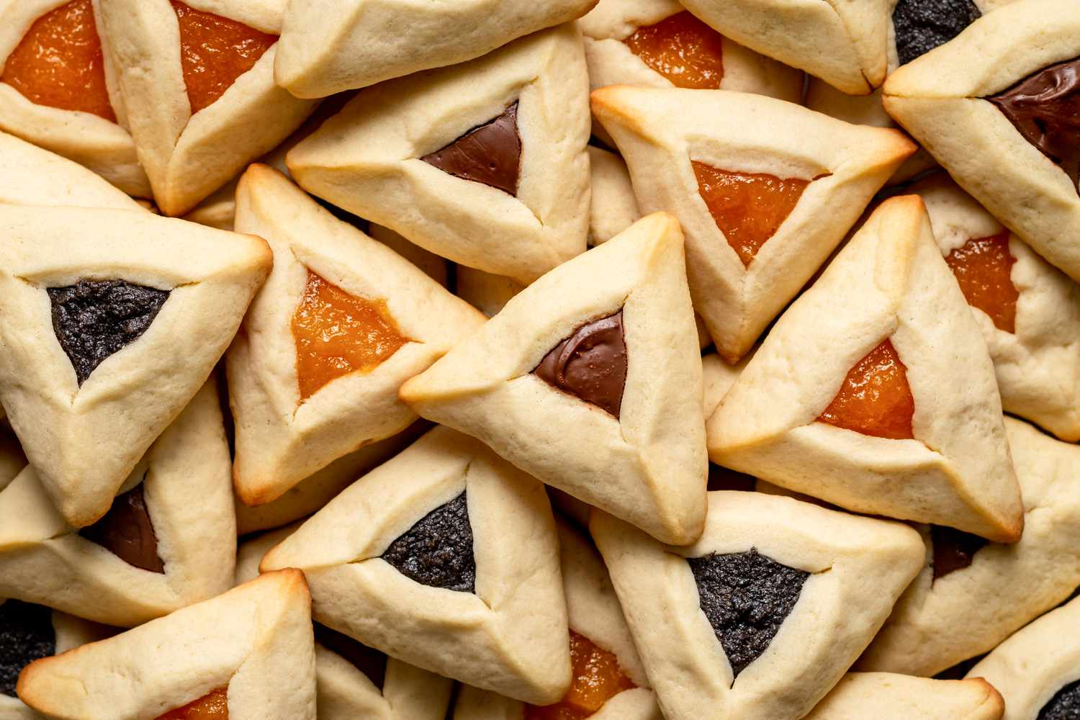
Happy Purim!
What are some different shapes we can make with triangles?
What can we make if we partition triangles?
2.G.A3
Notes:
March 7, 2023
Purim

Slide 8
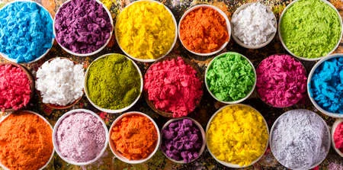
Happy Holi!
How many different equations can we create to match this photo?
2.OA.A1
Notes:
March 8, 2023

Slide 9
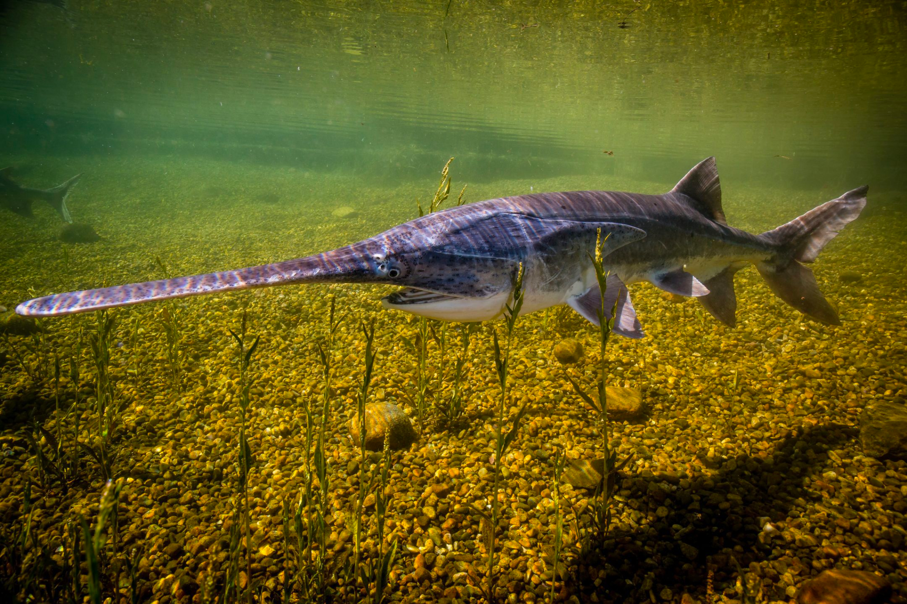
Today is American Paddlefish Day!
The American paddlefish is a 125-million year-old prehistoric species of freshwater fish.
The average length of a paddlefish is 8 feet long.
How long is that?
What else is about 8 feet long?
2.MD.A3

Slide 10

Happy Canberra Day!
March 12, 1913 Lady Gertrude Mary Denman, wife of then Governor-General Lord Denman, announced the official name of the city with the proclamation, “I name the capital of Australia, Canberra.”
How long ago was that?
What strategies can we use to solve this?
2.NBT.B7
Notes:
Week of March 13, 2023
Canberra Day in Australia

Slide 11
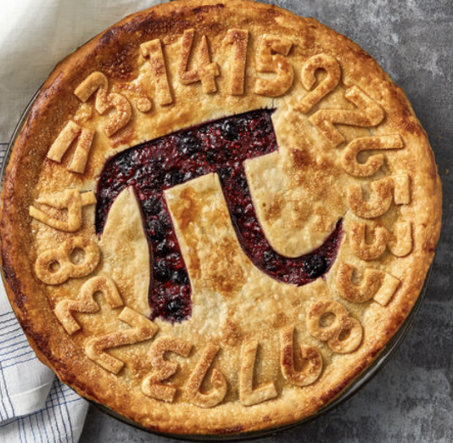
Happy Pi Day!
What do we notice about this pie?
What do we wonder?
How many different ways can we partition a circle into EQUAL pieces?
2.G.A3
Notes:
March 14, 2023
Pi Day!

Slide 12
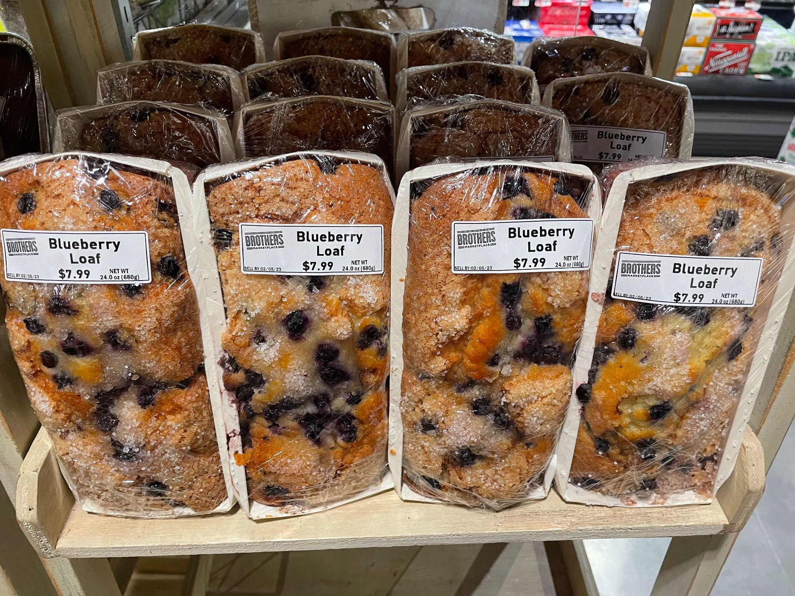
What do we notice?
What do we wonder?
Where’s the math?
2.OA.A4

Slide 13
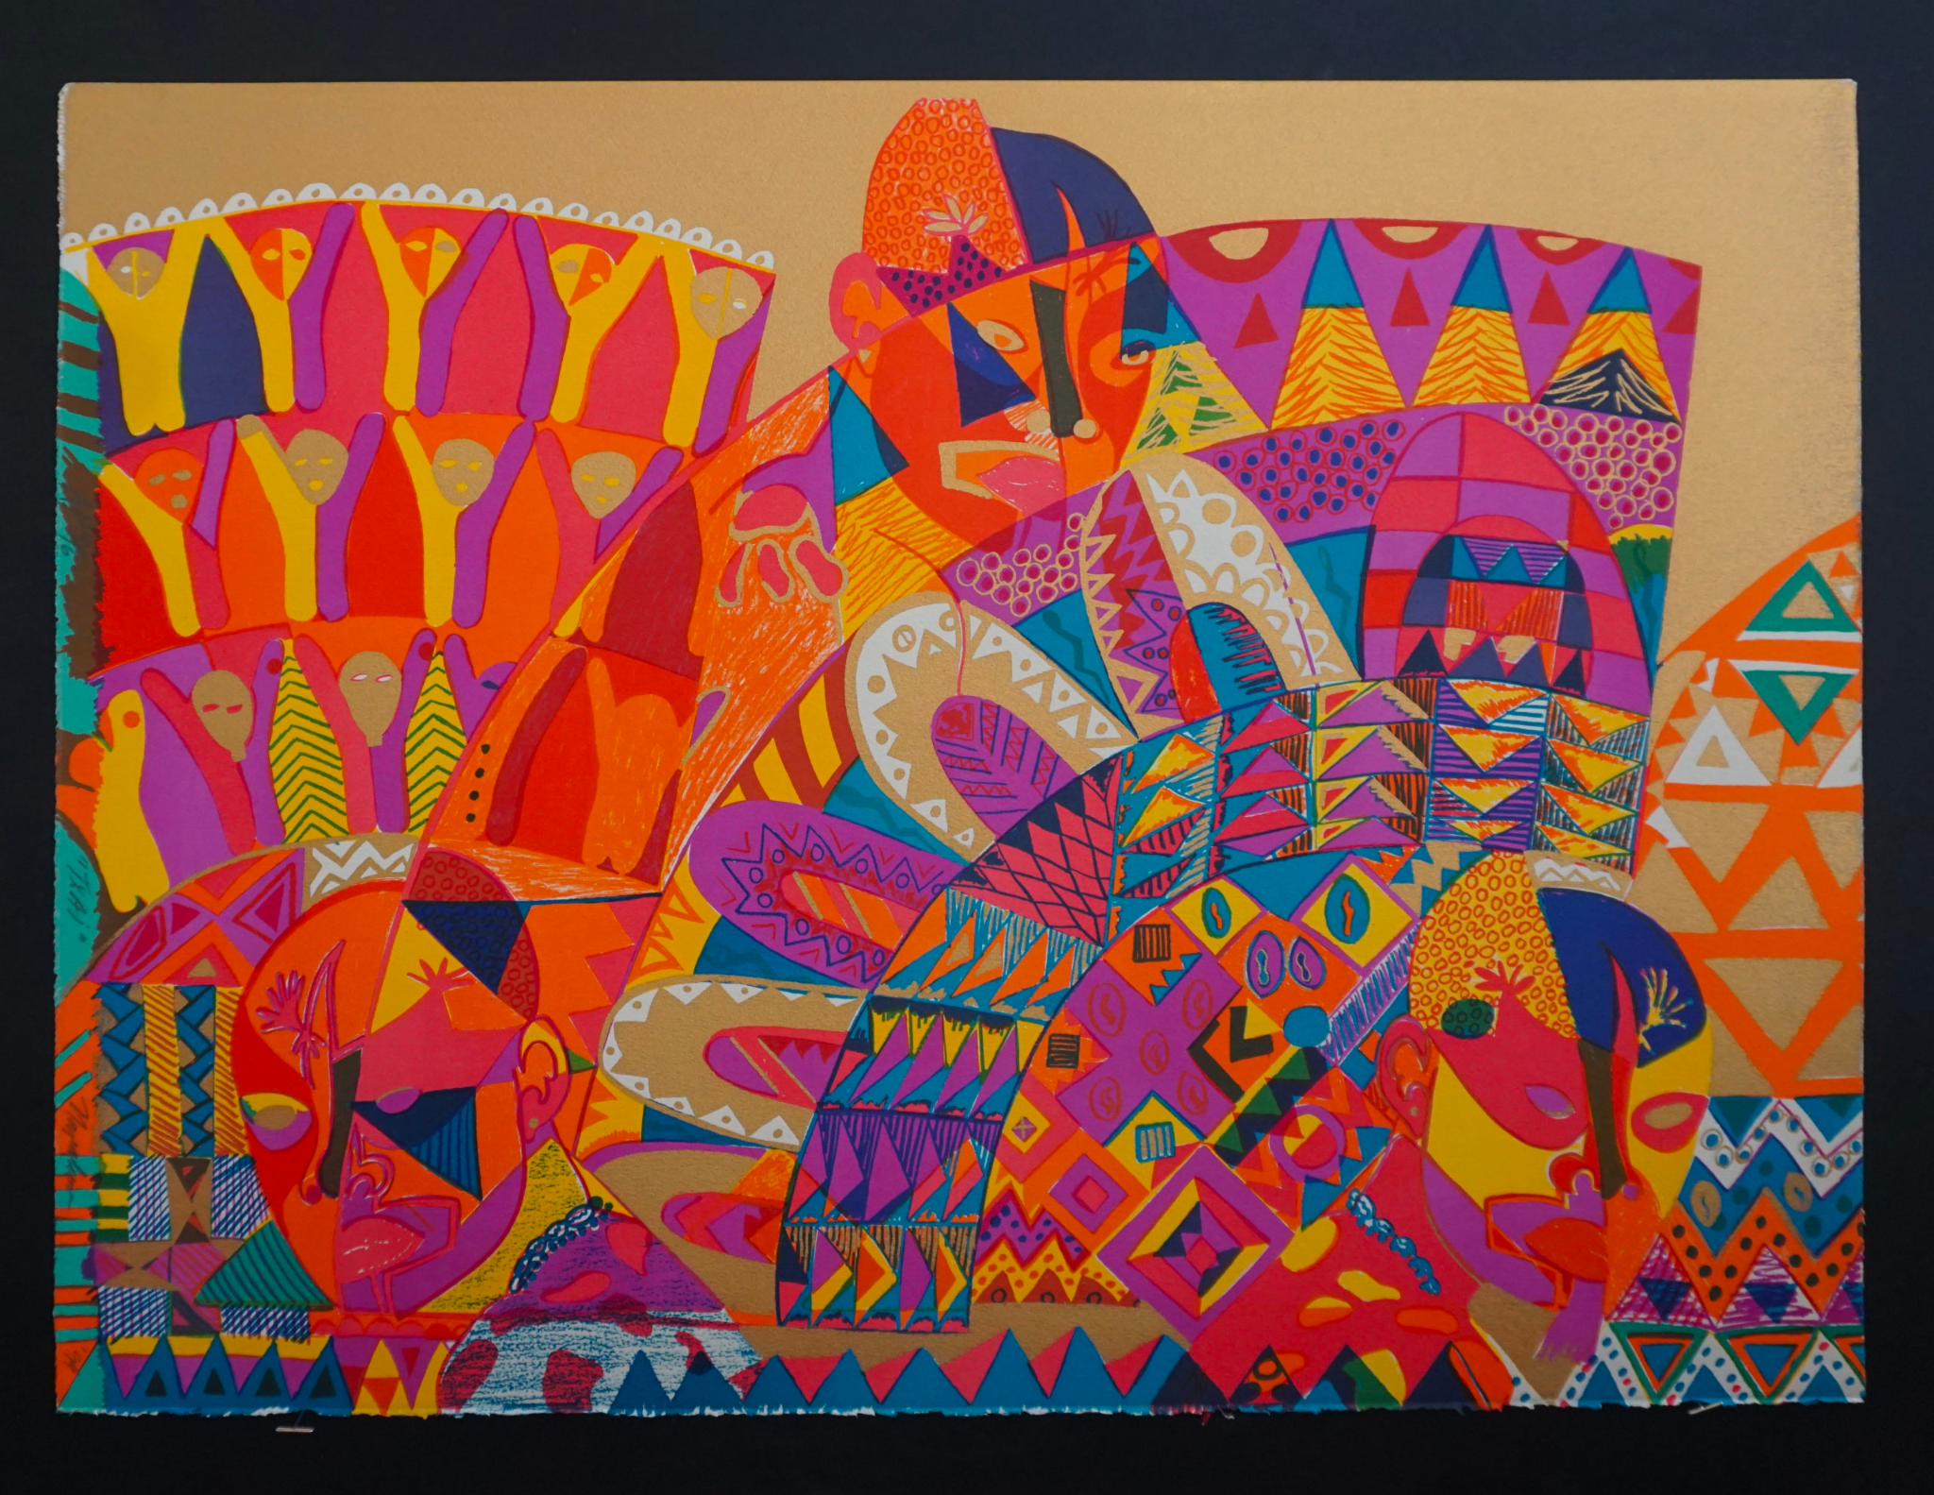
Let’s investigate the shapes we see in “Txai” by Napoleon Jones-Henderson.
Pick a shape and partition it!
What do you have now?
2.G.A3

Slide 14
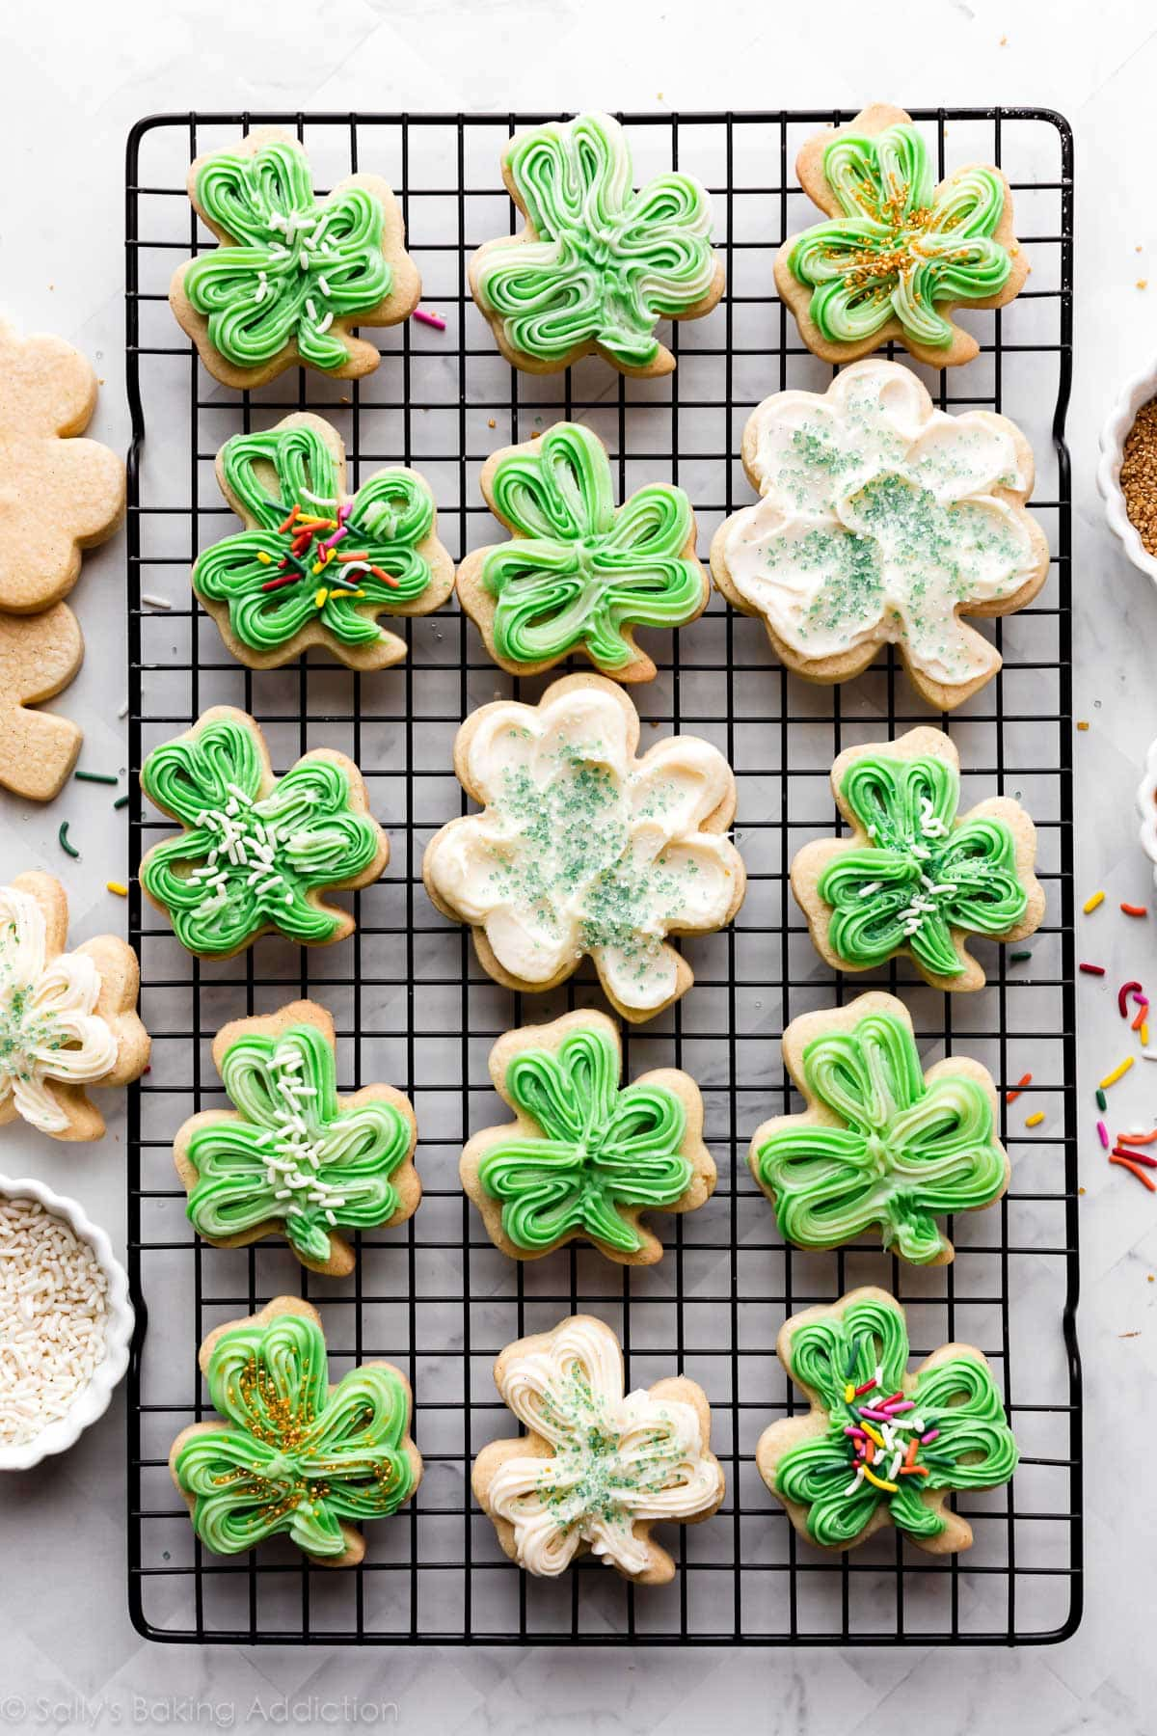
Happy St. Patrick’s Day
Here is 1 batch of cookies!
How many would there be in 2 batches of cookies?
3 batches?
Do we see any patterns?
2.OA.C3

Slide 15
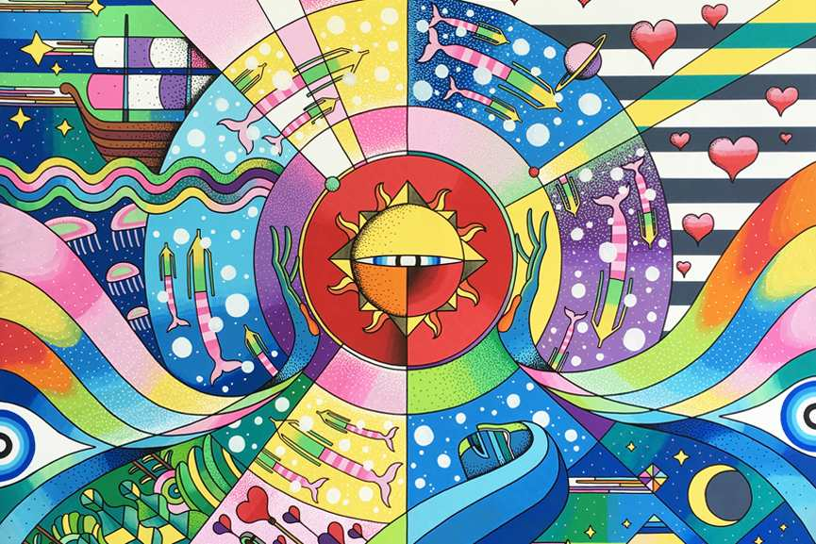
Today is International Day of Happiness!
Research shows that children smile an average of 400 times per day.
How many times do children smile in one week?
One month?
2.NBT.B8
GO SUGA
“Way to Happiness”
Notes:
Week of March 20, 2023
International Day of Happiness

Slide 16
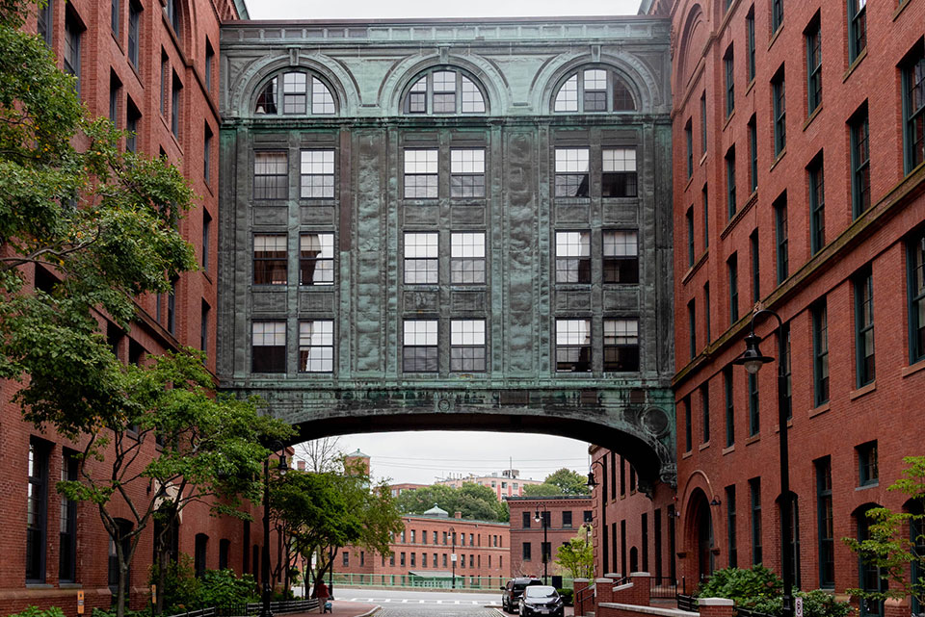
How many different quadrilaterals do we see here?
Can we name them?
How many windows are here?
How do we know?
2.G.A1

Slide 17

500 - 70 < 400 + 30
523 + 100 > 620
750 - 100 < 600
2.NBT.A1

Slide 18
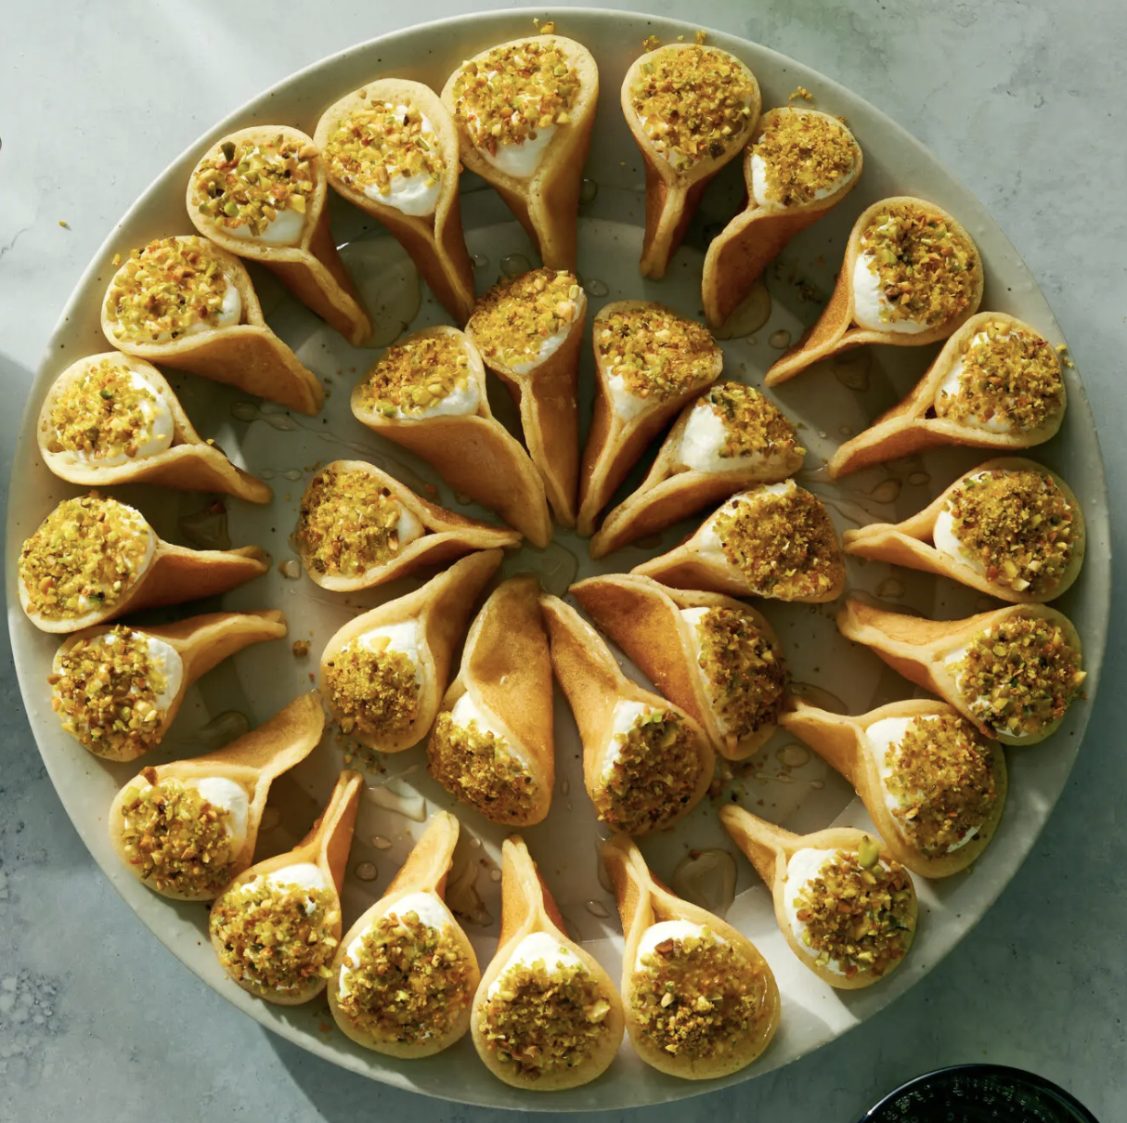
Ramadan Kareem
How many Qatayef Asafiri do we see here?
Let’s write a number sentence to match this photo.
2.OA.A1
Notes:
March 23, 2023
Ramadan

Slide 19
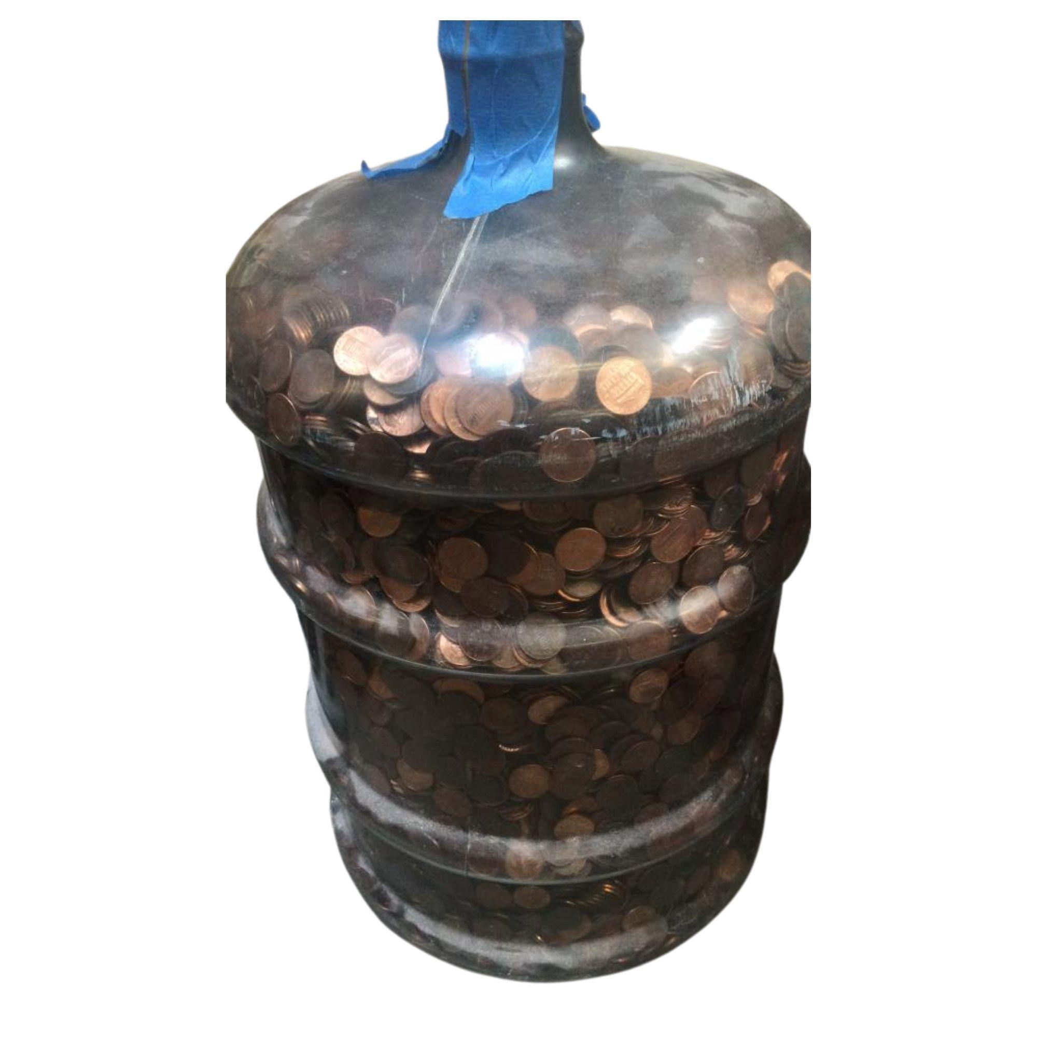
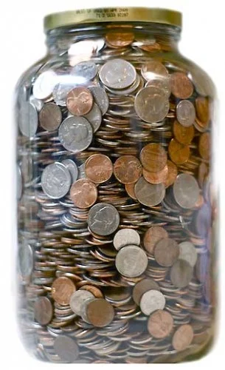
Would you rather …
5-gallon jug of pennies
OR
1-gallon jug of mixed coins?
2.MD.C8

Slide 20
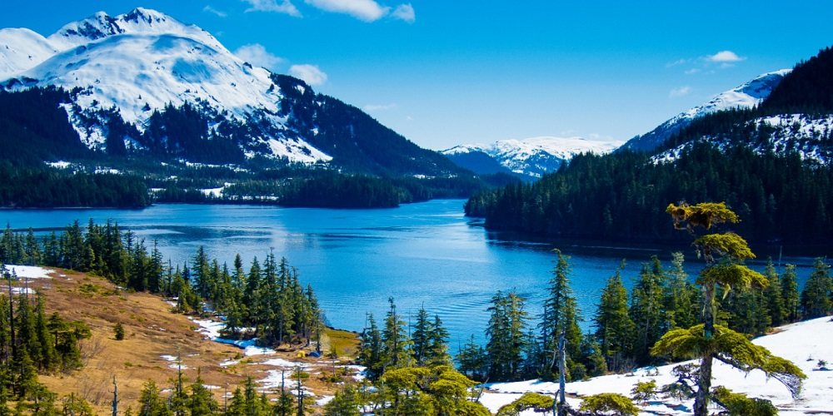
Today is Seward’s Day in Alaska, it commemorates the signing of the Alaska Purchase treaty on March 30, 1867!
How long ago was that? How do we know?
2.NBT.B7
Notes:
Week of March 27, 2023

Slide 21
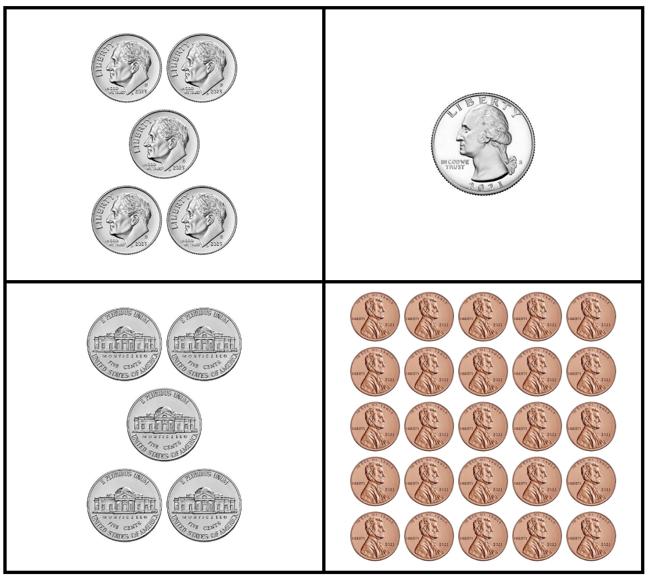
Which one doesn’t belong?
2.MD.B8

Slide 22
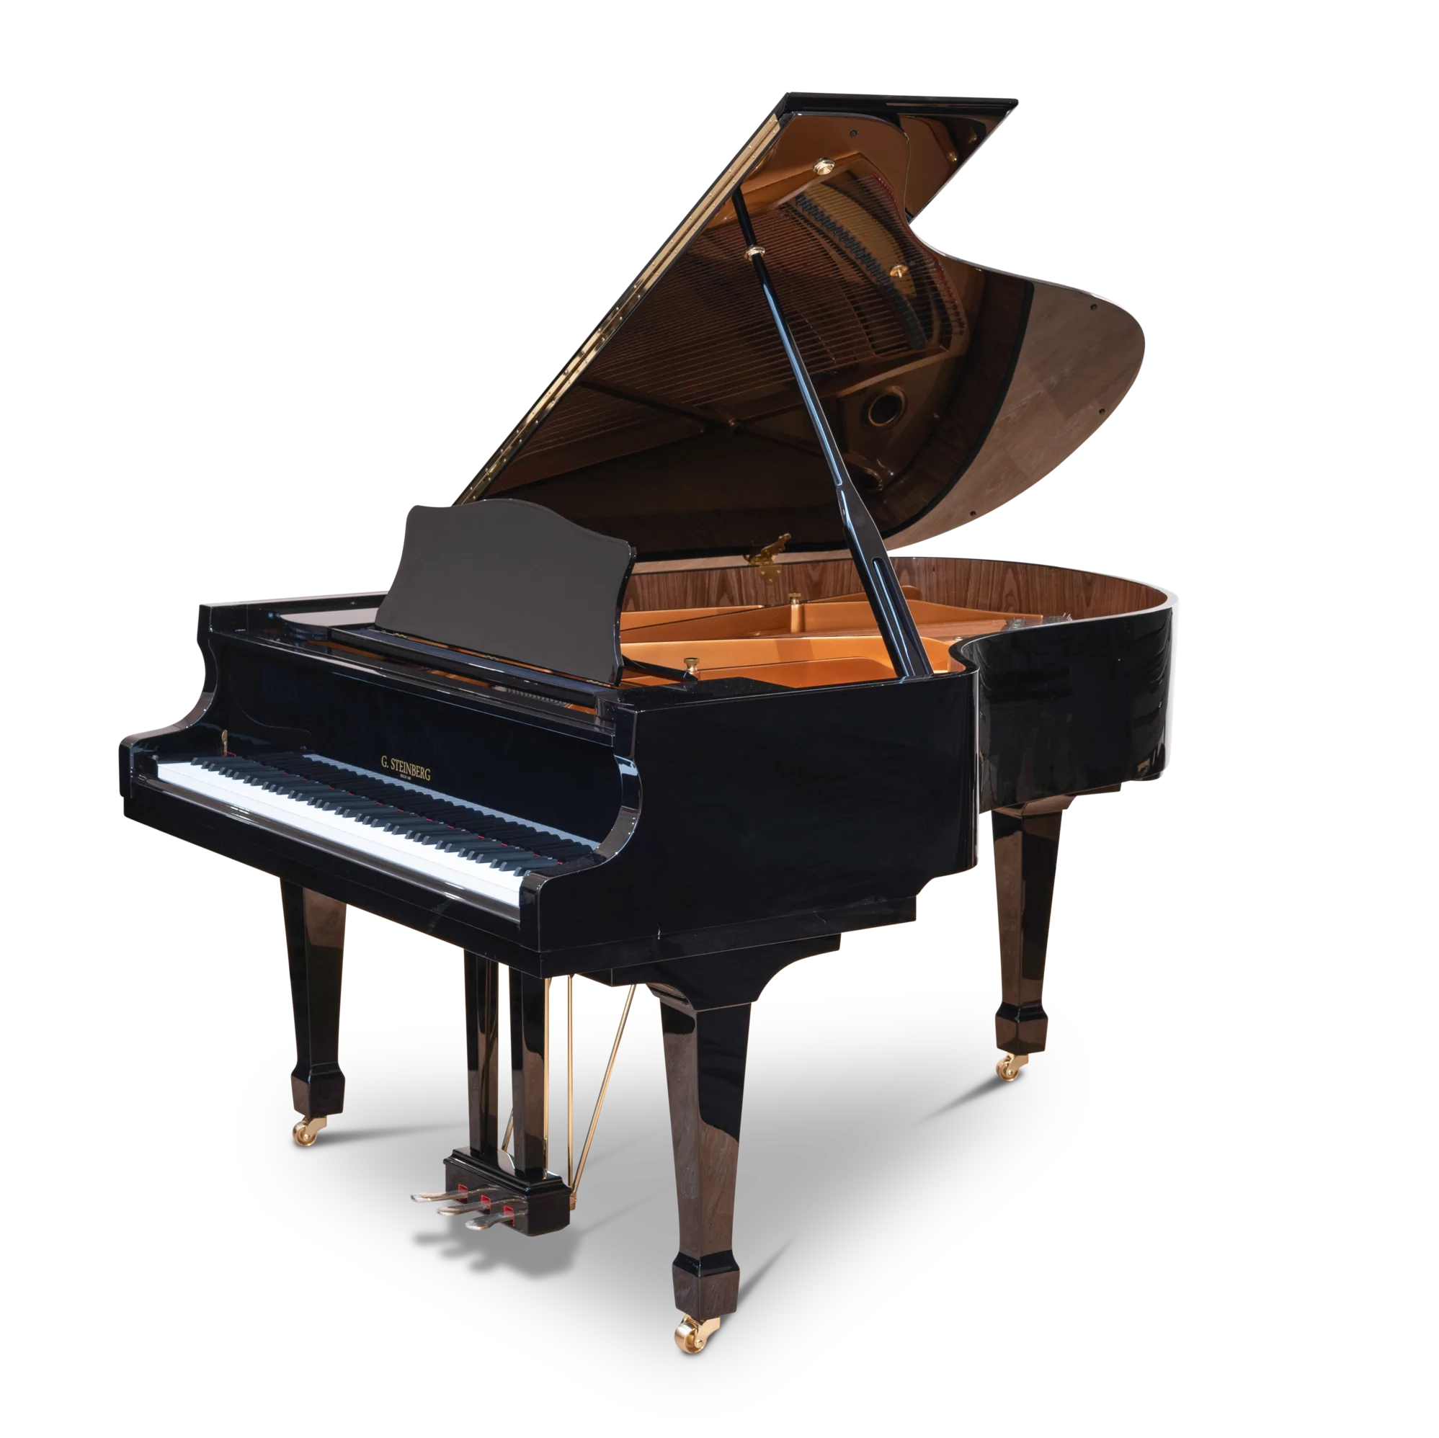
Today is World Piano Day!
World Piano Day is celebrated on the 88th day of the year!
Do you wonder why?
There are 88 keys on a piano?
There are 16 more white keys than black keys.
Can we figure out how many there are of each?
2.OA.A1

Slide 23
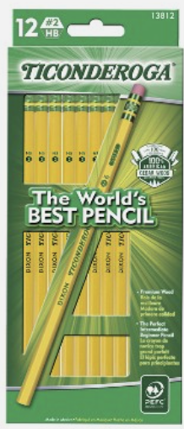
It’s National Pencil Day!
How many pencils are here altogether?
What strategies can we share to figure this out?
2.NBT.B5

Slide 24
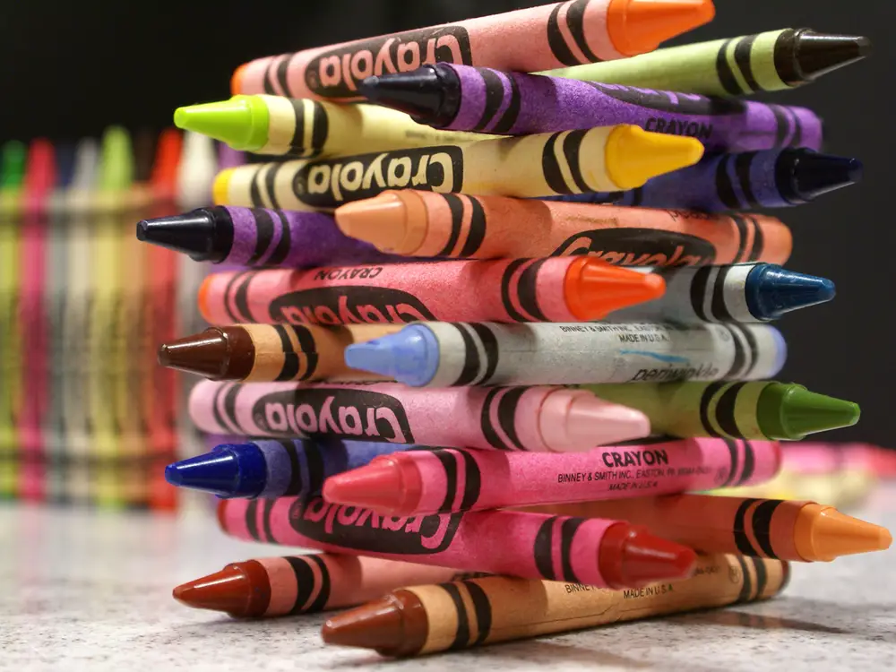
Happy Crayola Crayon Day!
There are currently 120 different Crayola Crayon colors!
How many different ways can we COUNT to 120?
How many different expressions can we create that equal 120?
2.NBT.A2

