Slide 1



What is the same?
What is different?
1.NBT.B2

Slide 2
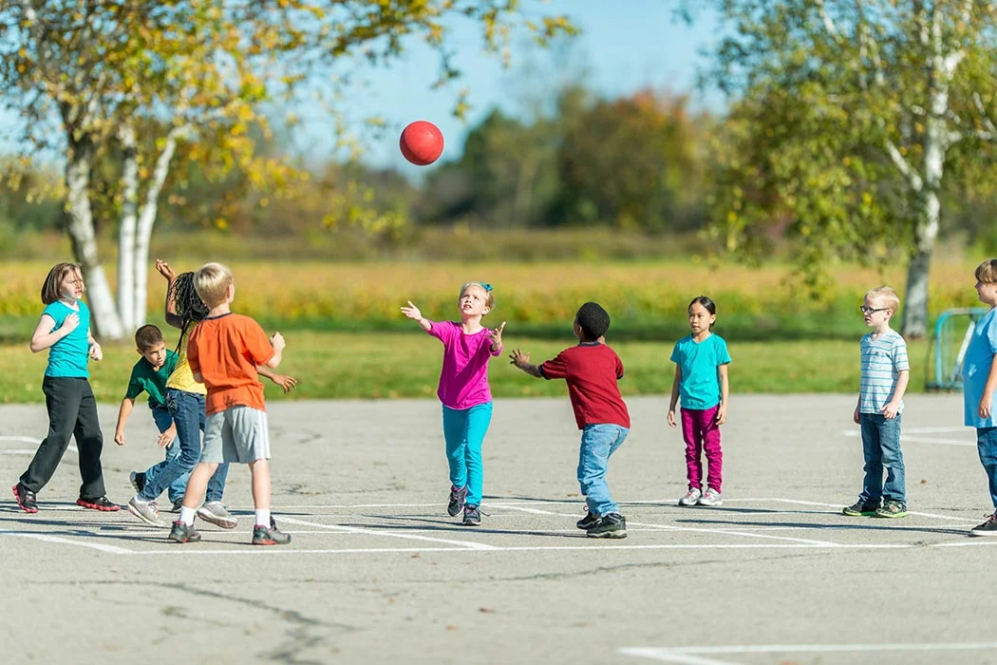
Would you rather…
Have THREE 15-minute recesses each day,
or ONE recess for 1 hour every day?
1.MD.B3

Slide 3
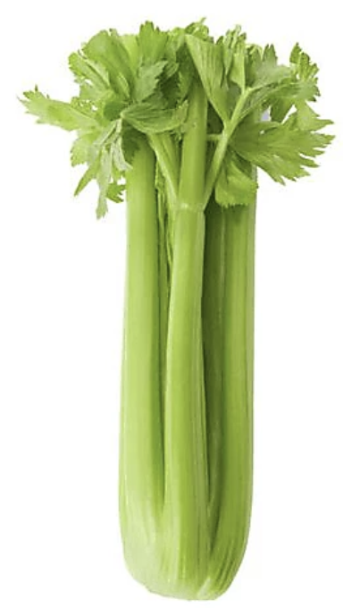
It’s National Celery Month!
How many stalks of celery do you think are here?
9
How many are here?
1.NBT.C4

Slide 4
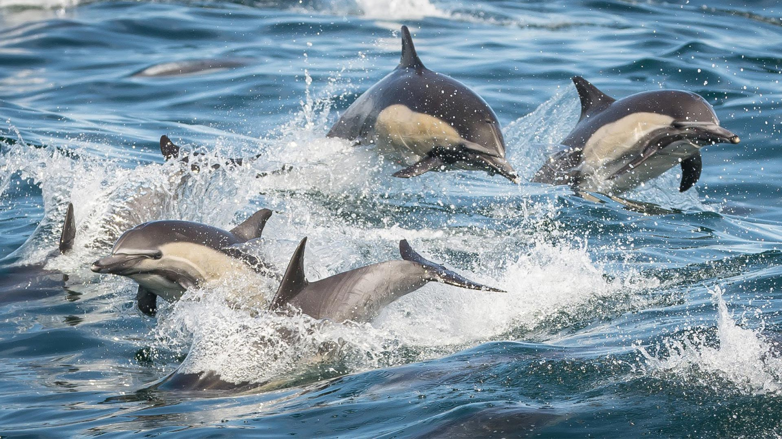
Happy Dolphin Month!
There are 38 different species of dolphins!
How many different expressions can we create that equal 38?
1.NBT.C4

Slide 5
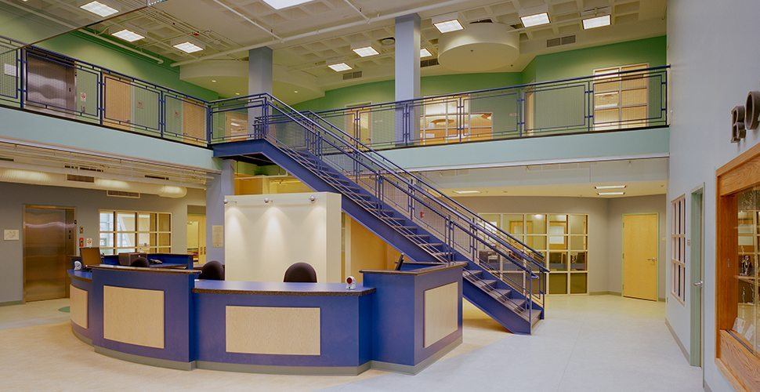
How many rectangles do we see in this photo of the Yawkey Boys & Girls Club?
1.G.A1

Slide 6

Happy Independence Day Ghana!
Let’s talk about the shapes we see in the flag of Ghana.
What would happen if we partitioned some of the shapes?
1.G.A3
Notes:
Week of March 6, 2023
Ghana Independence Day

Slide 7
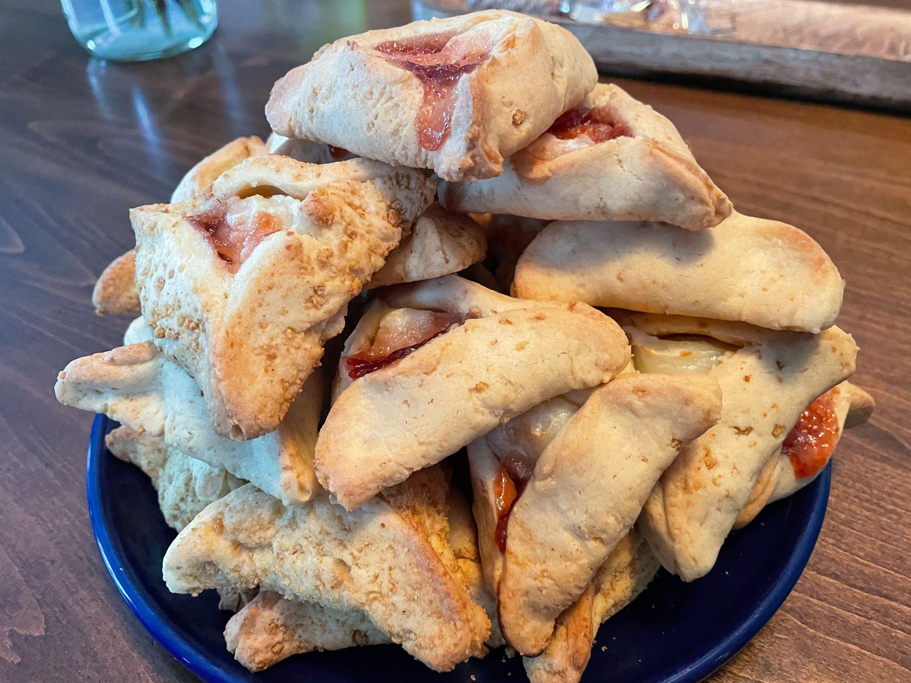
Happy Purim!
How many hamantaschen are here?
What is a good estimate?
Do we think there are more than 20 or less than 20?
1.OA.C5
Notes:
March 7, 2023
Purim

Slide 8
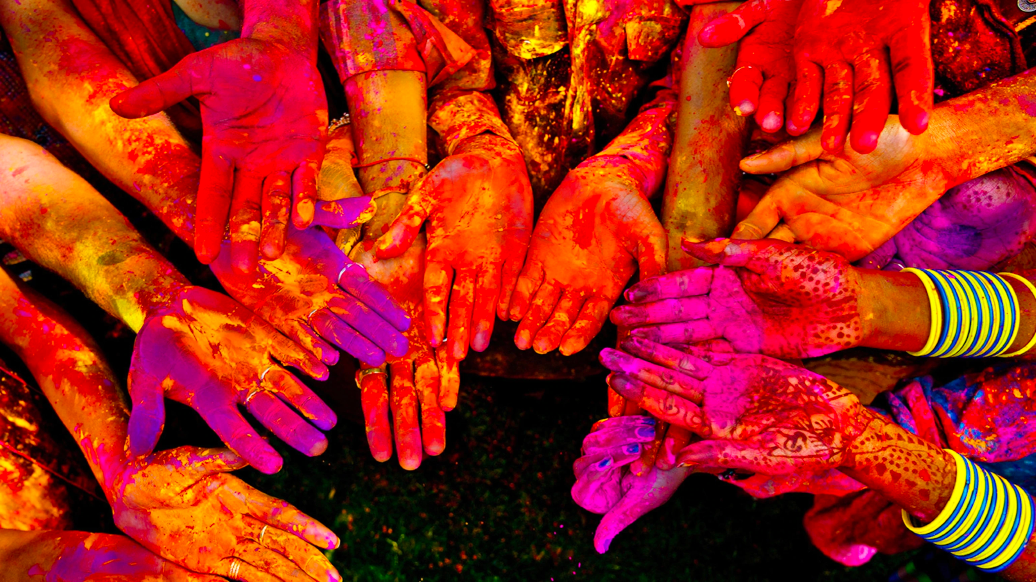
Happy Holi!
How many hands are here?
How many fingers?
1.NBT.A1
Notes:
March 7, 2023
Holi

Slide 9
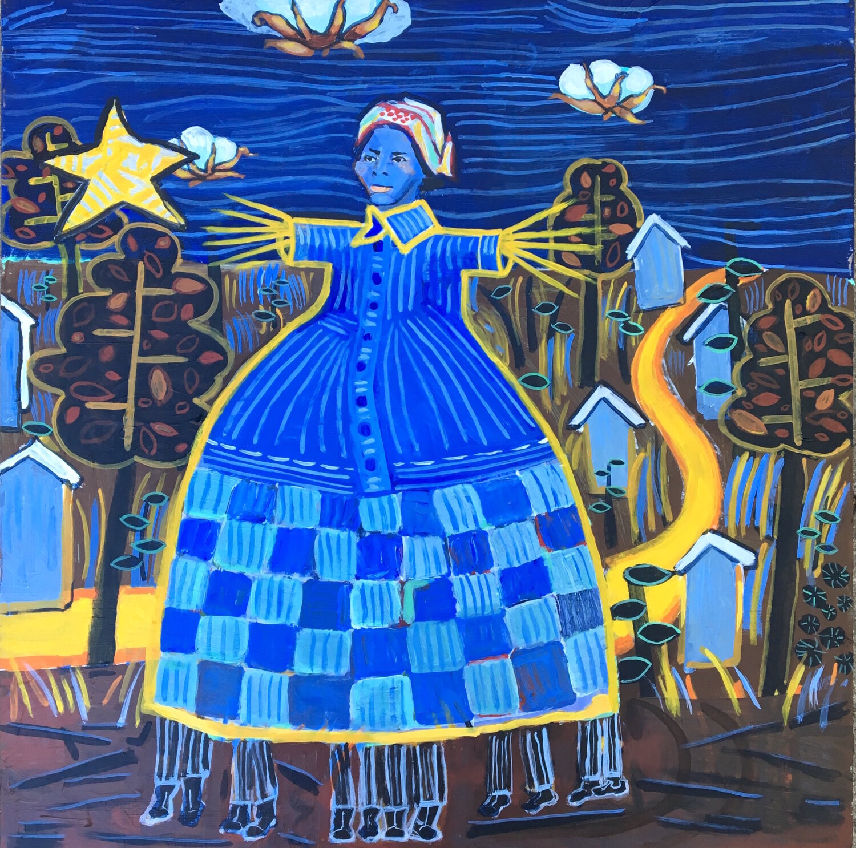
Celebrate Harriet Tubman Day!
What different shapes can we find in this painting by Anne Skok?
Sketch one of the shapes.
Now sketch a shape that is DIFFERENT than your shape in 2 ways!
1.G.A2
Notes:
March 9, 2023
Harriet Tubman Day

Slide 10
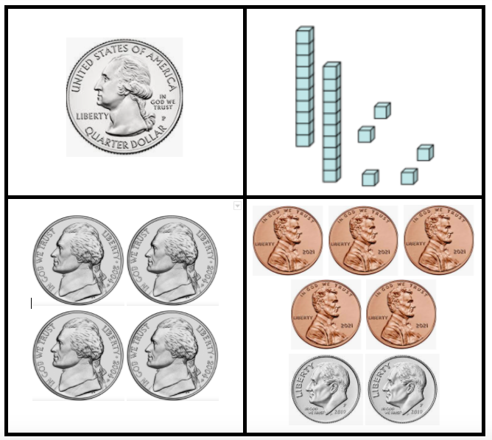
Which one doesn’t belong?
1.MD.D5
Notes:
Week of March 13, 2023

Slide 11

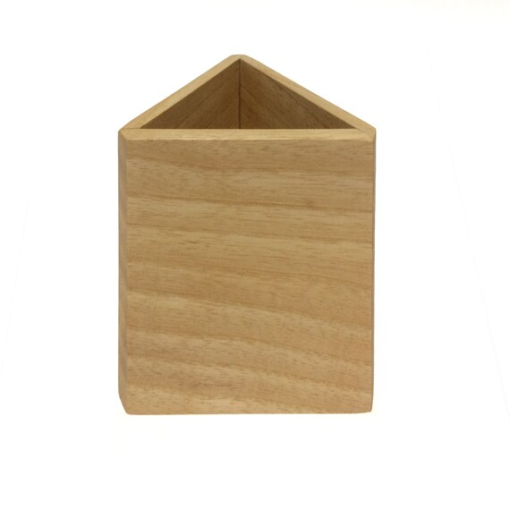
What is the same?
What is different?
1.G.A2

Slide 12
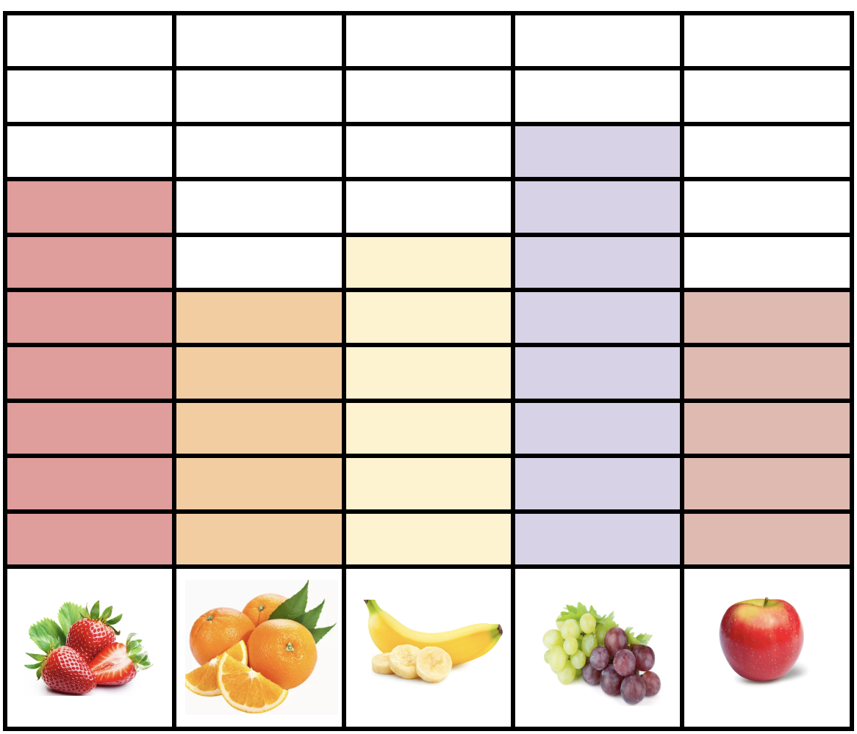
If this graph could talk what would it say?
What number statements can we make?
1.MD.C4

Slide 13
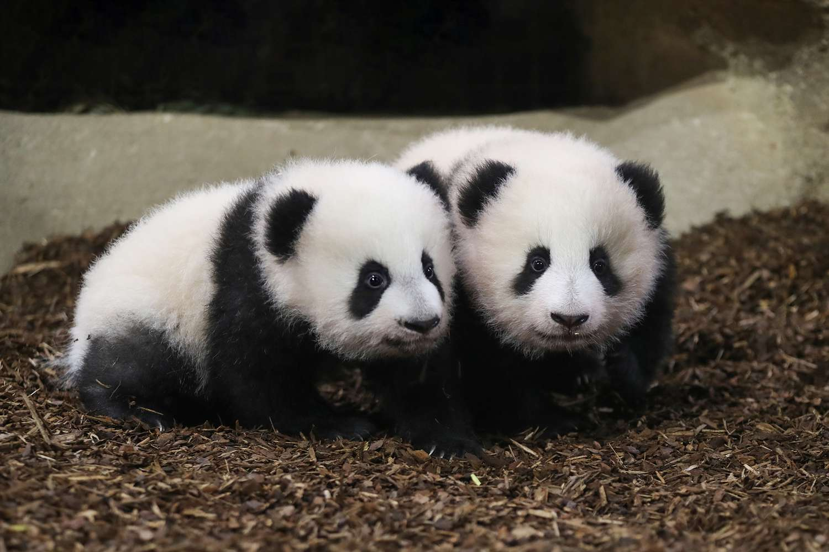
Happy National Panda Day!
These twin pandas weigh 35 pounds together.
What is possible?
1.NBT.C4
Notes:
March 16, 2023
National Panda Day

Slide 14
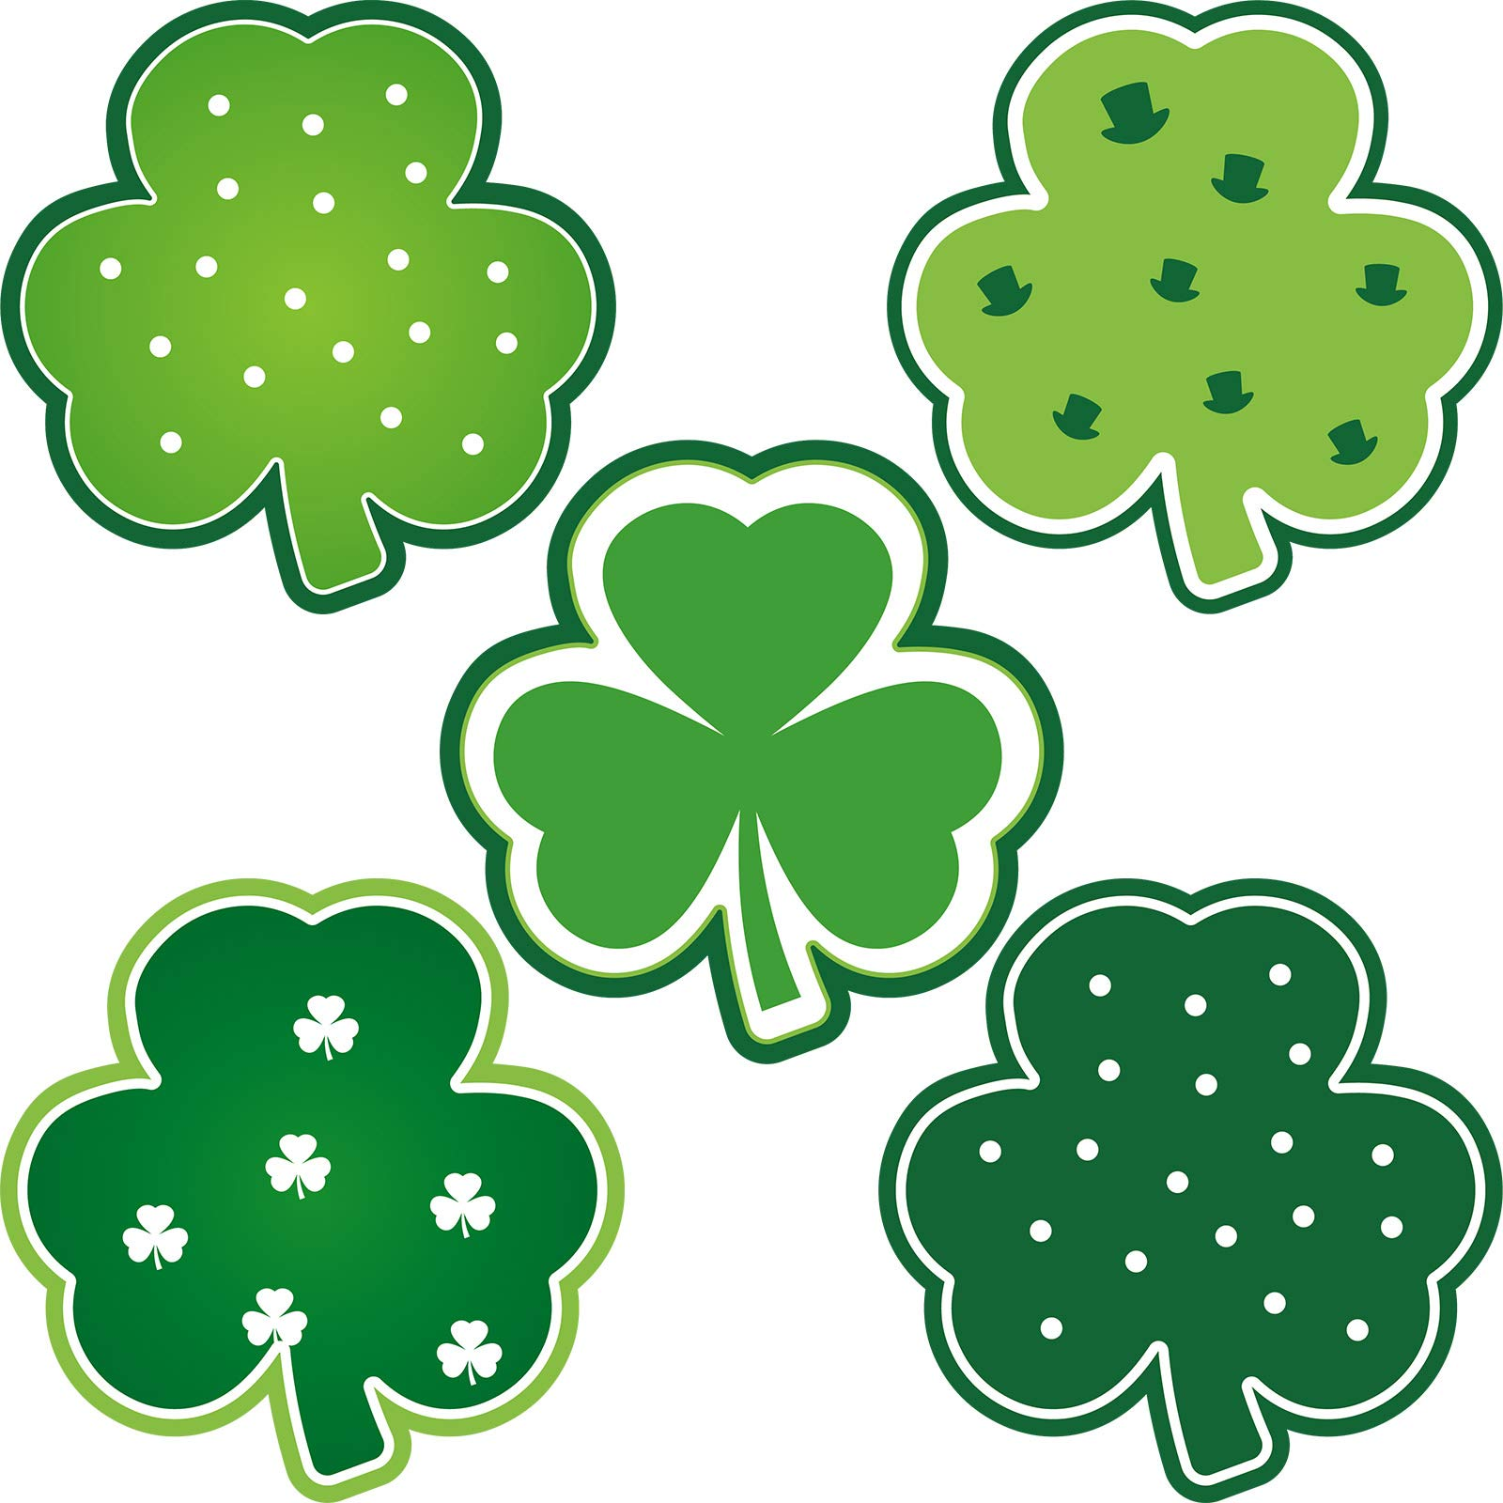
What is the same?
What is different?
Which one doesn’t belong?
1.SMP.3

Slide 15
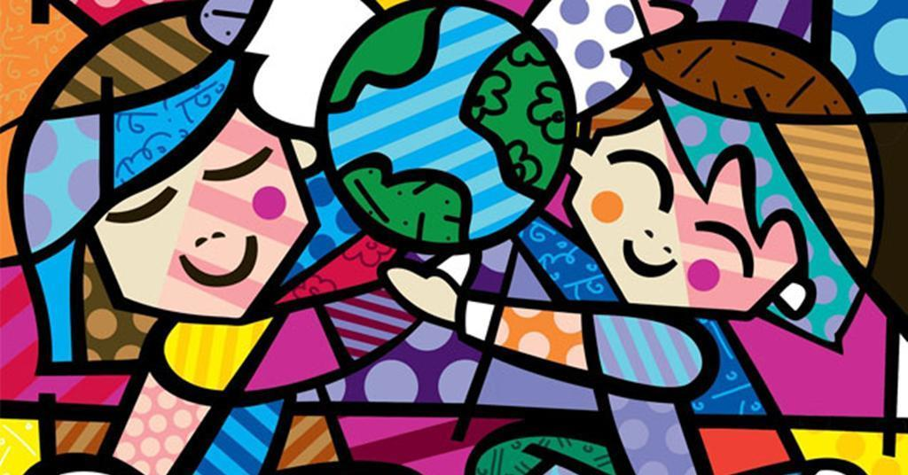
1.G.A1
It’s INTERNATIONAL HAPPINESS DAY! Let’s find some interesting shapes in this happy painting by Romero Britto.
Notes:
Week of March 20, 2023
Happiness Day!

Slide 16

34 + 50 = 30 + 54
70 + 9 = 19 + 50
13 + 30 = 20 + 23
1.NBT.B3

Slide 17
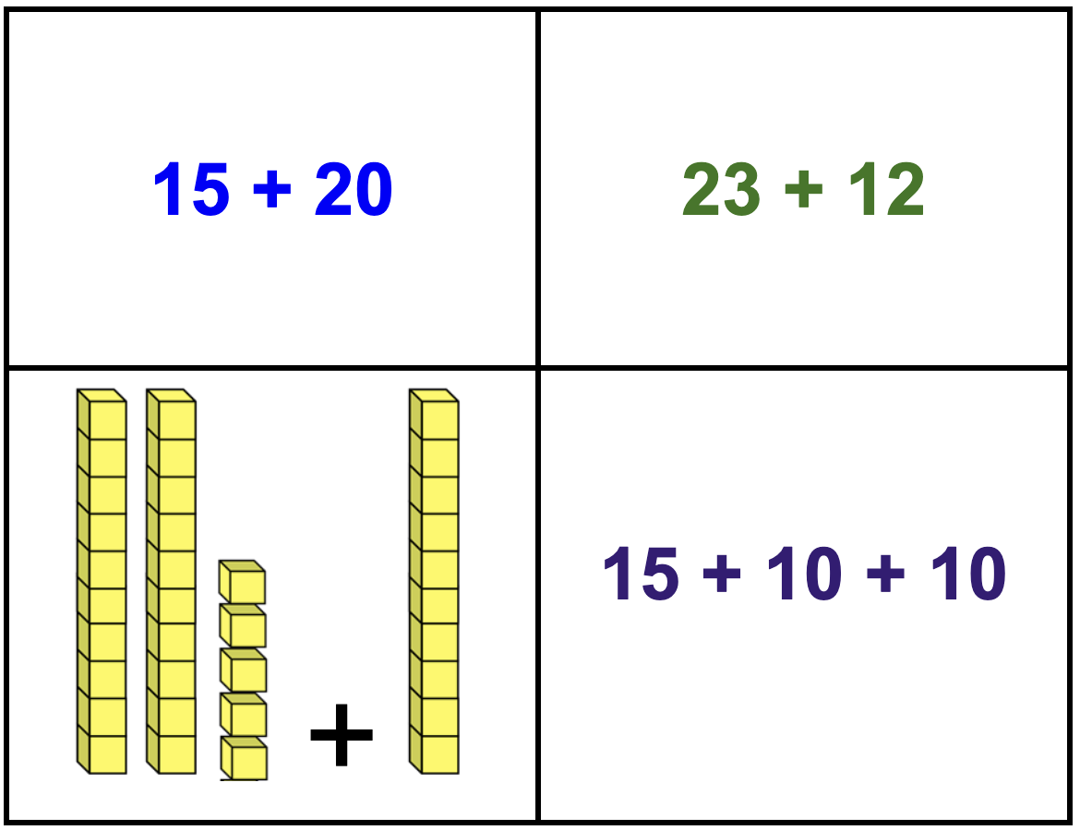
Which one does not belong?
What do they all have in common?
1.NBT.B2

Slide 18
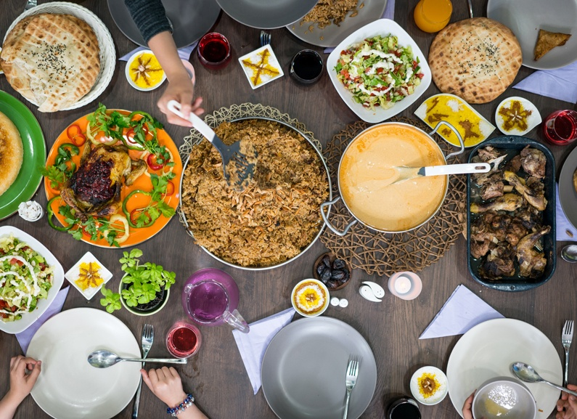
Today is the beginning of Ramadan
What fun shapes can we find hiding on this traditional Ramadan table?
1.G.A1
Notes:
March 23, 2023
Ramadan

Slide 19
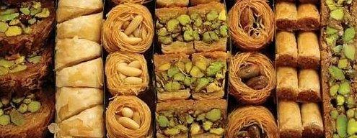
Happy Greek Independence Day!
What do we notice? What do we wonder?
Let’s create number sentences to match our math thinking!
1.NBT.B1

Slide 20
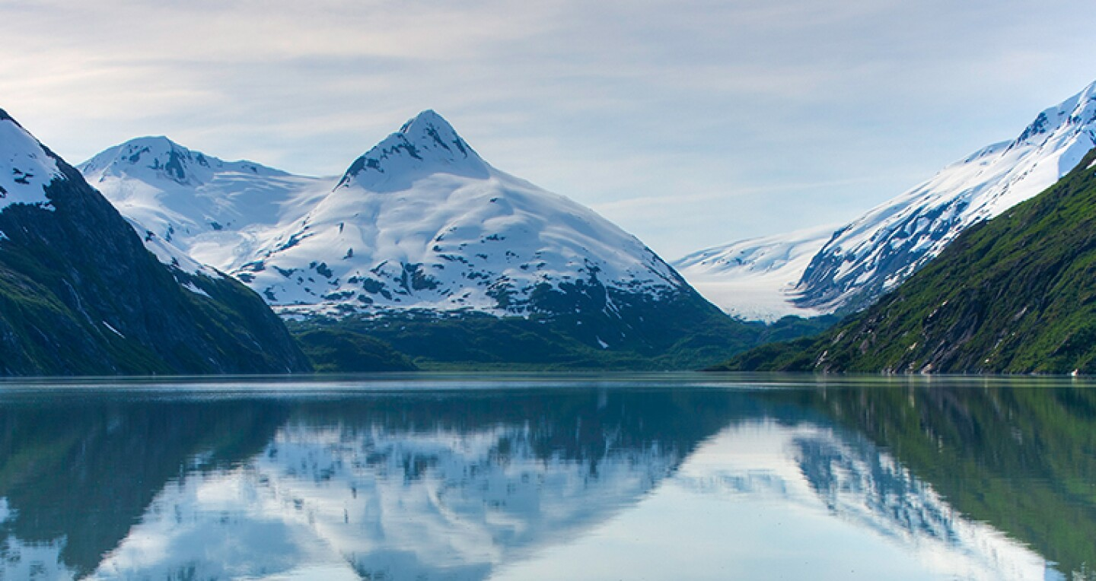
Happy Seward’s Day in Alaska!
Alaska is the 49th state, and by far the largest state in America!
How many different expressions can we create that equal 49?
1.NBT.C4
Notes:
Week of March 27, 2023

Slide 21
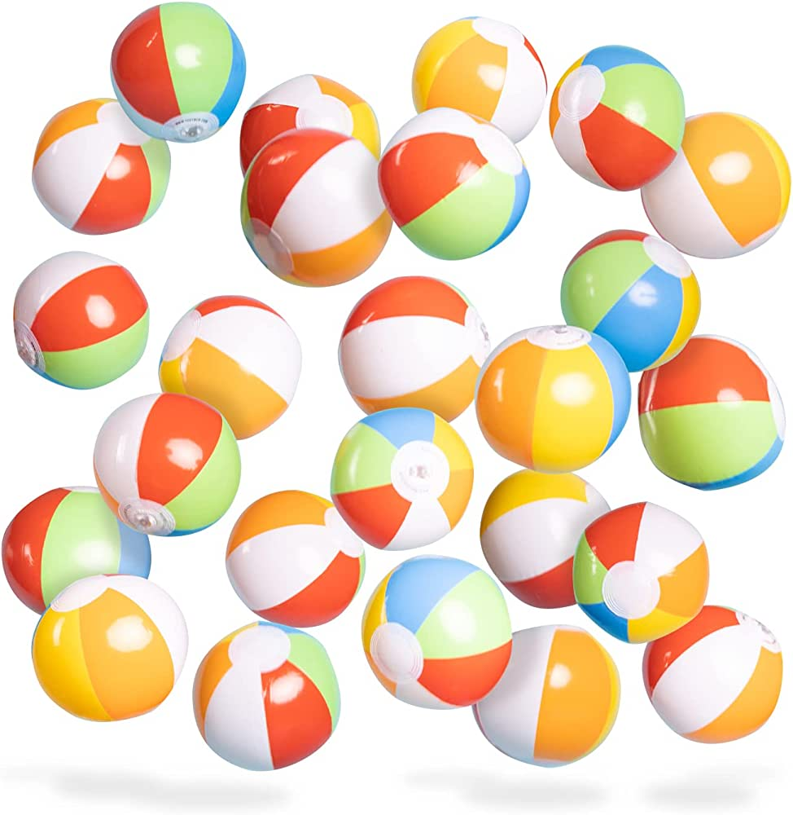
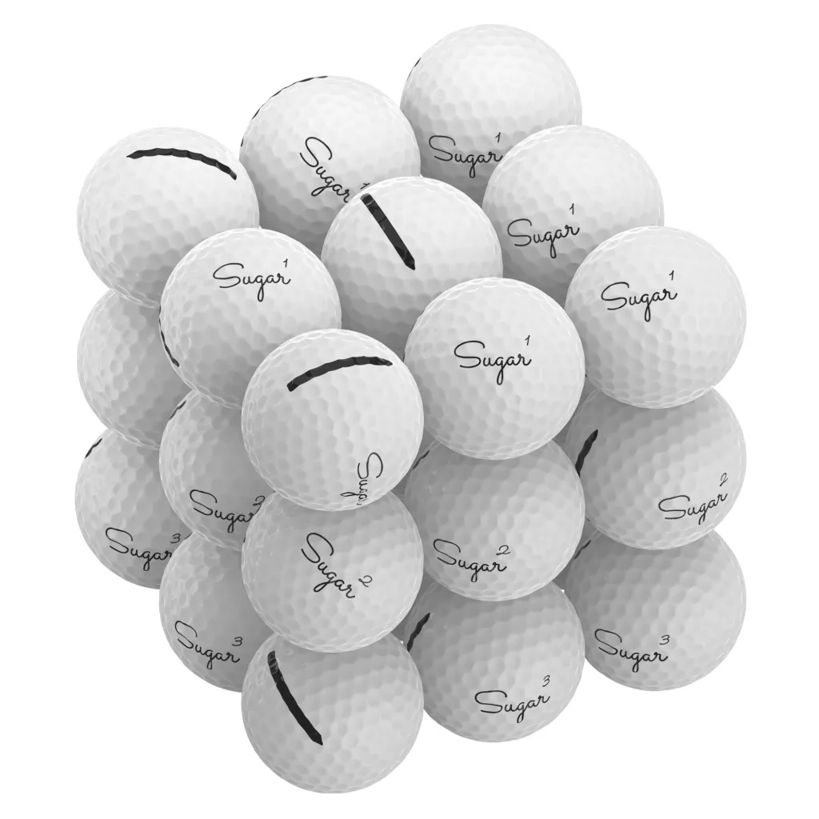
Would you rather ….
100 beach balls or
100 golf balls
Oh, and you have to carry them across the field.
1.MD.A1

Slide 22
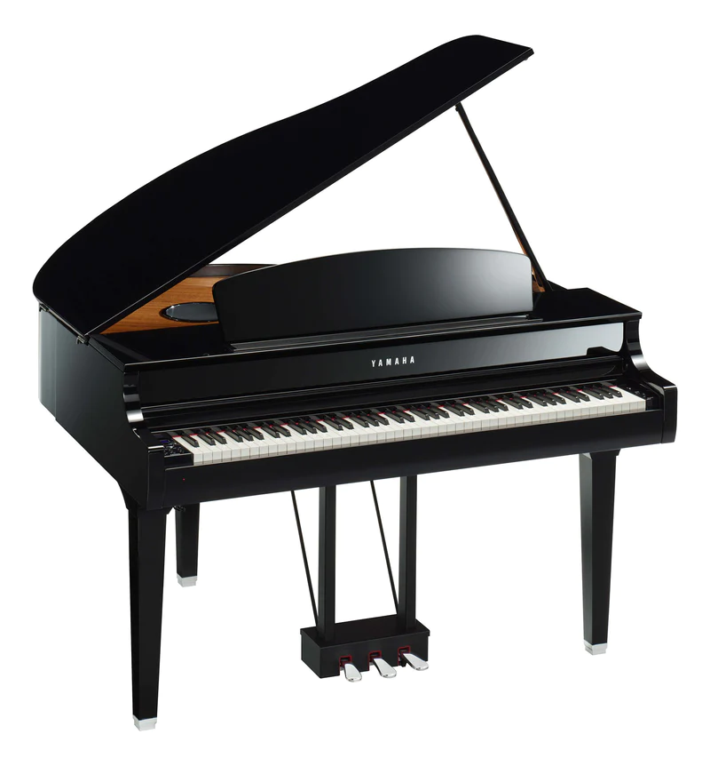
It’s National
Piano Day!
There are 88 keys on a piano.
52 of them are white.
How many are black?
How do you know?
1.NBT.C4

Slide 23
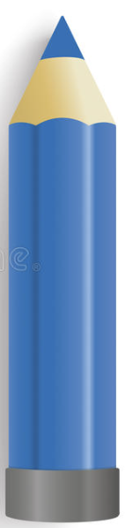
Today is National Pencil Day!
How can we compare these pencils?
1.MD.A1

Slide 24
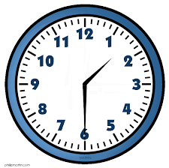
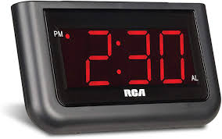
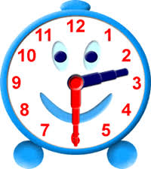
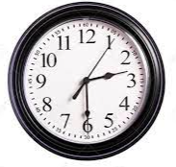
Which one doesn’t belong?
1.MD.B3

