Slide 1
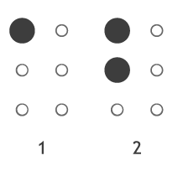

It’s National Braille Literacy Month!
This is what the numbers 1 and 2 look like in Braille.
What do you think 3 will look like?
Are we surprised?
K.CC.C
Notes:
Week of January 3, 2023
National Braille Literacy Month

Slide 2
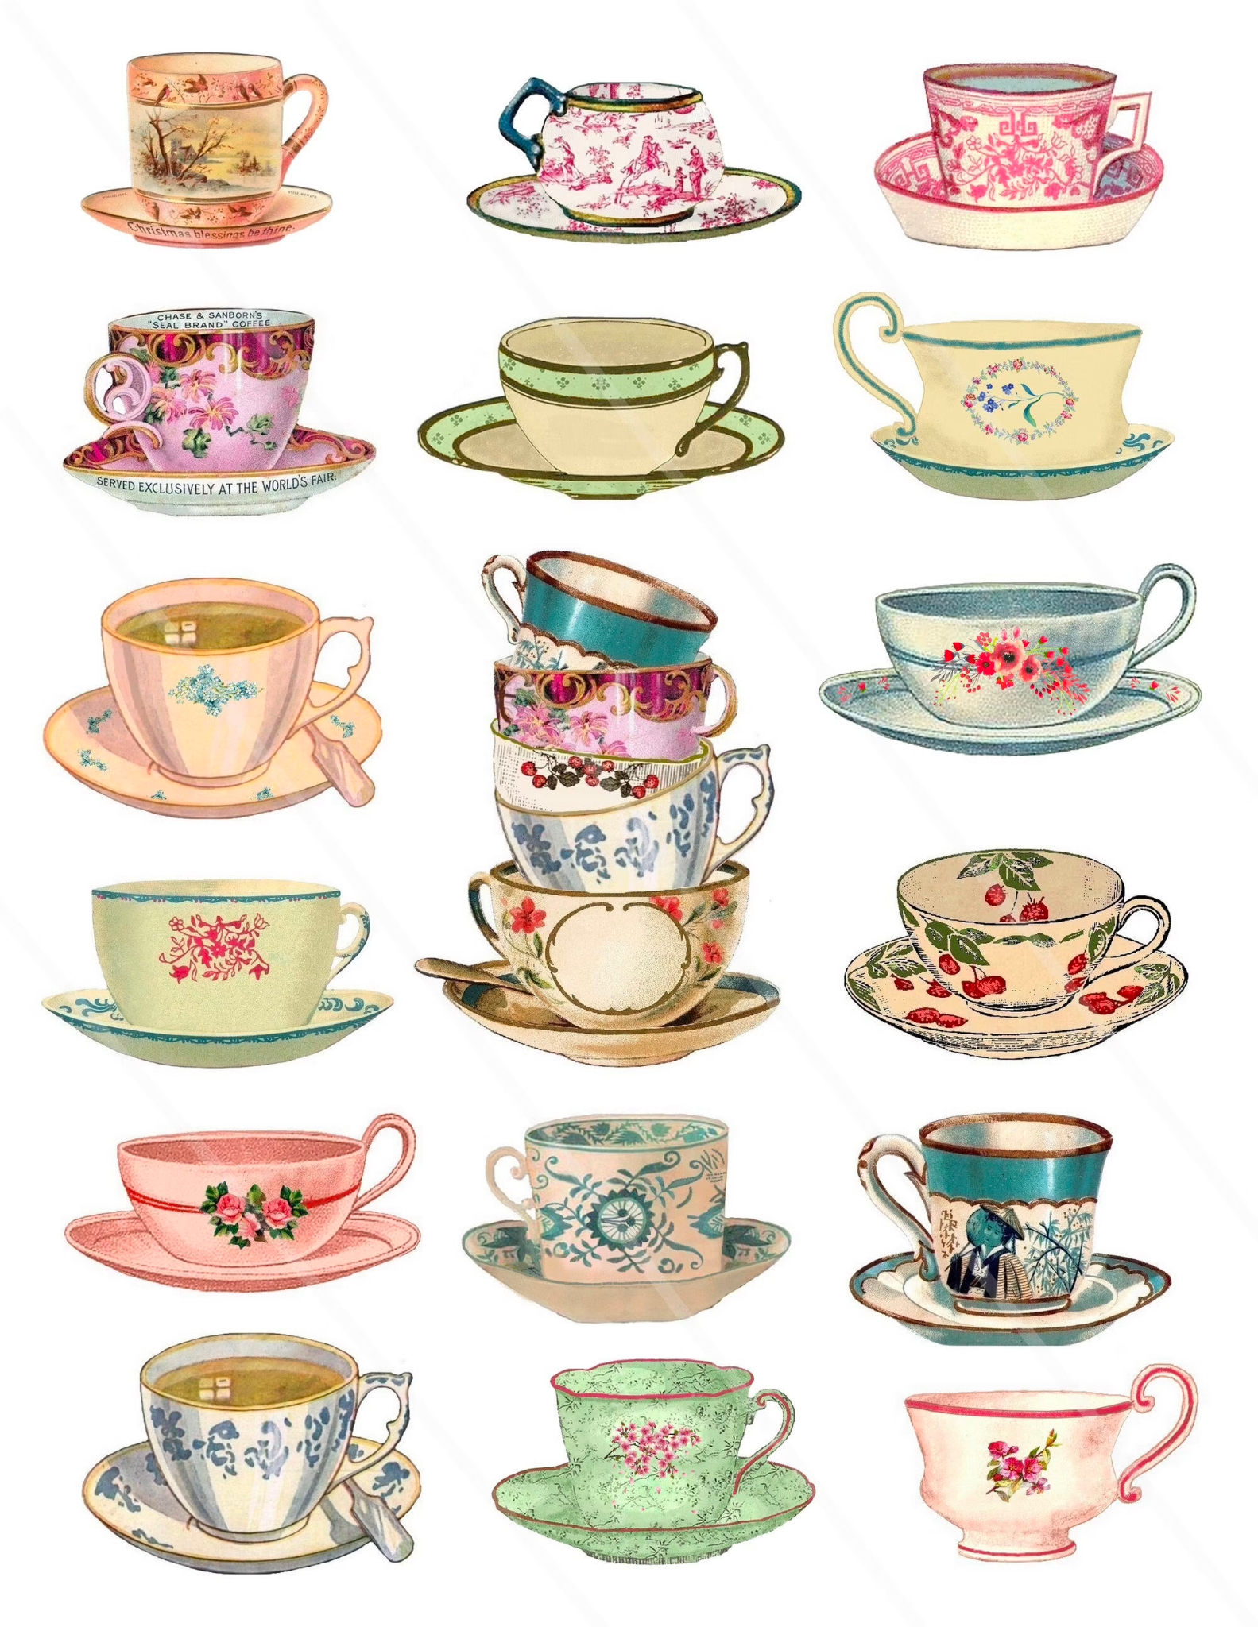
It is Hot Tea Month!
How many tea cups are here?
How can we count them?
How might we sort them?
K.CC.B5

Slide 3

What is the same?
What is different?
K.G.B4

Slide 4

Today is Children’s Day in Uruguay!
What can we count in this picture?
How can we be sure we have counted them all?
K.CC.B5
Notes:
January 6, 2023
Children’s Day ~ Uruguay

Slide 5
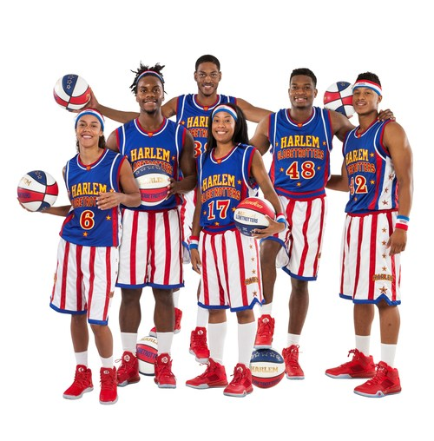
Happy Birthday to the Harlem Globetrotters!
How many players are here?
How many balls?
How many red sneakers?
K.CC.B4
Notes:
Week of January 9, 2023

Slide 6
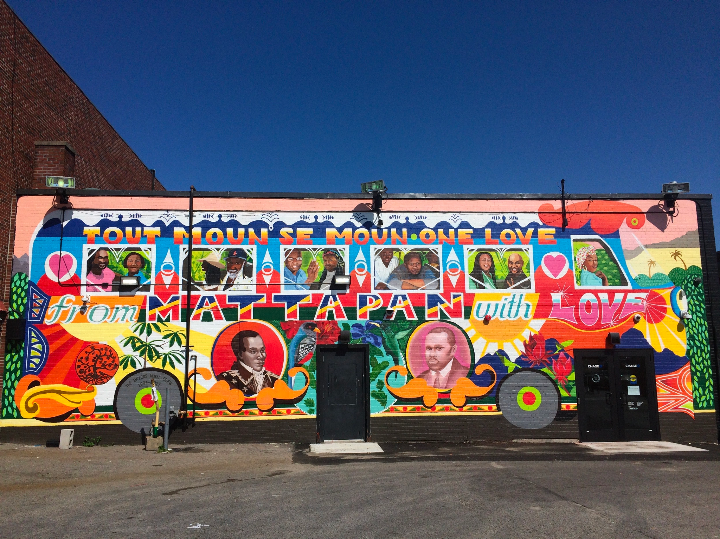
Let’s find some fun shapes in this Mattapan mural!
K.G.A2

Slide 7
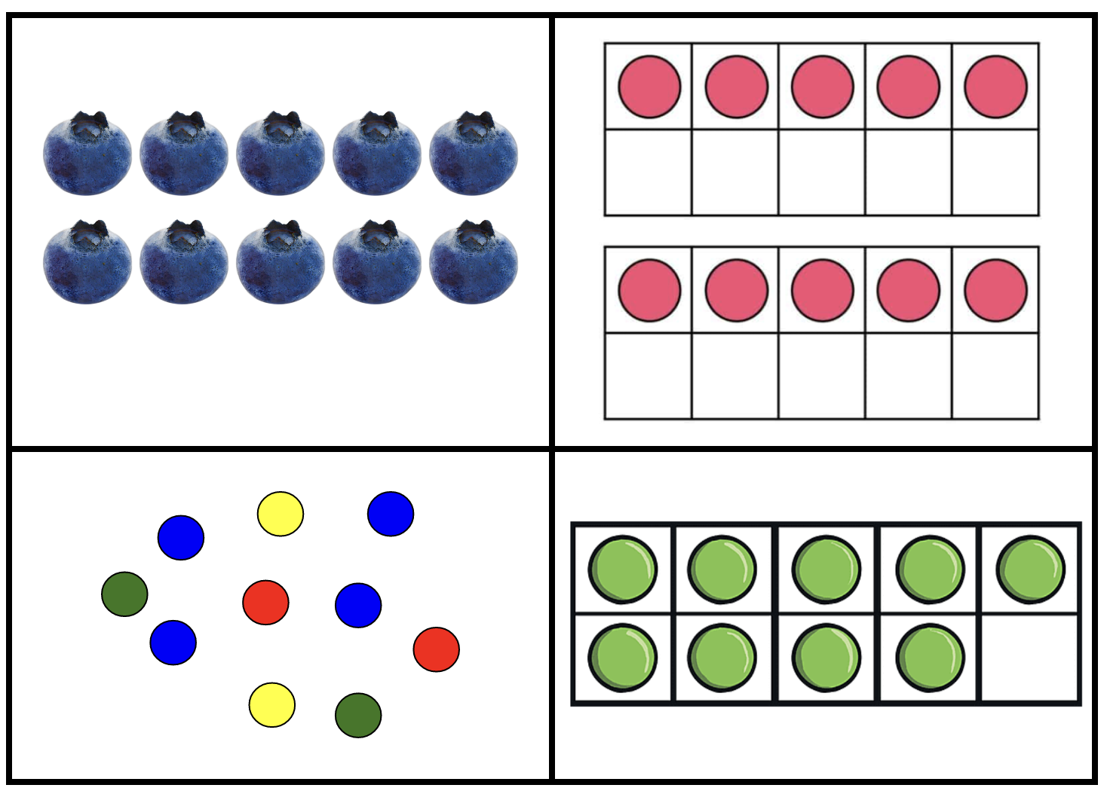
Which one doesn’t belong?
K.CC.C6
Notes:
Top left: not dots
Top right: not ten together
Bottom left: not in a frame
Bottom right: not ten

Slide 8
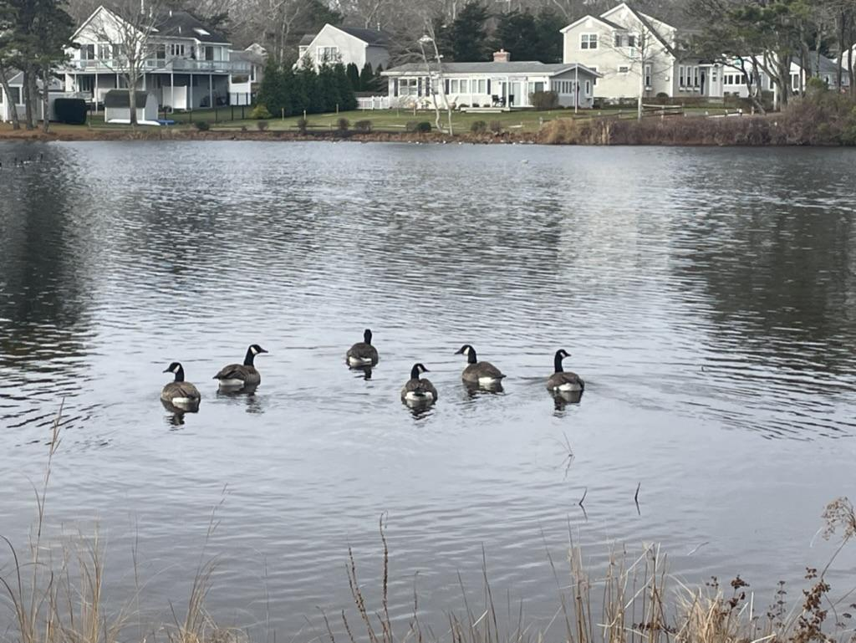
Brr… cold duckies in the pond!
How many are here?
What if 2 of them swim away?
Can we write an EXPRESSION to match our thinking?
K.OA.A1

Slide 9
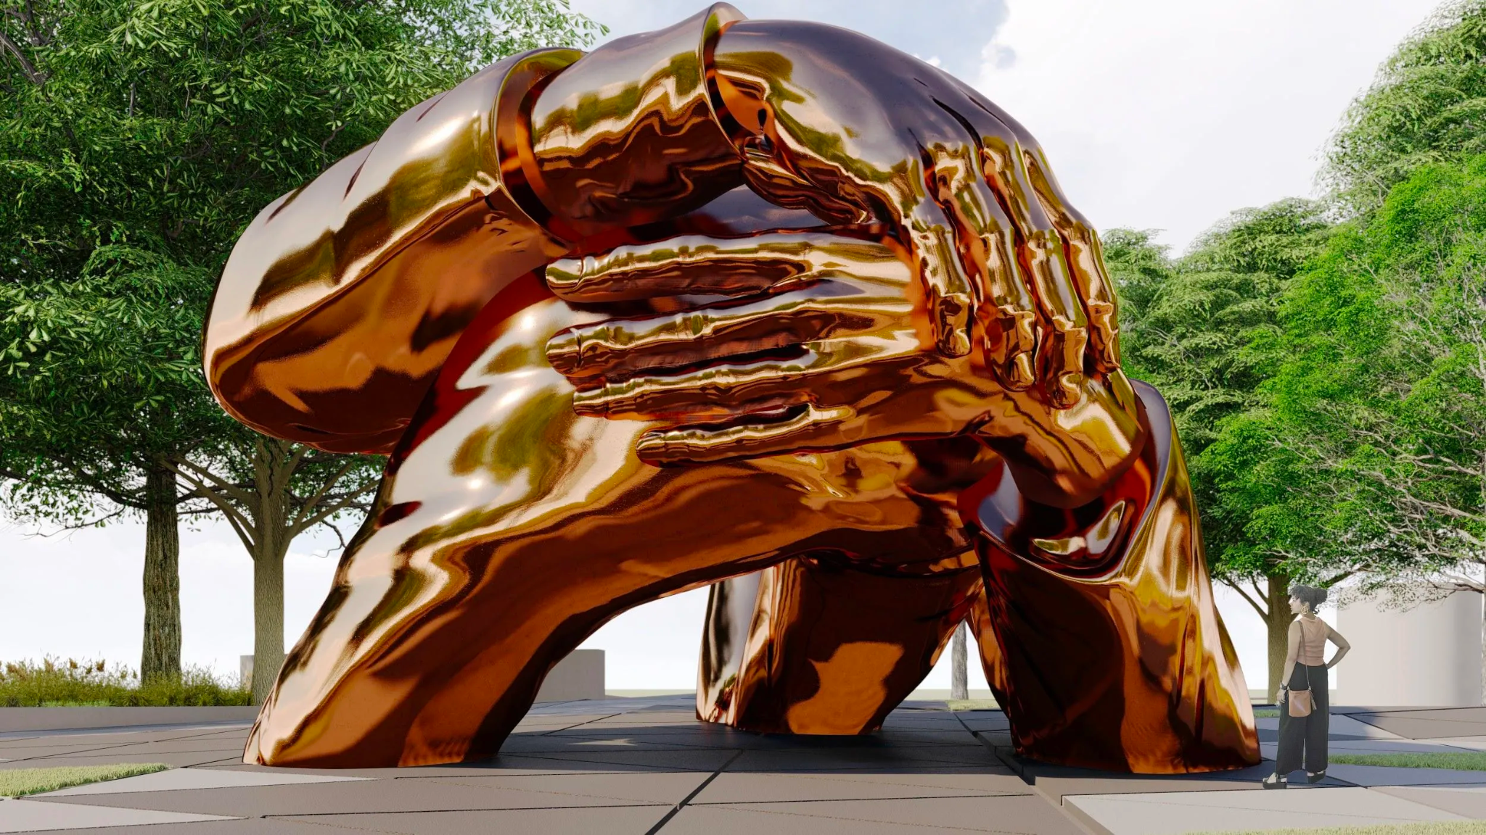
This new sculpture “Embrace” in Boston is a tribute to
Dr. Martin Luther King and his wife Coretta Scott King.
It stands 22 feet tall. Let’s count to 22. What can we say about the number 22?
K.NBT.A1
Notes:
Week of January 17, 2023
Celebrate Dr. Martin Luther King Day

Slide 10
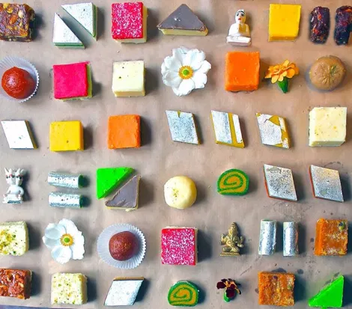
What fun shapes do we see in these traditional Indian Sweets?
How can we sort them?
How can we count them?
K.MD.B3

Slide 11
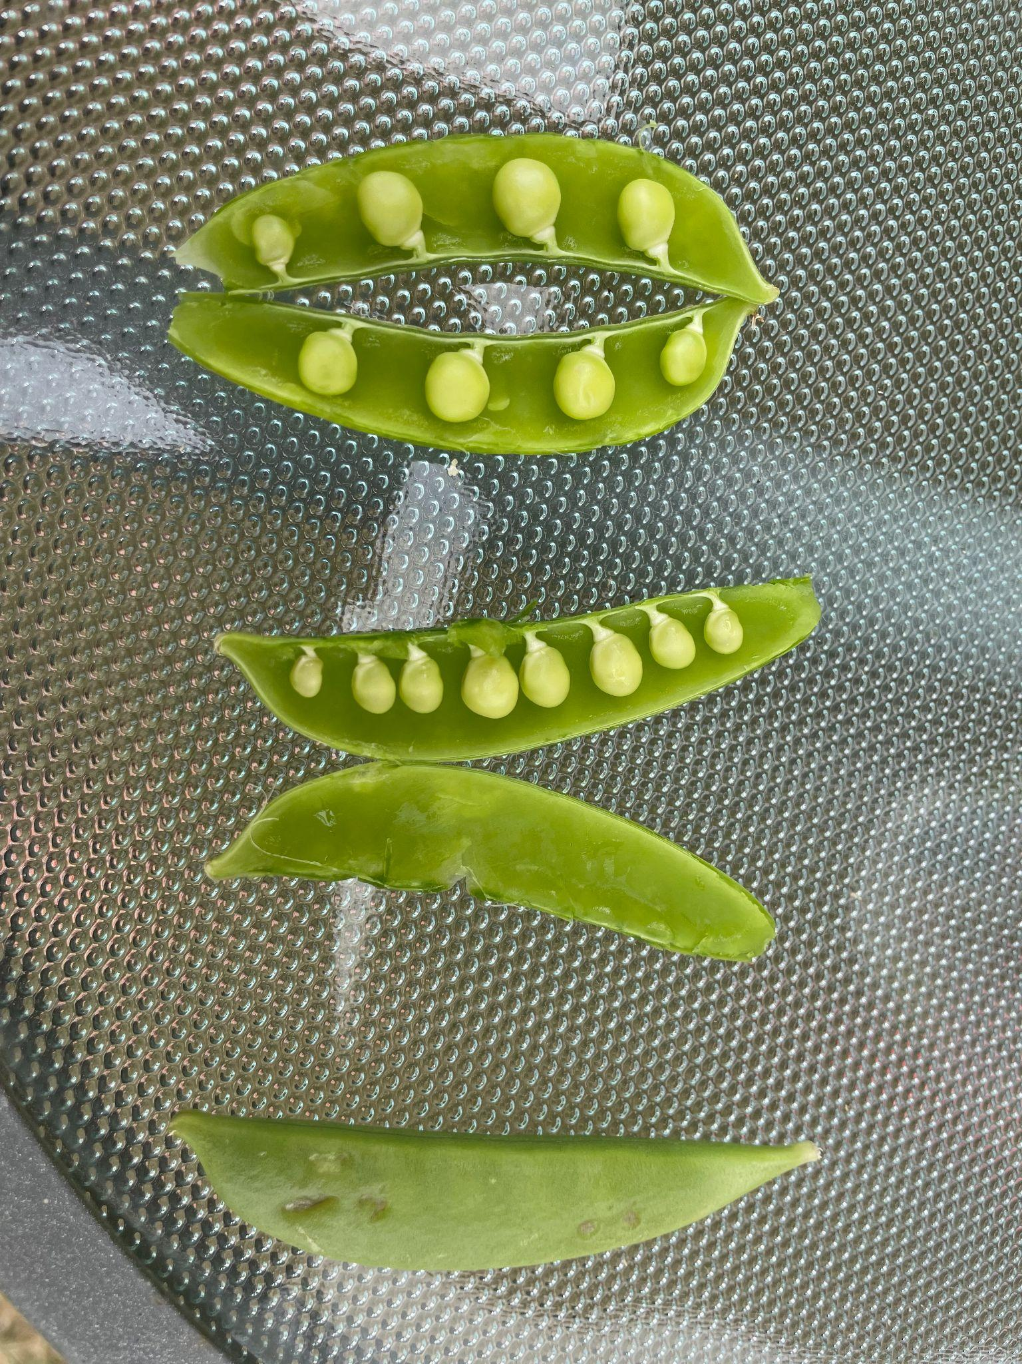
What do we notice?
What do we wonder?
ESTIMATE how many peas will be in the bottom pod.
Peas in a pod!
K.CC.C6

Slide 12
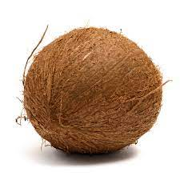
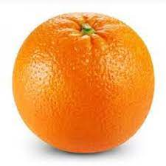
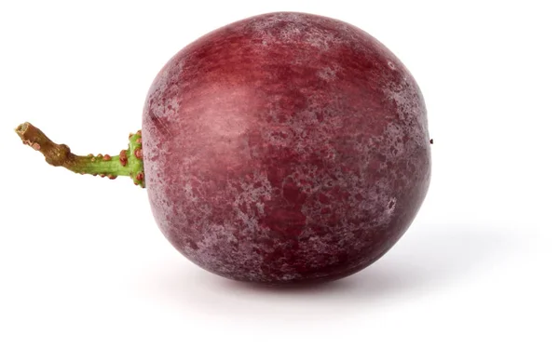
How can we compare these fruits?
Which one is bigger?
Which one do we think is the heaviest?
K.MD.A2

Slide 13
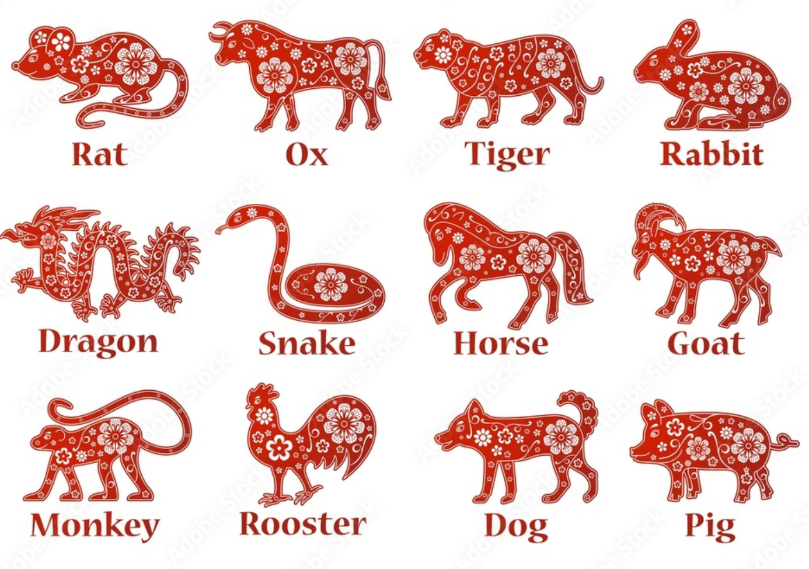
Happy Chinese New Year!
2023 is the year of the rabbit!
How many animals are in the Chinese New Year cycle?
How many different ways can we make 12?
K.OA.A1
Notes:
Week of January 23, 2023
Chinese New Year

Slide 14
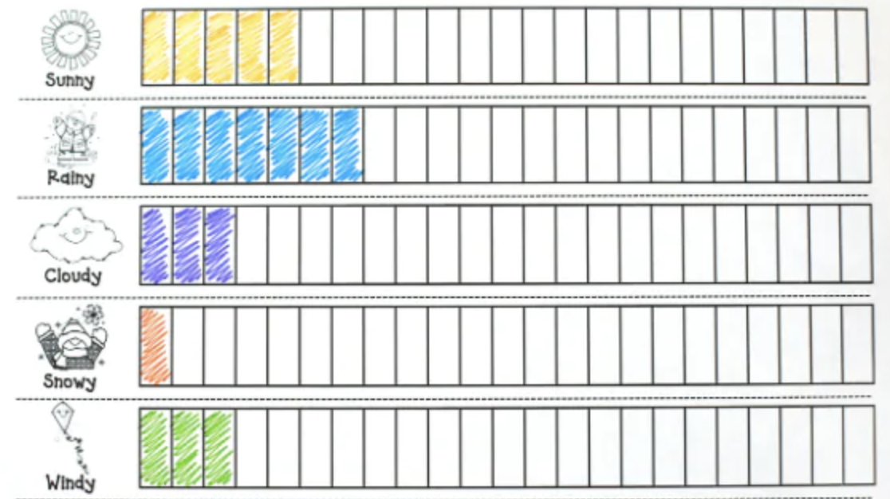
If this graph could talk, what would it say?
What is a good name for this graph?
K.MD.B3

Slide 15
What is the same?
What is the different?
What other shapes have 4 sides?
K.G.B4

Slide 16
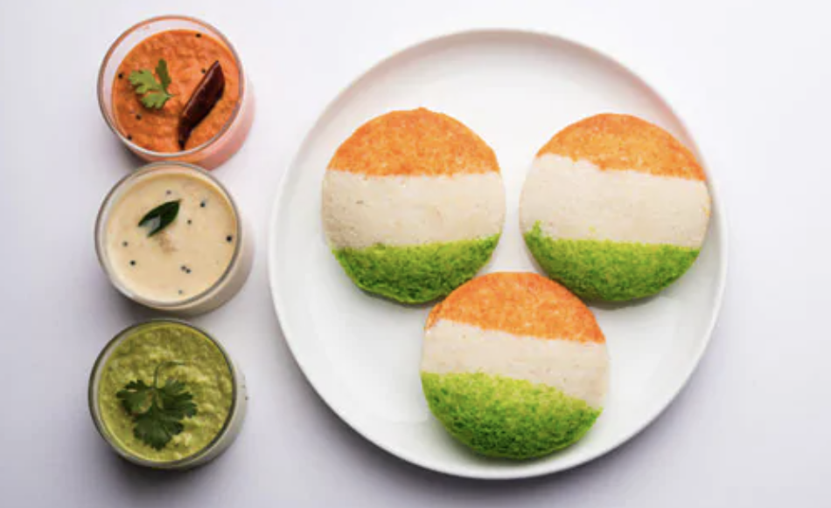
Today is India Republic Day!
What number do we see here?
How many different ways do we see it?
K.OA.A3
Notes:
January 26, 2023
India Republic Day

Slide 17
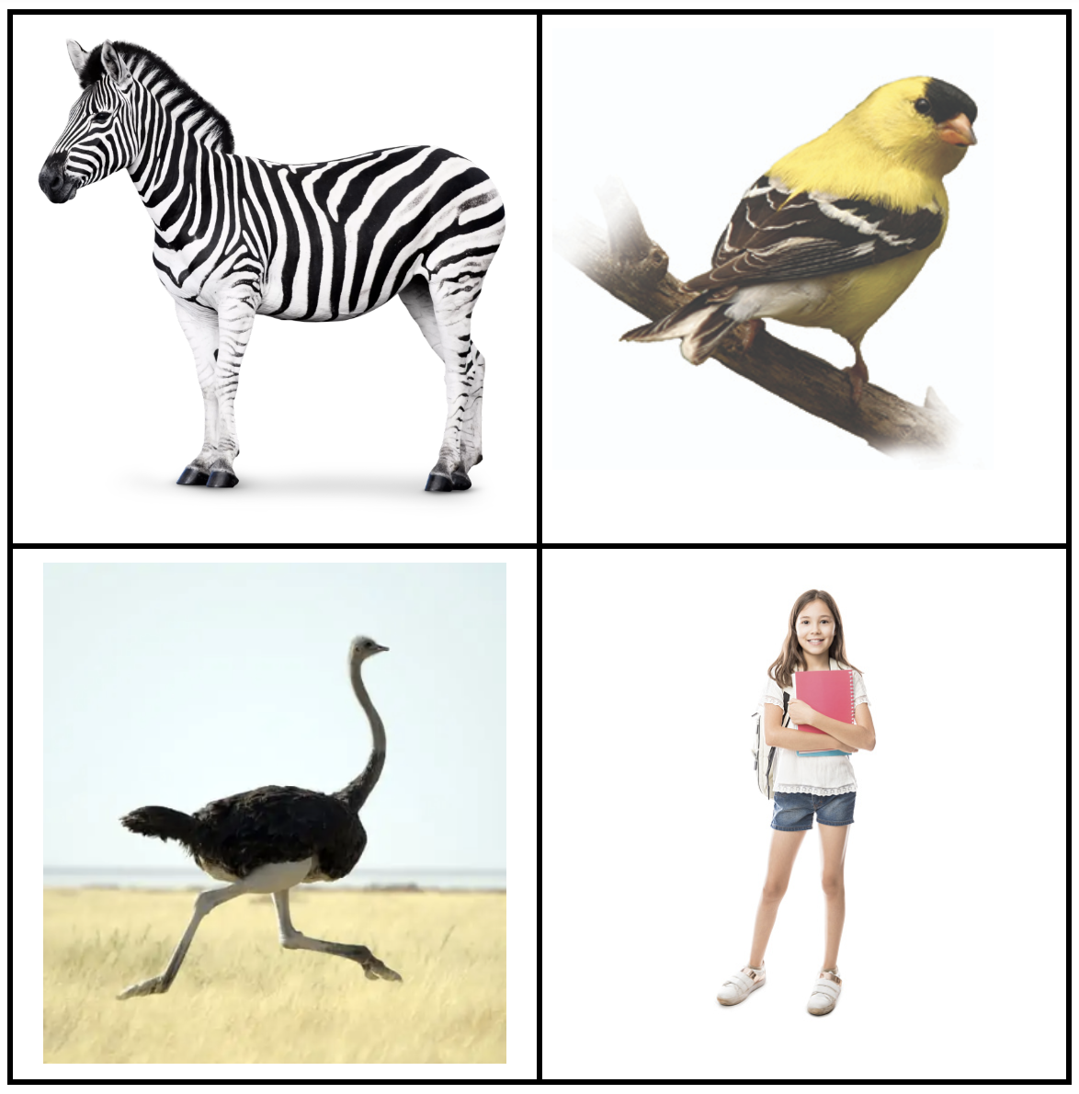
Which one does not belong?
K.MD.A1
Notes:
Top left: not 2 legs
Top right: not land animal, not big
Bottom left: not white background
Bottom right: not animal

